Slide 1

Scene-Based Movie Search using Multi-Modal Embeddings
CSCI 544: Applied Natural Language Processing
Spring 2024
Project Presentation - Group 31
Arun Karthik Sengottuvel
Ashwinkumar Venkatnarayanan
Rohil Wattal
Nitin Sairaj Paruchuri
Arun Prakash Jayakanthan

Slide 2
Table of Contents
Introduction
Dataset
Video Retrieval
Methodology
Results
Analysis
Challenges Faced and Mitigated
Conclusions
References

Slide 3
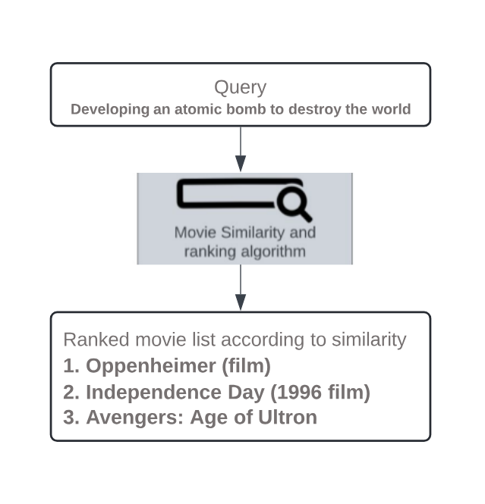
Introduction
In recent years, movie search has become an essential tool for navigating the extensive and continually expanding landscape of film content
Traditional movie search engines often rely on actors or titles, failing to capture the rich narrative structure and nuances of movies
Our project incorporates both textual and visual data to enhance scene-based movie searches by leveraging multi-modal information
With our context embedding based search engine, users can now explore movies based on their memorable moments, empowering a more personalized and engaging cinematic experience
Figure: Working Illustration of our Expected Model

Slide 4
Dataset
Data Collection
1. For textual data, scrapped plot summaries of highest-grossing movies from Wikipedia pages using Wikipedia API and stored it in JSON format
2. For visual data, retrieved video clips from “HowTo100M” that consists of 136 million clips from instructional videos, serving as a rich pre-trained dataset for various applications
Data Preprocessing
1. Implemented sentence tokenization using the NLTK package to split paragraphs into individual sentences.
2. Applied lemmatization to normalize the text data.
3. Removed NaN values to ensure data integrity.
Data Augmentation
Pegasus Summarization: Utilized the Pegasus-LARGE model (Zhang et al., 2020) to generate concise summaries of movie plots, addressing large plot sizes
Parrot Paraphraser: Generated query sentences from movie plots to create diverse query variations for training and testing purposes

Slide 5
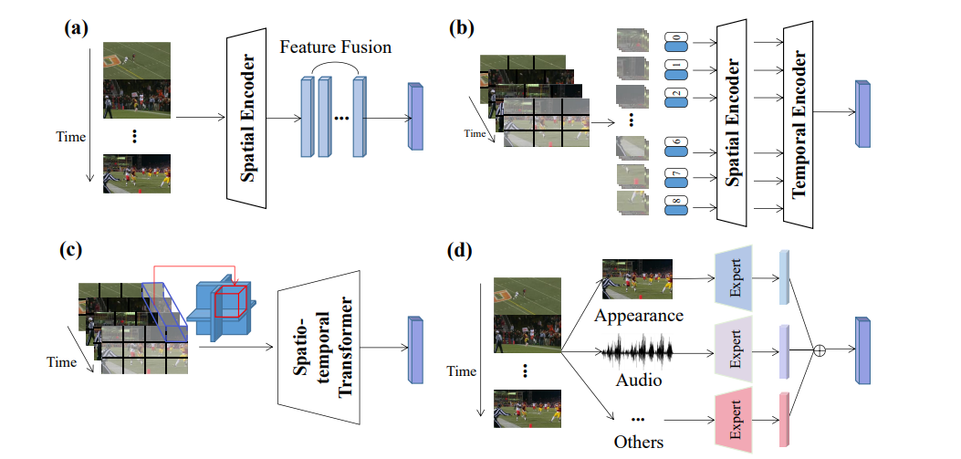
Video Retrieval
1. Spatial Feature Extraction
Converts sampled frames into 2D patches, then into 1D tokens
Utilizes multi-head self-attention, MLP, and layer-norm in stacked encoder-decoder blocks
2. Temporal Feature Extraction with Transformers:
Transformers capture temporal relations by modeling interactions between frames
They encode frame features and aggregate them into comprehensive representations
3. Multi-modal Video Feature Extraction: Integrates various modalities like:
Scene embeddings: Extracted from DenseNet-161 trained on Places365 dataset, capturing scene-level information
Face features: Extracted using SSD face detector for bounding boxes, then passed through ResNet50 trained on VGGFace2 dataset, capturing detailed facial features
Motion features: Extracted from networks like S3D and SlowFast trained on Kinetics dataset, capturing motion-related features

Slide 6
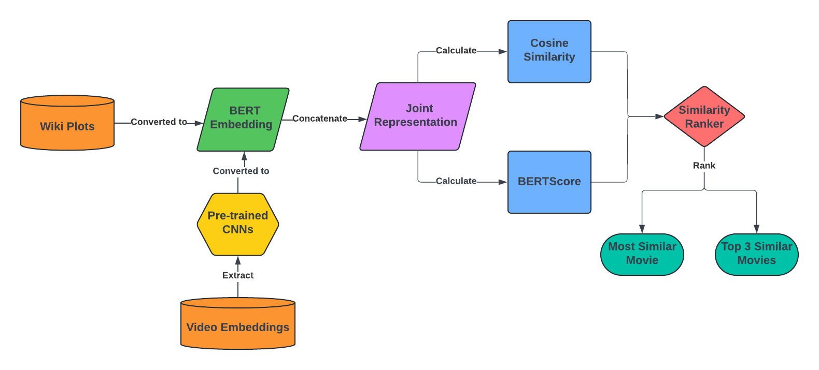
Methodology
Scene Separation:
Plots were split into scenes at both paragraph and sentence levels to provide flexibility and granularity in representing the narrative structure of the movies.
Three approaches were used for semantic similarity analysis
1. BERT + Cosine Similarity:
Leveraging BERT embeddings and cosine similarity captures semantic relationships more accurately due to BERT's contextual understanding of text.
768-dim embeddings, summed from the last 4 layers of the BERT model
2. BERTScore:
Evaluates similarity using F-1 scores, effectively capturing subtle semantic nuances.
Figure: Working of BERT + Cosine Similarity and BERTScore

Slide 7
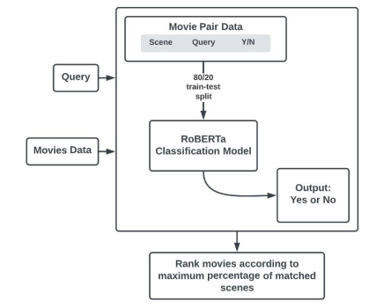
Methodology
3. Similarity as Classification: RoBERTa
Reframed similarity as a binary classification problem using RoBERTa (Liao et al., 2021)
Used the roberta-base variant, a transformer-based model architecture, for training.
Fine-tuned RoBERTa for sentence pair classification
Utilized a pairwise dataset created through manual annotation and weak supervision
Conducted an 80:20 train/test split over 1000 pairs
Trained for 100 epochs using the AdamW optimizer
Figure: Working of RoBERTa Classification Model

Slide 8
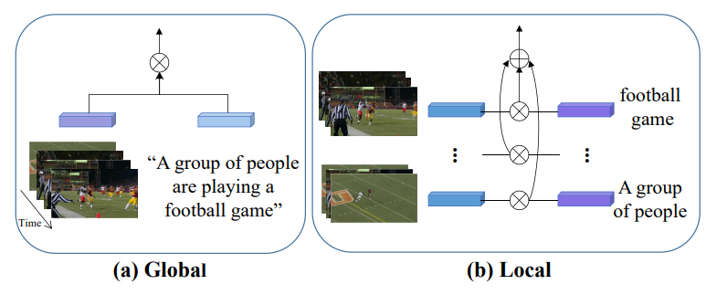
Methodology
Feature Embedding and Matching
Aligns video and textual features in a joint embedding space for similarity calculation.
Three categories: Global, Local, and Individual, improving feature matching accuracy.
Global matching uses linear projection and cosine similarity to align coarse-grained features.
Importance: Enables effective comparison between video and text, enhancing tasks like video-text retrieval and understanding.
Local matching divides features into fine-grained hierarchies, allowing for more detailed comparison and improved feature alignment

Slide 9

Methodology
Ranking
1. Similarity Score:
Measures the similarity between an input query and any scene in the dataset.
Provides a quantitative assessment of how closely a movie matches the query.
2. Percentage of Positive Classifications:
Uses our trained model to predict binary labels (Y/N) for each query-scene pair.
Aggregates the percentage of positive classifications for each movie.
Determines the likelihood of a movie being the best match for the query based on the proportion of positive classifications.

Slide 10
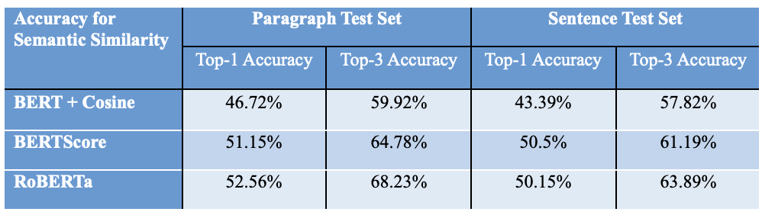
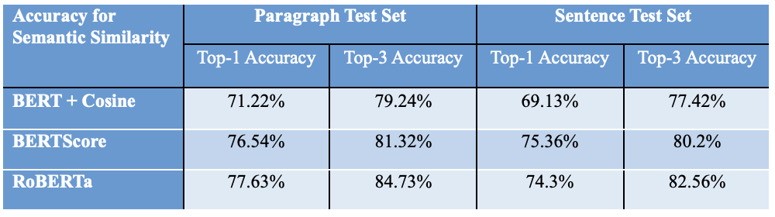
Results
Table: Accuracies when using only Wiki Plots (Textual Data)
Table: Accuracies when using Wiki Plots (Textual Data) + Video Embeddings (Visual Data)
Accuracy metrics (Top-1 and Top-3 Accuracy) for various Semantic Similarity approaches improve after incorporating video embeddings alongside textual data
By leveraging multi-modal information, our project enhances the accuracy and depth of scene-based movie searches

Slide 11
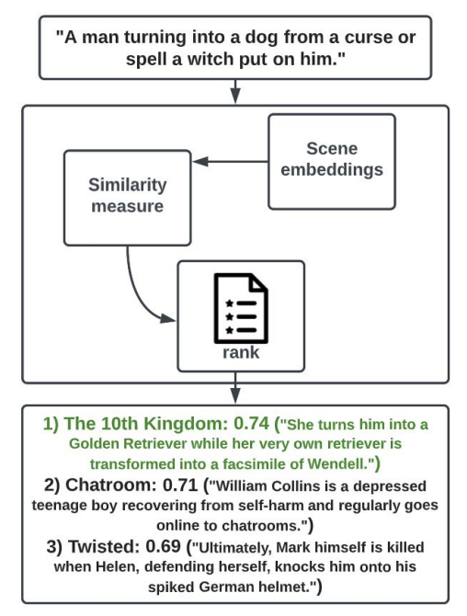
Analysis
Enhanced Context Understanding
Video embeddings provide additional contextual information that enriches the understanding of the plot descriptions.
Complementary Information
Video embeddings offer complementary information to textual data, capturing visual elements, actions, and scenes that may not be fully represented in plot descriptions alone.
This supplementary information helps the models make more informed similarity judgments, resulting in higher accuracy.
Contextual Embeddings
Methods like BERT + Cosine and RoBERTa benefit from contextual embeddings derived from both textual and visual inputs.
These embeddings capture the nuanced relationships between words and scenes, facilitating more accurate semantic similarity assessments.
Semantic Nuances
BERTScore evaluates semantic similarity based on F-1 scores, which consider precision and recall, thus capturing subtle semantic nuances more effectively.
When combined with video embeddings, it becomes more adept at discerning semantic similarities between textual descriptions and enriching visual content.
Fig: Sample Output

Slide 12
Challenges Faced and Mitigated
1. Producing accurate and contextually relevant paraphrased queries posed a significant challenge
Implemented integration of domain-specific knowledge by adding detailed information about movies, including scene descriptions, dialogues, and related metadata.
2. Ensuring impartial and optimal model performance in scene-based movie searches presented its own set of challenges.
Conducted performance evaluations using diverse datasets to identify biases and adjusted model parameters
Leveraged multi-modal embeddings to reduce bias and improve overall performance
3. Handling Vague Queries
Analyzed query structure and semantics to extract key entities and relationships using spaCy and NLTK
4. Limitations in computational resources to ensure efficient and scalable video synopsis generation
Implemented parallelization using CUDA framework thereby reducing processing time and enhancing scalability

Slide 13
Conclusion
The project achieve improvements in accuracy and relevance in scene-based movie search systems by leveraging state-of-the-art techniques such as RoBERTa and video embeddings
Our implemented ranking methodology, utilizing BERT embeddings and RoBERTa classifications, enabled the identification of the most likely movies based on input queries
Furthermore, the integration of video embeddings substantially expanded the project's scope, enhancing the capabilities of scene-based movie searches to provide users with a more immersive and personalized experience
Our model achieved an accuracy rate of 52.56% for top-1 accuracy and 68.23% for top-3 accuracy using textual data alone
With the incorporation of video embeddings, these accuracy rates saw significant improvements, soaring to 77.63% for top-1 accuracy and 84.73% for top-3 accuracy

Slide 14
References
[1] Max Bain, Arsha Nagrani, Andrew Brown, and Andrew Zisserman. 2020. Condensed movies: Story based retrieval with contextual embeddings. In Proceedings of the Asian Conference on Computer Vision.
[2] Umair Al Khan, Miguel A. Martinez-Del-Amor, Saleh M. Altowaijri, Adnan Ahmed, Atiq Ur Rahman, Najm Us Sama, Khalid Haseeb, and Naveed Islam. 2020. Movie tags prediction and segmentation using deep learning. IEEE access, 8: 6071-6086.
[3] Michal Kosinski. 2023. Theory of mind may have spontaneously emerged in large language models. arXiv preprint arXiv:2302.02083.
[4] Zhang, J., Zhao, Y., Saleh, M. and Liu, P., 2020, November. Pegasus: Pre-training with extracted gap-sentences for abstractive summarization. In International conference on machine learning (pp. 11328-11339). PMLR.
[5] Liao, W., Zeng, B., Yin, X. et al. An improved aspect-category sentiment analysis model for text sentiment analysis based on RoBERTa. Appl Intell 51, 3522–3533 (2021).

Slide 15


