Slide 1

Video Analytics
SBI - Hackathon

Slide 2

Problem Statement
01
Surveillance is being constantly carried out via Video Cameras at Branches, ATMs & Offices of the Bank. As a proactive measure and to protect against unscrupulous elements, the video feed is constantly monitored by personnel at Command Centers / Control rooms.

Slide 3
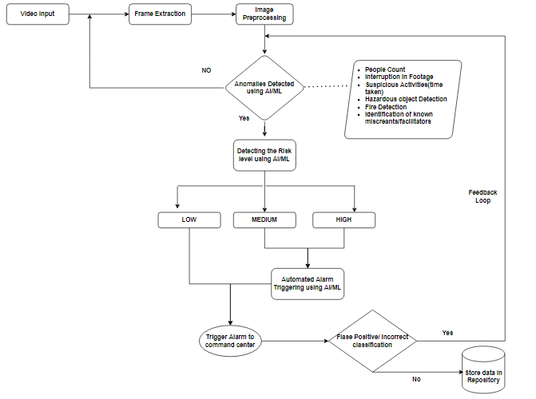
Proposed Solution
02

Slide 4

Key Benefits from the solution:
04
The feedback mechanism provided for identification of false positives/ incorrect classification will enhance the accuracy of prediction model.
Proactive detection of suspicious activities of specific kinds.
An accelerated and automated process in reporting of incidents such as tampering of cameras or interruption in footage for a longer time.
Solution includes a sophisticated AI/ML platform and prediction model that can identify, classify and report hazardous incidents such as fire, which could be directly alerted to the concerned department and officials.
Accelerated and efficient methods of processing, storage and retrieval of video files.

Slide 5
Thank You

