Slide 1
Fast TLB Simulation for RISC-V Systems
Xuan Guo, Robert Mullins
Department of Computer Science and Technology
Both the paper and the slides are made available under CC BY 4.0

Slide 2
The Simulator

Slide 3
Motivation
We want to evaluate TLB designs with meaningful workloads
Not just microbenchmarks
With the presence of an operating system
Existing simulators are too slow for the task
For TLB design, we don't need really cycle-accurate or cycle-approximate simulation

Slide 4
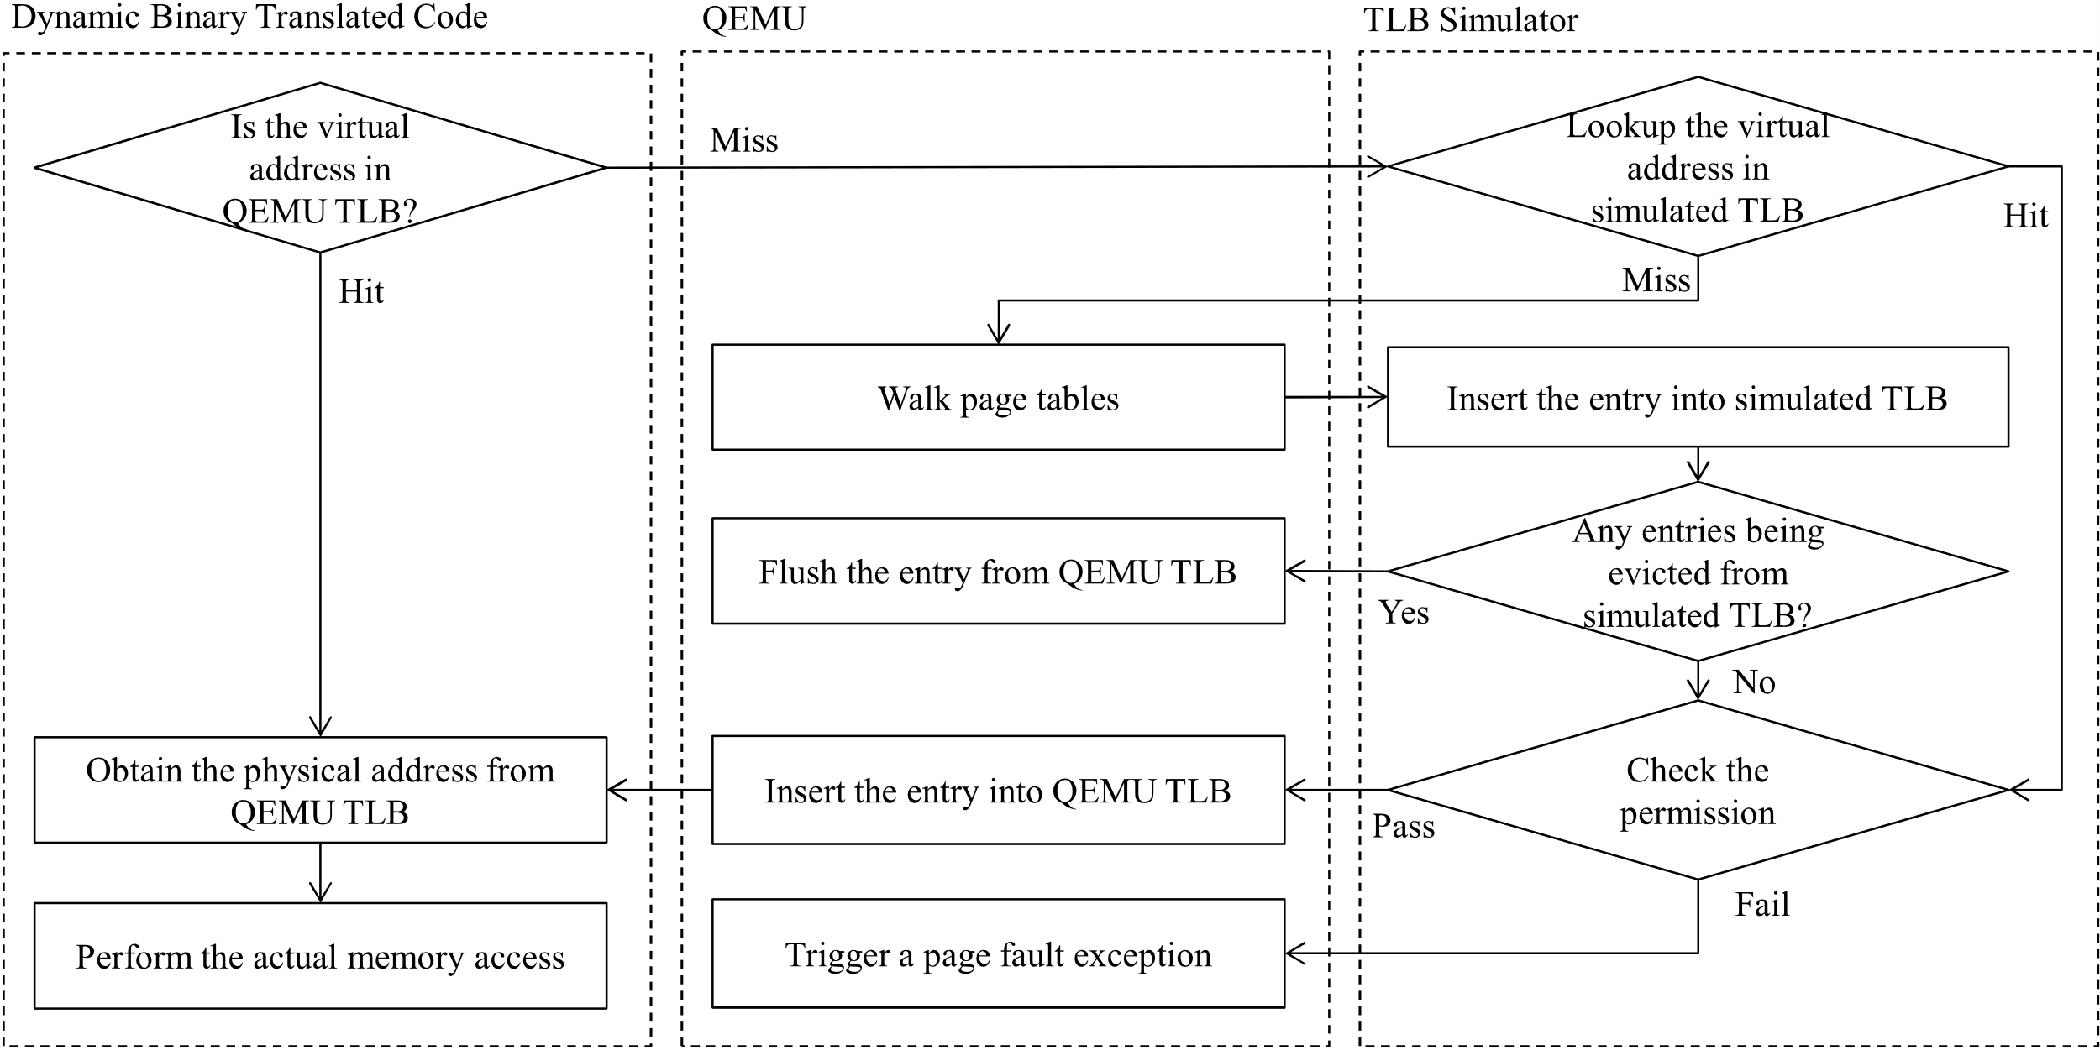
Design
Notes:
This is the control flow when only L1 TLB is simulated with the simulator.
The main highlight here is that when any entries are evicted from the L1 TLB, they are also forced to be evicted from the QEMU’s TLB.
Essentially, we can see the QEMU’s TLB as a L0 TLB, and the L1 TLB here is inclusive.

Slide 5
Design
The inclusion requirement makes all TLB misses seen by the TLB simulator
Not all TLB hits are seen by the TLB simulator
Not possible to implement replacement policies like LRU
Deliberate design choice to sacrifice some accuracy in exchange of performance
Can still count number of TLB accesses by just counting number of memory ops
This design keeps QEMU's fast path intact
Except counters of memory/total ops
Notes:
The inclusion requirement makes all TLB misses seen by the TLB simulator.
But not all TLB hits are seen by the TLB simulator.
Therefore it is not possible to implement replacement policies like LRU.
This is however, is the authors’ deliberate design choice to sacrifice some accuracy in exchange of performance.
Even though not all TLB hits are seen, we can still count number of TLB accesses by just counting number of memory ops.
This design keeps QEMU’s fast path intact as no code in the fast path is modified at all, except one or two simple instruction to keep the counters of memory and total number of retired instructions updated.
The expensive code is ran only when QEMU’s TLB misses, which is a slow path anyway.

Slide 6
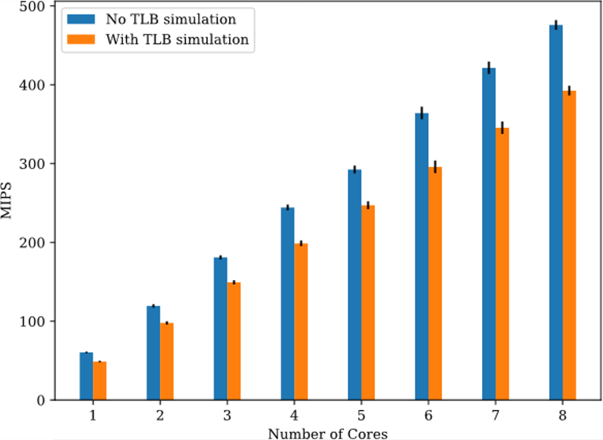
Performance
Notes:
The design makes little performance degradation compared to vanilla QEMU. Overall we see only ~20% performance loss. Even when simulating a two-level TLB design, a performance of 50MIPS can still be maintained on a old Xeon server, whose single-core performance isn’t really suitable for QEMU.

Slide 7
Application: Software Validation
Utilise an “ideal” TLB implemented using hash map
Can check incorrect use of ASID/page table
ASID reused without flushing;
Page table entries updated with different physical address or reduced permission, but there is no SFENCE.VMA.
Multiple ASIDs used to refer to the same page table.
We use the validator to validate our ASID implementation on Linux required for later experiments
Notes:
One of the application is to validate software.
The authors utilise ideal TLBs implemented using hash maps to check incorrect use of address space identifiers or page tables.
The following misuses can be identified.
While the last one is not strictly wrong, it often indicates an implementation error in software. For example, if multiple ASIDs are used to refer to the same page table, then invalidating a page within the page table would require multiple invalidations. It is very likely to be a bug, and at least is a performance issue. The tool therefore identify and point it out int the validator.

Slide 8
Application: Profiling Linux TLB Flush

Slide 9
Background: TLB Flushing in RISC-V
Quote from the spec:
The supervisor memory-management fence instruction SFENCE.VMA is used to synchronize updates to in-memory memory-management data structures with current execution. Instruction execution causes implicit reads and writes to these data structures; however, these implicit references are ordinarily not ordered with respect to loads and stores in the instruction stream. Executing an SFENCE.VMA instruction guarantees that any stores in the instruction stream prior to the SFENCE.VMA are ordered before all implicit references subsequent to the SFENCE.VMA.
This is a fence instruction, not a conventional flush
Notes:
From the spec we can see that the SFENCE.VMA is defined as a fence instruction, not a conventional TLB flush instruction. As a result, technically an implementation is allowed to cache invalid entries.

Slide 10
How Linux handles the specification
/* Commit new configuration to MMU hardware */
static inline void update_mmu_cache(struct vm_area_struct *vma,
unsigned long address, pte_t *ptep)
{
/*
* The kernel assumes that TLBs don't cache invalid entries, but
* in RISC-V, SFENCE.VMA specifies an ordering constraint, not a
* cache flush; it is necessary even after writing invalid entries.
* Relying on flush_tlb_fix_spurious_fault would suffice, but
* the extra traps reduce performance. So, eagerly SFENCE.VMA.
*/
local_flush_tlb_page(address);
}
Notes:
So this is how Linux implements the spec. Besides normal routines that Linux will call for explicit TLB flush, Linux has an update_mmu_cache which is usually used to allow the architecture code pre-insert entries into the TLB. RISC-V implementation do a trick here, using this function to flush the cache instead.
As the comment points out, we can also rely on flush_tlb_fix_spurious_fault. Even if invalid entries are cached, not flushing the TLB causes an additional spurious fault, but it is not incorrect nor a security vulnerability. When the fault is taken, the TLB can be flushed, and the program can continue as normal. But the performance will terrible in such case because there will be two faults instead of 1.

Slide 11
Implication of Linux’s Choice
Notes:
By using the ideal TLB, we can easy see if a flushed address is previous accessed or not, and whether they are valid or not.
The authors classify them into 4 categories:
The first category is never-accessed pages. Typical case is that when the linker loads the program and shared libraries.
The second category is previous invalid pages. The first access triggers a trap. These are usually lazily allocated stack or heap.
The third category is previous readonly pages, and the flush is issued within the trap handler of the first write access. This happens in copy-on-write.
The fourth is the truly necessary flush, e.g. after mprotect or copy-on-write changes the page.
Never-accessed and previous invalid pages are the vast majority, accounting for 94% of all flushes issued.

Slide 12
Classification of Flushes
Never Accessed | Previously Invalid | Previous Non-writable | Necessary
Cache: ✔️ | Cache: ✔️ | Cache: ✔️ | Cache: ✔️
Eager: ❌ | Eager: ❌ | Eager: ❌ | Eager: ✔️
Linux: ❌ | Linux: ❌ | Linux: ✔️ | Linux: ✔️
Sensible Hardware: ❌ | Sensible Hardware: ❌ | Sensible Hardware: ❔ | Sensible Hardware: ✔️
Notes:
So all 4 types are allowed to be cached in the TLB for the current spec.
1,2,3 can all be done lazily, as Linux code already points out. But we don’t want extra traps, because they are more expensive than a flush.
The generic part of Linux will flush 3 and 4.
A sensible hardware would never caches invalid entries. If a write faults, some hardware will remove it, and some may leave it there, so we may or may not need the flush. For category 4, as most hardware does not keep TLB coherent with in-memory page table, they would expect a flush.
It can be seen that Linux’s expectation would fit all sensible hardware, and probably that’s why it expects that in the first place. RISC-V spec clearly breaks the assumption, and the authors think that the spec would need some patching.

Slide 13
Spec Suggestions
Recommend against hardware from caching invalid entries
Recommend software to assume that such case is unlikely
But the software should still handle such case correctly
Assuming a0 points to the PTE of a1, (a0) is originally invalid PTE and a2 is a valid PTE.
sd a2, (a0)
ld a3, (a1)
If the load is issued and executed first, then the TLB may be accessed before the store is completed, so the SFENCE.VMA between sd and ld is necessary for this sequence despite hardware not caching invalid entries.
Does not happen in proper OS though!
Notes:
The authors believe that the spec should be modified to make expectation on par with reality.
They suggest that the spec should recommend against hardware from caching invalid entries, and recommend software to assume that such case is unlikely.
The authors still that the software should still handle the case correctly as in some cases speculative execution may appear similar to cached address translation entries.

Slide 14
Application: Shared ASID Space and TLB

Slide 15
Background: ASID Space in RISC-V
If OS/HW supports no ASIDs, ASID 0 is used everywhere.
Implicitly suggest ASID 0 is not shared across harts.
Different architectures have different design choices:
ARM: Globally shared ASID space
X86: Hart-local ASID space
Notes:
Here’s some background. On RISC-V, if OS or hardware supports no ASIDs. The special ASID 0 is used everywhere.
This pattern implicitly suggest ASID 0 is not shared across hardware threads, otherwise different harts cannot execute different processes.
Different architectures have different design choices. For example, on x86 the ASID (well, Intel call these PCID) are added pretty late, so all existing processors already assume that each core should have their own TLB and page table walkers, so when PCID is added they didn’t bother using a global one.
ARMv8, on the other hand, is designed with ASID in mind, so the ASID space is globally shared. The shared ASID space is important for ARM as they also have instructions for remote TLB shootdown.

Slide 16
Importance of Shared ASID Space
Remote TLB shootdown
Shared last-level TLB
Inter-core cooperative prefetching
Notes:
Besides remote TLB shootdown, the shared ASID space can also facilitate TLB sharing, and allows techniques such as inter-core cooperative prefetching to further improve address translation performance.

Slide 17
Experimental Setup
Private
Shared w/o Global ASID
Shared w/ Global ASID
Tag
ASID | VPN
HartID | ASID | VPN
ASID | VPN
L1 TLB
Separate I-TLB & D-TLB, fully associative, 32 entries each
L2 TLB
8-way associative, 128 entries
per each core
8-way associative, 128*8 entries
Notes:
The authors use three setups to see how a shared ASID space and shared TLB would help in RISC-V’s case.
The first setup is a private setup, where each core has its own L1 I-TLB, D-TLB and L2 TLB. Its tag only contain an ASID and a virtual page number.
The second setup is a shared TLB setup. All cores share a single L2 TLB, but the design does not assume a global ASID space. Therefore, it needs to also tag entries with the hart ID that they are coming from.
The third setup is a shared TLB setup, but this time with global ASID space assumption. It therefore does not need to tag entries with hart ID, and can serve entry populated with one core to another.
All setups have the same L1 TLB setup, and the L2 TLB are all 8-way associative and 128 entries per core.

Slide 18
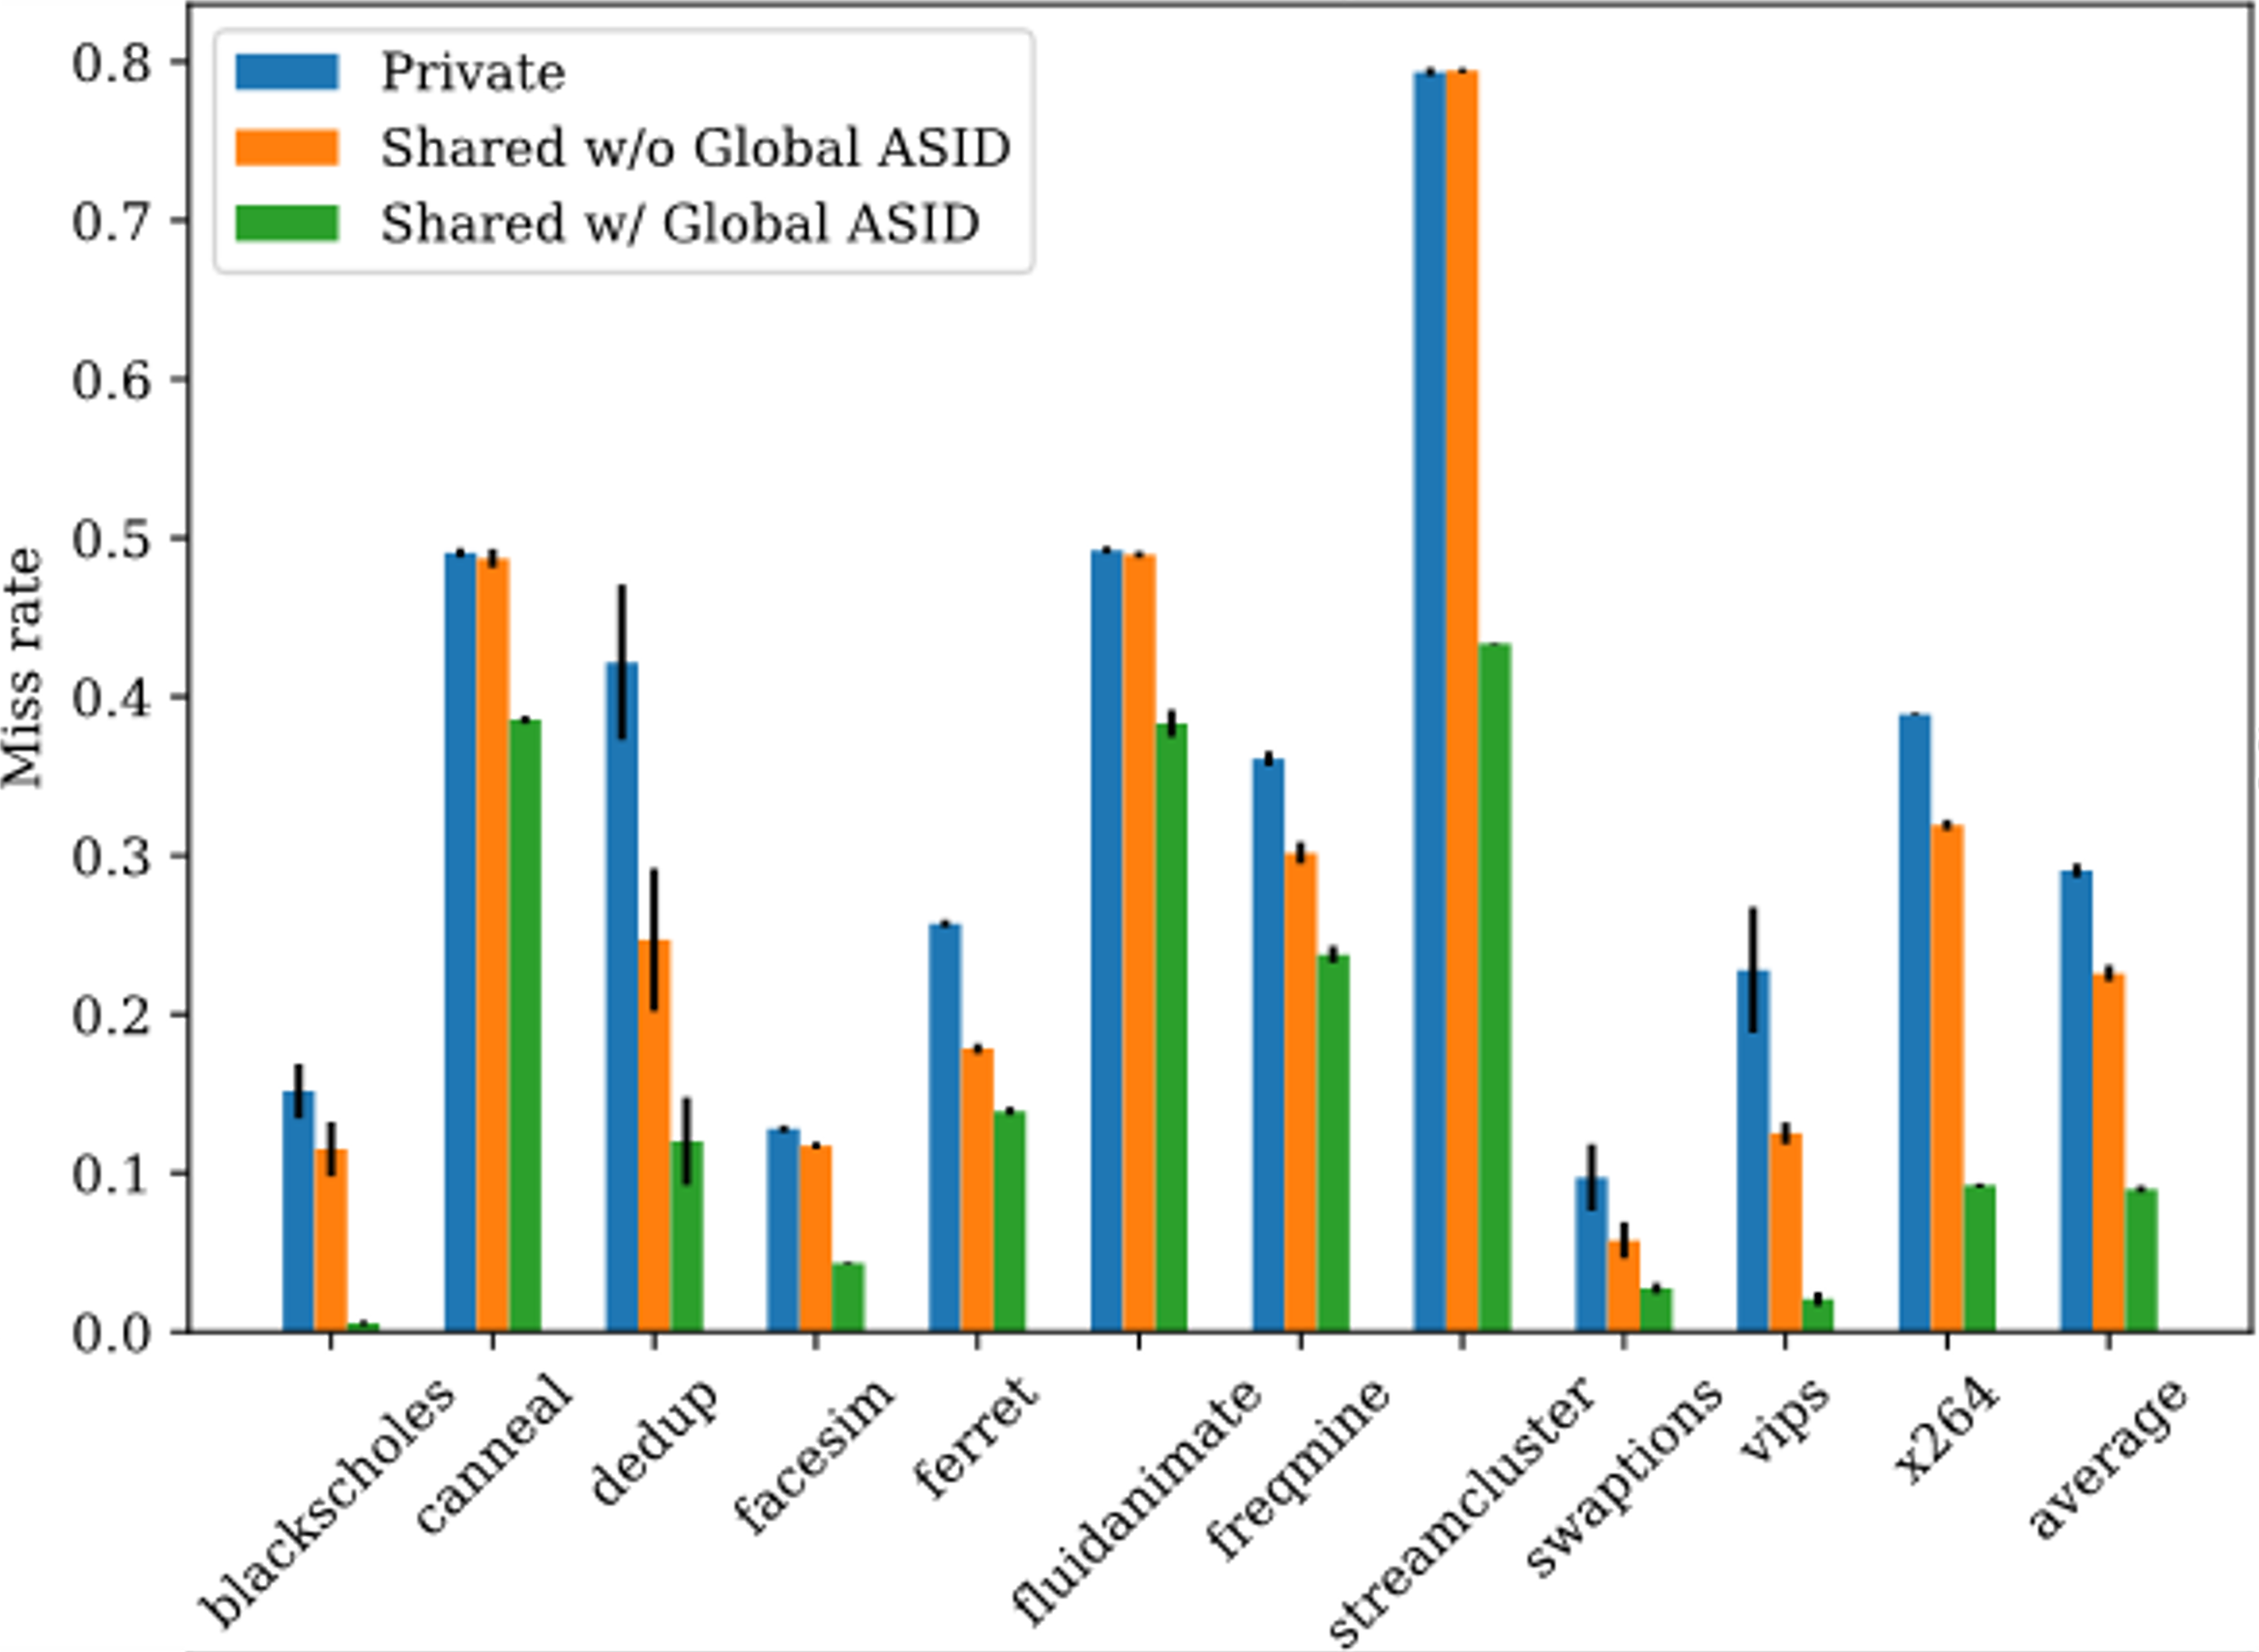
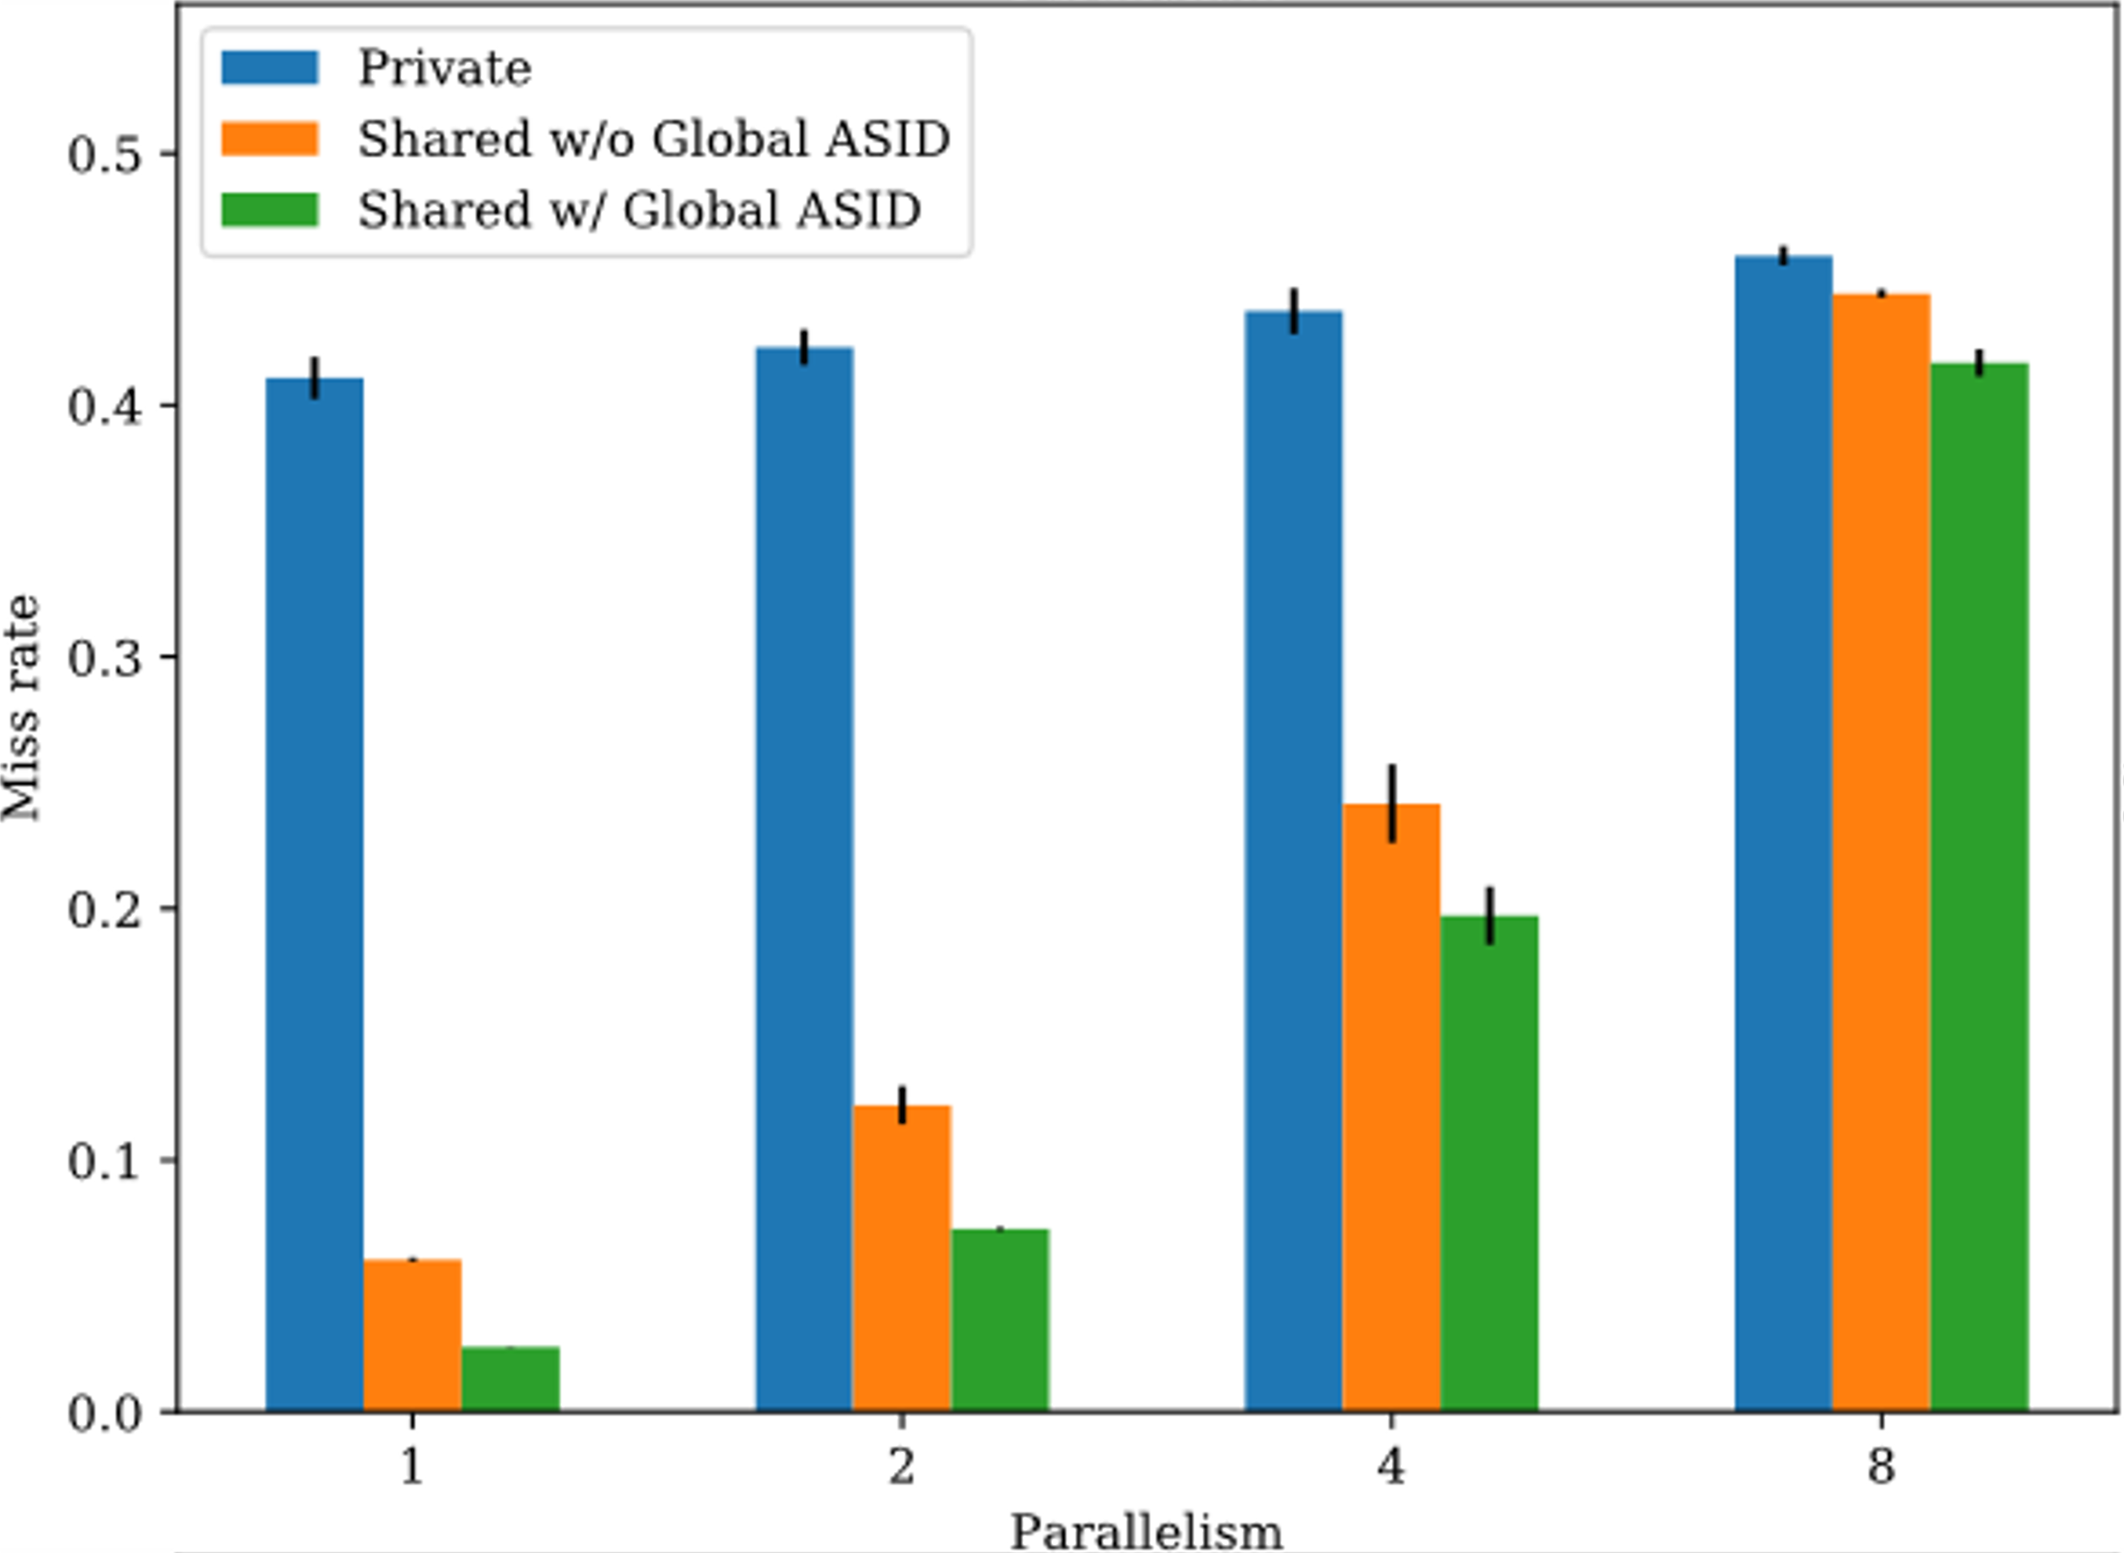
Results
Notes:
The authors run two benchmarks.
The one on the left is PARSEC. Shared L2 TLB without global ASID performs marginally better than private one, while the shared L2 TLB with global ASID performs way better than all other two setups. Considering that PARSEC benchmark composes of highly threaded applications, the results are reasonable because only the third setup exploits the sharing of the ASID.
The one on the right is the compilation of Linux with make. When parallelism is high, each core is essentially executing different processes and thus different ASID, so the gain of shared TLB is not high. When parallelism is small, the busy cores and use the shared TLB entries that are not utilised by the idle cores, so the miss rate reduces dramatically.

Slide 19
Conclusion
Allowing a shared ASID space has a clear advantage
It will allow more possible hardware implementation
It is vital for many-core designs and GPU-like systems
Should definitely be allowed by the spec
Notes:
The authors therefore conclude that allowing a shared ASID space has a clear advantage.
It will allow more possible hardware implementation, and is vital for many-core designs and GPU-like systems.
Designs with shared TLBs should definitely be allowed by the spec.

Slide 20
MASI: Proposed Extension
Single Extra CSR
MASI (Machine Address Space Isolation)
WARL
Implementation can decide number of writable bits, from 0 to XLEN
Non-writable bits are not necessary zero
TLB entries are tagged with MASI
MASI | ASID | VPN
Notes:
We could not just simply say that non-zero ASIDs are now global, because it will the envisioned logical partition use cases, as one OS’s use of ASID may interfere with another.
The authors therefore propose an extension to the spec instead. The extension adds a single CSR, named MASI, machine address space isolation.
The CSR is write-any-read-legal. There will be both writable and readonly bits. The implementation can decide number of writable bits, from 0 to XLEN, but usually the number would not exceed the log of the total number of cores.
The important bit of this extension is that the readonly bits are not necessary zero, and we will see that later.
The MASI is essentially another thing to tag in TLB besides ASID, virtual page number, and possibly VMID if hypervisor extension is present. Of course, only writable bits need to be tagged.

Slide 21
Matching TLB Entries
If MASI/VMID mismatches, entries are isolated
If MASI/VMID matches:
Global entries can match any ASID
Non-zero ASIDs are shared across all harts
Non-zero distinct ASIDs are isolated from each other
ASID 0 of each hart is isolated from other harts' ASID 0
ASID 0 of harts may not be isolated from other non-zero ASIDs
Notes:
Whether TLB entries are isolated from each other would be revised like this.

Slide 22
Matching TLB Entries
ASID 0 of harts may not be isolated from other non-zero ASIDs
This constraint is cheap for software
Makes initialisation slightly harder
No extra overhead otherwise
This constraint makes hardware handling of 0 much easier
A hardware can simply map ASID 0 to some unique ASID number, e.g. their hart ID
Now the only constraint is "Non-zero distinct ASIDs are isolated from each other"!
Notes:
It is important that ASID 0 of harts may not be isolated from other non-zero ASIDs. The constraint is super cheap for software. Once the OS decides whether to use the ASID of not, it does not need to care about this constraint anymore. It only adds a little subtly to the transition process when the OS is detecting the presence of ASID.
The constraint, on the other hand, makes hardware design significantly easier. With this design, a hardware can simply map ASID 0 to some unique ASID number, e.g. the hart ID. Now it can forget about the specialness of ASID 0 all-together, because they’re no long zero.

Slide 23
MASI: Examples
Implementation that does not share TLBs
MASI
Hardwired to 0
MASI
Hardwired to 1
MASI
Hardwired to 2
MASI
Hardwired to 3
Notes:
So here are some examples about how MASI can be implemented.
On implementations that do not share TLBs, which is most hardware today, they can be simply wired to their hart IDs.
As now MASI of each core is guaranteed to be distinct, so MASI can be forgotten as if it’s never proposed.
This is how the firmware can treat the hardware if MASI extension is not present.
No additional complexity is needed in the TLB, just a simple CSR wiring.

Slide 24
MASI: Examples
Implementation that does not support LPAR
MASI
Hardwired to 0
MASI
Hardwired to 0
MASI
Hardwired to 0
MASI
Hardwired to 0
Notes:
On systems that want to exploit ASID sharing and have no interest in logical partitioning, then it can simply wire them to all zero.
Now there is a global ASID space, and the firmware can detect that by seeing that MASI reports 0 for all cores and there are no writable bits.

Slide 25
MASI: Examples
Implementation that supports LPAR in addition to shared TLBs
MASI
0bXX
MASI
0bXX
MASI
0bXX
MASI
0bXX
Notes:
To support both shared TLB and logical partitioning, we would actually need to implement the writable bits and tag them in the TLB.

Slide 26
MASI: Examples
Multi-tile system where TLB is shared within a tile
MASI
Hardwired to 0
MASI
Hardwired to 0
MASI
Hardwired to 1
MASI
Hardwired to 1
Notes:
MASI is actually very flexible design. If we have a multi-tile system, e.g. multi-socket computer, each socket may want to share TLBs internally, but not between cores.
In this case it can signal by the wiring shown in the figure. All harts within one socket can have a same constant, and a different constant in another socket.
In this system we can logically partition the system across sockets, but not within a tile.
Of course we can still wire every MASIs to 0 in this case, but we cannot do logical partitioning anymore.

Slide 27
MASI: Examples
Multi-tile system where TLB is shared within a tile, with LPAR within tile
MASI
0b0X
MASI
0b0X
MASI
0b1X
MASI
0b1X
Notes:
If finer-grained logical partitioning is needed, it is as simple as implement a writable-bit and an additional bit in all tags!

Slide 28
MASI: Conclusion
Flexible
For most systems, it is just readonly
Allows implementations to exploit ASID sharing at merely no cost
Backward Compatible
Existing supervisors either do not use ASID or assume shared ASID space anyway
Notes:
In conclusion, the authors believe that MASI is an good extension to be considered for RISC-V. It does address what the spec is falling short, allowing implementations to exploit ASID sharing. And importantly, on most systems, MASI is just readonly, and is almost free to implement. It is also backward compatible and transparent to supervisors, which either do not use ASID, or assume they are shared anyway.

Slide 29
Questions
If you have questions or are generally interested in this topic, please contact author at Gary.Guo@cl.cam.ac.uk

