Slide 1

DAIKIN
AUTOMATION PROCESS
Fast

Slide 2
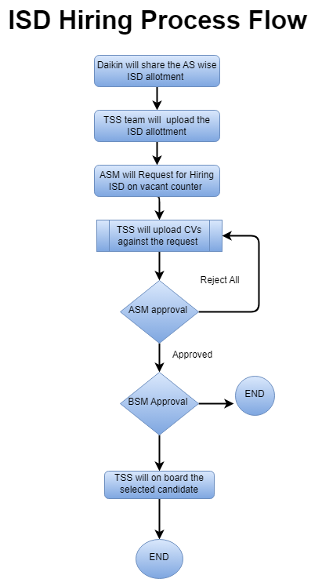
Hiring Process Flow
Daikin HO will share the ASM wise ISD allotment to Thrivera Team.
Thrivera team will update the ISD allotment on the application.
ASM will raise an request for new / replacement of ISD allotment. Application will not allow to raise hiring request more then allotted ISD.
Thrivera team will upload resume on the portal against the open requirement.
ASM interview the candidates and approve the selected candidate on the portal and forward the same for BM approval.
If ASM reject all candidate then it will be pending for TSS team for to upload new candidate resumes.
BM can approve or reject the request. post BM approval request for onboarding will be sent to Thrivera team.

Slide 3
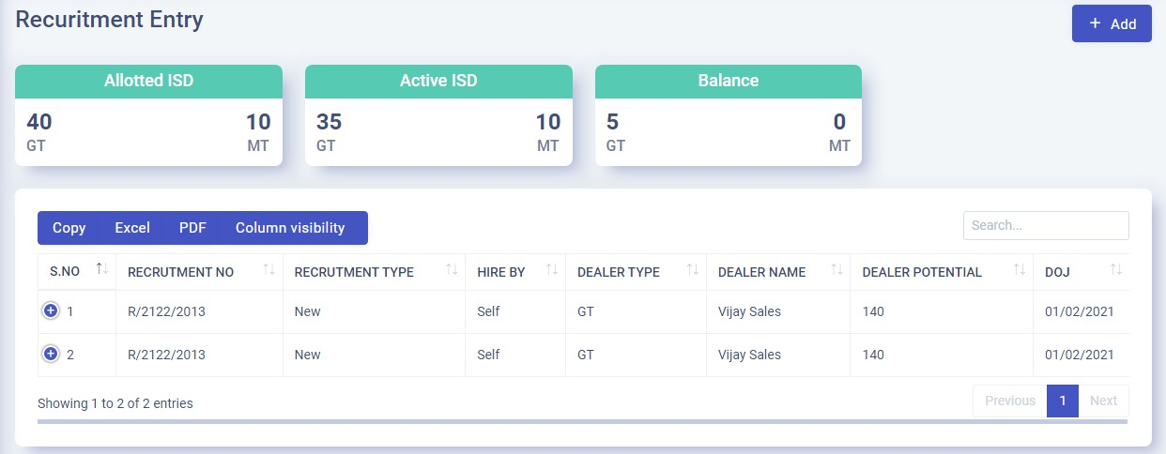
New Hiring Entry
Total allotted ISD to ASM
Total Active Head count
Vacant ISD count
ASM Request information along with Status

Slide 4
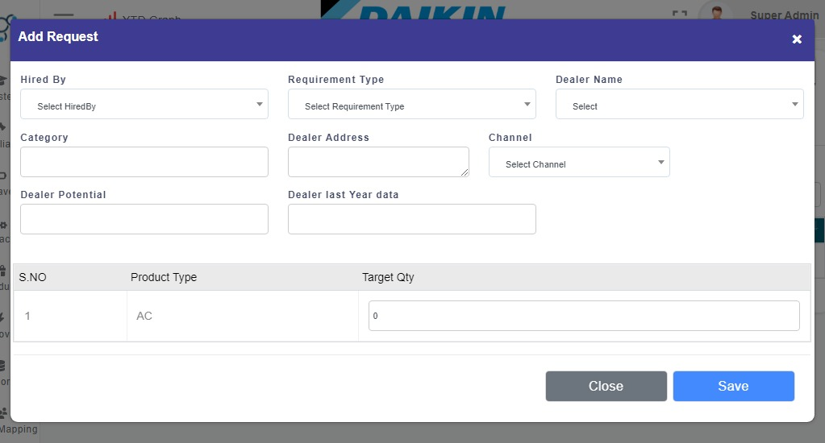
RECRUITMENT ENTRY
Basis of pending headcount ASM can
select the dealer name from dropdown
Hired By – Self if ISD is hired by ASM else Thrivera
Requirement Type - New or Replacement
Dealer Name – Select dealer where ISD to be appoint
Category - Dealer category (DSP, GT,MT)
Dealer Address – dealer address will automatically fills
Dear Potential - Input dealer potential
Target – Enter target for ISD

Slide 5



HIRING STATUS
Pending Request
CV Shared with ASM
Scheduled Interview/ ASM Approval
RMM/BM Approval
On boarding in-process
Onboard and Application shared

Slide 6

Daikin Buddy
Daikin Buddy- We are introducing the concept of training for new joiners, TL will align the on-floor training for new joiners at the nearest and experience ISDs counter for 3 days to 5 days and 1 hour every day. This will help new joiners learn about product and sales skills.

Slide 7
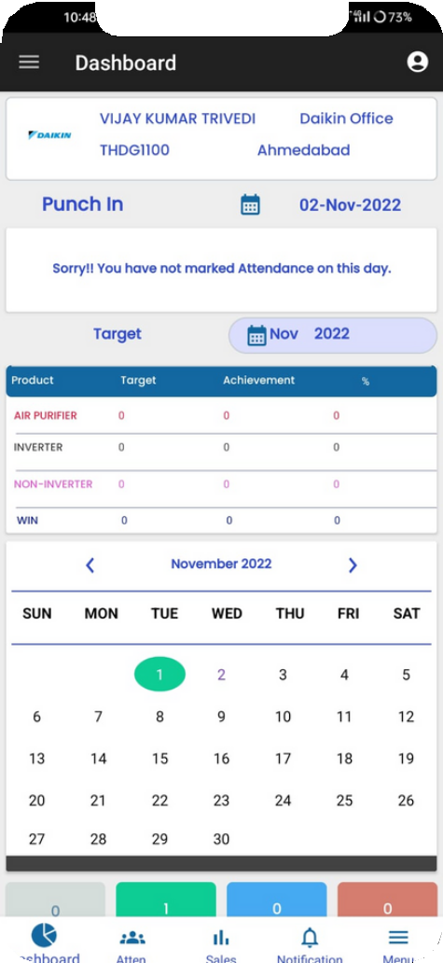
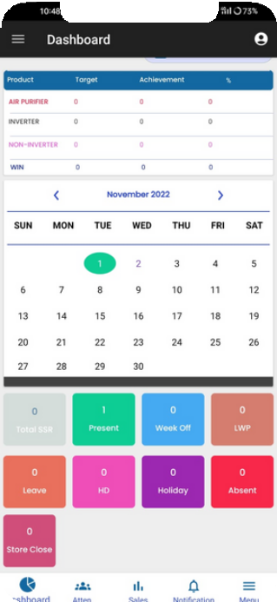
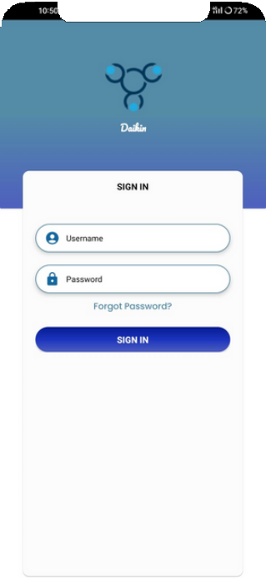
Thrivera Mobile Application

Slide 8

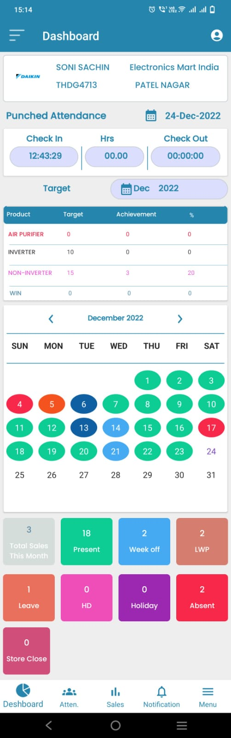

ATTENDANCE
we have implemented the geo-fence in our application.
Our application captures the dealer latitude and longitude. User can mark his / her attendance insides the enabled geo-fence distance.
GEO FENCING
User can view his/her attendance count as per the attendance status i.e. Absent, Present, leave , W.off etc.
User can view his month attendance calendar.
ATTENDANCE SUMMARY
ATTENDANCE CALENDAR
Aapplication captures IN and out time of employee and same will visible to user.
we store user selfie while marking his/her attendance to validate the user availability
IMAGE REPORTING
IN-OUT TIMINGS

Slide 9
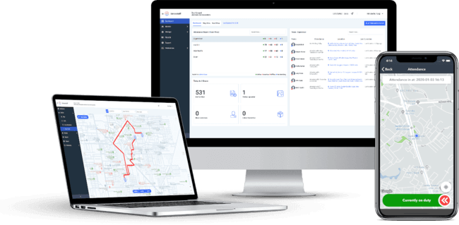
ATTENDANCE HYGINE KEY POINTS
GEO Fencing- ISDs can mark the attendance within 200mts from his allocated counter.
IMEI Tracker- ISDs can mark the attendance from his register mobile number only.
Image tracker- ISDs has to mark attendance by clicking the image in-front of Daikin ac display wall.
In time-out time punching- ISDs has to mark attendance twice a day and has to complete 8.30 hours at least t o avoid half day pay lose.
Week off policy- ISDs can mark 1 week off in a week. Minimum 6 days gap required to mark next week off .
Leave request - ISDs can apply for leave through the portal only. In case of unapproved leave ISD salary for the day will be deducted .
Request for correction - ISDs can apply for RFC in case of they have genuinely missed to mark attendance. Option will be available within 24 hours.
DSP site visit- DSP geo fending will be bypass in case DSP is visiting the customer site.

Slide 10
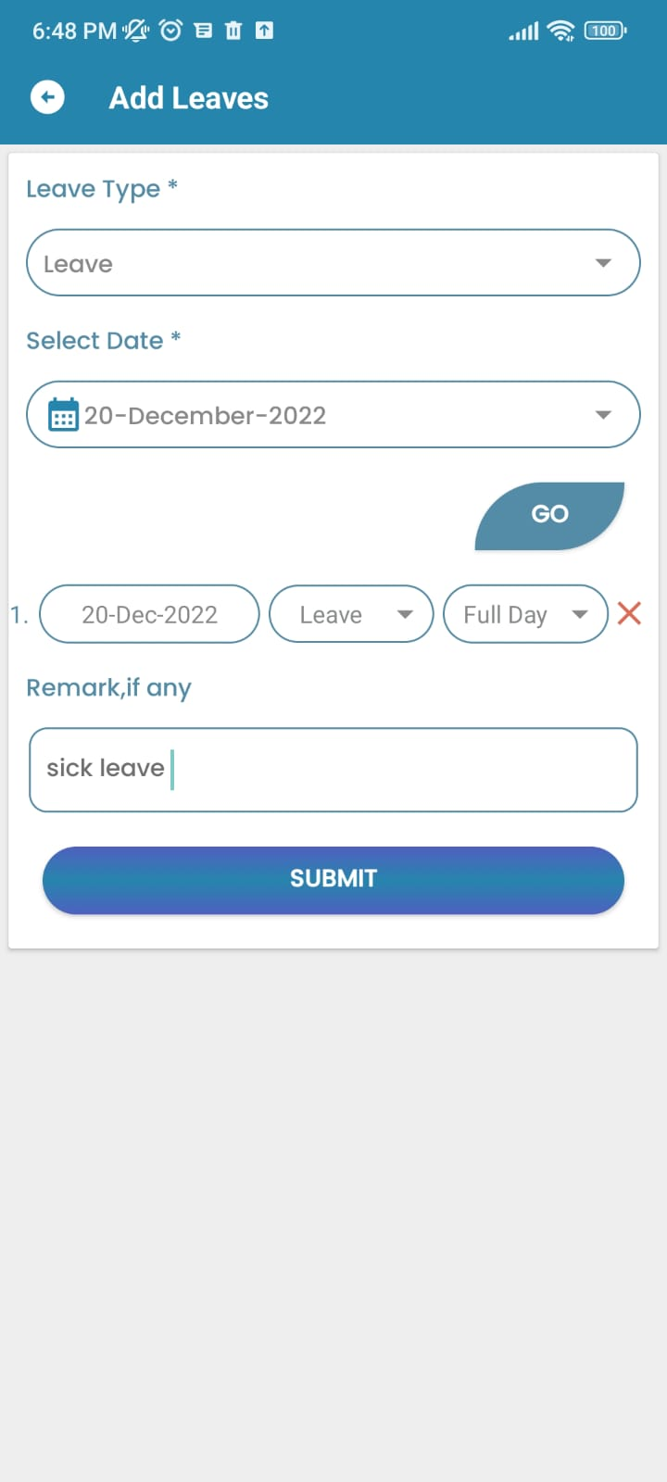
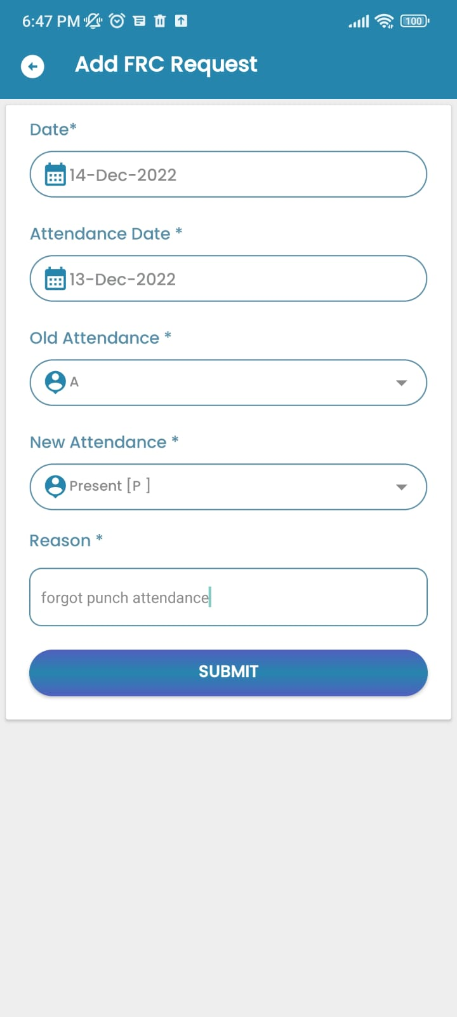
LEAVE & RFC
Leave Request- ISD has to apply for the leave in advance. Leaves will be deducted from the leave balance. Leave without approval will be count as loss of pay for the day.
RFC Request- in case ISD missed to mark the attendance due to any reason. Next day ISD has to submit reason of absent for previous day. Than only he can resume his current day.

Slide 11
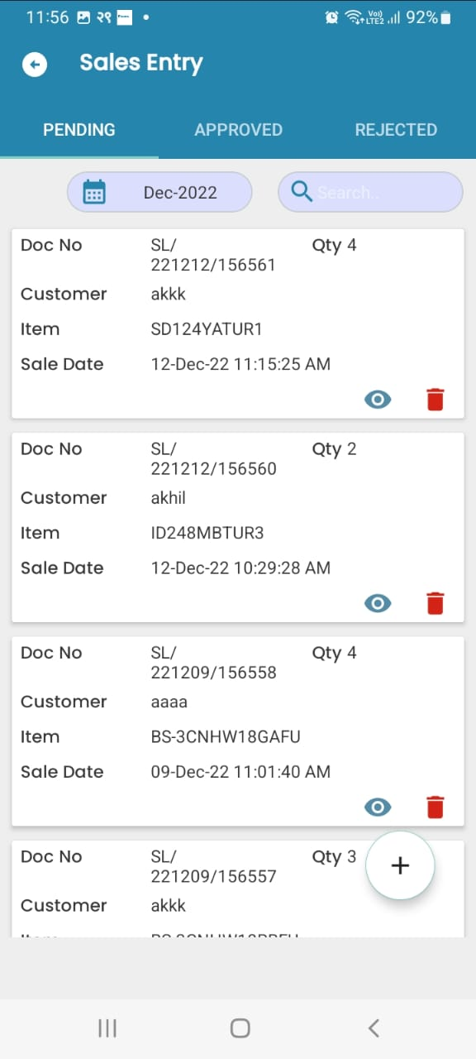
Performance
SECONDARY SALES
Capture secondary sales information in our application. ISD will entre the sales information at dealer end.
INCENTIVE
Incentive will auto calculated at per the Target achieve by ISD. Same will be displayed to ISD.
TARGET AND ACHIEVEMENT
we provide target to ISD month wise. ISD target and achievement are shown on ISD application.

Slide 12
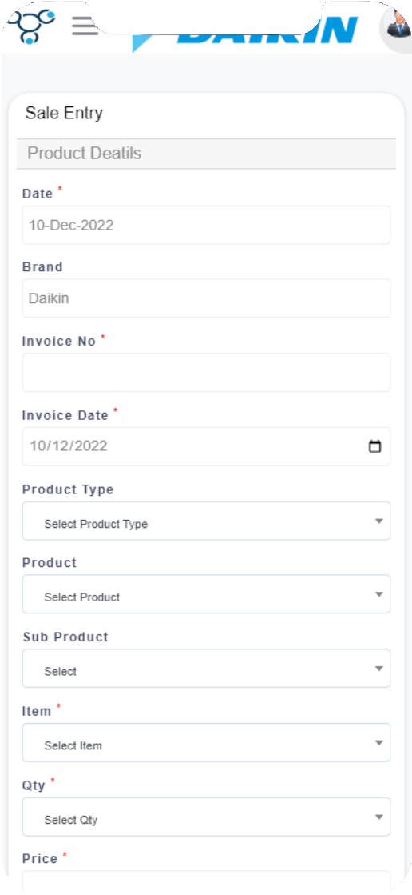
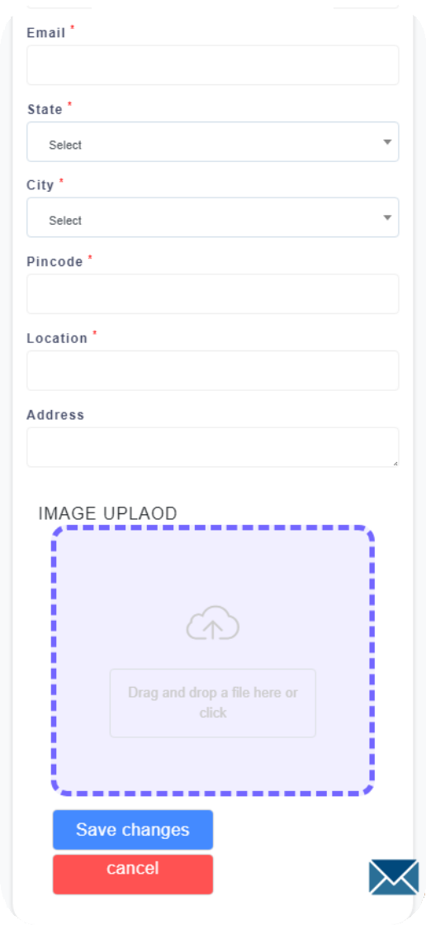
Sales data entry
Product Details
i.e. ac type and model
Sales details i.e. price and quantity
Customer details
i.e. name address and contact
Invoice copy

Slide 13
Target and Achievement
Target vs. Achievement- month Targets are available on the home screen of the ISD’s mobile application. As soon as ISDs punches the sale percentage of achievement shown on the home page of app. This will motivate the ISD to complete the pending target to earn the incentive.
Announcement
Provision to add announcements at mobile application. Announcement will be shown at user Dashboard. Multiple Announcements can be added and it will auto expire after end defined.

Slide 14


ISDs App Notifications
Notification on app
if ISD forget to mark attendance till 12.30 am
If RFC or leave will get rejected
If sale get rejected
If on 0 sales from last 5 days.
If any scheme launch by management

Slide 15


CLIENT PORTAL
Dash Board
Detailed Excel Reports
Attendance/sales Approvals
Auto Sales reports on E-mail

Slide 16
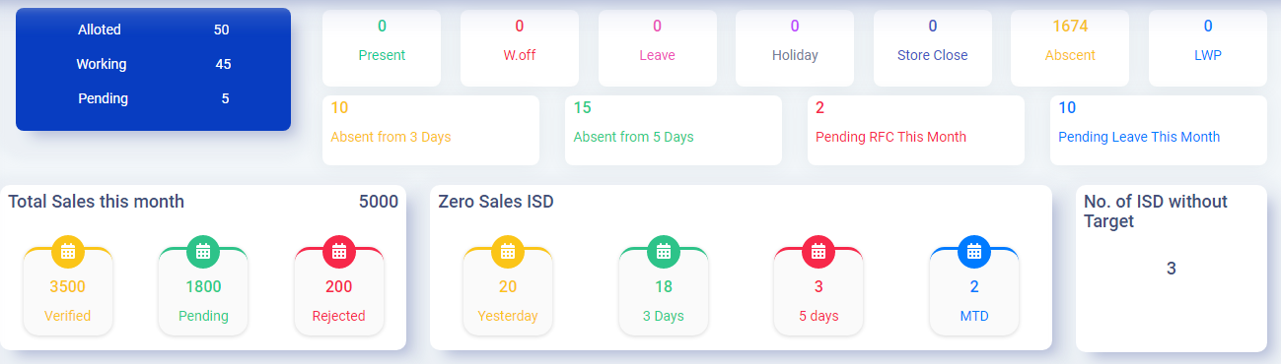
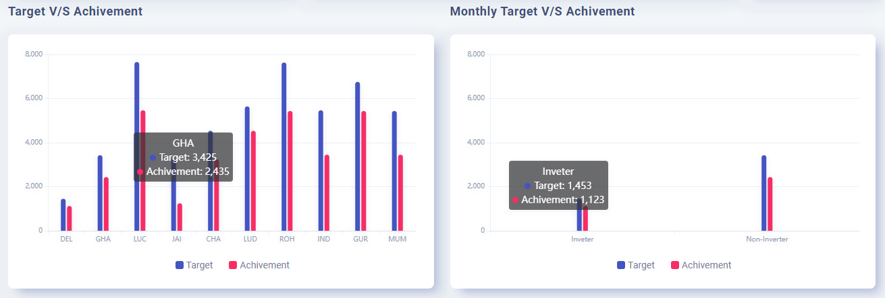
ASM Dashboard
Attendance Hygiene at asm level
Allotted - ISD allotted to ASM
Working – Active head count
Pending - Balance ISD ASM can Hire
Current date ISD attendance Status
Count of ISDs who are absent from last 3 days
Count of ISDs who are absent from last 5 days
RFC and leave pending at ASM level
Sales Status
Verified - count of sales that has been approved , rejected and pending
Detail of non-performer ISDs
ISD working without target
Target vs achievement
Graph 1 – Month wise TvsA (FY)
Graph 2 – current Month product wise TvsA

Slide 17
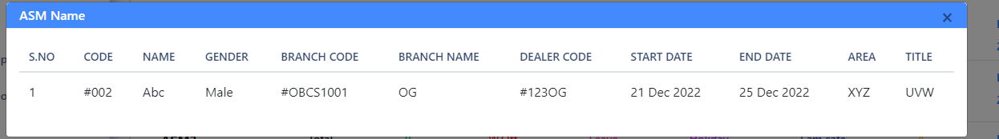
ASM Wise Attendance Count
Attendance Detail Information
At ASM login ASM can view all his ISD / Counter wise attendance
On click on attendance
Present – All ISD who are present on current date will show along with counter information.
W.Off – All ISD who are on week off on current date will show along with counter information.
Leave – All ISD who are Leave on current date will show along with counter information.
Holiday – All ISD who are on leave on current date will show along with counter information.
Store Close – All ISD whose store is closed on current date will show along with counter information.
Absent – All ISD who are Absent on current date will show along with counter information.
On click at attendance status

Slide 18
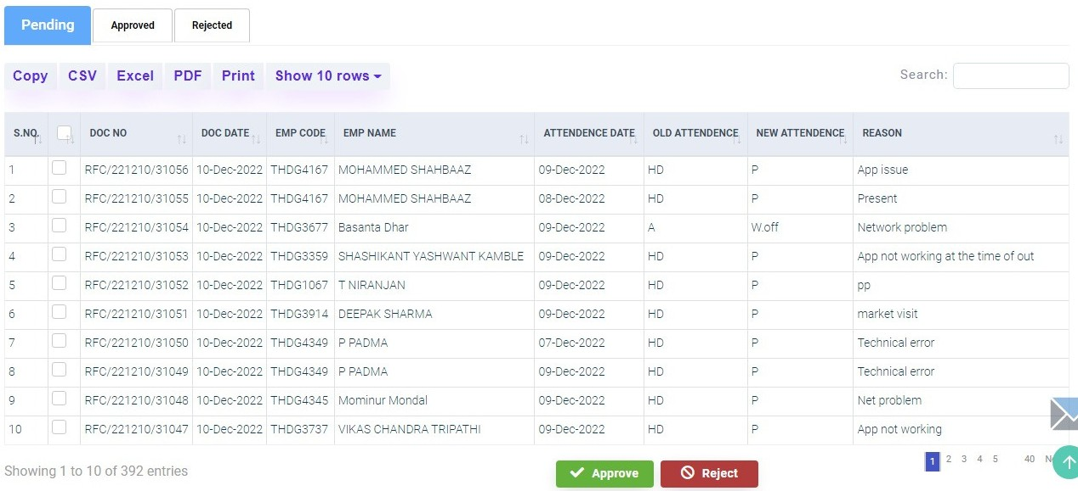
RFC and leave APPROVAL
ASM Has to approve or reject the RFC/leave request raised by the ISDs within 2 days.
Leave balance is available on the ASM level

Slide 19
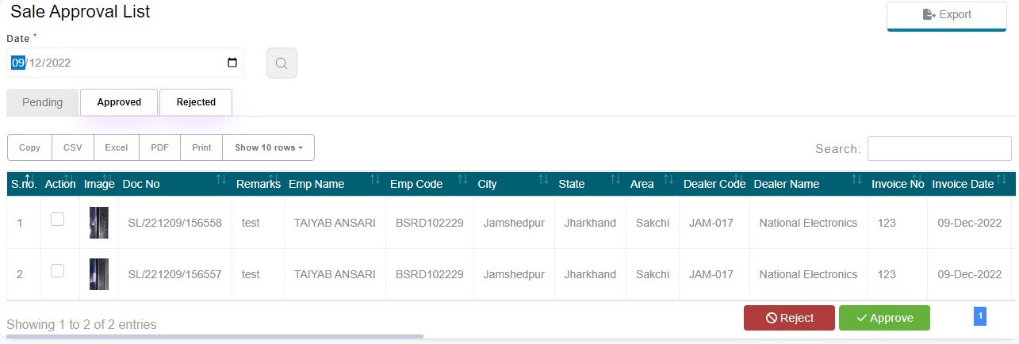
SALES APPROVALPORTAL
Sales uploaded by ISDs needs to be verified by ASM within 3 days time.
Key points to check
Model number and quantity
invoice date and invoice number
Customer details
Invoice copy

Slide 20
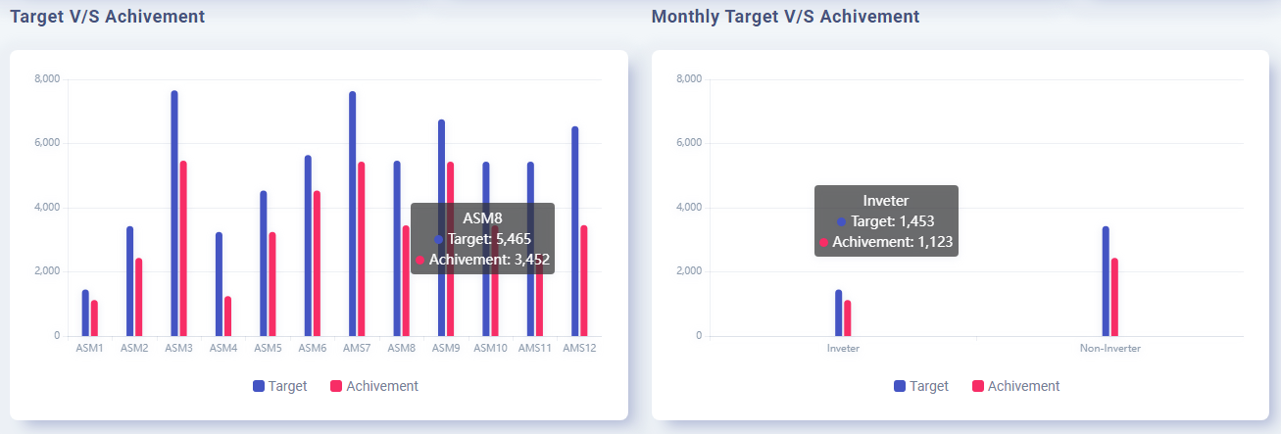
BM Dashboard
Attendance Hygiene Branch level
Allotted - ISD allotted to branch
Working – Active head count
Pending - Balance ISD
Current date ISD attendance Status
Count of ISDs who are absent from last 3 days
Count of ISDs who are absent from last 5 days
RFC and leave pending at ASM
Sales Status BSM Level
Verified - count of sales that has been approved , rejected and pending
Detail of non-performer ISDs
ISD working without target
Target vs achievement
Graph 1 – ASM wise target and achievement
Graph 2 – Branch performance product wise

Slide 21
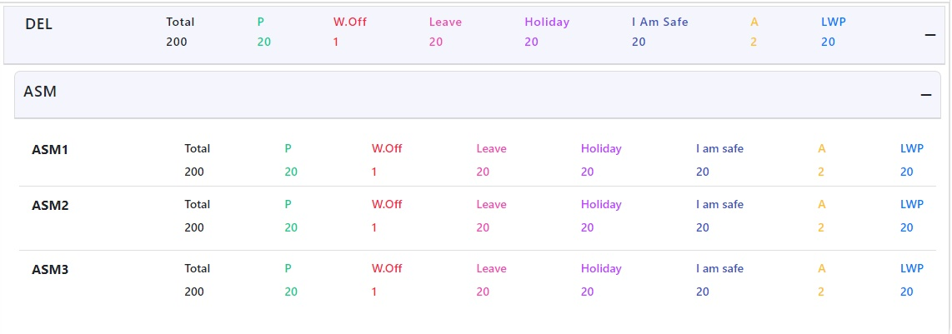
ASM wise Attendance Count
Attendance Detail Information
At Branch login BM can view all his ASM wise ISD current Date attendance.
On click on ASM BM can view counter wise/ ISD wise attendance Graph 2 – All inverter and non inverter Target and Achievement
On click at ASM Name

Slide 22
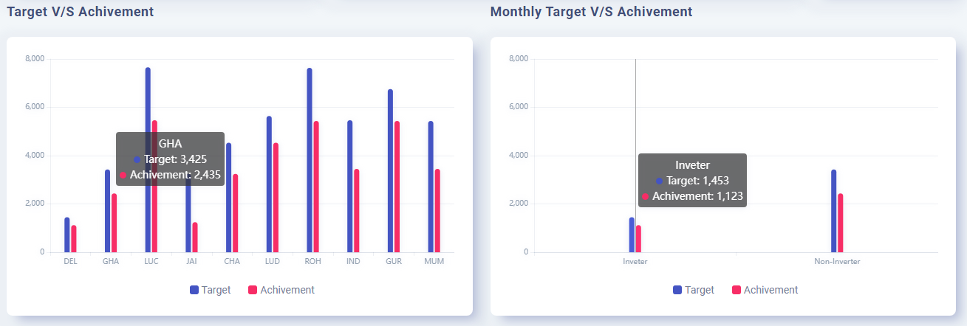
RM Dashboard
Attendance Hygiene
Allotted - ISD allotted to ASM
Working – Active head count
Pending - Balance ISD ASM can Hire
Current date ISD attendance Status
Count of ISDs who are absent from last 3 days
Count of ISDs who are absent from last 5 days
RFC and leave pending at ASM
Sales Status
Verified - count of sales that has been approved by all ASM, of the region
Pending - Count of sales that has been pending for all ASM Level
Rejected – Count of sales that has been rejected by all ASM
Target vs achievement
Graph 1 – Branch wise target and achievement
Graph 2 – All inverter and non inverter Target and Achievement of region

Slide 23
Reports
Attendance Reports
Daily attendance report – Day wise attendance along with user punch distance , in and out time and ISD selfie
Monthly In –out Report – Monthly ISD attendance status with in –out time and working hours
Final Attendance Report – All approved RFC and leave approved will updated in final attendance
Leave Report – All Leave request raised by ISD along with their status
RFC Report- All RFC request raised by ISD along with their status
Sales Reports
Sales Entry - Month wise sales made by ISD
MTD Sales Report - Month till date sales data
Target vs Achievement Report – ISD wise target and achievement and productivity
Competition Report – Competition Brand sales entry
Counter Display Report - Dealer counter display entry report
Other Reports
Daily Automated mail report - Daily automated reports on email along with attendance sales and productivity summary
Region & Branch Wise summary report -
Customize report - We can develop customized reports as per the client requirements.

Slide 24

Email Notifications
RFC request and Approval email to requester and approver.
Leave Request and Approval email to requester and approver .
3 and 5 days absent email with daily report.
Sales approved / rejected mail.
Low productive employee information.
Current date ISD information who has not mark his attendance every day at 12 PM.
Daily attendance summary and sales summary email at every day 6 AM.

Slide 25
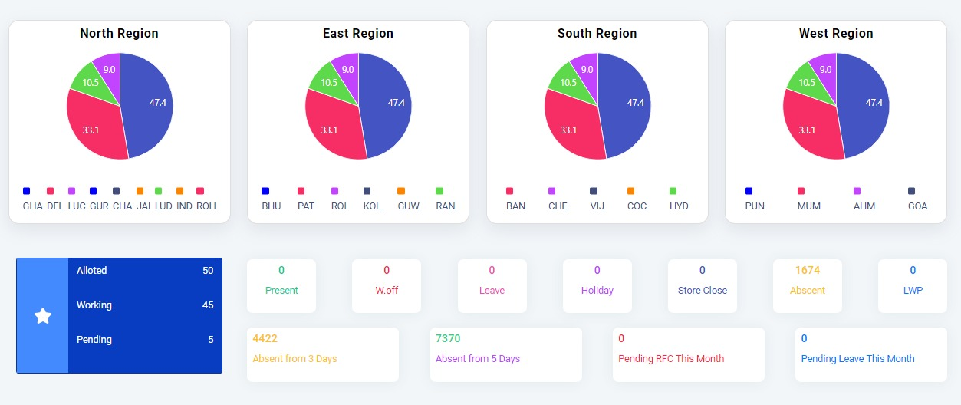
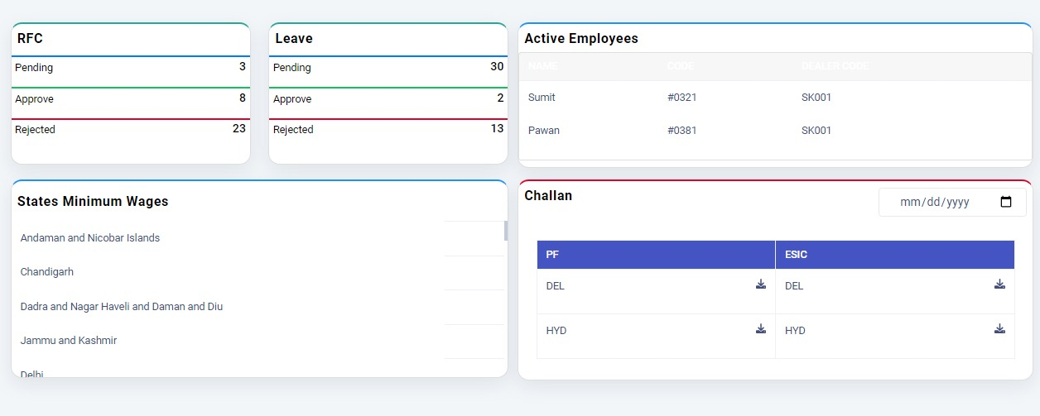
HR Dashboard
Attendance Hygiene
Graph -Region wise branch wise ISD active head count
Allotted - ALL India ISD allotted
Working – All India Active head count
Pending - All India Balance ISD to hired
Current date ISD attendance Status
Count of ISDs who are absent from last 3 days
Count of ISDs who are absent from last 5 days
RFC and leave pending at ASM
Table 1 – Active Employees Salary Register for the Month.
Table 2- State wise minimum wages list
Table 3 – Monthly Challan and ESIC documents

Slide 26

CONTACT US
9899520000
ashesh@thrivera. in www. thrivera. In Gurgaon,Haryana

