Slide 1




Module Name – Priority Queue and Heap
Topic– Name: Priority Queue and Heap
Instructor: Vikash Dubey
EditEdit MasterMaster texttext stylesstyles

Slide 2
Time Allocation Summary
Element | Slide numbers | Maximum time(min)
Today’s Agenda
Spot Test
Introduction To priority queue.
Priority Queue ADT.
Introduction To Heap
Insertion and Deletion in heap.
Total Time |  | 120

Slide 3

Today’s Agenda
Introduction To priority queue.
Priority Queue ADT.
Introduction To Heap
Insertion in heap.
Deletion in heap.

Slide 4
Priority Queue
Priority Queue is an extension of queue with following properties.​
Every item has a priority associated with it.​
An element with high priority is dequeued before an element with low priority.​
If two elements have the same priority, they are served according to their order in the queue.​
​
​

Slide 5
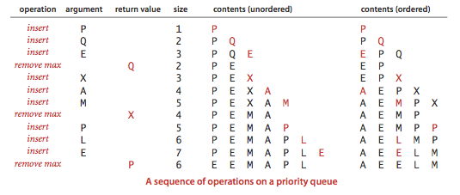
Typical Representation of priority queue

Slide 6
Application Of Priority Queue
Operating systems: It is also use in Operating System for load balancing (load balancing on server), interrupt handling.
Heap Sort : Heap sort is typically implemented using Heap which is an implementation of Priority Queue.
Data compression : It is used in Huffman codes which is used to compresses data.
Prim’s algorithm: It is used to implement Prim’s Algorithm to store keys of nodes and extract minimum key node at every step.
Dijkstra’s Shortest Path Algorithm using priority queue: When the graph is stored in the form of adjacency list or matrix, priority queue can be used to extract minimum efficiently when implementing Dijkstra’s algorithm.

Slide 7
Priority Queue Implementation
PriorityQueue<Integer> pQueue = new PriorityQueue<Integer>();
// Adding items to the pQueue using add()
pQueue.add(10);
pQueue.add(20);
pQueue.add(15);
// Printing the top element of PriorityQueue
System.out.println(pQueue.peek());
// Printing the top element and removing it
// from the PriorityQueue container
System.out.println(pQueue.poll());
// Printing the top element again
System.out.println(pQueue.peek());

Slide 8
Introduction to Heap
A Heap is a special Tree-based data structure in which the tree is a complete binary tree. Generally, Heaps can be of two types:
Max-Heap: In a Max-Heap the key present at the root node must be greatest among the keys present at all of it’s children. The same property must be recursively true for all sub-trees in that Binary Tree.
Min-Heap: In a Min-Heap the key present at the root node must be minimum among the keys present at all of it’s children. The same property must be recursively true for all sub-trees in that Binary Tree.

Slide 9
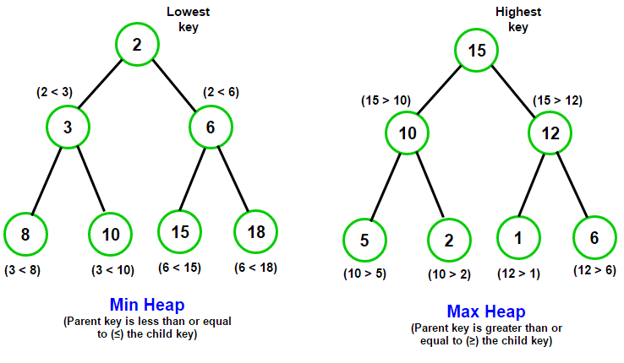
Heap Representation

Slide 10

Thank You!
Happy learning!
#LifeKoKaroLift

