Slide 1




Module Name – Trees & BSTs
Topic Name: Binary Search Tree (BST)
Instructor: Arun Kudiyal
EditEdit MasterMaster texttext stylesstyles

Slide 2
Time Allocation Summary
Element | Slide numbers | Maximum time(min)
Today’s Agenda
Spot Test
Introduction to Binary Seach Trees (BST)
Insertion in BST
Searching in BST
Deletion from BST
Total Time |  | 120

Slide 3

Today’s Agenda
Introduction to Binary Seach Trees (BST)
Inserting a node in a BST
Searching a node in a BST
Deleting a node from a BST
Lowest Common Ancestor in BST

Slide 4
Introduction to Binary Search Trees (BST)
BST is a collection of nodes arranged in a way where they maintain BST properties. Each node has a key and an associated value.
A Binary Search Tree (BST) is a tree in which all the nodes follow the below-mentioned properties :
The left sub-tree of a node has a key less than or equal to its parent node's key.
The right sub-tree of a node has a key greater than to its parent node's key.
While searching, the desired key is compared to the keys in BST and if found, the associated value is retrieved.

Slide 5
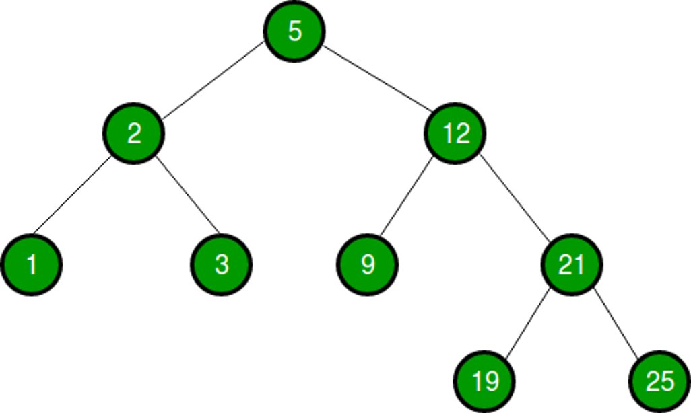
Typical Representation of a BST

Slide 6
Tree Terminologies
Path - Path refers to the sequence of nodes along the edges of a tree..
Root – The node at the top of the tree is called root. There only exist one root per tree.
Parent – Any node except the root node has one edge upward to a node called parent.
Child – Any node below a given node connected by its edge downward is called its child node.
Leaf – The node which does not have any children is called a leaf node.
Subtree – The descents of any given node is called a Subtree.

Slide 7
Tree Terminologies
Visiting - Visiting refers to checking the value of a node when control is on the node.
Traversing – Traversing means passing through nodes in a specific order.
Level – Level of a node represents the generation of a node. If the root node is at level 0, then its next child node is at level 1, its grandchild is at level 2, and so on.
Key – Key represents a value of a node based on which a search operation is to be carried out for a node.

Slide 8
Java Implementation of a Binary Seach Tree
As discussed in the previous slides, a BST contains left sub-tree of nodes which has key less than or equal to its parent node's key & right sub-tree nodes which has key greater than to its parent node's key.
public Node insert(int data) {
// if tree is empty, make root the first node
if(root == null) {
root = new Node(data);
return root;
}
// otherwise put the data either to left or right
if(data < root.key)
// store to the left hand side
root.left = new Node(data);
else if(data > root.key)
// store to the right hand side
root.right = new Node(data);
return root;
}

Slide 9
Java Implementation of a Binary Seach Tree
As discussed in the previous slides, a BST contains left sub-tree of nodes which has key less than or equal to its parent node's key & right sub-tree nodes which has key greater than to its parent node's key. So, in this case the searching becomes easy as the whole tree can be disintegrated into two halves.
public Node search(int data, int data) {
// if tree is empty or the data is in the root
if(root == null || root.data== data)
return root;
// otherwise search the data either to left or right
if(data < root.key)
// data will be found in the left side of the tree
return search(root.left);
// else data will be found in the right hand side
return seach(root.right);
}
}

Slide 10
Java Implementation of a Binary Seach Tree
When we delete a node from the BST, we have to make sure that the right candidate node takes place when the node is deleted. When a node is deleted the data greatest from the let sub tree or the smallest from the right sub tree turns out to be the perfect candidate.
public Node delete(Node root, int data) {
// if tree is empty, make root the first node
if(root == null)
return root;
// otherwise search the node
if(data < root.key)
root.left = delete(root.left, data);
else if(data > root.key)
root.right = delete(root.right, data);
// once the key is found, delete the node
else {
// for the case of leaf node
if(root.left == null)
return root.right;
else if(root.right == null)
return root.left;
// else find the minimum-most node from the right & delete
root.key = minValue(root.right);
Root.right = delete(root.right, root.key)
}
return root; }

Slide 11

Thank You!
Happy learning!
#LifeKoKaroLift

