Slide 1


Data Structures
#LifeKoKaroLift

Slide 2



Module Name - Stacks & Queues
Topic Name: Queues
EditEdit MasterMaster texttext stylesstyles

Slide 3

Today’s Agenda
Introduction to Queues
Ticket Building System using Queue
Implementation of Queue

Slide 4
Today’s Agenda
Implementation of Stack using two Queues
Implementation of Stack using one Queue
Identify Palindromic String Problem

Slide 5
Today’s Agenda
Duplicate Parentheses Problem
Reversing a Stack
Finding Kth Largest Element Problem

Slide 6

Introduction to Queues
Well that was all about LIFO order, we all know that most lines( or QUEUES) follow the FIFO order. Don’t they?
When was the last time you had to stand in a queue?
There’s a high probability it was resolved on the First In First Out basis. Because that is the defining property of a queue.

Slide 7
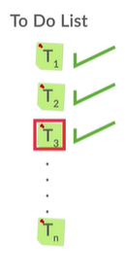
Introduction to Queues
Before we start with the technical details, try to imagine the application of queues in real life.
They are practically almost everywhere from queues at a bus stop, to a queue outside the ATM and sometimes there are even queues outside the elevators.
One such example of queues is a normal To-Do List whose tasks are resolved on the First In First Out basis. Let’s write a simple java code to implement this To-Do list:

Slide 8
Introduction to Queues
Let’s run the following code and see the output we obtain:
public class ToDoList {
public static void main(String[] args) {
MyQueue<String> todolist = new MyQueue<String>();
makeToDoList(todolist);
doAllTasks(todolist); }
public static void makeToDoList(MyQueue<String> todolist) {
todolist.add("task 1");
todolist.add("task 2");
todolist.add("task 3");
todolist.add("task 4"); }
public static void doAllTasks(MyQueue<String> todolist) {
while (todolist.size() != 0) {
System.out.println(todolist.remove()); }}}

Slide 9
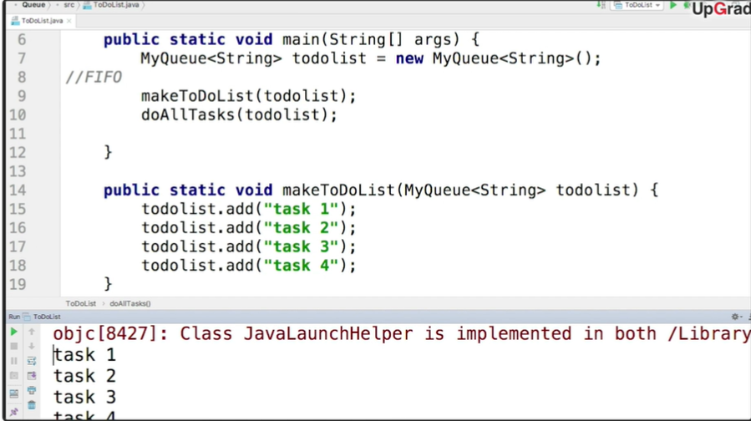
Introduction to Queues
And just as we expected, the output is all the tasks being printed in the FIFO order.

Slide 10
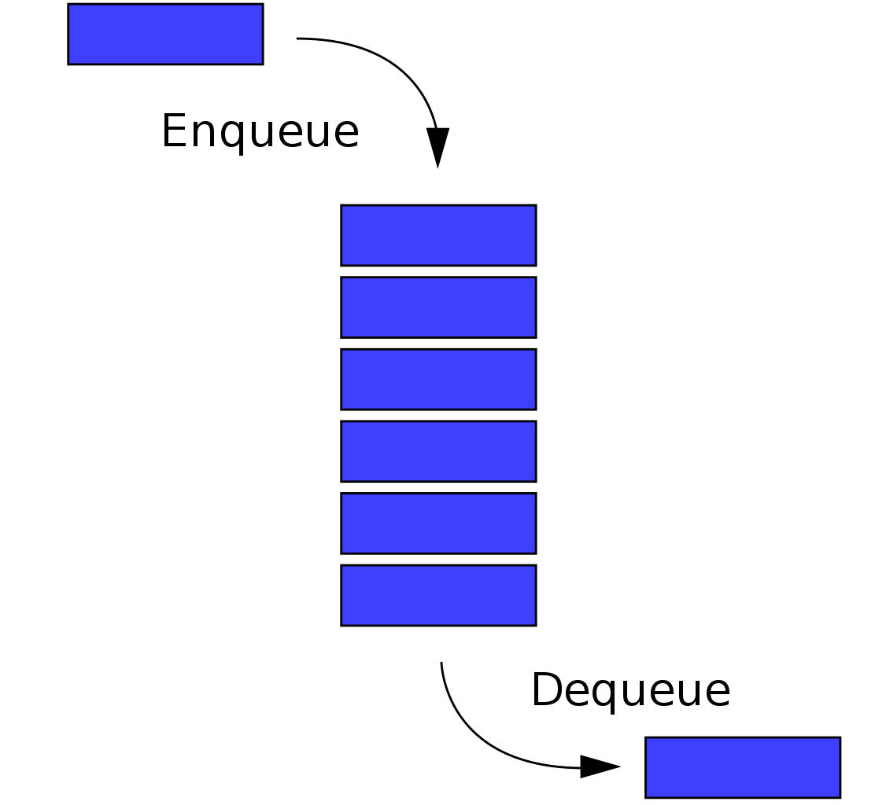
Introduction to Queues
Therefore, a queue is a data structure which follows the First In First Out order.
There are two primary operations for queues:
The insertion operation similar to Push in stack is called Enqueue. The elements are added at the top/head of the queue.
The deletion of element is performed by Dequeue operation. This deletion of elements happens at the bottom/tail of the queue.

Slide 11
Introduction to Queues
In Java, you can use an inbuilt Queue implemented using a Linked List.
Here, the convention changes a bit - Java queues don't have enqueue and dequeue methods, these operations are carried out using the following methods:
(ENQUEUE) add(x): Throws an exception if it fails to insert the object, i.e. when the queue is full
(DEQUEUE) remove(): Throws an exception if the queue is empty
peek(): Returns null if the queue is empty
isEmpty(): Returns true if the queue is empty

Slide 12

Ticket Booking System Using Queues
Well, let’s now see one of the practical applications of queue.
Ticket booking systems heavily use queues for their processes.
When an individual would make a booking request, it would be stored in queues, so that the customer who makes the request first, gets tickets first.

Slide 13
Ticket Booking System Using Queues
Another, important feature in the system is that a request could be accepted only if there are sufficient tickets in the system.
So, if a customer is making a request for 4 tickets, but there are only three tickets in the system, this request would have to be denied.
Thus, each time a request is made, the tickets available are checked. If the tickets are available, then the request is dequeued and the next request in the queue is processed.

Slide 14

Implementation of Queue
Unlike Stack, which is a class in Java, Queue is an interface that often needs to be implemented as a linked list.
Remember that you learnt about interfaces in polymorphism. They are classes that contain only abstract methods and cannot be instantiated.
In Java the Queue interface needs to be implemented by a class (usually the LinkedList class) before you can instantiate and use it.
ID: 570834163

Slide 15
Implementation of Queue
Here’s the code for the linked list implementation:
private LinkedList<T> list = new LinkedList<T>();
public void add(T el) {
this.list.add(el); }
public T remove() {
return this.list.remove(); }
public int size() {
return this.list.size(); }

Slide 16
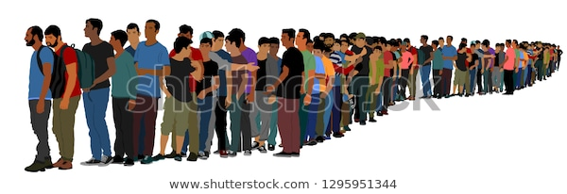
Implementation of Stack using Queues
Well, now you’ve learnt the basics of both stacks and queues. Here’s a challenging task for you.
Can you implement a stack using queues?
But, before let’s revise the difference between them once again.

Slide 17
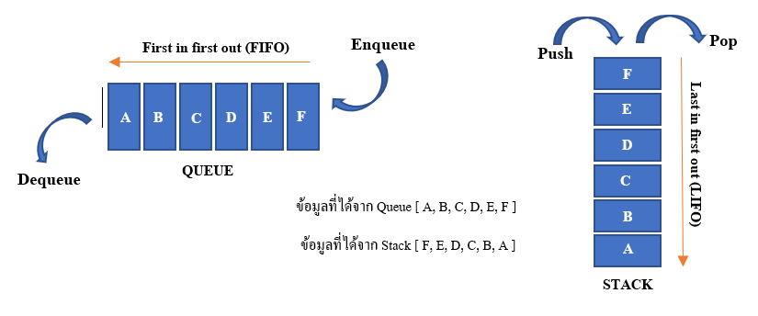
Implementation of Stack using Queues
Stacks are the data structure that follows LIFO property. Stack has a restriction that insertion and deletion can be done only at one end which is known as the 'TOP' of the stack.

Slide 18
Implementation of Stack using Queues
On the other hand, Queues are the data structure that follows FIFO property.
In queues, you can insert (enqueue) elements only at one end which is known as ‘TAIL’ and deletion (dequeue) of elements in the queue can take place at the other end which is known as ‘HEAD’.

Slide 19
Implementation of Stack using Queues
The major difference therefore is that if the elements are inserted at the same end in both these data structures, they removal takes place at different end or vice-versa.
We can therefore conclude that either the PUSH operation will be same as ENQUEUE or the POP operation will be same as DEQUEUE in our stack implemented with queues.
The former case is called implementing stack making POP operation costly and the latter is called, as you would have guessed already, implementing stack making PUSH operation costly.

Slide 20
Implementation of Stack using Queues
Let us see the implementation making POP operation costly:
The algorithm uses two queues Q1 and Q2.
The first queue Q1 will be acting as our stack, i.e PUSH and POP operations will insert and remove elements from the head of Q1.
As told already, this implementation involves assuming the heads of both stack and queue as same.
Therefore, the ENQUEUE operation does the same task as the PUSH operation and add elements to the head of Q1. Q2 is not used in PUSH.

Slide 21
Implementation of Stack using Queues
Let’s see a visual demonstration to understand the PUSH operation’s execution:
PUSH 1: 1 is enqueued to Q1. The head of the Q1 becomes the head of the stack.
PUSH 5: 5 is enqueued to Q1.
PUSH 3: 3 is enqueued to Q1.
1
5 | 1
3 | 5 | 1

Slide 22
Implementation of Stack using Queues
Here is the flow of the implementation of the costly POP operation:
The POP operation will be performed using both queues Q1 and Q2.
All the elements except the last one( the element to be popped) will be dequeued one by one from Q1 and enqueued into the Q2.
The remaining element from Q1 is dequeued and returned after the names of Q1 and Q2 are swapped.
Let’s perform the pop operation on this stack from our last slide:
3 | 5 | 1

Slide 23
Implementation of Stack using Queues
Q1: Q2:
STEP 1: Dequeue all the elements except last from Q1 and enqueue them to Q2.
Q1: Q2:
Q1: Q2:
STEP 2: Dequeue the last element from Q1 and return it.
Q1: Return 3; Q2:
STEP 3: Swap Q1 and Q2.
Q2: Q1:
3 | 5 | 1
3 | 5
1
3
5 | 1
5 | 1
5 | 1

Slide 24
Implementation of Stack using Queues
Let’s test your newly learnt knowledge now...
What will be the output after the following commands are executed?
PUSH(1)
PUSH(2)
PUSH(3)
POP
PUSH(1), (2) and (3) will enqueue 1, 2 and 3 into Q1.
What about the POP operation now? Will it be simple?

Slide 25
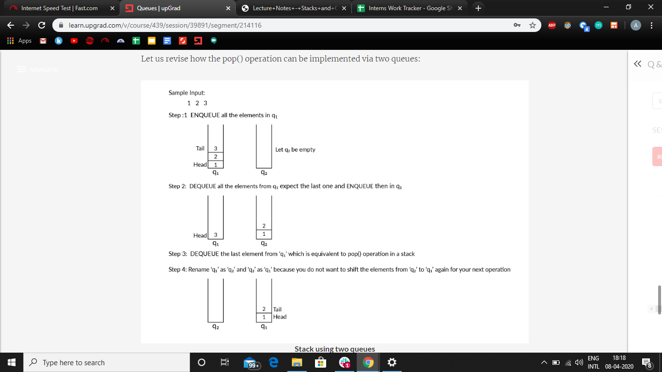
Implementation of Stack using Queues
For the POP operation:

Slide 26
Implementation of Stack using Queues
For the POP operation:

Slide 27
Implementation of Stack using Queues

Slide 28
Implementation of Stack using Queues
Let’s quickly check the algorithm if we implement the stack making PUSH operation costly:
The POP operation in this case will simply be a dequeue from our queue Q1.
For the PUSH operation, the steps will be:
Enqueue the element to be pushed in Q2.
Dequeue all the elements from Q1 one by one and enqueue them to Q2.
Swap the names of Q1 and Q2

Slide 29

Implementation of Stack using Queues
Well, that was the implementation of a stack using two queues.
Do you think it is possible to implement a stack using only queue?
YES!!! It is possible. Let’s check how.

Slide 30
Implementation of Stack using Queues
To implement a stack using a single queue, we basically need to solve the purpose of the other queue we used to implement the stack using two queues.
We assigned either ENQUEUE or DEQUEUE operation as PUSH or POP and used the second queue to implement the remaining function.
This was because if the elements in both queue and stack are added/ removed from same end, they are removed/added to different ends.

Slide 31
Implementation of Stack using Queues
So our new objective is to manipulate our queue such that if the element is added at one end, it reaches the opposite end before the next operation. Let’s see our new PUSH and POP functions now:
PUSH(x)
Calculate size(S) of the queue Q.
Enqueue x to Q
One by one Dequeue s items from Q and enqueue them back.
POP
Dequeue an item from Q

Slide 32
Implementation of Stack using Queues
Let’s understand with the help of an example:
Assume that our queue already has elements 1, 2, 3 in it and now we want want to PUSH 4 into our stack.
Step 1 will be to calculate the size of the stack/queue which will be equal to 3 here.
Now we enqueue 4 to our queue. The queue now becomes 1, 2, 3, 4.
Now we dequeue from the queue and enqueue the element i.e. 1 back to the queue. The queue now becomes 2, 3, 4, 1.
We repeat the same step 3(size) times. Finally the queue becomes 4, 1, 2, 3.

Slide 33
Implementation of Stack using Queues
The following illustration will help you understand the concept better:
Queue: Head Tail Size = 3 Next operation: PUSH 4
3 | 2 | 1
Enqueue 4
Dequeue 1
3 | 2 | 1
4 | 3 | 2 | 1
1 | 4 | 3 | 2
Enqueue 1
Dequeue 2
Enqueue 2
Dequeue 3
3 | 2 | 1 | 4
2 | 1 | 4 | 3
Enqueue 3

Slide 34
Implementation of Stack using Queues
Well let’s see the java implementation of the same now:
void push(int x){
int size = q.size();
q.add(x);
for (int i = 0; i < size; i++){
int temp= q.remove();
q.add(temp); }}
int pop(){
if (q.isEmpty()) {
System.out.println("Stack is empty");
System.exit(0); }
int x = q.remove();
return x; }

Slide 35
Identify a Palindromic String
Well here’s the last problem of the topics and it’s a problem you already are familiar with.
Just to revise, a palindrome is a word, string, phrase or sentence that reads same backward as forward. For example, “MALAYALAM”, “LEVEL” etc.
As queues and stacks are one of the most frequently used data structures for storing and modifying information, we need to devise an algorithm to check whether the characters of the input string forms a palindrome or not using either stacks or queues.

Slide 36
Identify a Palindromic String
Let’s see the steps of the algorithm to help us check the palindromic nature of a stack.
Use a ‘for’ loop to push each character of the string into an array stack.
Initialise an empty string say “reversedString”.
pop() the characters from the stack one by one and add it to the reversedString.
Compare the input string and the reversed string. If they are equal, then print “The input String is a palindrome”.
If they are not equal, then print “The input String is not a palindrome”.

Slide 37
Identify a Palindromic String
Will the time complexity of our algorithm be O(n) or O(n²)???
The space complexity of the discussed approach is O(n²) due to the variable string used.
Strings are immutable in Java; therefore, a new string of length ‘n’ will be created ‘n’ times.
To avoid creating a new string everytime you add a character, you can use StringBuilder class in Java.
The strings created using StringBuilder class are modifiable and do not need any repetitive creation.
Therefore, the space complexity is reduced to O(n).

Slide 38
Duplicate Parentheses Problem
You all remember the “Matching Parentheses” problem from Stacks. Don’t you?
Well here’s another problem statement involving those parentheses again.
For any programming language structure or for any algebraic expression, it is mandatory to have all parenthesis “( )” balanced.
However, there may be instances where these parentheses are duplicated.For example: (((1*2))+5)
Let’s see the approach now:

Slide 39
Duplicate Parentheses Problem
If you had to solve this problem manually, wou will definitely start by resolving the innermost parentheses. Our algorithm works on the same principle.
We start by declaring a stack and iterating through the complete length of string and pushing the elements inside the stack until we encounter the first closing parentheses “)”.

Slide 40
Duplicate Parentheses Problem
Now we start popping the elements till we encounter the first “(”.
If the count of number of elements popped is 1 or 0, we say that string contains duplicate parentheses.
Otherwise, after full string traversal, we say that it does not contains duplicate parentheses.

Slide 41
Duplicate Parentheses Problem
Let’s see the java code:
Stack<Character> stack = new Stack();
for (int i = 0; i < inputString.length(); i++) {
char ch = inputString.charAt(i);
if (ch != ')') {
stack.push(ch);
}else{
char top = stack.peek();
stack.pop();
int count = 0;
while (top != '(') {
top = stack.peek();
stack.pop();
count++; }
if (count <= 1) { return "true"; }}}
return "false";

Slide 42
Reverse A Stack
In the coming few slides, we will be shortly discussing a few problem statements on stacks and queues, which will be followed by the approach to solve the question. These questions are:
Reverse a stack
Find K^{th} largest element
Identify a palindromic string

Slide 43
Reverse A Stack
Let’s start with the first one, Reversing a stack.
One of the applications of a stack is to reverse an input sequence. To reverse a sequence, you can insert the characters of that sequence one by one and later pop them out to get the reversed output.
But what if we want the input sequence to be reversed within the stack itself?
For example: If the input stack contains elements { a b c d e } where 'e' is the element at the top of the stack then reverse stack would contain elements { e d c b a } where 'a' is the element at the top of the stack.

Slide 44
Reverse A Stack
Let’s approach this problem with the pseudocode given below which uses two functions in its implementation:
//Pseudocode to reverse the stack
function reverse()
A. IF stack is not empty
//Hold all items in function call stack until we reach the end of the stack
1. LET i contains top element from stack.
2. POP the top element from stack.
3. reverse()
// Insert all the items in function call stack one by one from the bottom to top. Each item is inserted at the bottom of the stack
4. insertAtEnd(i)

Slide 45
Reverse A Stack
// This function inserts an element at the bottom of a stack
function insertAtEnd(i)
A. IF stack is empty
1. PUSH i to the top of the stack
B. ELSE
/* All items are held in function call stack until we reach end of the stack.When the stack becomes empty the item is inserted at the bottom.*/
1. In variable j we will store the value which is at the top of stack.
2. POP the top element from the stack
3. insertAtEnd(i)
//Push all the items which are held in function call stack once the item is inserted at the bottom
4. PUSH j to the top of the stack

Slide 46
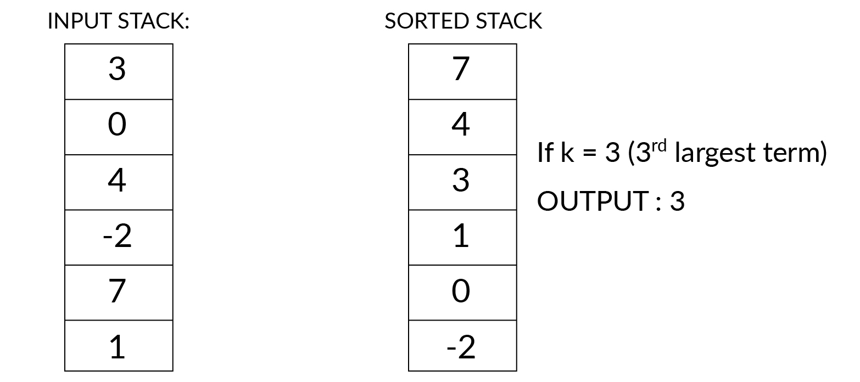
Finding K^{th} Largest Element
The next problem is about finding the k^{th} largest element given a set of elements.
To find the kth largest element, you will have to somehow compare every element with every other element. Here, the task is to first sort and then find the kth largest element in the given input sequence.
Consider the example on the right. It clarifies further the need to sort the stack for our solution

Slide 47
Finding K^{th} Largest Element
Here’s the approach to solve our problem( sort the stack):
Create a new stack and name it temp.
While the input stack is NOT empty.
pop() the top value from input stack and store it in temporary integer variable ‘value’.
While ‘temp’ stack is NOT empty AND ‘value’<top value in ‘temp’ stack
Pop the top value from the ‘temp’ stack and push it to ‘input’ stack.
c. Push the ‘value’ to the ‘temp’ stack.
3. Return ‘temp’ stack, which contains all the elements in the input stack in descending sorted order.

Slide 48
Key Takeaways
It’s time to answer the key takeaways from this lesson.
Follow the path to answer:
Module:- Stack & Queues
Session:- Queues
Segment:- Summary
OR
Follow the link:
<https://learn.upgrad.com/v/course/439/session/39891/segment/214112>

Slide 49
Thank You!
P.S. - Don’t forget the home assignment for today.
<https://learn.upgrad.com/v/course/439/session/39891/segment/214114>
Happy learning!
#LifeKoKaroLift

