Slide 1

Capstone Project - 01
Auto Insurance -
Quote to New Policy Conversion

Slide 2
Agenda
Auto Ins - Quote to Policy Conversion 03
Quotes Trends Analysis by Month wise 04
New Policy Conversion by Month wise 05
Recommendation of Classification Model 06
Exploratory Data Analysis [ KPI’S ] 07

Slide 3
1.Auto Insurance - Quote to Policy Conversion
Problem Statement: Client is looking for the Predictive Analytics in Sales & Marketing module of Auto Insurance Line of Business.
Salient Business Features:
Business is serving in 8 regions
Auto insurance Policy Types - Car, Van & Trunk
Auto policies selling through EA / IA (~ 300) channels
Quotes data - Provide data of ~ 1,46,000 which covers the 12 months (01-Oct-2019 to 30-Sep-2020)
Client Expectations:
Quotes Trend Analysis by Month - To understand the quotations trend with 3 months predictions
Quote to Policy Conversion by Month - To understand the New Policy bind trend with 3 months predictions
Predicting the buying behavior pattern of auto insurance customer by using the client provided data
Exploratory Data Analysis of Auto Insurance Quotes and New Policies data (KPI’s)

Slide 4
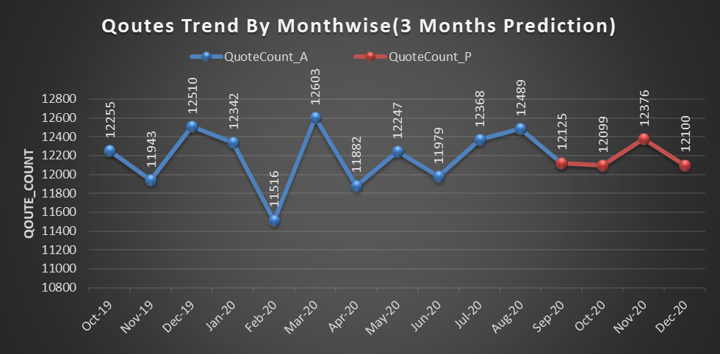
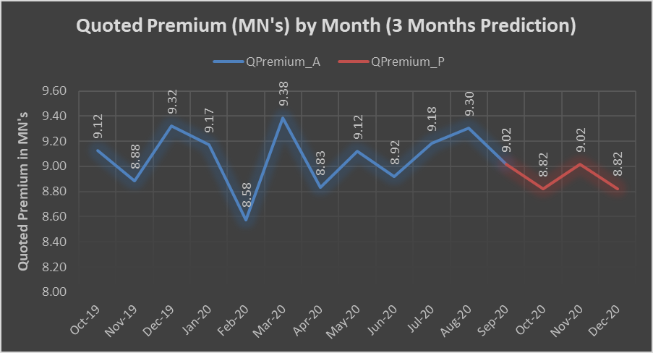
1.QuoteTrend is very Less because trend is following irregularity 2.Quotes are highest in the month of MAR-20 and lowest in the month of FEB-20
2.Quotes Trend Analysis by Month wise
1.Quoted Premium Trend is slightly decreasing and increasing alternately
2.Quoted premium is Highest in the month of MAR-20 and lowest in the month of FEB-20

Slide 5
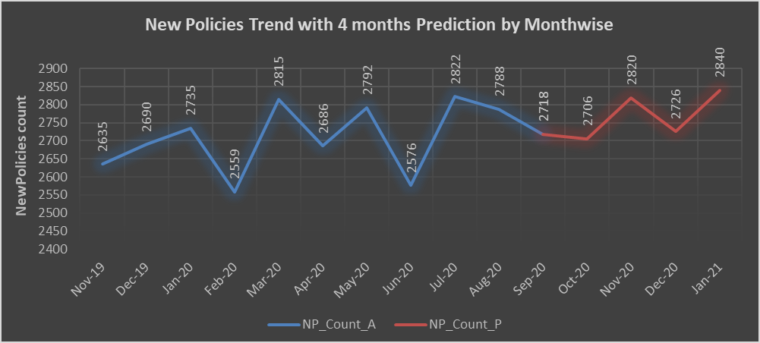
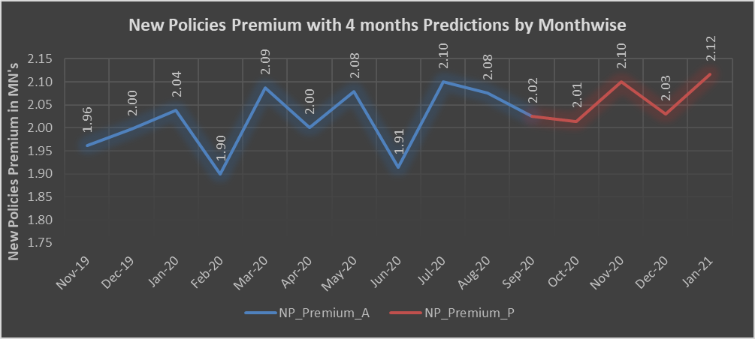
1.New policies trend is increasing irregularly 2.New policies are highest in the month of JAN-21 and lowest in the month of FEB-20
3.New Policy Conversion by Month wise
1.New policy premium trend is increasing irregularly.
2.New Policy premium is highest in the month of JAN-21 and lowest in the month of FEB-20

Slide 6
Random Forest Algorithm with U/O Sampling (Sampling Strategy=0.45) 01 - Accuracy 84.07% 02 - F1 Score 84.07% 03 - ROC AUC Score 0.746
4.Recommendation of Classification Model

Slide 7
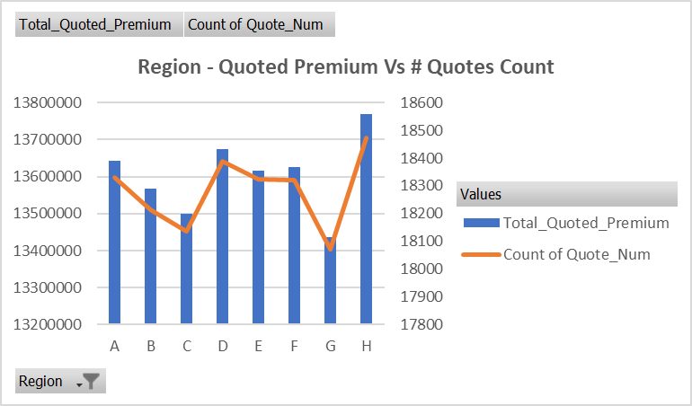
REGION-H is having more quotations and quoted premium REGION-G is having very less quotations and quoted premium
5.Exploratory Data Analysis - KPI 01

Slide 8
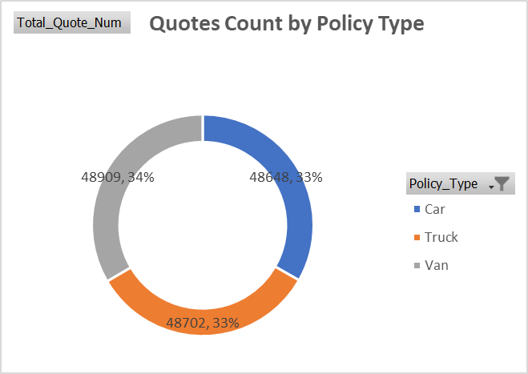
Van quotes are high when compared to truck and car
Exploratory Data Analysis - KPI 02

Slide 9
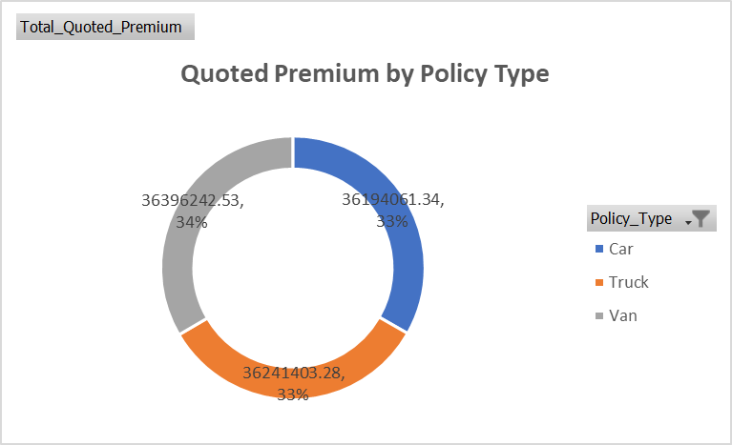
Van quoted premium is high when compared to car and truck
Exploratory Data Analysis - KPI 03

Slide 10
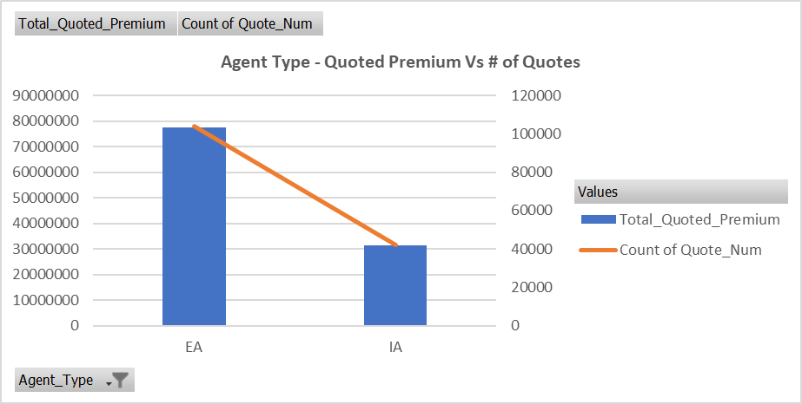
Exclusive Agent holding more quotes and quoted premium when compared to Independent Agent
Exploratory Data Analysis - KPI 04

Slide 11
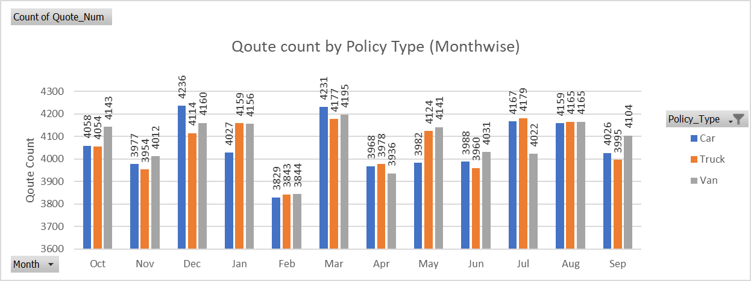
MAR-20 Quote count of car,van and truck is high FEB-20 Quote Count of car,van and truck is very less
Exploratory Data Analysis - KPI 05

Slide 12
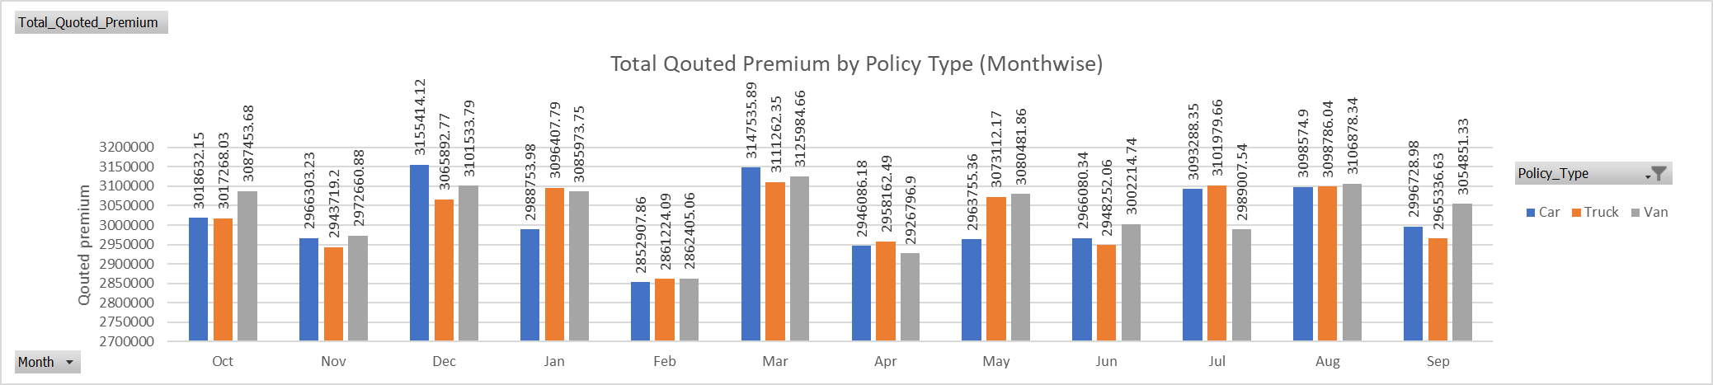
MAR-20 Quoted Premium of car,van and truck is high FEB-20 Quoted Premium of car,van and truck is very less
Exploratory Data Analysis - KPI 06

Slide 13
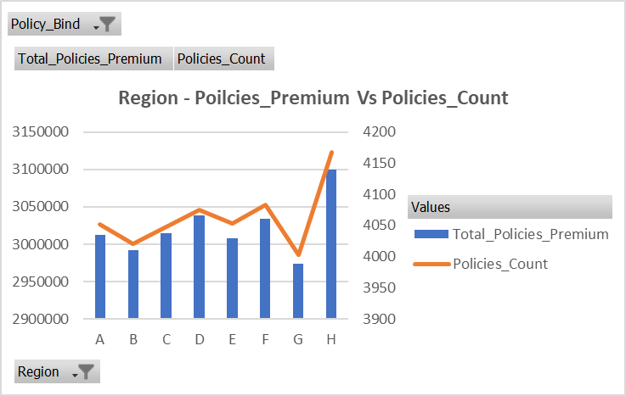
REGION-H is having more New Policies and New policy premium REGION-G is having very less New Policies and New policy premium
Exploratory Data Analysis - KPI 07

Slide 14
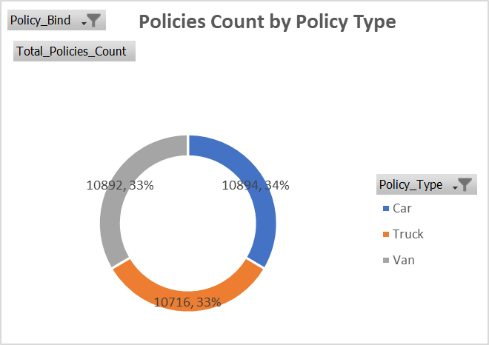
Car New Policies are high when compared to truck and Van
Exploratory Data Analysis - KPI 08

Slide 15
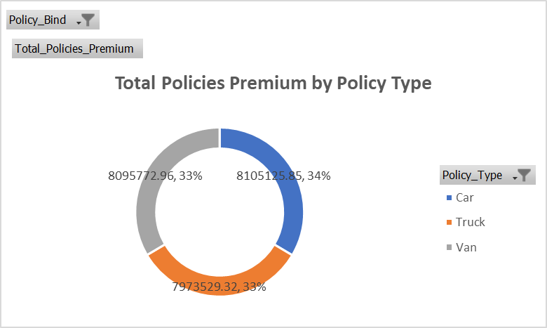
Car New Policies Premium are high when compared to truck and Van
Exploratory Data Analysis - KPI 09

Slide 16
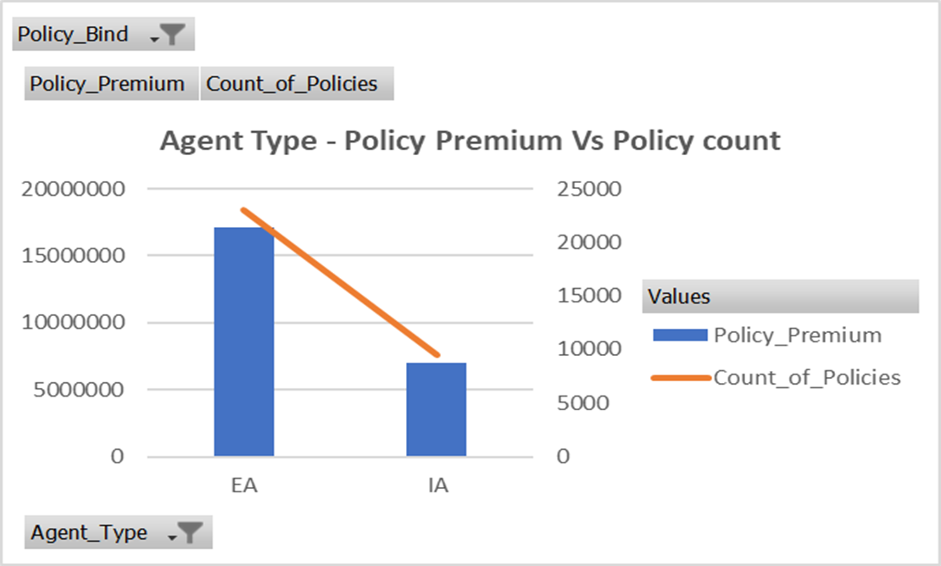
Exclusive Agent holding more New Policies and New Policy premium when compared to Independent Agent
Exploratory Data Analysis - KPI 10

Slide 17
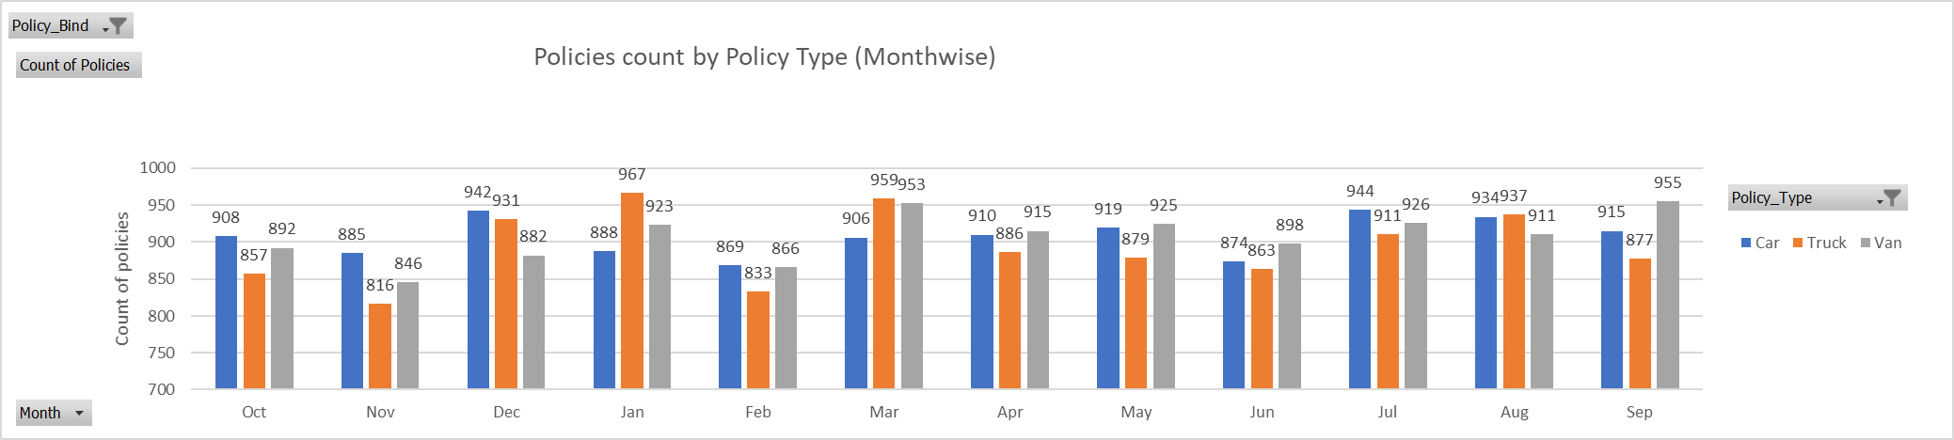
New policies Count of Car, Van and Truck is continuously Varying by Month wise.
Exploratory Data Analysis - KPI 11

Slide 18
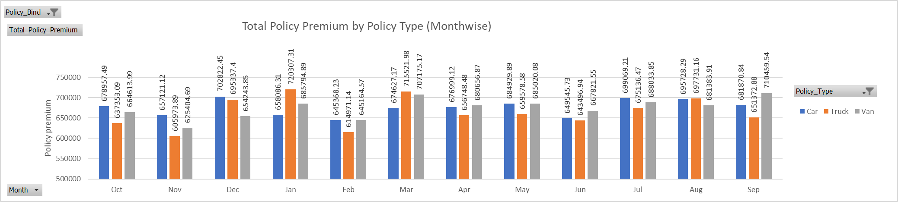
New policies Premium of Car, Van and Truck is continuously Varying by Month wise.
Exploratory Data Analysis - KPI 12

Slide 19
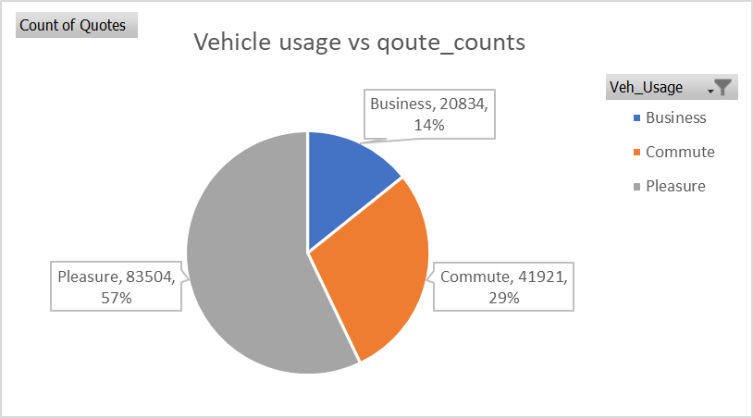
Pleasure vehicle usage has More Quotations when compared to Commute and Business .
Exploratory Data Analysis - KPI 12

Slide 20
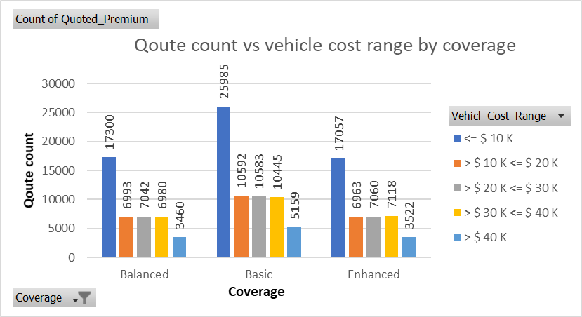
Basic coverage has More Quotes when compared to Balanced and Enhanced Coverage Vehicle cost range <=10k $ more quotes
Exploratory Data Analysis - KPI 13

Slide 21
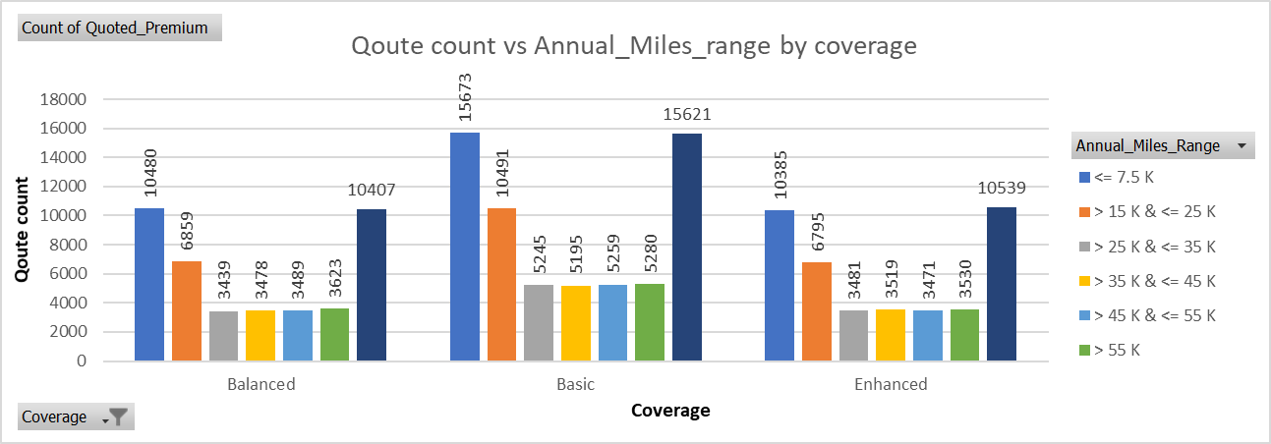
Basic coverage has More Quotes when compared to Balanced and Enhanced Coverage Annual Miles range <=7.5K, > 45K & <= 55K has more quotes
Exploratory Data Analysis - KPI 14

Slide 22
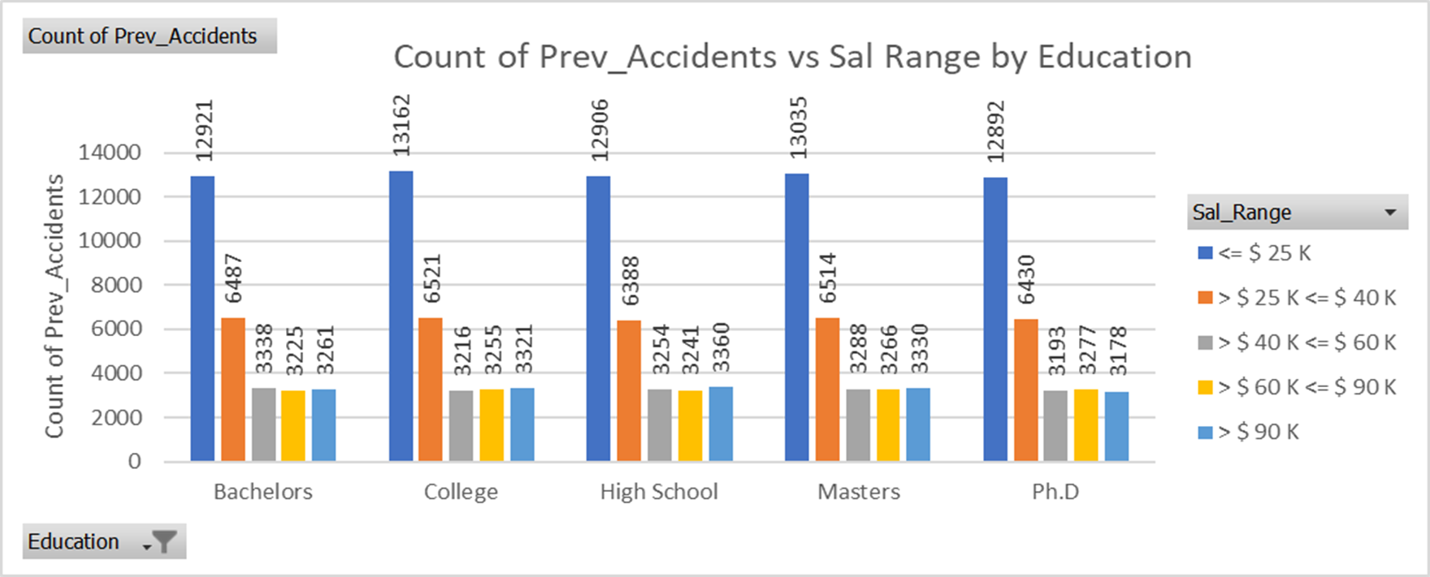
Sal Range <= 25K $ count of Prev Accidents are More of any Education considered to be risk Sal Range >90K $ Count of Prev Accidents are Less of any Education considered to be safe
Exploratory Data Analysis - KPI 15

Slide 23
Thank You
Q & A
Bollam.ArunKumar
118EC0020
Mobile: +91 8074636272
Email: 118ec0020@iiitk.ac.in
IIIT-DM, Kurnool - India

