Slide 1
Analyzing E-Commerce Product Reviews: Are Review Ratings reliable? October 2020
Arunkumar Akkineni

Slide 2




The Project
Our Objective
Who Benefits
What is being tested
Null Hypothesis
Consumers who want to buy products from Ebay
Consumer would know whether the average rating for products in the same product category is reliable or not
Is the average rating for a product reliable?
Do two or more products in the same product category have the same distribution of reviews across each review category
The distribution of product reviews for 1 star, 2 star, 3 star, 4 star, and 5 star ratings is the same for two or more products in a given product category with similar mean average ratings
Provide consumers with a tool to analyze product reviews on E-Commerce websites

Slide 3
Approach and Macro-level Challenges
What is the problem
Collect Data
Validate Data
Analyze Data
Draw Conclusions
What is the Hypothesis
Test The Hypothesis

Slide 4


Data Used
Product Data From Ebay Website
Categorical Review Data
Two Categories with 3 Products each
~Selected two major product categories and scrapped customer review data on three products with similar average rating in each category
Web Scraper with Crawl Function
Scrapped 4825 Reviews
~Automated the modular script to crawl through over 400 weblinks links for 6 products in the Home Appliances and Gaming Console Categories. The script took approximately 8 hours to run.
10 different categories for each product
Stored review text of each review for further analysis
~Data categories include review author name, product name, review text, review star rating, average ebay review rating, review rating, review date, review word count

Slide 5
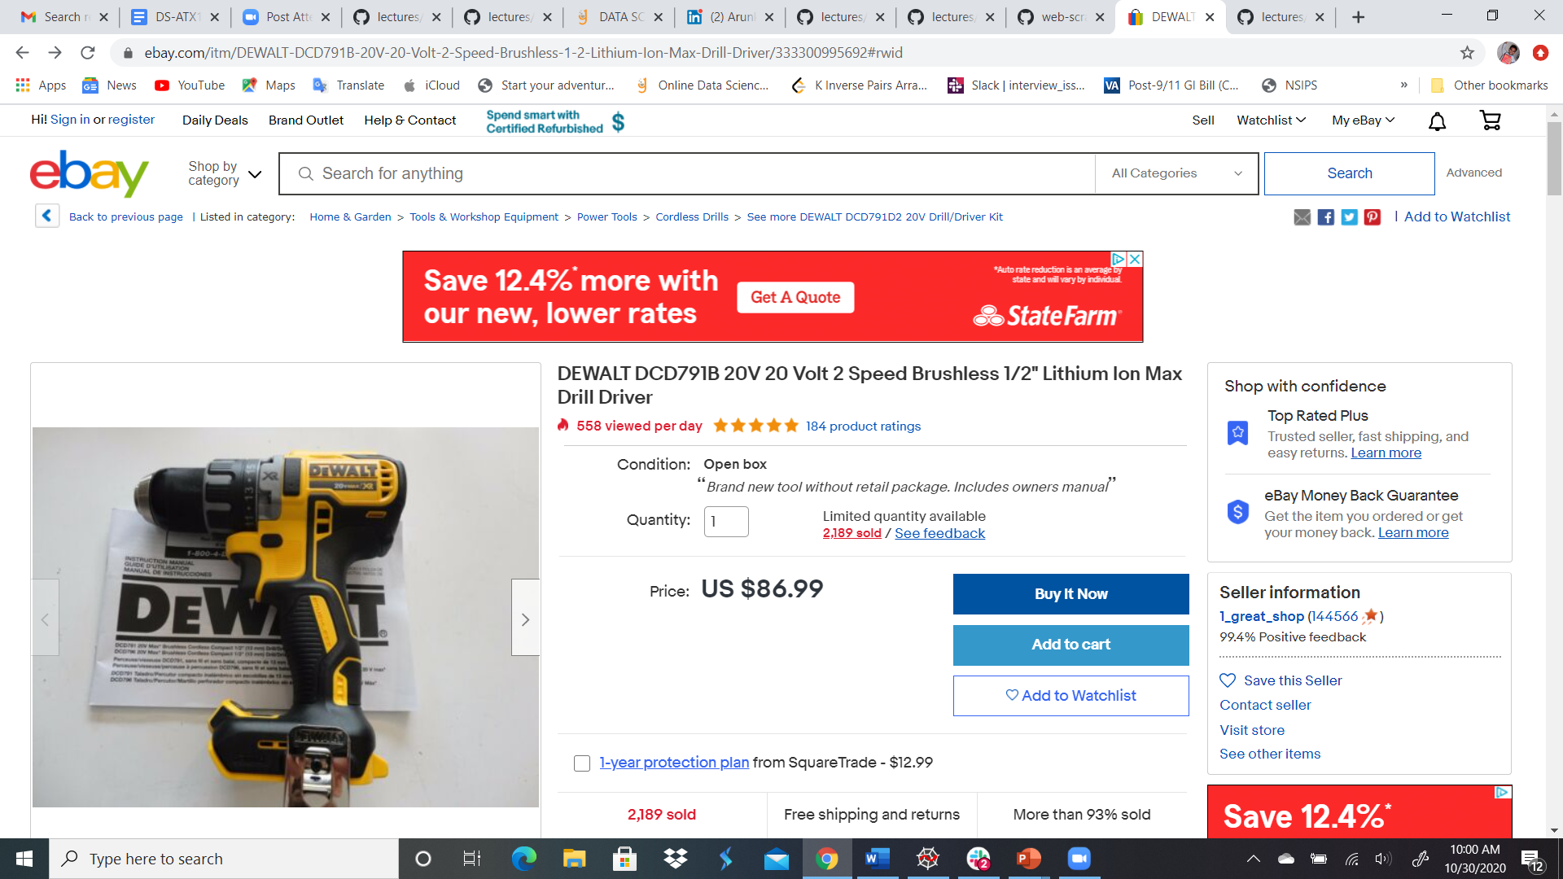
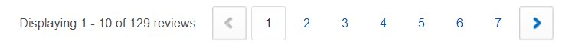

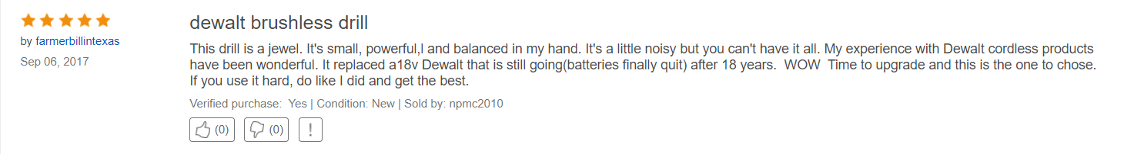
Data Used
10 different categories for each product
Stored review text of each review for further analysis
~Data categories include review author name, product name, review text, review star rating, average ebay review rating, review rating, review date, review word count

Slide 6




Technology Stack
2
Visualization
Data Source
Web Scraper
Data Analysis
Data Store

Slide 7
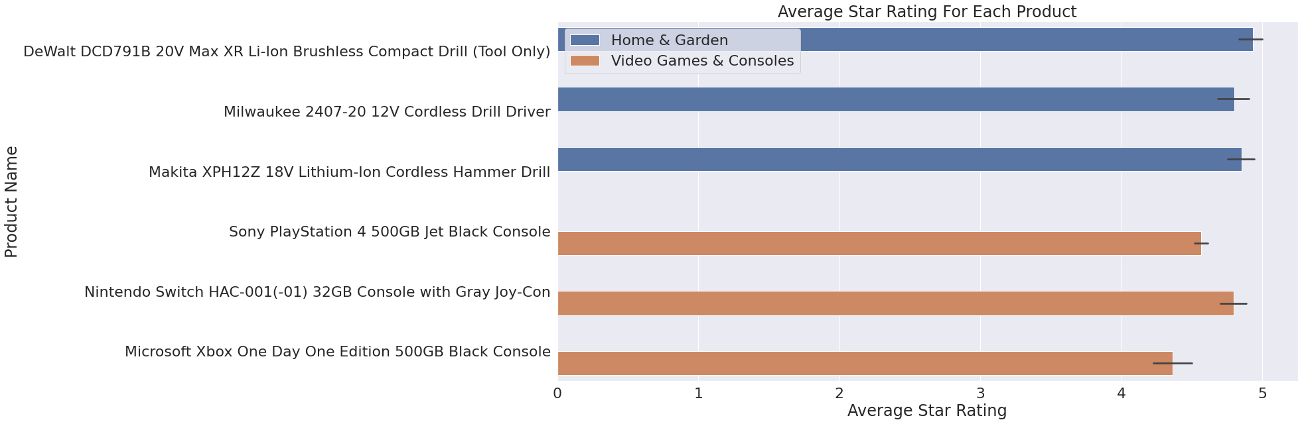
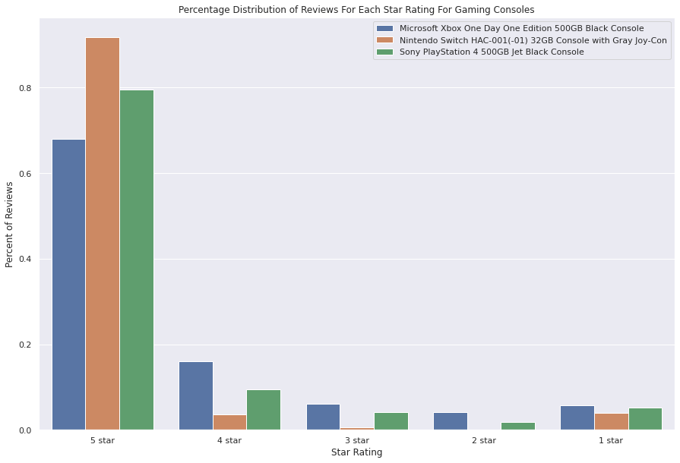
Results of Data Analysis
Average Star Rating For Each Product
Distribution of Reviews For Each Product in Gaming Category

Slide 8
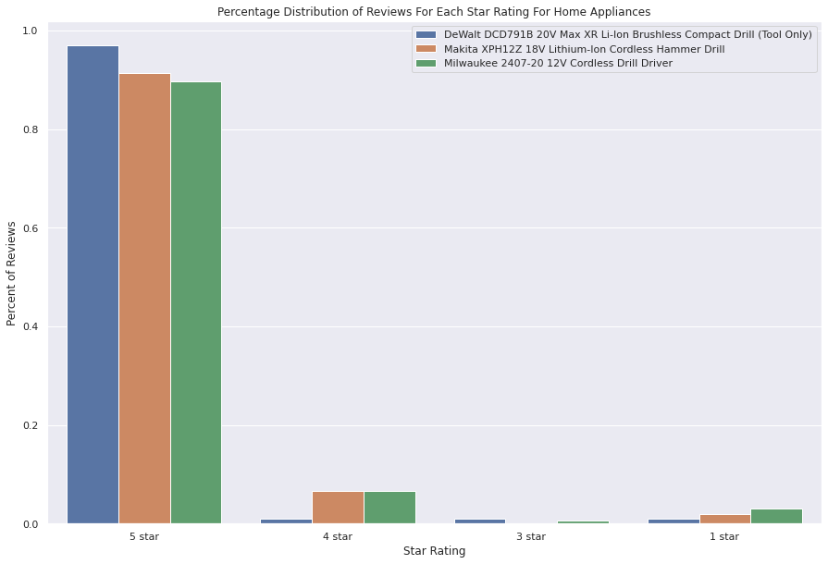
Results of Data Analysis
Average Star Rating For Each Product
Distribution of Reviews For Each Product in Cordless Drills Category

Slide 9
Chi Squared Hypothesis Test
Rating | Xbox | Nintendo | Play Station
1 Star | 14 | 12 | 90
2 Star | 10 | 0 | 31
3 Star | 15 | 2 | 72
4 Star | 39 | 11 | 164
5 Star | 166 | 282 | 1391
Rating | Nintendo | Play Station
1 Star | 12 | 90
2 Star | 0 | 31
3 Star | 2 | 72
4 Star | 11 | 164
5 Star | 282 | 1391
Rating | Xbox | Nintendo
1 Star | 14 | 12
2 Star | 10 | 0
3 Star | 15 | 2
4 Star | 39 | 11
5 Star | 166 | 282
Degrees of Freedom: (5 -1)*(3-1) = 8
Degrees of Freedom: (5 -1)*(2-1) = 4
Degrees of Freedom: (5 -1)*(2-1) = 4
Fully automated code that generates chi squared test matricies for different combinations of products in a given product category for all five ratings
Significance level alpha = 0.05 for all cases
A series of tests were conducted for the two product categories: Gaming Consoles, Cordless Drills
Tested Null Hypothesis: The distribution of product ratings is the same across all product categories analyzed
We are more concerned about Type 2 Errors than type I.
If we fail to reject the false null hypothesis and the user ends up believing that the products analyzed are the same, which can mislead the user into buying a bad product without conducting more research

Slide 10
Takeaways from Hypothesis Test
Cordless Drill
Gaming Consoles
Key Conclusions
The review distributions are similar for all three Cordless Drillers
Though the rating review scores are similar for Playstation and Xbox, their review distributions are different
Consumer needs to be more skeptical about the ratings for high/premium products like Gaming Consoles that have far more features than lower end products
The user can buy any of the three Cordless Drill’s and be assured of similar quality
 | Pvalue | Accept Null
Makita, DeWalt | 0.25 | Yes
Makita, Milwaukee | 0.98 | Yes
DeWalt, Milwaukee | 0.18 | Yes
DeWalt, Milwaukee, Makita | 0.57 | Yes
 | Pvalue | Accept Null
Xbox, Nintendo | 0 | No
Xbox, Playstation | 0.0003 | No
Playstation, Nintendo | 0 | No
Xbox, Playstation, Nintendo | 0 | No
Failed To Reject Null Hypothesis
All Null Hypothesis Rejected

Slide 11
Future Steps
1
2
3
Further automate the Webscraper script
Use NLP to interpret the reviews and score them by sentiment
Build a recommender that interprets the reviews and provides feedback to the users

Slide 12

Thankyou!
Arunkumar Akkineni
2
3
Email arunkumar.akkineni@gmail.com
Github https://github.com/arunkumarakkineni/
LinkedIn https://www.linkedin.com/in/arunkumarakkineni/

