Slide 1




Department of Artificial Intelligence & Machine Learning
Department of Master of Computer Applications
The Email Campaign Generator
Revolutionizing Email Marketing with AI
Team Members
1.Abhinav Anand -- 1RV21AI002
2.Aman Tripathi -- 1RV21AI008
3.Shubham Kumar -- 1RV21AI050
4.Arun Kumar Arali -- 1RV23MC016
5.Shashanka -- 1RV23MC092
6.Sindhu M Hegde -- 1RV23MC101

Slide 2
Objective:
Creating an Email Campaign Generator Using AI
Combining NLP and ML

Slide 3
Why AI for Email Campaign Generators:
1.Optimized Content and Timing
2.Personalization at Scale
3.Dynamic Content Generation
4.Scalability and Efficiency:
5.Data-driven Insights
6.Ability to learn complex patterns
7.Continuous Improvement

Slide 4
Challenges:
1.Selecting An Appropriate Model Depending On Parameter
2.Data Collection & Validation
3.Producing Demographic Content

Slide 5
Methodology:
1.Collect A Dataset Suitable For Training The Model
2.Develop An AI Model Capable Of Generating Email Content
3.Train And Validate The Model To Generate Content
4.Deploy The Model

Slide 6
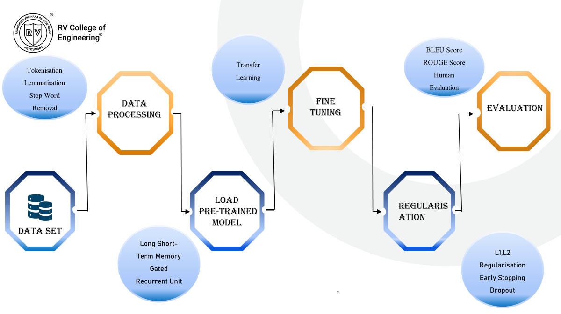

Slide 7
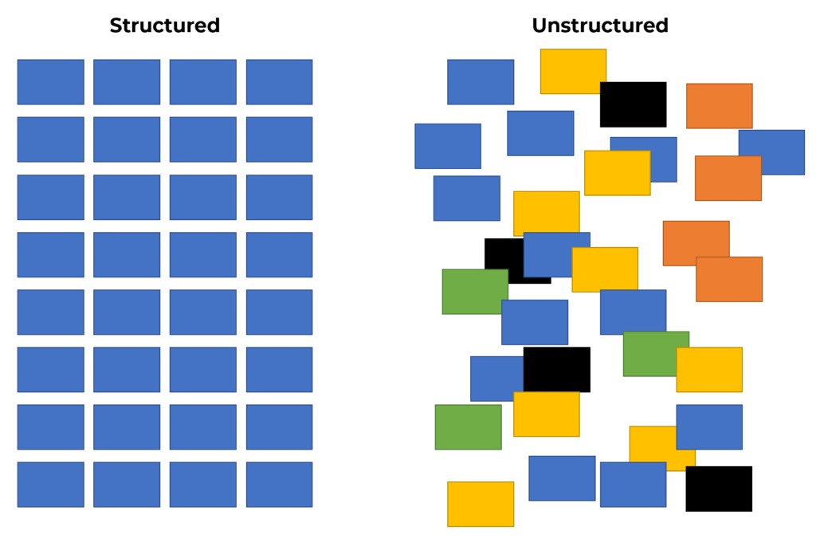
Approaches
1.Collecting And Validating Dataset
The data in email campaigning can be both structured and unstructured, depending on the specific type of data being considered.

Slide 8
2.Development Of AI Model
Why Python for creating AI Model?
1.Rich Ecosystem Of Libraries
2.NLP Capabilities
3.Ease Of Use And Readability
4.Integration With Email APIs And Services
5.Availability Of Pre-trained Models
6.Scalability And Performance

Slide 9
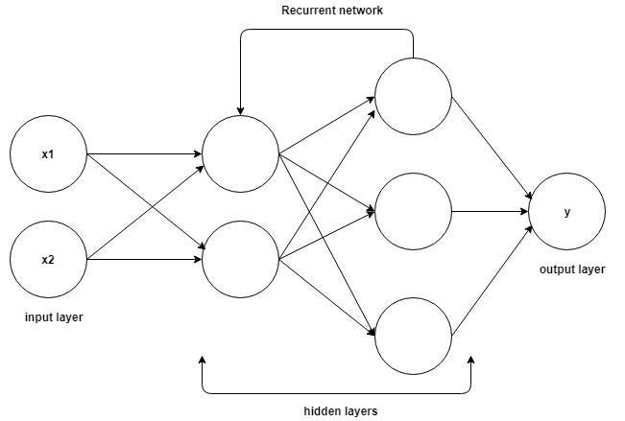
3.Selection Of Model
1.Recurrent Neural Networks(RNNs)
RNNs are a type of neural network that is well-suited for sequence modeling tasks, making them suitable for generating text-based content.

Slide 10
Pros | Cons
- Suitable for sequential data modeling | - Difficulty capturing long-range dependencies
- Intuitive architecture for text generation tasks | - Prone to vanishing/exploding gradients
- Memory efficient for processing sequences of varying lengths | - Limited parallelization
- Interpretable and easier to visualize sequence generation process | - Limited context window

Slide 11
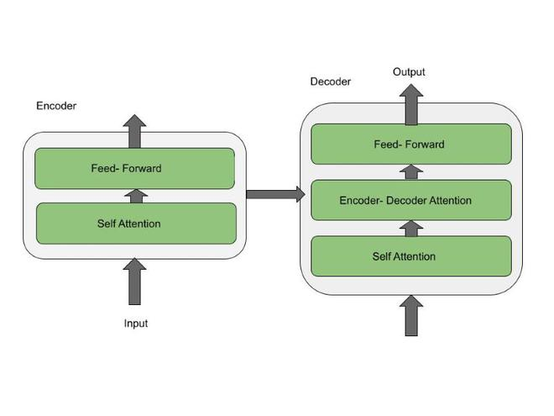
2.Transformers
Transformers are a type of neural network architecture that transforms or changes an input sequence into an output sequence.
They do this by learning context and tracking relationships between sequence components

Slide 12
Pros | Cons
- Highly effective at capturing long-range dependencies in text data | - Require large amounts of computational resources
- Parallel processing enables faster training times and better scalability | - Higher computational cost compared to RNNs
- Large context window allows for more comprehensive understanding of text | - May require extensive hyperparameter tuning
- Transfer learning from pre-trained models can boost performance and reduce training time | - Lack of interpretability and explainability

Slide 13
Reason for Choosing Transformers
Attention Mechanism
Parallelization
Large Context Window
Transfer Learning

Slide 14
Thank You

