Slide 1

Authorised Attack-Surface Inventory
& Continuous Change Monitor
Security Engineering Research Team
security-research@corp.internal
AIORI Hackathon 3
October 5, 2026

Slide 2
AIORI 3
Abstract
Problem Description
• Black-box EASM scans lack Jira/change-window context, causing false alarms during approved maintenance.
• Static CMDB/ITAM records miss ephemeral cloud assets and shadow IT.
• Weekly scans can miss short-lived CI/CD services; exposed assets may be discovered by attackers within minutes.
• Teams spend days tracing exposed ports, subdomains and IPs back to owners.
• CDN IP rotation and certificate renewals create noise that can hide critical drift.
Security Engineering Research Team · A3-PS001-TC001 · October 5, 2026

Slide 3
AIORI 3
Background
Background
Enterprise security must reconcile declared intent (Git/IaC, CMDB and approvals) with observed internet reachability.
• Cloud load balancers, DNS records and services can appear within seconds.
• Certificate Transparency logs provide near-real-time visibility into newly issued certificates.
• Periodic scans are too slow for workloads that live only a few hours.
• The monitor must distinguish routine CDN changes from risky exposures such as public database or RDP ports.
Security Engineering Research Team · A3-PS001-TC001 · October 5, 2026

Slide 4
AIORI 3
Literature & RFC Review
Literature & RFC Review
• RFC 8555 (ACME): automated certificate issuance and renewal.
• RFC 6962 (Certificate Transparency): append-only public logs that support certificate discovery.
• RFC 8499: DNS terminology useful for understanding alias chains and dangling CNAMEs.
• NIST SP 800-137 / SP 800-53 CA-7: continuous security monitoring.
• CISA BOD 22-01 and 19-02: guidance and mandates for identifying and reducing exposed risks.
Together, these standards support continuous discovery, monitoring and timely remediation.
Security Engineering Research Team · A3-PS001-TC001 · October 5, 2026

Slide 5
AIORI 3
Proposed Solution
Proposed Solution
The platform continuously reconciles the authorised ASaC baseline with observed internet-facing assets.
1. Ingest cloud, DNS and Certificate Transparency events.
2. Run targeted probes within a <60-second detection target.
3. Classify benign CDN changes versus risky exposures.
4. Trace assets to repositories and owners through Neo4j.
5. Create Git PRs/Jira tickets or trigger approved emergency containment.
Security Engineering Research Team · A3-PS001-TC001 · October 5, 2026

Slide 6
AIORI 3
Solution Optimization
Optimization Proposed
The proposed continuous platform reduces discovery delay, improves ownership context and prioritises real security drift.
Metric | Legacy approach | Proposed platform
Discovery | 7–30 day scans | Event-driven; target <60s
Authorisation | No change context | Git/Jira baseline reconciliation
Ephemeral assets | Often missed | Real-time tracking + TTL
Triage / ownership | Manual; days | Semantic filter + Neo4j graph
Response | Backlog tickets | Git PR/Jira; Tier-2 containment
Security Engineering Research Team · A3-PS001-TC001 · October 5, 2026

Slide 7
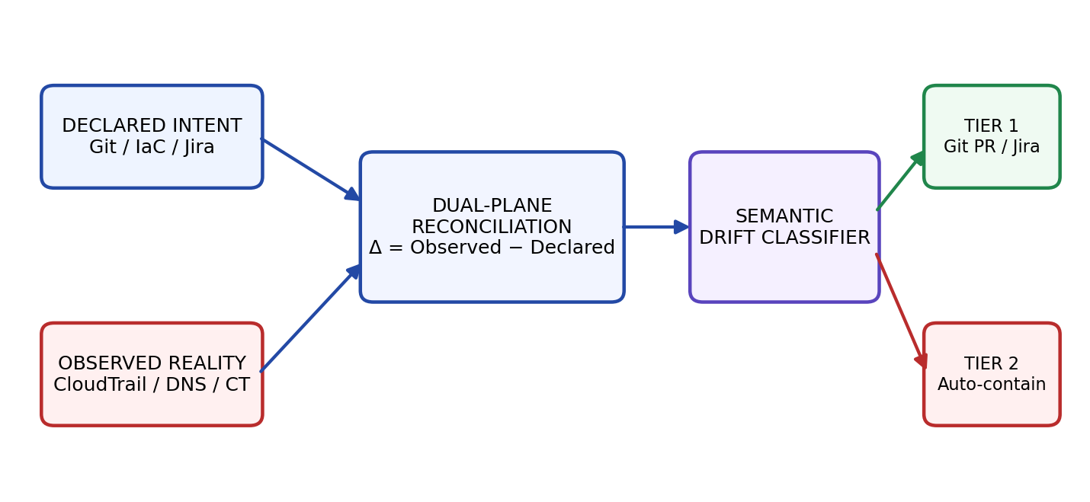
AIORI 3
Solution Architecture & Design
Architecture Design (UML Diagram)
Declared intent and observed reality are reconciled before drift is classified and remediated.
Figure: Dual-Plane Reconciliation & Ownership Attribution Architecture
Security Engineering Research Team · A3-PS001-TC001 · October 5, 2026

Slide 8
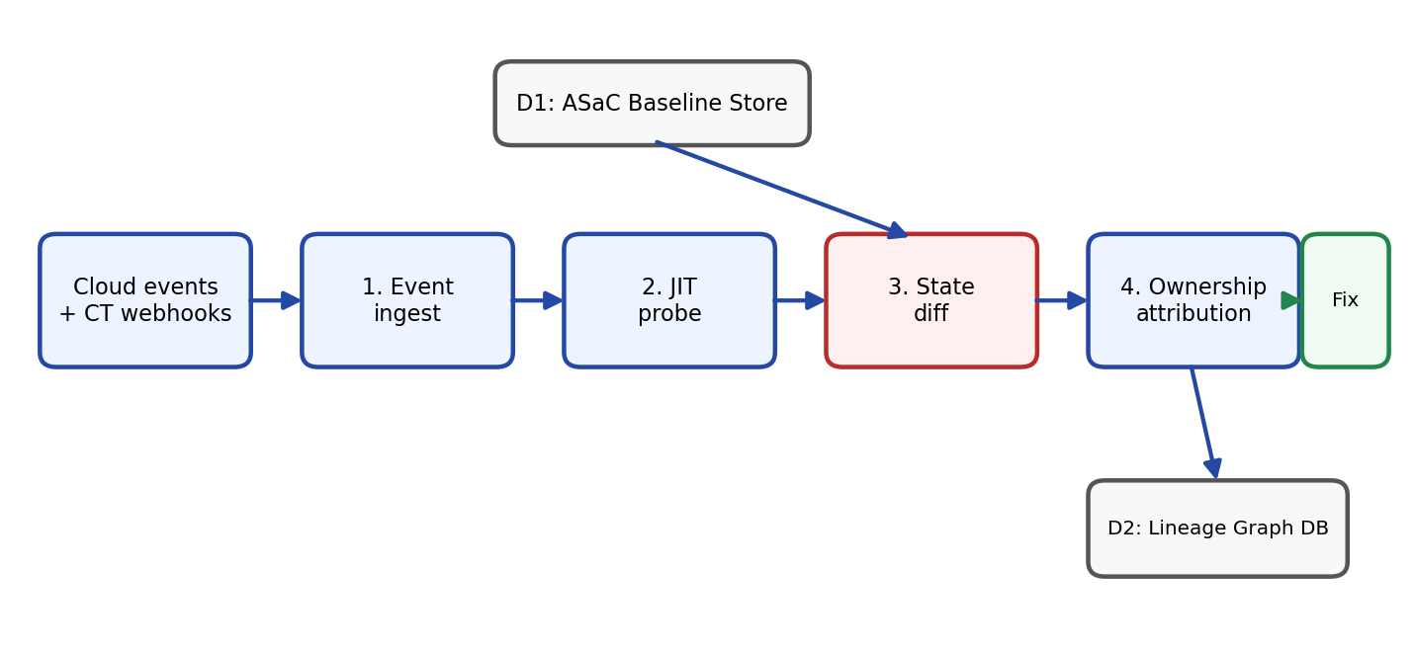
Data Flow Diagram
Event-driven ingestion → probe → state diff → attribution → remediation
AIORI 3 Data Flow Diagram
Figure: Event-Driven Ingestion & Closed-Loop Remediation
Security Engineering Research Team · A3-PS001-TC001 · October 5, 2026

Slide 9
AIORI 3
Deployment Timeline
Deployment Timeline
Phase 1 — Ingestion (Weeks 1–4): Parse ASaC; connect CT and CloudTrail events.
Phase 2 — Reconciliation (Weeks 5–8): Build the diff controller, JIT probes and CDN filter.
Phase 3 — Attribution (Weeks 9–12): Link Git and cloud topology in Neo4j.
Phase 4 — Response (Weeks 13–16): Deploy Git PR/Jira automation and serverless containment.
Targets: detection <60s; <10s revocation of exposed database/RDP rules.
Security Engineering Research Team · A3-PS001-TC001 · October 5, 2026

Slide 10
Bibliography
Bibliography
[1] NIST, SP 800-137, Information Security Continuous Monitoring (ISCM), 2011.
[2] B. Laurie, A. Langley & E. Kasper, RFC 6962: Certificate Transparency, 2013; R. Barnes et al., RFC 8555: ACME, 2019.
[3] K. Borgolte et al., “Cloud Strife: Mitigating the Risks of Domain-Validated Certificates,” ACM IMC, 2018.
[4] CISA, Binding Operational Directive 22-01, Reducing the Significant Risk of Known Exploited Vulnerabilities, 2021.
Security Engineering Research Team · A3-PS001-TC001 · October 5, 2026

Slide 11
Thank You for Your Attention!
Questions & Discussion
Authorised Attack-Surface Inventory and Continuous Change Monitor

