Slide 1

Automated Filtration of synthetic images using a lightweight SigLIP 2 Hybrid architecture
Arun Kumar M (24MDT1131)
Under the guidance of
Dr. Hannah Grace G
Department of Mathematics
School of Advanced Sciences
Vellore Institute of Technology Chennai

Slide 2
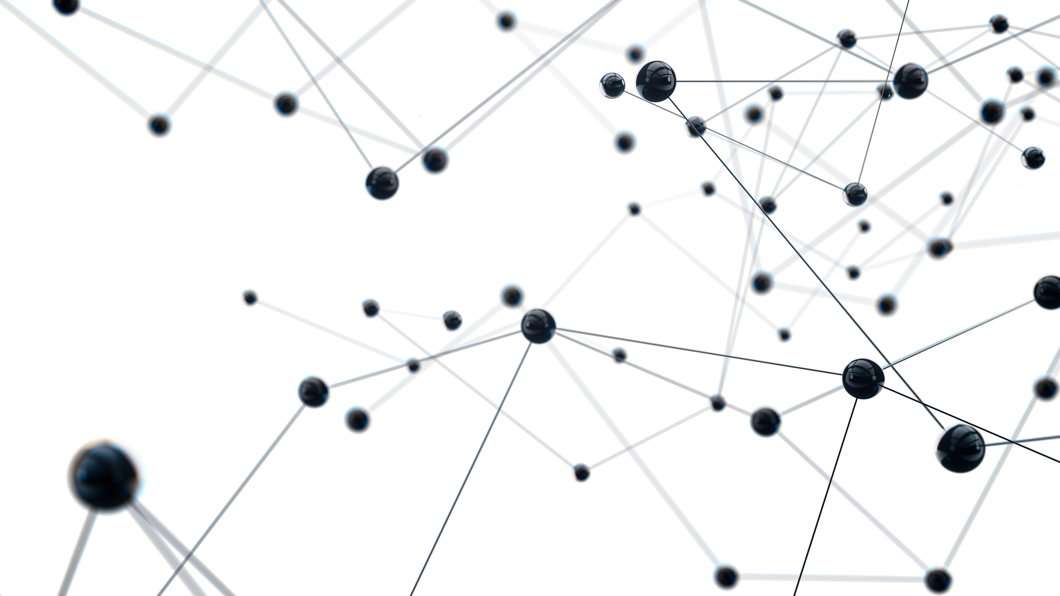
Table of Contents
Problem Statement
Aim and Objective
Literature Gap
Literature Reviews
Workflow
Dataset Construction
Novelty
Model Overview
Algorithms
Result
Discussion
Twin Image Test
Conclusion
References

Slide 3
Problem Statement
The rapid advancement of AI image generators has made it exceedingly difficult to reliably distinguish between real and synthetic images.
Existing single model classifiers such as standard CNNs and heavy Vision-Language Models are experience significant drops in accuracy when processing complex, real-world images, text overlays, and diverse artistic styles.
The industry currently relies on ensemble models to compensate for these accuracy drops, these multi-model systems are computationally expensive, highly resource-intensive, and fundamentally too slow for real-time deployment.

Slide 4
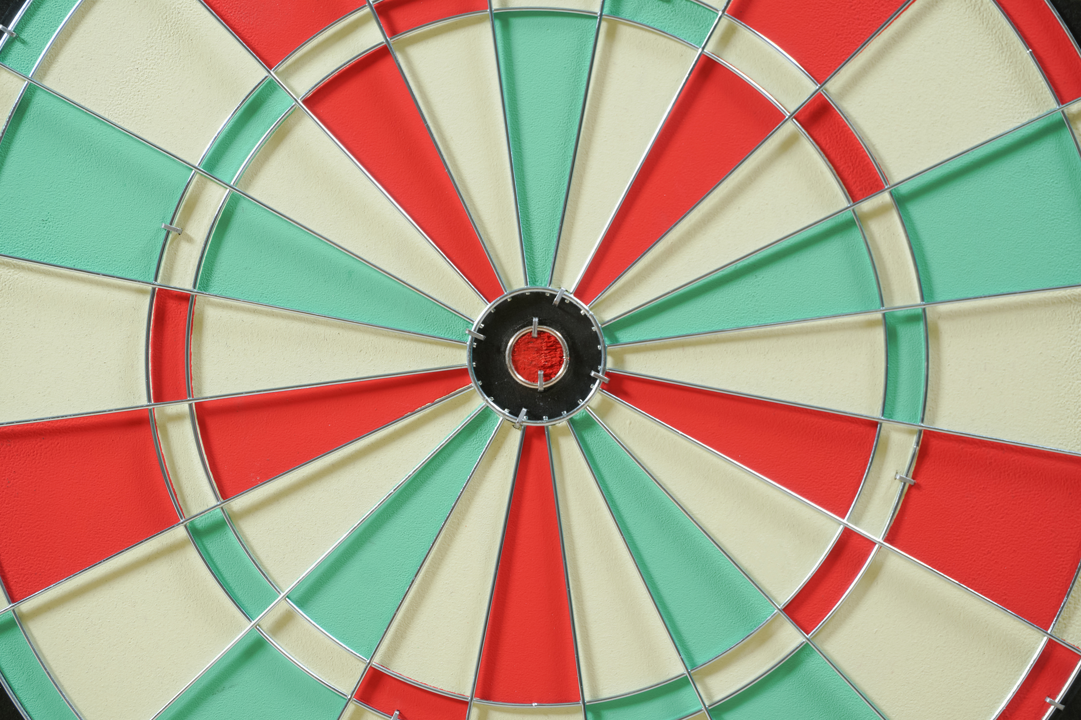
Aim and Objective
Build a single pass AI image detector that is as accurate as heavy ensemble models but faster and lighter.
Replace its default head with a custom classifier a 3-layer attention-based network designed to spot AI artifacts.
Isolate the spatial feature extraction capabilities of the SigLIP 2 model by intentionally removing its text-processing components, thereby drastically reducing memory footprint and inference time.
Resize SigLIP 2's position embeddings from 224×224 to 512×512 using bicubic interpolation to capture fine-grained forensic details
Develop a architecture that combines deep visual embeddings with explicit traditional forensic signals for a robust, single-pass prediction.

Slide 5

Literature Gap
Currently most existing AI detectors rely on older CNNs and plain ViTs. No work has explored using vision encoders of VLM-pretrained models (like SigLIP 2), whose image-text training gives far richer visual representations.
Existing models are not rigorously tested on 'hard negatives’.
To achieve state-of-the-art robustness, the industry currently resorts to computationally massive, high-latency ensembles and too slow for real-time web deployment.
There is a critical gap for streamlined, single-pass architectures that can match this robustness while operating efficiently enough for real-time web deployment.

Slide 6
Literature Reviews
S.No | Author | Title / Journal | Dataset Used | Key Contribution
1 | Ziqiang Li, Jiazhen Yan et al. | Is Artificial Intelligence Generated Image Detection a Solved Problem? (arXiv 2025) | AIGIBench (a benchmark comprising 23 diverse subsets of fake images, alongside real images sampled from FFHQ, CelebA-HQ, and Open Images V7). | Introduces AIGIBench to evaluate the robustness and generalization of 11 advanced detectors across multi-source generalization, image degradation, data augmentation, and pre-processing, revealing significant performance drops on real-world data and highlighting vulnerabilities to perturbations like JPEG compression
2 | Simiao Ren, Yuchen Zhou et al. | How well are open sourced AI-generated image detection models out-of-the-box: A comprehensive benchmark study (arXiv 2026) | GenImage, AIGCDetectionBench, WildFake, OpenFake, Diffusion 1kstep, SynthBuster | Presents the first comprehensive zero-shot evaluation of 16 state-of-the-art detection methods, demonstrating massive performance gaps, ranking instability, and the dominance of training data alignment over architecture.
3 | Alan Perotti, Marco Nurisso et al. | No Detector to Rule Them All (ACM Multimedia 2025) | COCO, ImageNet, celeba | Benchmarked open-source deepfake detectors, showing poor cross-model generalization, and demonstrated that ensemble methods with latent feature fusion achieve state-of-the-art robustness over single binary classifiers.

Slide 7
Literature Reviews (contd.)
S.No | Author | Title / Journal | Dataset Used | Key Contribution
4 | Bilva Chandra | Analyzing Harms from AI-Generated Images and Safeguarding Online Authenticity (RAND 2024) | LAION-5B | Outlines safety harms misinformation from AI image generators and evaluates industry solutions for content authenticity, proposing policy measures like NIST standards and FTC actions.
5 | Michael Tschannen et al. | SigLIP 2: Multilingual Vision-Language Encoders with Improved Semantic Understanding (arXiv 2025) | WebLI 10B | Introduces SigLIP 2 with pairwise sigmoid loss and "NaFlex" resolution handling, providing the dense feature extraction necessary for visual forensics.
6 | Huan Liu, Zichang Tan et al. | Forgery-aware Adaptive Transformer for Generalizable Synthetic Image Detection (CVPR 2024) | ProGAN | Introduced FatFormer, a novel forgery-aware adaptive transformer that builds on the pre-trained vision-language spaces of CLIP. It demonstrated strong robustness, achieving 98% average accuracy on unseen GANs and 95% on unseen diffusion models.
7 | Harshit et al. | Deepfake Detection using Efficientnet-B0 and GRU (IJERT 2025) | FaceForensics++ | Demonstrates a streamlined hybrid architecture (EfficientNet+GRU) for real-time detection, emphasizing computational efficiency for web deployment.
8 | Geeta Rani, Atharv Kothekar et al. | Lightweight and hybrid transformer-based solution for quick and reliable deepfake detection (Frontiers 2025) | Celeb DF-v2, iBUG 300-W | Proposes a hybrid architecture combining Vision Transformer (ViT) and Linformer models for deepfake video detection, which significantly reduces execution time and computational overhead while achieving a high detection accuracy of 98.9%.

Slide 8

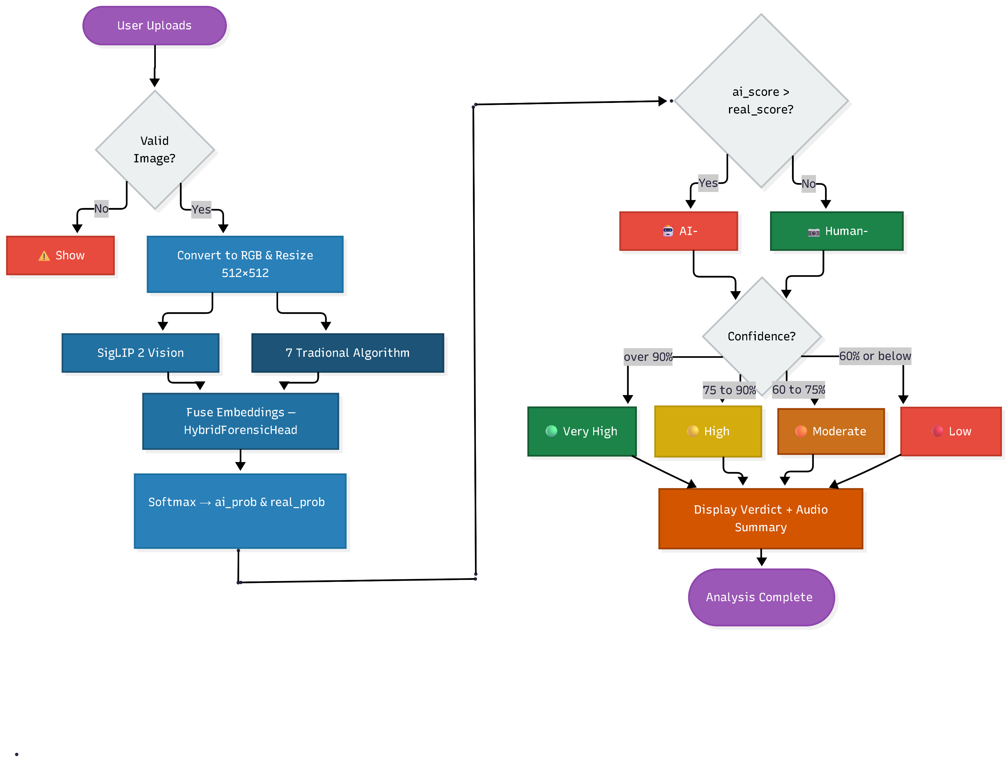
Workflow

Slide 9
Dataset Construction
Real Images 4,212
Sources:
Reddit photography communities
Discord forums
Curated high-quality photograph collections
Diverse subjects:
Portraits, landscapes, objects, text overlays, artistic styles
Total Dataset 7,592
Stratified Split (Real / AI):
Train 70% (5,320 — 3,080 real / 2,240 AI)
Val 15% (1,140 — 660 real / 480 AI)
Test 15% (1,132 — 472 real / 660 AI)
Actual Dataset Totals:
4,212 Real (55.5%) | 3,380 AI (44.5%)
Test set fully withheld from all training decisions
AI Images 3,380
5 Generative Paradigms:
OpenAI Sora
ChatGPT DALL-E
Google Gemini
Ideogram Explorer
Leonardo AI (Stable Diffusion variants)
Covers diffusion and multimodal generation paradigms

Slide 10
Novelty
A custom 3-layer head using SE-style channel attention , first applied in this Classification task type
Position embeddings bicubically interpolated from 224 to 512 enabling the model to detect fine-grained artifacts invisible at low resolution.
Explicitly computing 7 traditional frequency and statistical metrics to cover deep learning blind spots without relying on computationally expensive multi-pass inference.
A novel approach combining a deep spatial embedding from the vision backbone with an embedded representation of traditional forensic features.

Slide 11
Model Overview
SigLIP 2 Vision Encoder Text components removed, image encoder only. Embeddings bicubically interpolated from 224×224 to 512×512 for fine-grained detail capture.
3-layer attention network with SE-style channel attention, replacing the default head to focus on AI artifact patterns.
A dedicated module that computes 7 explicit statistical signals directly from the image pixels and frequency domain (LBP, DCT, Wavelet, FFT, Bayer Noise, Edge Sharpness, Gradient Co-occurrence).

Slide 12
Algorithms
S.No | Feature Name | Why It Helps Detection
1 | Local Binary Pattern (LBP) | AI images have unnaturally uniform or over-random texture patterns
2 | Discrete Cosine Transform (DCT) | AI images violate natural frequency distributions
3 | Gradient Co-occurrence | AI images often have smoother, less varied gradient transitions
4 | Haar Wavelet Transform | AI images lack fine diagonal detail compared to real photographs
5 | Fast Fourier Transform (FFT) | AI images consistently show a slope near −2.5 in log-log frequency space
6 | Bayer Noise Pattern | Real cameras leave unique noise fingerprints absent in AI images
7 | Edge Sharpness Grid | AI images show unnatural centre-vs-peripheral sharpness ratios

Slide 13
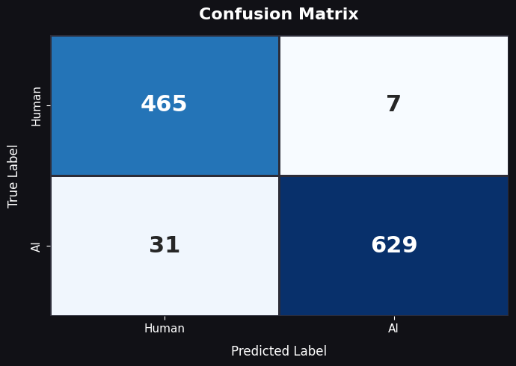
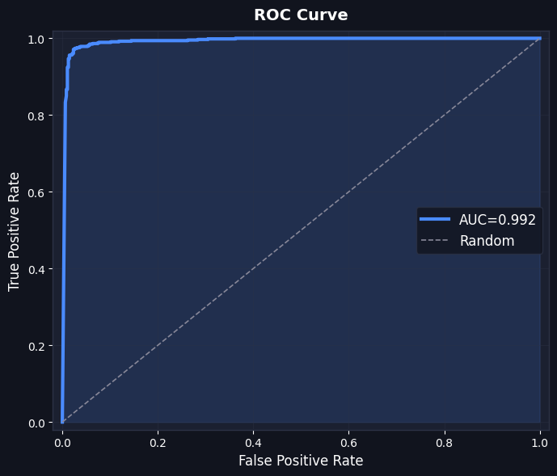
Results
Key Metrics
96.6%
Accuracy
95.3%
Recall
98.9%
Precision
97%
F1-Score
96.6% Accuracy and a 0.992 AUC demonstrate highly effective separation of synthetic and real images.
With only 31 False Positives, the model is appropriately conservative, when it flags an image as AI-generated, it is highly trustworthy.
A 97% F1-Score reflects a well-tuned AI image and real image classifier.

Slide 14
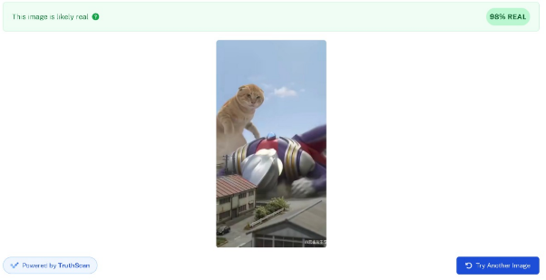
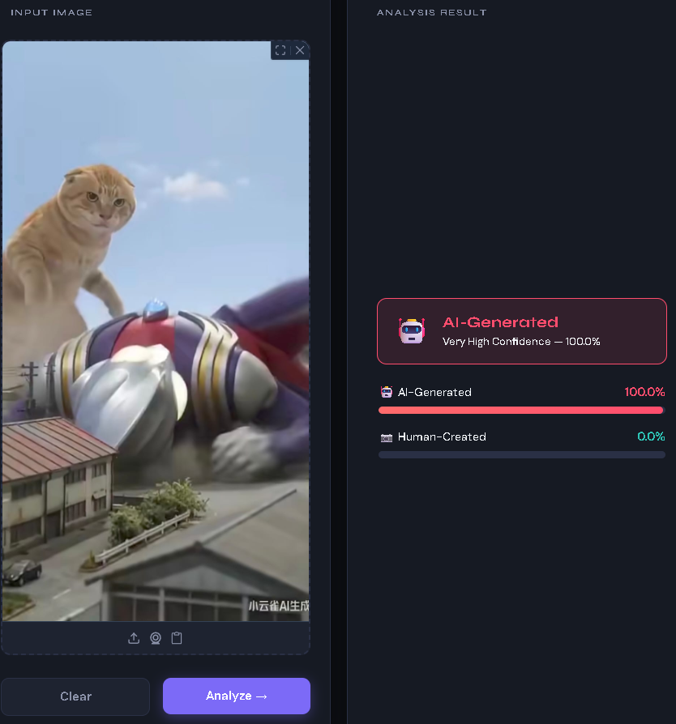
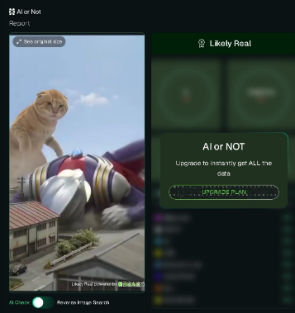
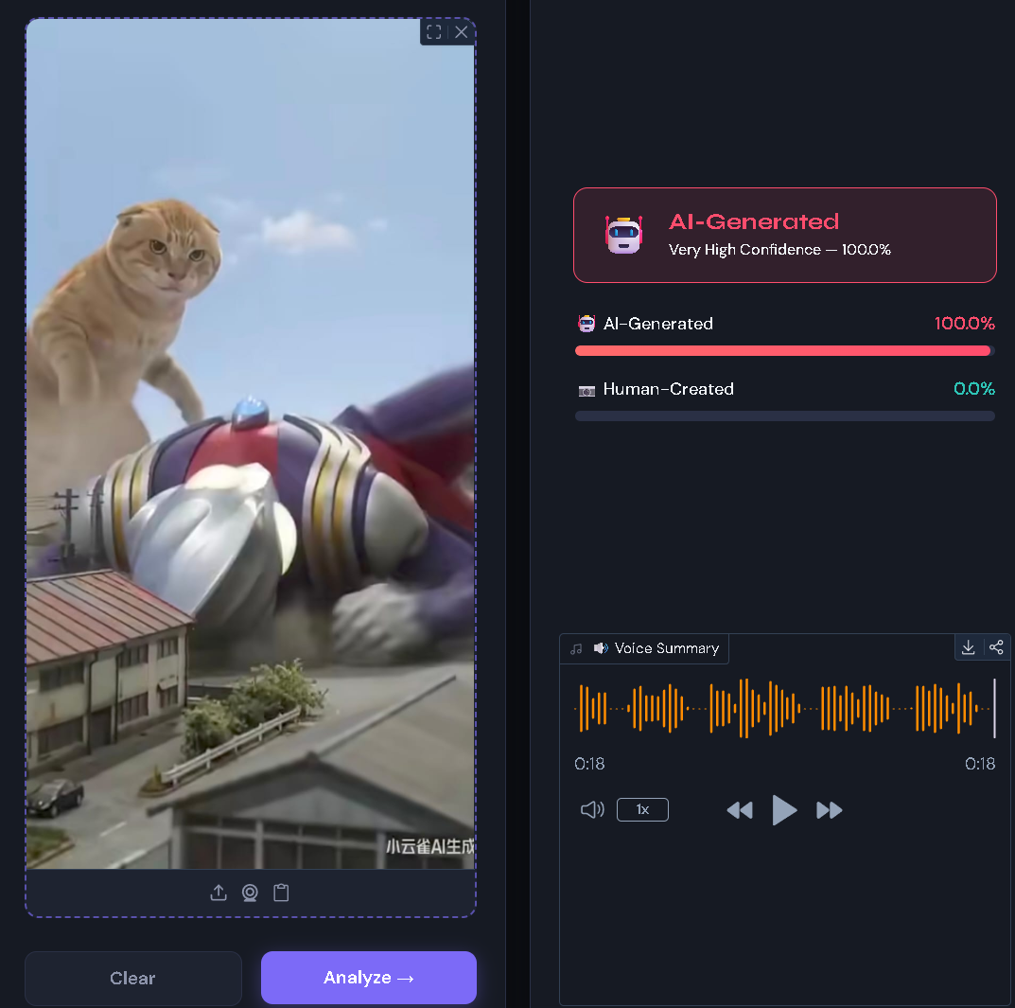
Discussion
Same AI generated image tested across three detectors
Undetectable AI: 98% REAL
Time Taken: 5230 ms
Our Model: 100% AI
Time Taken: 142.4 ms
AI or Not: Likely Real
Time Taken: 920 ms
Key Takeaway: Commercial tools like Undetectable AI and AI or Not misclassified this AI-generated image as real. Our model correctly identified it as AI-generated with 93.5% confidence with significantly less time.

Slide 15
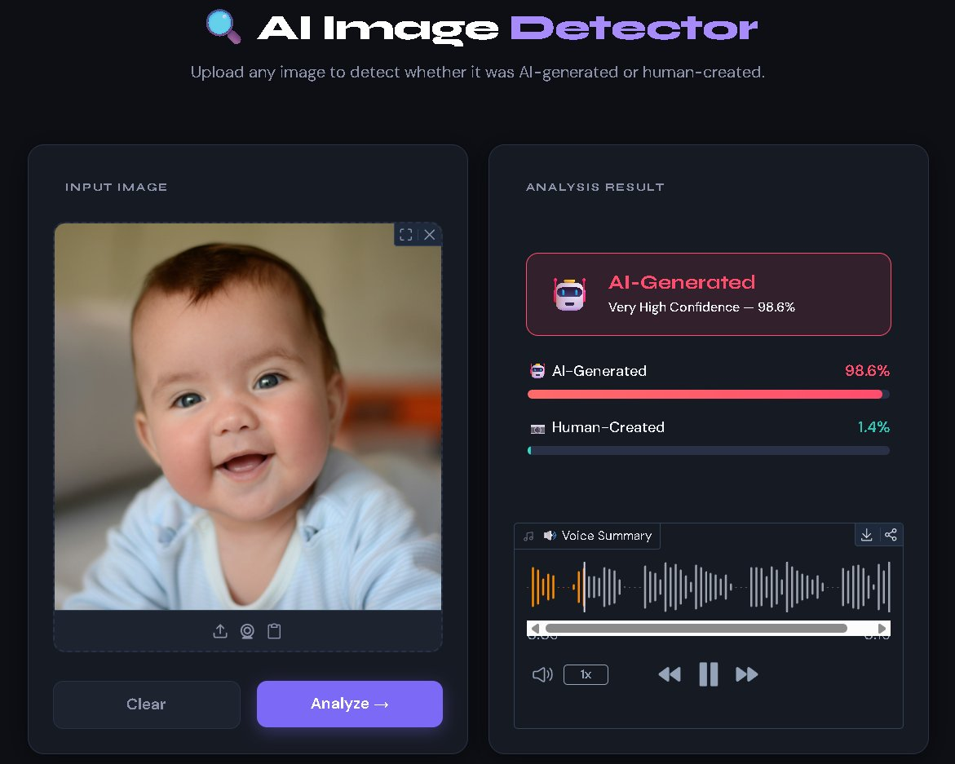
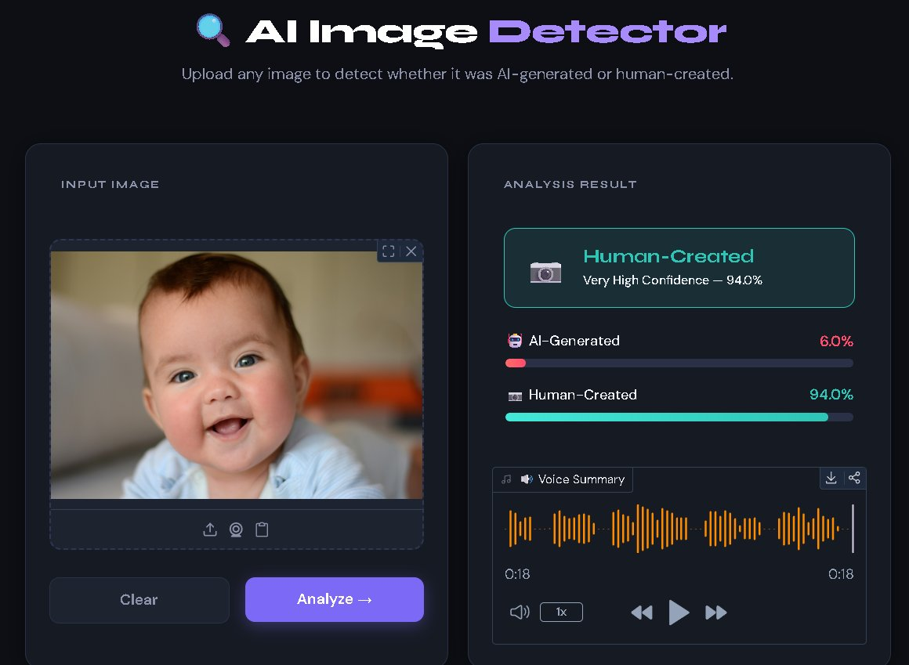
Twin Image Test — Visually Identical, Real vs AI
Twin Image Test: Two images that look visually identical to the human eye, one is a genuine real photograph, the other is AI-generated. This is a twin image test. Our model correctly identifies both: Left is AI-Generated (98.6%) | Right is Human-Created (94.0%)

Slide 16
Conclusion
Built a lightweight, single-pass AI image detector achieving 96.6% accuracy and a 0.992 AUC-ROC on a test dataset.
Achieved an exceptional 98.9% precision rate, establishing a highly conservative detection model that strictly minimizes false accusations of human-made content.
Deployed an interactive inference pipeline via Hugging Face Spaces, allowing for real-time testing and accessible demonstration.
Outperformed commercial tools (Undetectable AI, AI or Not) on hard-negative synthetic images, delivering superior accuracy and faster inference speeds in real-world testing.

Slide 17
References
[1] Ziqiang Li, Jiazhen Yan et al., "Is Artificial Intelligence Generated Image Detection a Solved Problem?”, arXiv, 2025 . DOI: 10.48550/arXiv.2505.12335.
[2] S. Ren, Y. Zhou, et al., "How well are open sourced AI-generated image detection models out-of-the-box: A comprehensive benchmark study," arXiv, 2026 . DOI: 10.48550/arXiv.2602.07814.
[3] A. Perotti, M. Nurisso, et al., "No Detector to Rule Them All," ACM Multimedia, 2025. DOI: 10.1145/3746265.3759659.
[4] B. Chandra, "Analyzing Harms from AI-Generated Images and Safeguarding Online Authenticity," RAND, 2024. DOI: 10.7249/PEA3131-1.
[5] M. Tschannen et al., "SigLIP 2: Multilingual Vision-Language Encoders with Improved Semantic Understanding," arXiv, 2025. DOI: 10.48550/arXiv.2502.14786.

Slide 18
References (Contd.)
[6] H. Liu, Z. Tan, et al., "Forgery-aware Adaptive Transformer for Generalizable Synthetic Image Detection," CVPR, 2024. DOI: 10.48550/arXiv.2312.16649.
[7] Harshit, Y.V.S Sarath, et al., "Deepfake Detection using Efficientnet-B0 and GRU," IJERT, 2025. DOI: 10.5281/zenodo.18106890.
[8] G. Rani, A. Kothekar, et al., "Lightweight and hybrid transformer-based solution for quick and reliable deepfake detection," Frontiers, 2025. DOI: https://doi.org/10.3389/fdata.2025.1521653.

Slide 19

Thank you

