Slide 1
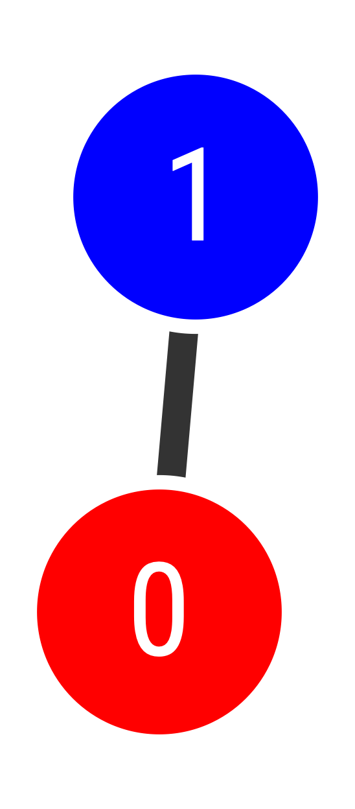
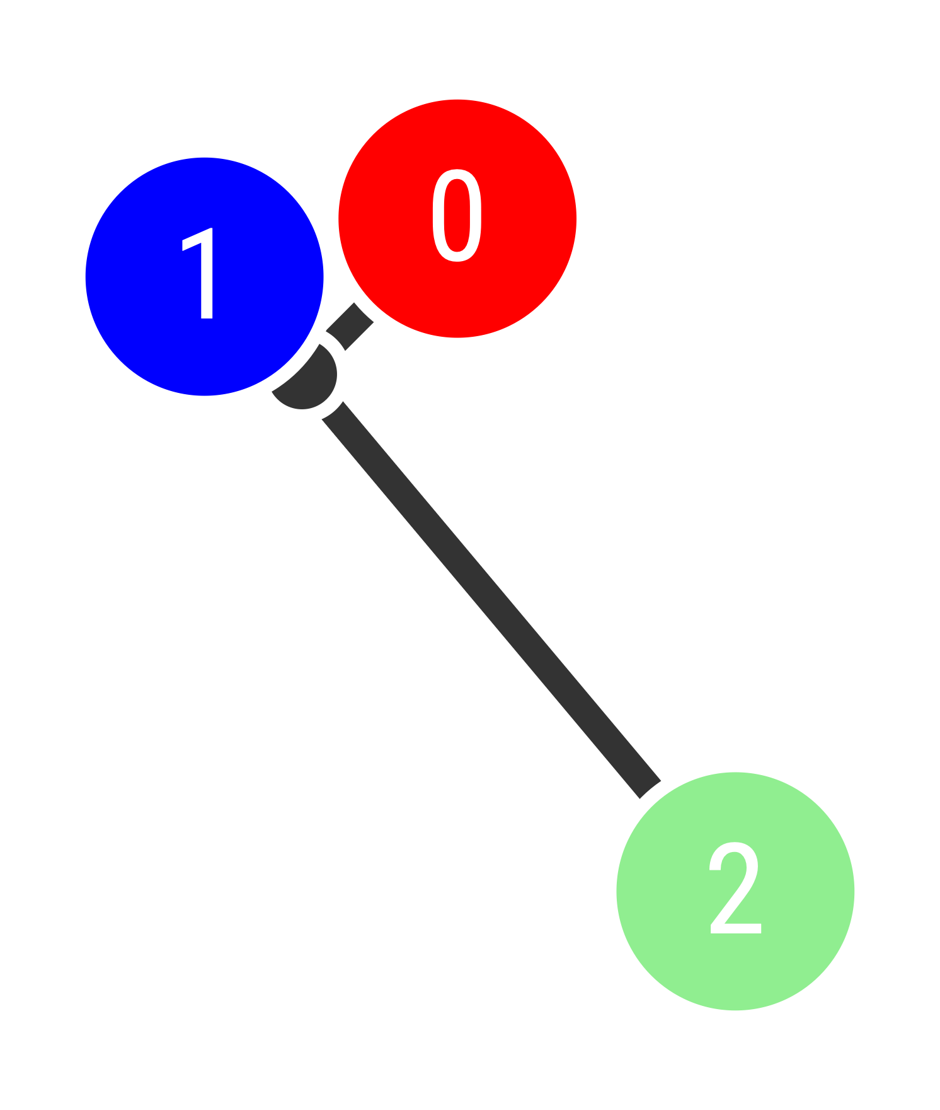
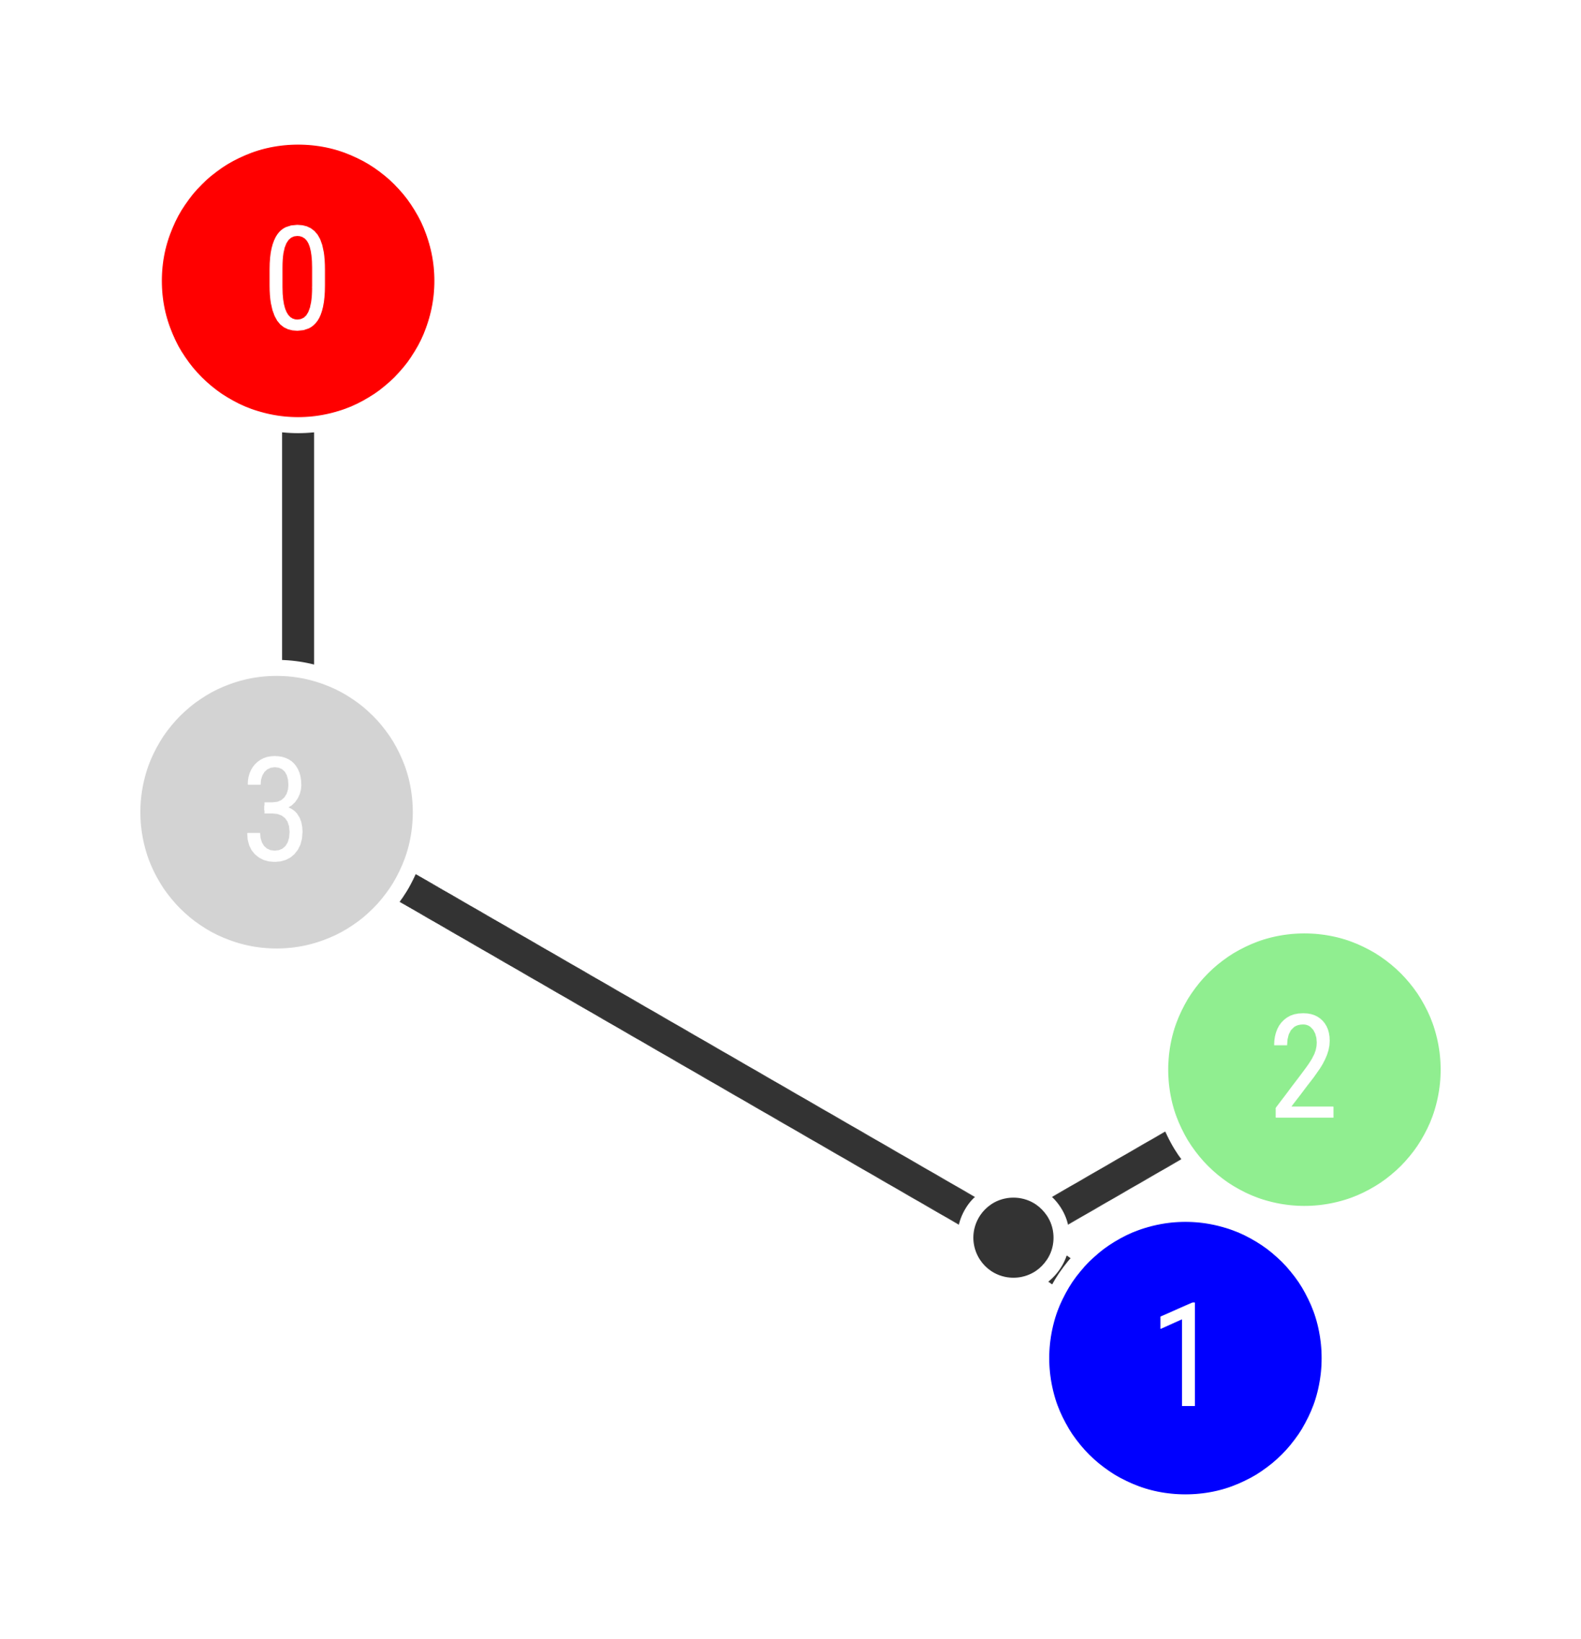
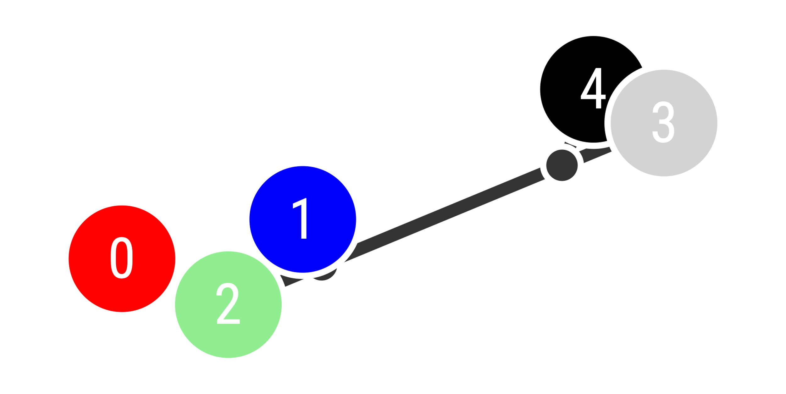
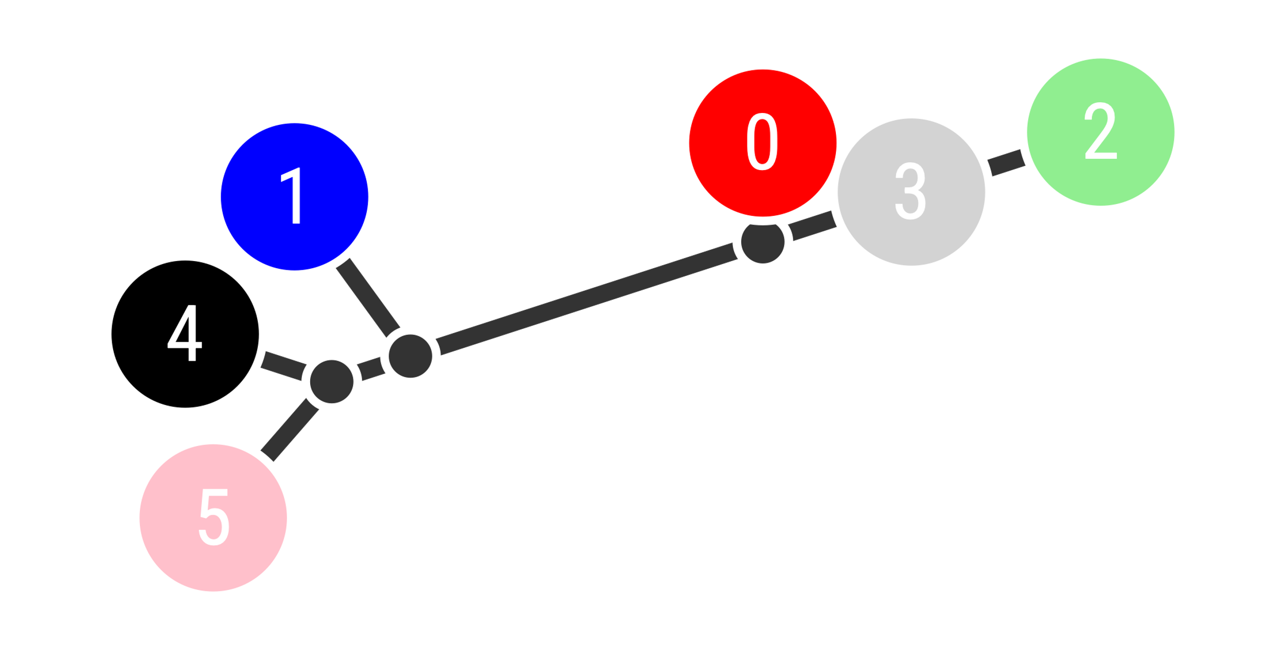
A
B
C
D
E
F
K | Log likelihood ratio test statistic (global) | P-value (global) | Log likelihood ratio test statistic (Southern Africa) | P-value (Southern Africa)
2 | 1.52 | 0.05 | - | -
3 | 21.38 | <0.001 | 22.52 | <0.001
4 | 18.97 | 0.001 | 22.26 | <0.001
5 | 17.06 | 0.008 | 22.36 | <0.001
6 | 21.37 | 0.005 | 27 | <0.001

