Slide 1
Super Market Sales Analysis
End-to-end analytics with Python, SQL, Excel and Power BI
Arunkumar R | Data Analyst Portfolio Project
Notes:
Introduce yourself and the project: supermarket sales, 2015-2018, cleaned with Python, queried with SQL, summarised in Excel and visualised in Power BI.

Slide 2
Project overview
Objectives
Tools used
Clean and prepare the raw sales data
Explore sales trends and patterns
Find top categories, sub-categories and customers
Compare regions, segments and shipping modes
Build Excel and Power BI dashboards
Python
Pandas, cleaning, EDA
SQL / MySQL
Filtering, grouping, aggregation
Excel
Dashboard, SUMIFS, charts
Power BI
Interactive dashboard

Slide 3
The business at a glance
$2.25M
4,916
793
$458
Total sales
Orders
Customers
Avg. sales per order
9,789 cleaned rows across 1,860 products, Jan 2015 to Dec 2018. The data has Sales only, no Profit column.

Slide 4
From raw data to dashboard
1
2
3
4
Raw data
train.csv: 9,800 rows, 18 columns
Clean
11 rows with missing Postal Code removed, month fields added: 9,789 rows
Analyse
EDA in Python, queries in MySQL
Visualise
Dashboards in Excel and Power BI

Slide 5
Technology leads, but the gap is narrow
Technology is 36.7% of sales; Phones is the top sub-category at $326K, with Chairs close behind.

Slide 6
Sales grew 21% in 2018
$721K
Best year (2018)
$454K
Lowest year (2016)
Sales dipped in 2016, then rose for two years: +31% in 2017 and +21% in 2018.

Slide 7
Strong year-end seasonality
November is the peak at $345K and February the lowest at $59K (all four years combined). Sep to Dec is the busy season.

Slide 8
West and East drive 61% of sales
California ($446K) and New York ($306K) together contribute about a third of total sales.

Slide 9
Consumers and Standard Class dominate
Consumer is 51% of sales and Standard Class carries 59% of sales, so shipping speed is not the main driver.

Slide 10
Top customers by sales
Sean Miller is the top customer at $25.0K, well ahead of Tamara Chand at $19.1K.

Slide 11
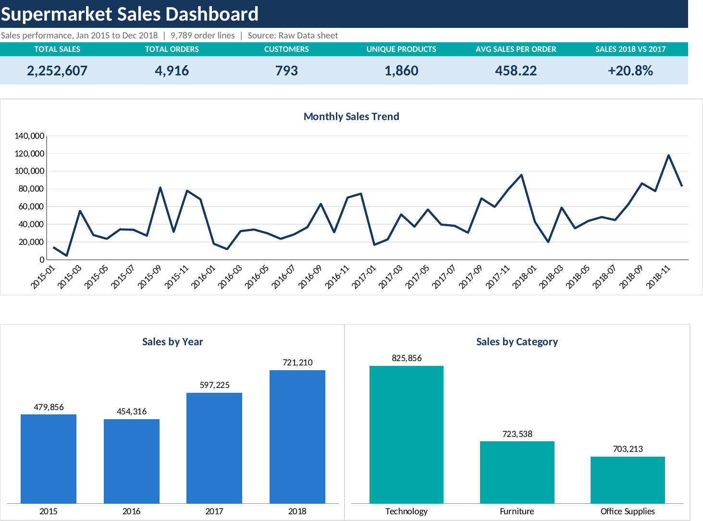
The same analysis built in Excel
4 sheets
Dashboard, Detailed Charts, Summary Tables and Raw Data
11 charts
Monthly trend, yearly sales, category, region, segment, shipping, top products, customers, states and cities
SUMIFS and COUNTIFS
Summary tables are formulas on the 9,789-row Raw Data sheet, so they update with the data
Excel totals match the Python analysis: $2.25M sales, 4,916 orders, 793 customers.

Slide 12
Key insights and next steps
Insights
Next steps
Technology and Phones lead sales
Sales peak in Nov and fall in Feb
West and East regions are strongest
Sales grew in 2017 and 2018
Stock up ahead of Sep to Dec peak
Run promotions in low months like Feb
Reward top customers to retain them
Add Profit data to measure margins

Slide 13
Thank you
arunkumarrasik@gmail.com | linkedin.com/in/arunkumar-r-06aa1143b

