Slide 1
PROBLEM FRAMING AND RECOMMENDATION
Decision: pilot proactive diabetes care for high-utilization patients
PROBLEM STATEMENT • A small number of patients repeatedly use acute hospital care, but the hospital lacks a validated way to identify preventable encounters, coordinate follow-up, and measure clinical and financial impact.
WHY IT MATTERS
WHAT TO DO
WHAT SUCCESS MEANS
101,766 encounter records; 71,518 unique patients; 16,773 patients have multiple encounters.
Launch a clinician-led 90-day pilot: identify repeated acute use, review causes, provide rapid diabetes follow-up.
Fewer avoidable acute visits, no safety deterioration, improved care access, and positive net contribution.
Recommendation: start with transparent utilization rules and care navigation. Add predictive AI only after clinical and financial validation.

Slide 2
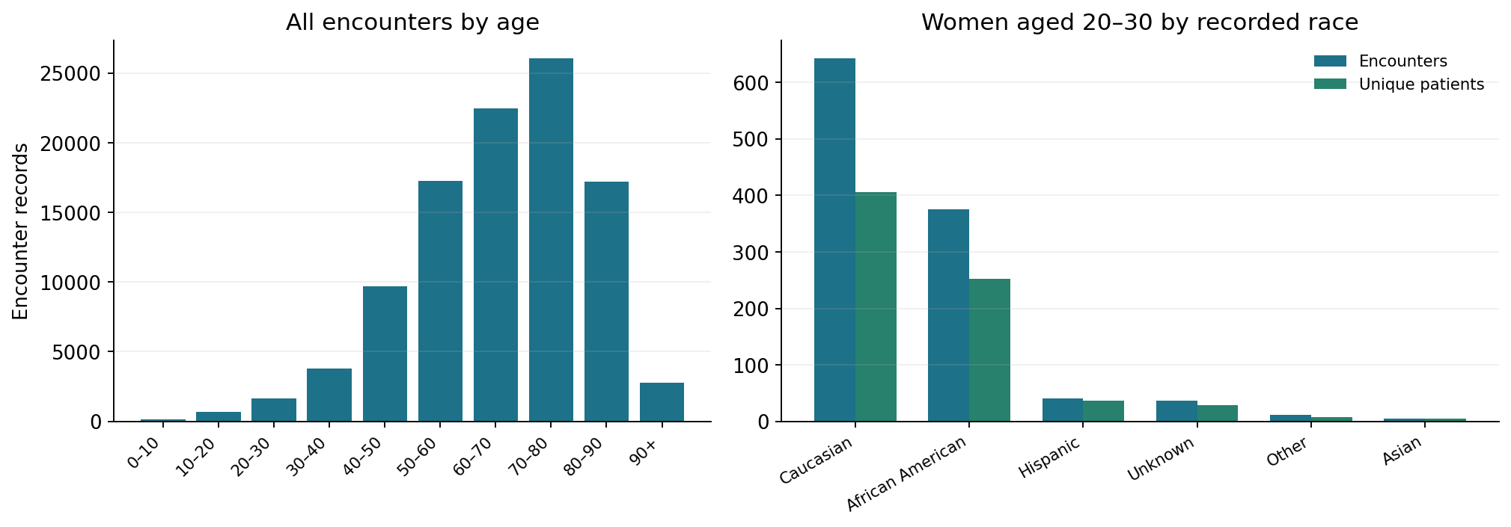
FACTS AND DATA REASONING
Evidence: volumes are concentrated, but counts are not risk rates
FACT: 70–80 has the most encounters (26,068). Women 20–30: Caucasian 643 encounters / 406 patients; African American 376 / 252.

Slide 3
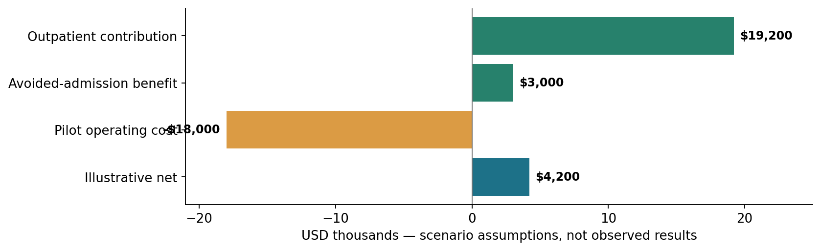
BUSINESS VALUE AND BREAK-EVEN
Financial case: test contribution margin and show the break-even
ILLUSTRATIVE ASSUMPTIONS: 120 patients × 2 incremental outpatient visits × $80 contribution = $19,200; plus 12 avoided admissions × $250 net benefit = $3,000; minus $18,000 pilot cost. Break-even = 188 incremental visits if admission benefit holds.

Slide 4
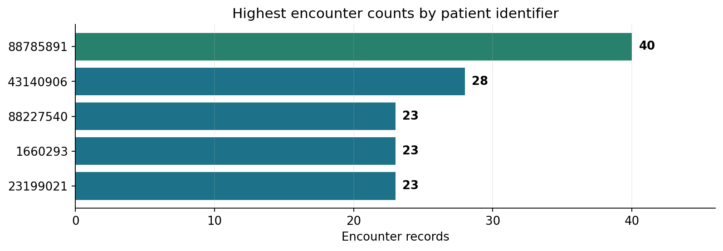
TOP PATIENTS AND INTERVENTION
Target the highest users with tailored, clinician-led interventions
PATIENT 88785891
40 encounters • 23 records labeled <30 days • 127 hospital days
PATIENT 43140906
28 encounters • 22 records labeled <30 days • 85 hospital days
Care pathway: identify repeated acute use → nurse + endocrinology chart review → assess DKA triggers, medication/insulin access and discharge barriers → arrange follow-up within 48–72 hours → monitor escalation and outcomes.

Slide 5
AI SOLUTION AND OPERATIONAL WORKFLOW
Best-fit AI: a transparent care-management prioritization worklist
1. INGEST
Encounter history, coded diagnoses, demographics, follow-up activity
2. PRIORITIZE
Rules first: recurrent unplanned acute use; test ML for incremental lift
3. VALIDATE
Clinician reviews acuity, context, barriers and suggested actions
4. INTERVENE
Care manager arranges clinic, educator, medication and social support
5. LEARN
Track outcomes, equity, false alerts, workload and net contribution

Slide 6
EVIDENCE GAPS, EXPERIMENTS AND COMMUNICATION
Unknowns, validation plan and go/no-go decision
UNKNOWN / TEST BEFORE CLAIMING IMPACT
90-DAY VALIDATION PATH
• Which acute visits were preventable?
• Are encounter dates and cross-provider histories complete?
• What are actual payer mix, costs and service capacity?
• Is young-female race concentration explained by cohort size or case mix?
Days 1–30: audit IDs, episodes, coding, timeline and hospital finance.
Days 31–60: clinician-led outreach with comparison cohort.
Days 61–90: review safety, utilization, access, and net value.
GO / NO-GO: scale only if adjusted avoidable acute utilization falls, safety is not worse, subgroup performance is acceptable, patients receive timely follow-up, and verified net financial value is positive.

