Slide 1

Smart Attendance Tracking
PSE Surat College
GTU Mandatory 75% Attendance Criteria

Slide 2
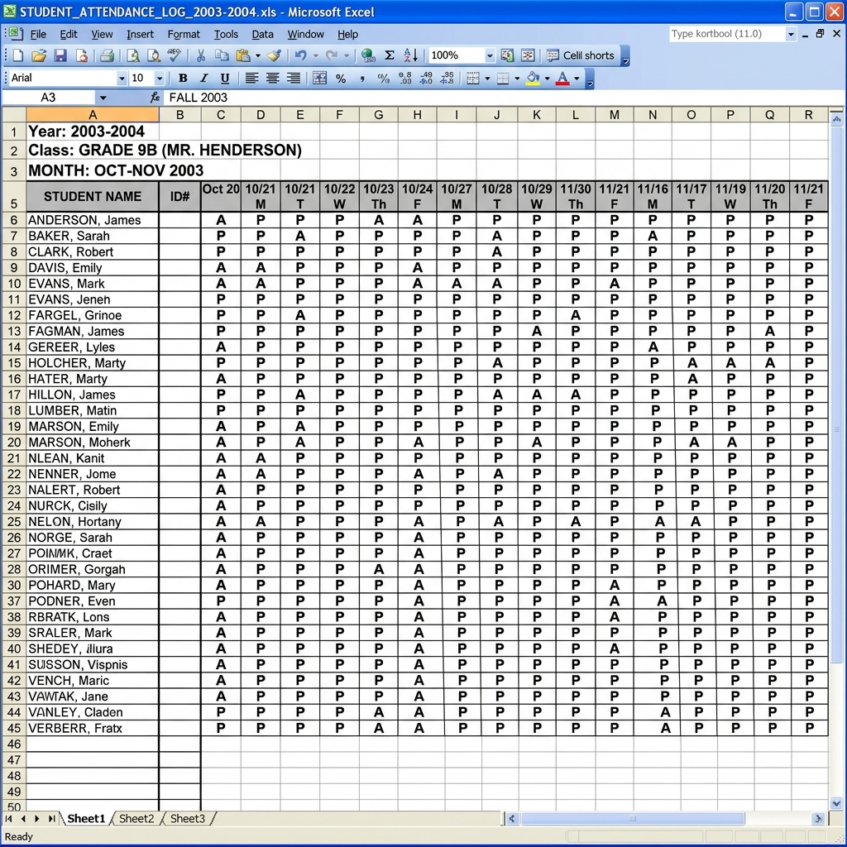
The Problem: Old Pen & Paper Format
Earlier, attendance was taken manually, which caused several issues:
As a Student: Unsure of current attendance %, proxies by others, difficult to track GTU 75% criteria.
As a Teacher: Time-consuming to call out names, manual data entry in excel, hard to calculate low attendance.

Slide 3
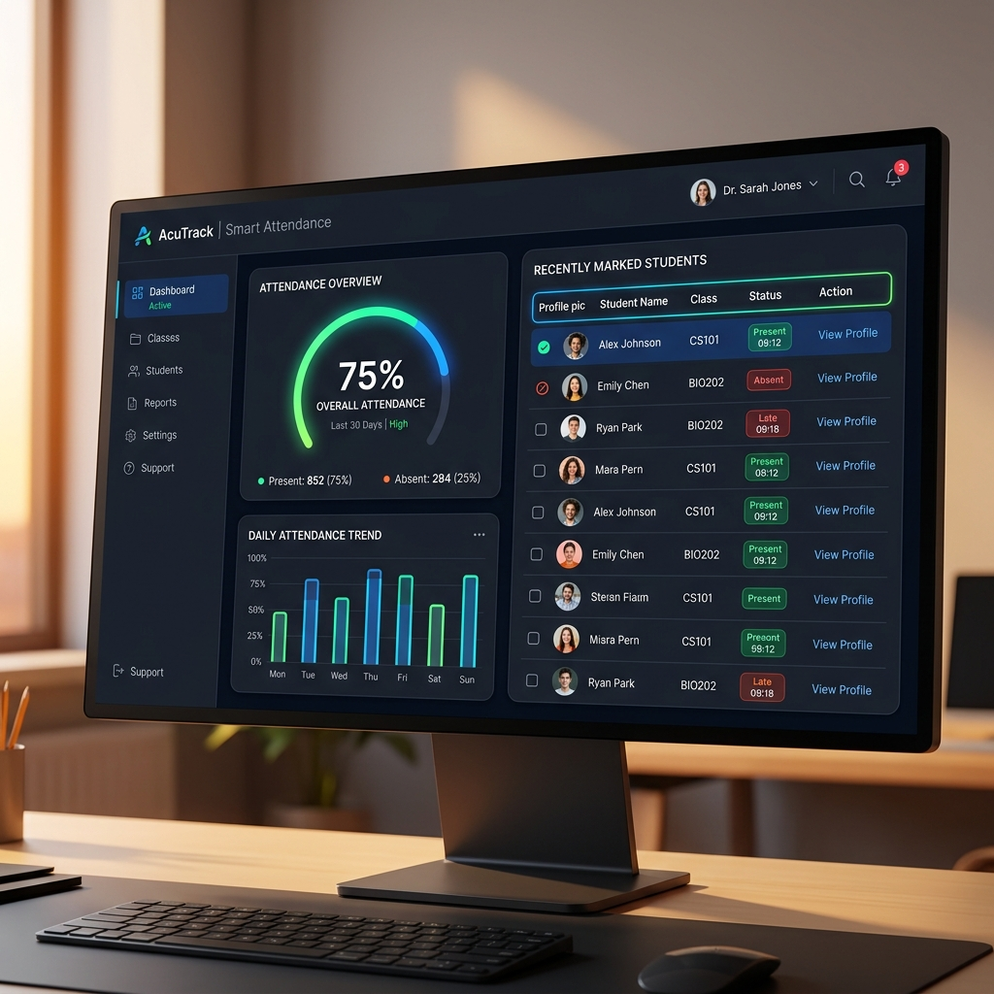
Our Solution
Smart Attendance Tracking site digitizes the entire process.
Student Solution: Real-time dashboard to check attendance %, alerts for low attendance, no proxies.
Teacher Solution: One-click attendance taking, automated calculations, export reports easily.

Slide 4
Features
Student Features:
- Live Attendance Dashboard
- GTU 75% Alert System
- Leave Request Portal
Teacher Features:
- Quick Mark Interface
- Defaulter List Generator
- Subject-wise Reports

Slide 5
Tech Used
We built this with modern and easy tools:
Frontend: HTML, CSS, JavaScript (The face of the site, e.g., buttons and colors)
Backend: Node.js / Python (The brain behind the site doing calculations)
Database: MongoDB / SQL (Where all student data is saved securely)

Slide 6
Any Questions?

Slide 7
Visit Our Site
Click below to track your attendance now!
https://smartattendance.psesurat.edu

