Slide 1

SMART ATTENDANCE TRACKING
Empowering PSE Surat College | Meeting the GTU 75% Mandate

Slide 2
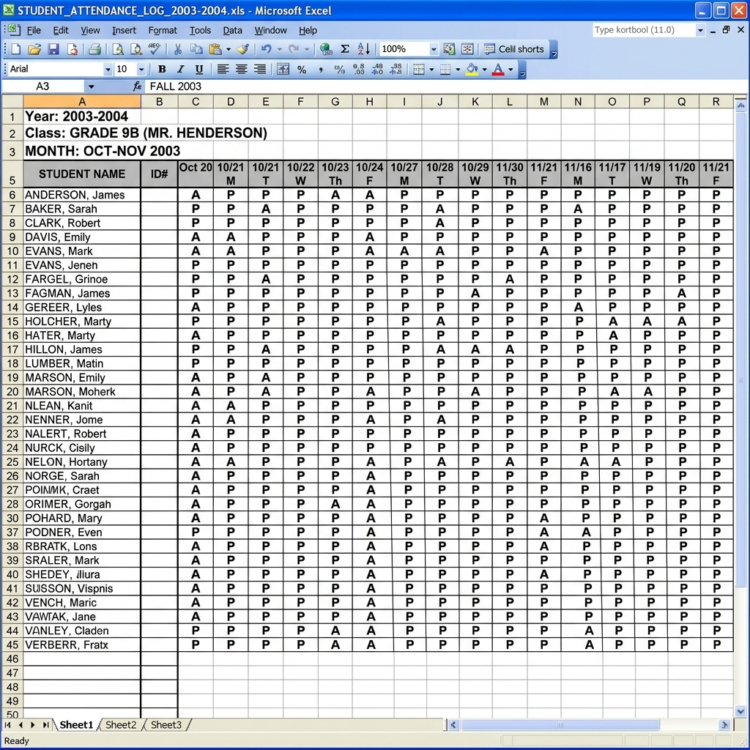
The Challenge: Archaic Pen & Paper
Traditional attendance tracking is prone to errors and inefficiency:
For Students:
- Constant anxiety about meeting the 75% GTU criteria.
- Vulnerable to fake proxies.
For Teachers:
- Wastes 10+ minutes of lecture time.
- Cumbersome data entry at the end of the month.

Slide 3
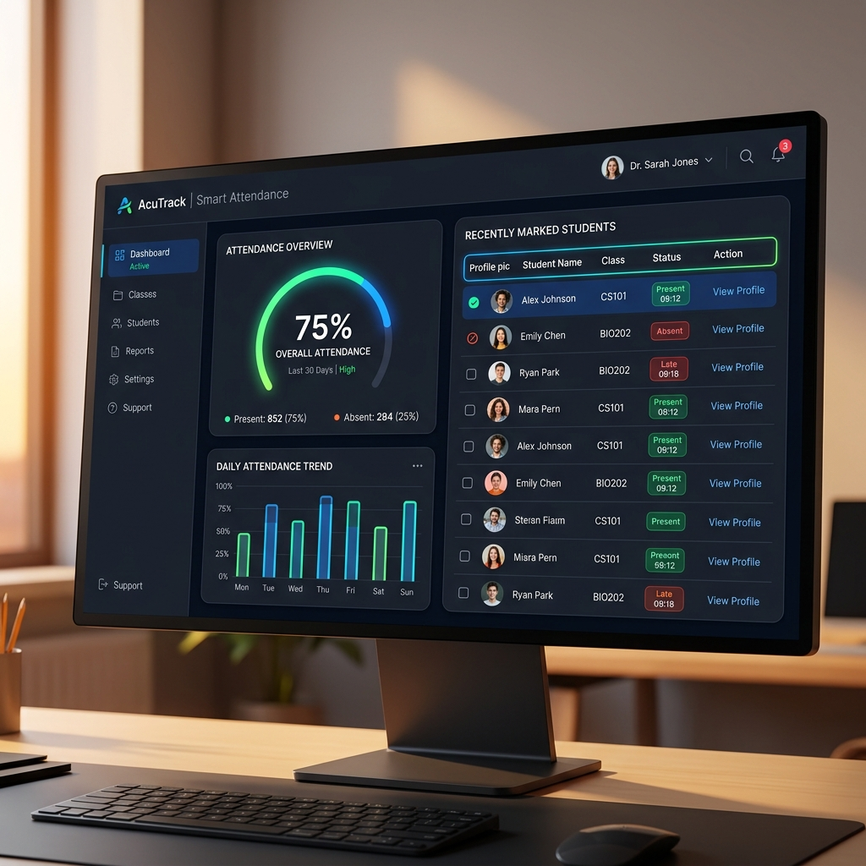
The Innovation: Smart Dashboard
A seamless digital experience replacing spreadsheets.
Student Portal:
- Crystal-clear analytics of attendance.
- Instant alerts before falling below 75%.
Teacher Portal:
- Rapid, secure attendance marking.
- One-click PDF/Excel report generation.

Slide 4
Key Features
Empowering Students:
- Dynamic Attendance Gauge
- GTU Threshold Notifications
- Digital Leave Management
Empowering Faculty:
- Biometric / QR Based Quick Mark
- Auto-generated Defaulter Lists
- Comprehensive Analytics

Slide 5
Technology Stack
Built for Scale and Speed:
User Interface (React/Next.js): Delivering a smooth, app-like experience.
Server Engine (Node.js/Express): Fast processing of thousands of records.
Database (MongoDB): Secure, scalable storage for college data.

Slide 6
Questions?

Slide 7
Experience It Now
Join the future of education.
https://smartattendance.psesurat.edu

