Slide 1
HIGGS BOSSON - EVENT CLASSIFICATION ML PROJECT
Prepared & Presented by
ARUN MALIK

Slide 2
OBJECTIVE OF PROBLEM
In the Large Hadron collider at CERN interaction of subatomic particles generates huge amounts of data through sensors.
Challenge to extract the signal of Higgs boson from background noises
The primary objective of the classification problem is to distinguish SIGNAL & BACKGROUND events baced on data of the events collected from the Large Hadron Collider sensors.

Slide 3
CONTENTS
Importing necessary libraries
Basic Data Understanding
Exploratory data analysis
Analysis of Outliers
Analysis of Correlated Columns
Removing Irrelevant columns
Target manipulation
Scaling Data & Handling Imbalance
Feature Selection
Model Training
LOGISTIC REGRESSION
DECISION TREE
RANDOM FOREST
ADA-BOOST
Evaluation & Model Selection
Summary of the Project

Slide 4
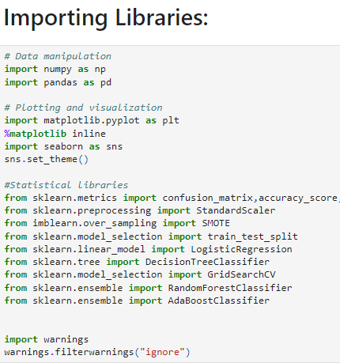
NECESSERY LIBRARIES

Slide 5
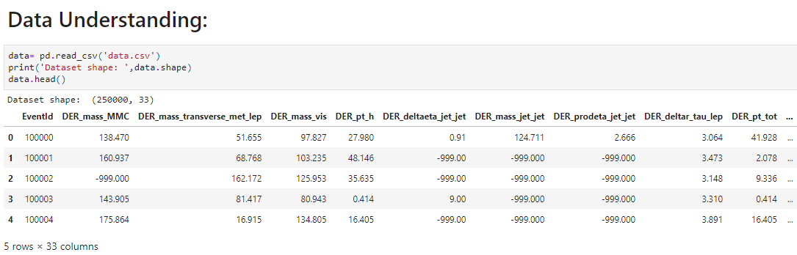
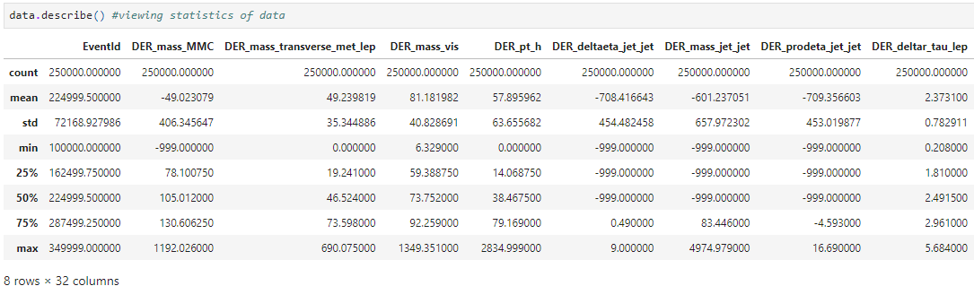
DATA UNDERSTANDING

Slide 6
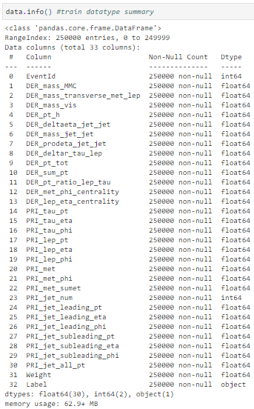
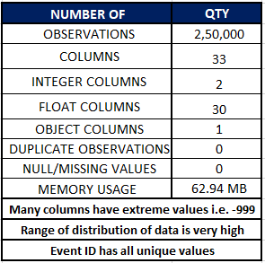
DATA SUMMARY

Slide 7
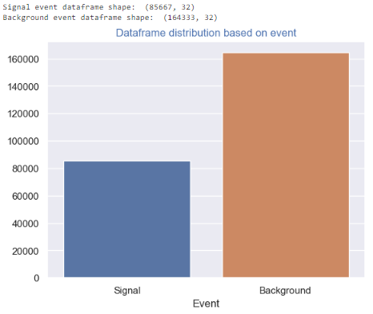
EXPLORATORY DATA ANALYSIS
Separately storing data based on target column (Signal & Background)
Checking distribution based on event.
Signal and Background events are nearly 1:2 ratio & Data imbalance has to be handled

Slide 8
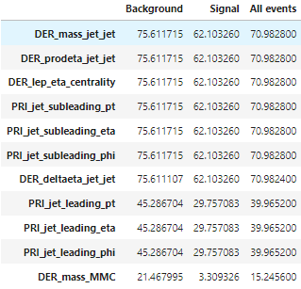
OUTLIERS (-999) VALUES
PERCENTAGE OF (-999) VALUES IN COLUMNS
OBSERVATIONS
7 Features have more than 70 % outliers
We will further check their relation with target and colinearity with each other
In feature selection we will check and drop the non required features through mutual information gain and coorelation of these features

Slide 9
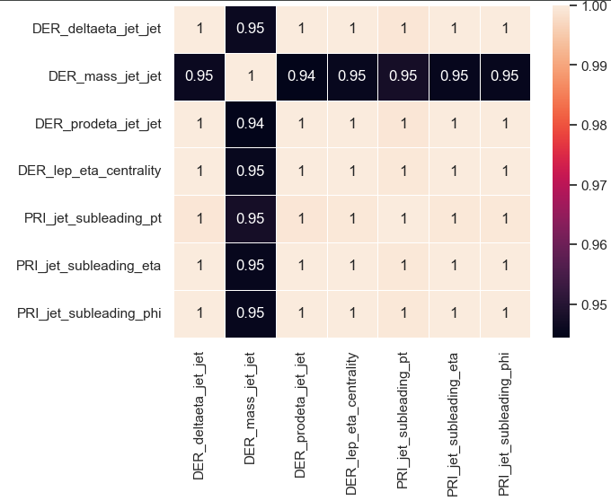
CORRELATION OF OUTLIER FEATURES
Correlation Heatmap shows very high correlation between all selected features.
Observation : We will further check after replacing (-999) values with Numpy.NAN

Slide 10
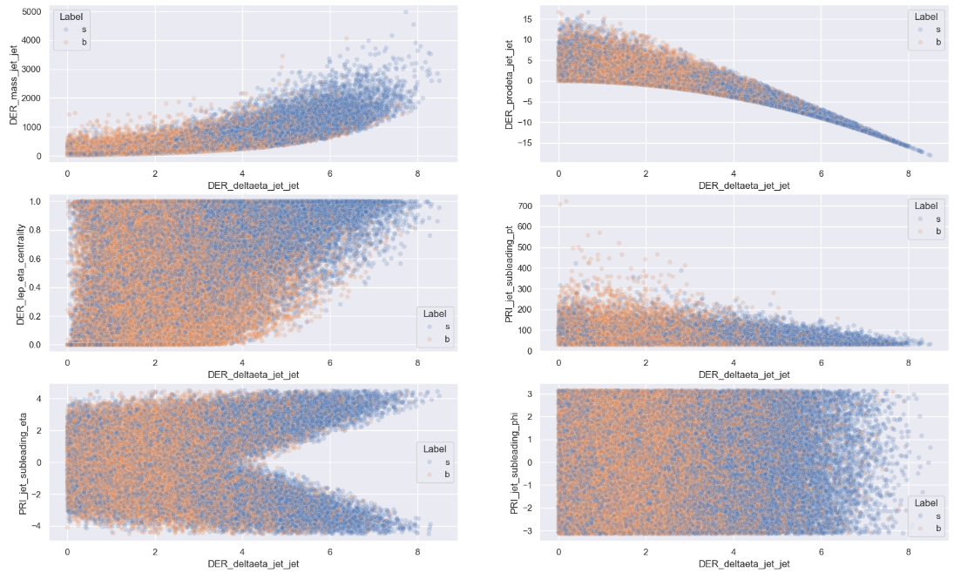
INFERENCE OF COLUMNS BY S & N
Relation between selected features based on the target variable is plotted to check the inference on target.
Plotting after replacing outliers with nan
Features don’t show highly distinctive relation with target variable

Slide 11
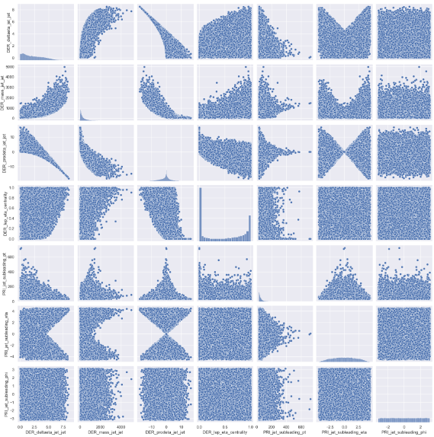
COLINEARITY IN FEATURES
THIS IS THE RELATION BETWEEN SELECTED VARIABLE WITH EACH OTHER
ALL THE (-999) VALUES HAVE BEEN REPLACED BY NUMPY.NAN
ALL THE FEATURES WITH MORE THAN 70 % OUTLIERS , HIGH CORRELATION & COLINEARITY ARE DROPPED

Slide 12
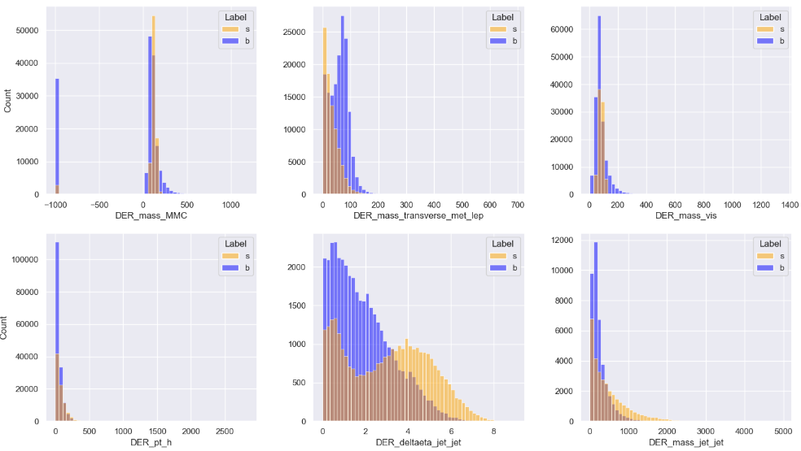
FEATURES DISTRIBUTION BY TARGET

Slide 13
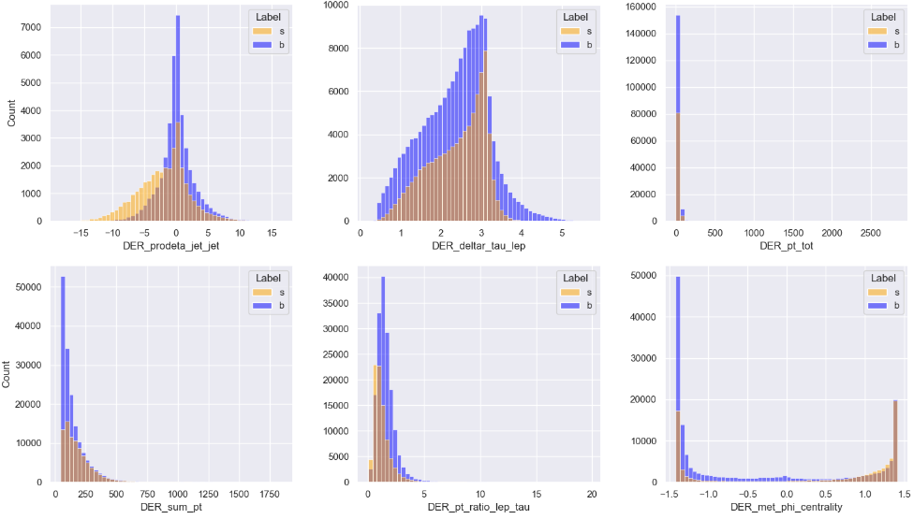
FEATURES DISTRIBUTION BY TARGET

Slide 14
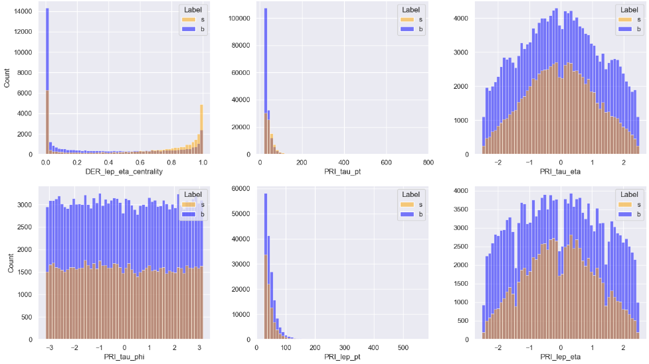
FEATURES DISTRIBUTION BY TARGET

Slide 15
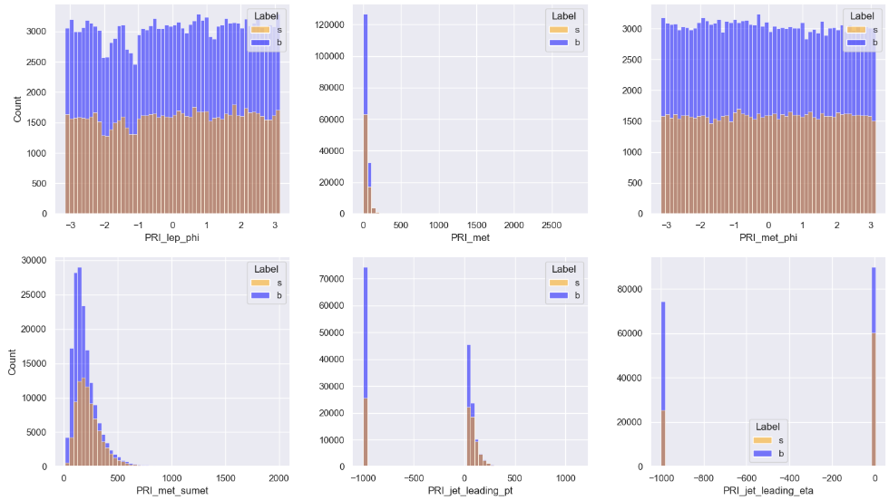
FEATURES DISTRIBUTION BY TARGET

Slide 16
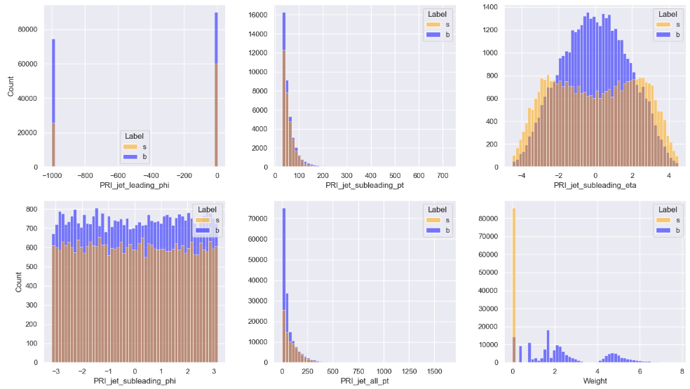
FEATURES DISTRIBUTION BY TARGET

Slide 17
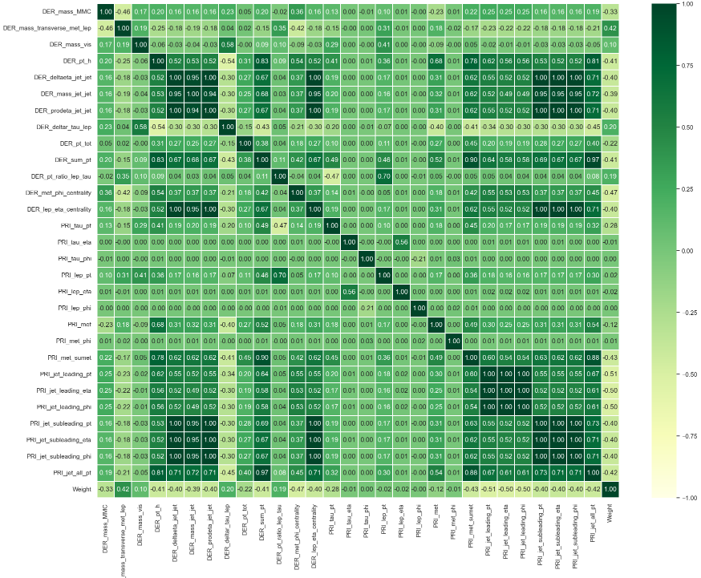
CORRELATION
Correlation heatmap is plotted for all the features in the data set.
Observation
Heatmap shows many highly correlated columns represented by dark Green colour
We will further check the correlation coefficients to find and keep only one from highly correlated columns
We will plot the correlation heatmap separately for each target value i.e. singal & background

Slide 18
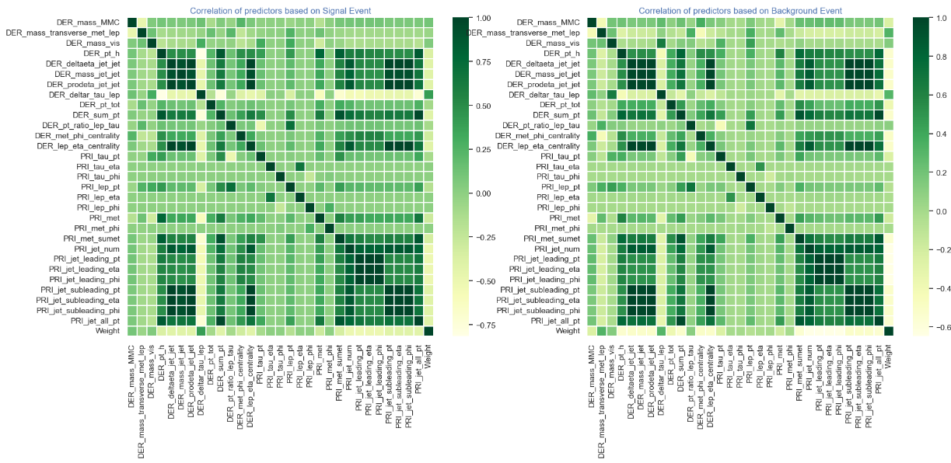
Correlation heatmap based on Target Variable
Observation:
Heatmap shows many highly correlated columns
We will further check & group the highly correlated features in the dataset

Slide 19
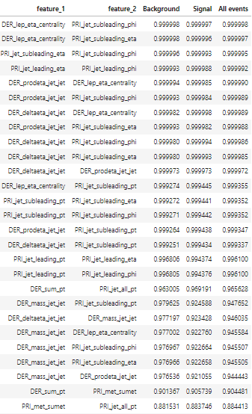
CORRELATED FEATURES ANALYSIS
Correlation coefficients of features greater than 90% in the dataset.

Slide 20
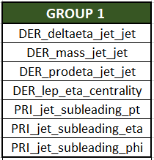
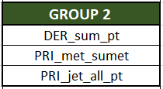
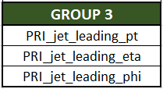
CORRELATED FEATURES GROUPS
Three groups of highly correlated features were found
Each feature in a group is very highly correlated with any other feature in the same group
We will further take into account the groups during feature selection
Group 1 has nearly 99 % , Group 2 has > 96 % & Group 3 has >90% correlation approximately

Slide 21
Dropping Irrelevant features for Model
EventId –
This is not a feature of experiment but a unique ID given to each event hence has no significance in out model.
Weight –
Weight is again not an outcome of experiment its for adjusting the contribution of each event due to the increased frequency of signal event in the dataset than in actual experiment.
In the actual experiment there were only 6 signal events produced per 1000 total events hence a weight is applied to adjust the contribution of each event.
We will not use it as a feature but can be used in some models which take in weight to adjust the weightage.
Assigning Target variable Label as '1' and '0'
s -> Signal event = ‘1’
b -> Backround event = ‘0’

Slide 22
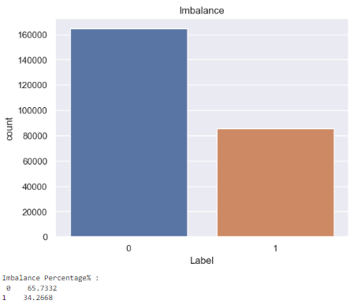
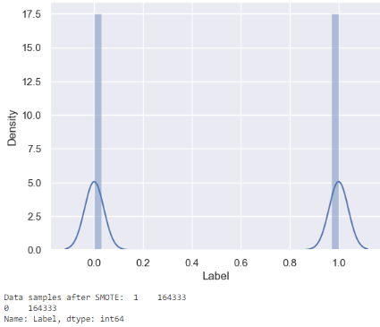
SCALING & HANDLING IMBALANCE
Using StandardScaler() to normalize the features in dataset
Using SMOTE to handle data imbalance in the target variable
SMOTE

Slide 23
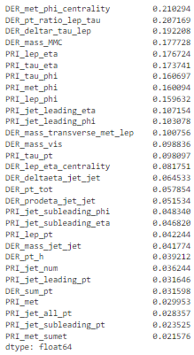
MUTUAL INFORMATION GAIN
USING MUTUAL_INFO_CLASSIF FUNCTION ON FEATURES

Slide 24
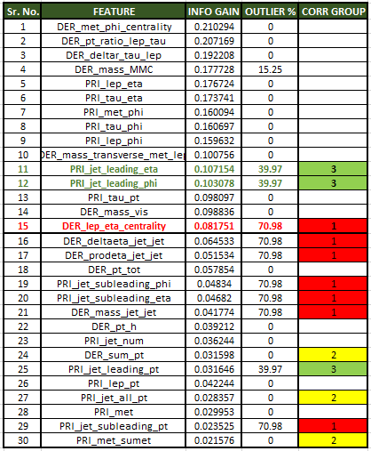
FEATURE SELECTION
Combining the information gain , % of outliers in features & Correlation groups
OBSERVATIONS :
Selecting first 20 features based on info gain would result in high number of outliers features in data & 5 very high correlated features in data
We can see a sharp dip in info gain after 9th feature & 14th feature.
Selecting only 9 features out of 30 would be very less & moreover would not carry any feature from the highly correlated groups resulting in information loss from group 1 of 7 correlated features.
Selecting 14 features can serve our purpose by eliminating all features with more than 70 % outliers but will miss the information carried by 7 features of group 1 of 99 % correlated features.
Selecting first 15 features seems to be the best scenario as
50 % of the features with more than 80 % mutual info score would be included in model learning.
It contains 1 feature from group 1 of 7 99% correlated features
It would automatically eliminate the 6 features with more than 70 % outliers.
Hence proceeding with first 15 features and dropping the rest for model building.

Slide 25
SPLITTING TEST /TRAIN DATA
Using train_test_split
Splitting the data set into training/validation set(80-20%) with random state=42
TRAINING MACHINE LEARNING MODELS
MODELS TO BE TRAINED & EVALUATED
LOGISTIC REGRESSION CLASSIFIER
DECISION TREE CLASSIFIER
RANDOM FOREST
ADABOOST

Slide 26
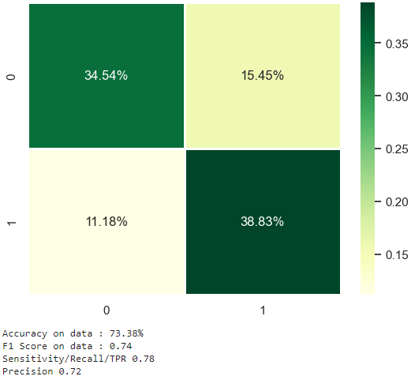
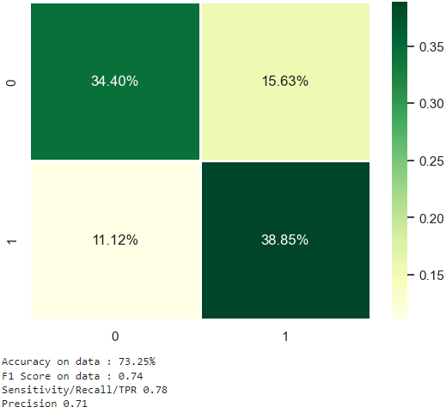
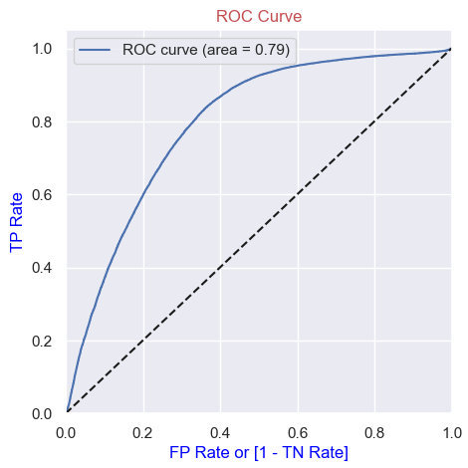
LOGISTIC REGRESSION
TRAINING DATA
73.38 %
VALIDATION DATA
73.25 %
ROC/AUC
79 %

Slide 27
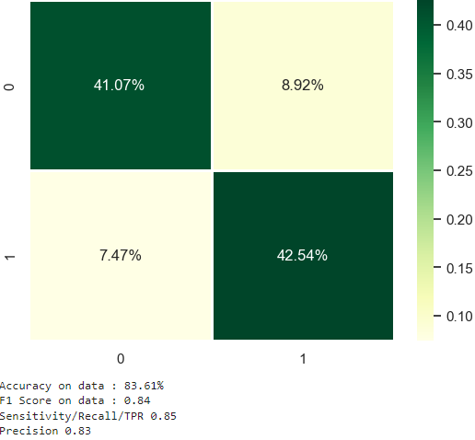
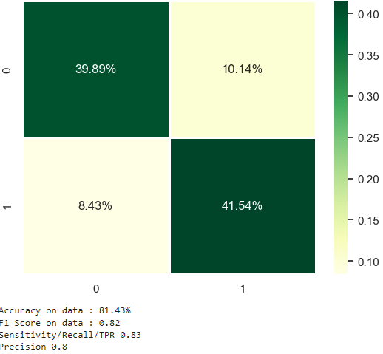
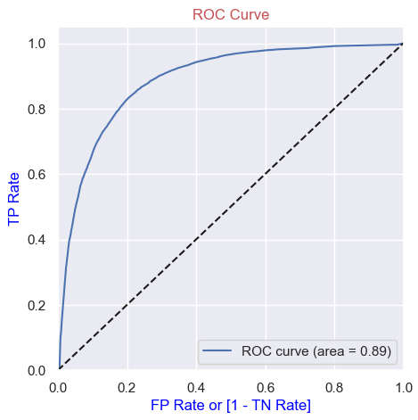
DECISION TREE CLASSIFIER
TRAINING SCORE
83.61 %
VALIDATION SCORE
81.43%
ROC/AUC
0.89

Slide 28
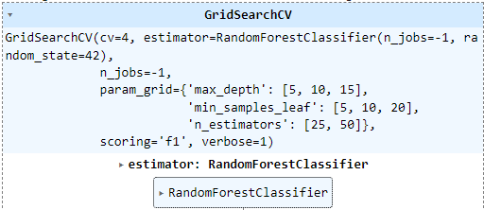

RANDOM FOREST (ENSAMBLE HYPER PARAMETER TUNING
INPUT PARAMETERS IN GRID SEARCH
BEST PARAMETERS

Slide 29
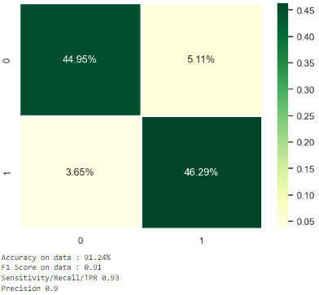
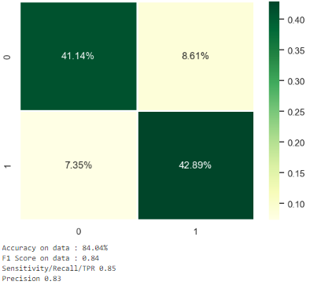
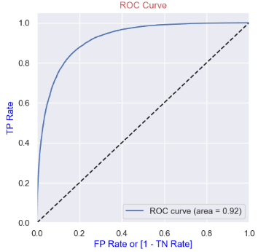
RANDOM FOREST (ENSAMBLE HYPER PARAMETER TUNING
TRAINING DATA
91 %
VALIDATION DATA
83.25 %
ROC/AUC
92 %

Slide 30
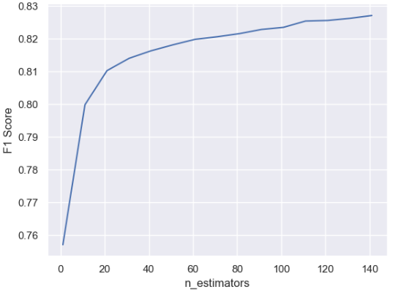
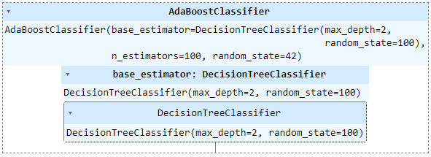
ADABOOST (PARAMETERS)
Z score platues near n_est = 110
Building AdaBoost with n_estimaters =110

Slide 31
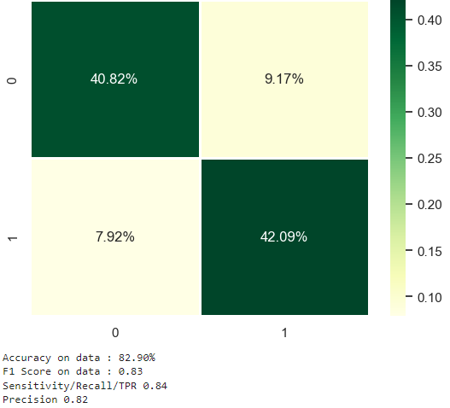
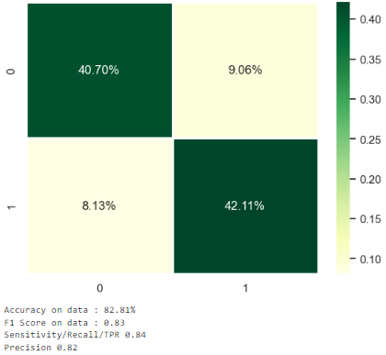
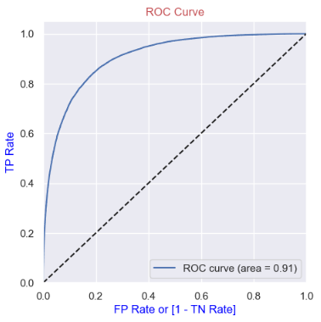
ADABOOST (PARAMETER TUNING EVALUATION)
TRAINING SCORE
82.90 %
VALIDATION SCORE
82.81 %
ROC/AUC
91 %

Slide 32
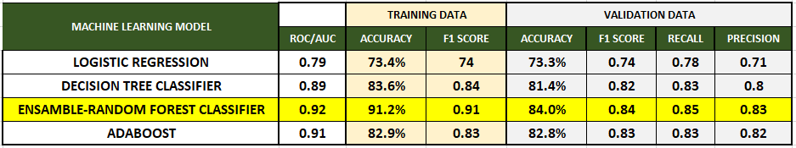
EVALUATION & SELECTION
BOTH ADABOOST & RANDOM FOREST HAVE GIVEN ALMOST SAME ACCURACY ON VALIDATION SET
CONSIDERING THE COMPUTAIONAL COST WHICH IS HIGHER FOR ADABOOST I HAVE SELECTED RANDOM FOREST WITH HYPERPARAMETER TUNING AS THE BEST MODEL

Slide 33
#splitting the data set into train/validation set(80-20%) with random state=42
THANK YOU
KINDLY SHARE YOUR VALUEABLE FEEDBACK

