Slide 1
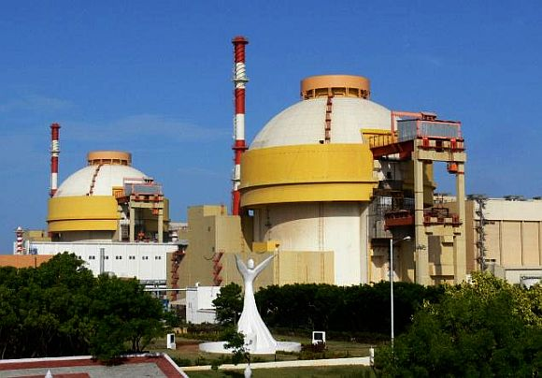

KUDANKULAM NUCLEAR POWER PLANT

Slide 2
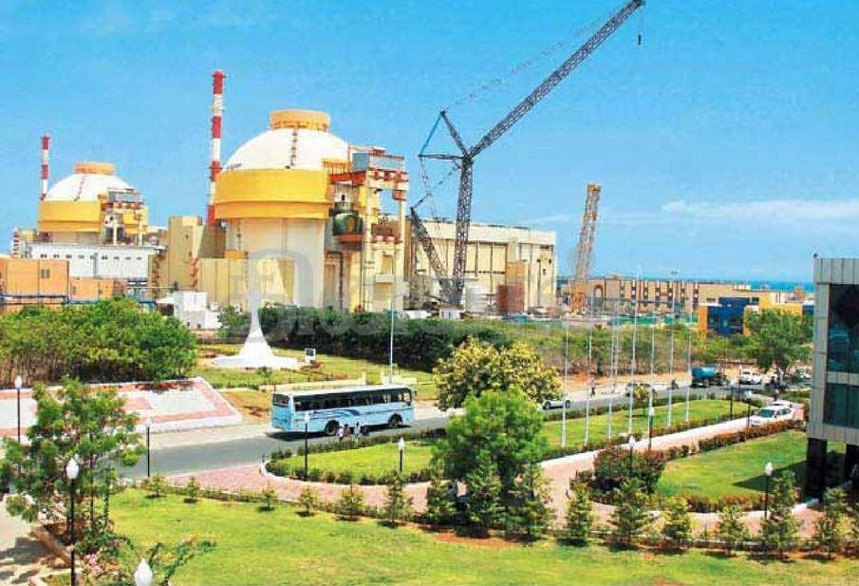
KUDANKULAM NUCLEAR POWER PLANT
Located on the coast of the Gulf of Mannar, at 25 KM to the north-east from
Kanyakumari, inTamil Nadu State.
In Kudankulam we use world’s most advanced VVER-1000 reactors designed by
Russians

Slide 3
Nuclear Power Plants in India
Power station Operator State Type Units Total capacity(MW)
Kaiga NPCIL Karnataka PHWR 220 x 4 880
Kakrapar NPCIL Gujarat PHWR 220 x 2 440
Kalpakkam NPCIL Tamil Nadu PHWR 220 x 2 440
Narora NPCIL Uttar Pradesh PHWR 220 x 2 440
Rawatbhata NPCIL Rajasthan PHWR 100 x 1 200 x 1 1180 220 x 4
Tarapur NPCIL Maharashtra BWR 160 x 2 (PHWR) 540 x 2 1400
Total 20 4780
The projects under construction are:
Power station Operator State Type Units Total capacity (MW)
Kudankulam NPCIL Tamil Nadu VVER-1000 1000 x 2 2000
Kalpakkam BHAVINI Tamil Nadu PFBR 500 x 1 500
Kakrapar NPCIL Gujarat PHWR 700 x 2 1400
Rawatbhata NPCIL Rajasthan PHWR 700 x 2 1400
Total 7 5300

Slide 4
What is a nuclear reactor

Slide 5
What kind of reactor is used in Kudankulam ?
VVER (WWER)-Vodo-Vodyanoi Energetichesky Reactor (water- water power reactor)
First version → VVER – 440 model V230
Modified version → VVER- 440 model V213 (includes safety standards)
advanced version → VVER-1000 (one used in Kudankulam plant)
VVER-1000 developed by Russian in 1975, capacity of generating 1000 MW.
a) Water cooled, water-moderated- energy reactor (similar to PWR).
Reactor fuel is fully immersed in water at 15 Mpa of pressure.
b) Fuel is low enriched (2.4–4.4% ²³⁵U) uranium dioxide (UO₂),pressed into
pellets and assembled into fuel rods.
c) Has a four loop system housed in a containment type structure.

Slide 6
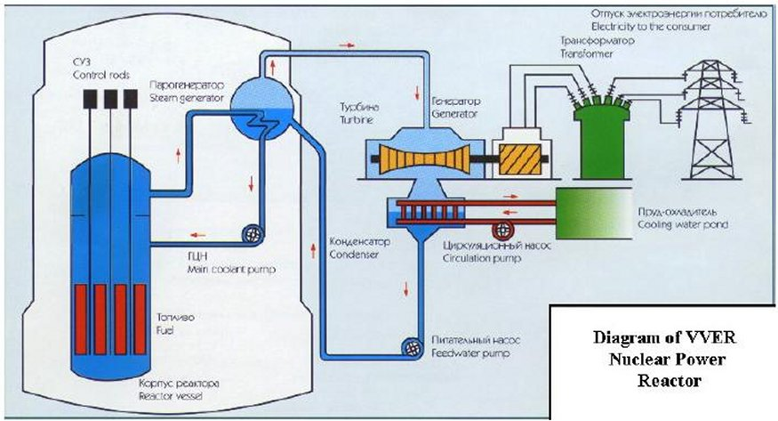
VVER – Russian PWR( pressurized water reactor) (Water-Cooled, Water-Moderated, Energy Reactor)
http://www.nucleartourist.com/

Slide 7
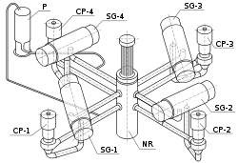
Primary cooling circuit
Reactor : Water flows through fuel rod assemblies
and is heated by the nuclear chain reaction.
Volume compensator : To keep the water under
constant but controlled pressure.
Steam Generator : heat from primary coolant water is used
to boil water in the secondary circuit.
Pump : The pump ensures proper circulation of the
water through the circuit.
Secondary circuit and electrical output
Steam Generator : Secondary water is boiled taking heat from the primary circuit.
Turbine : The expanding steam drives a turbine, which connects to an electrical generator.
Condenser : The steam is cooled and allowed to condense, shedding waste heat into a
cooling circuit.
Deaerator : Removes gases from the coolant.
Pump : The circulation pumps are each driven by their own small steam turbine.
Safety barriers
A typical design feature of nuclear reactors is layered safety barriers preventing
escape of radioactive material. VVER reactors have four layers:
Fuel pellets : Radioactive elements are retained within the crystal structure of the fuel pellets.
Fuel rods : The zircaloy tubes provide a further barrier resistant to heat and high pressure.
Reactor Shell : A massive steel shell.
Reactor Building : A concrete containment building.

Slide 8

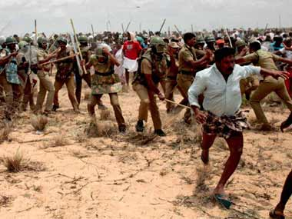
Local protest

Slide 9
SAFETY AT KUDANKULAM
Inherent safety – 1. Reactor has negative power coefficient, which means that
any increase in reactor power is self terminating.
2. Reactor has negative void coefficient, reactor will shut down
if there is any loss of water.
Reactor is equipped with five barrier to prevent radioactivity into the environment.
1. Fuel matrix 2. Fuel cladding 3. Main circulation circuit 4. Inner containment
system 5. Outer containment system.
Double containment building – 1. Primary containment designed to maintain
pressure at 0.4Mpa
2. Secondary Containment designed for external
effects, such as missile attack, aircraft crash and shockwaves.
Two stage Hydro Accumulators – They ensure the supply of borated water to the
reactor core in case of loss of coolant or low pressure.
Core catcher – in extreme situation of core melting and breaching the pressure vessel, the
core catcher below the pressure vessel will ensure that the molten core mixes with a large
quantity of neutron absorbing material and thus prevent the possibility of a nuclear
explosion. Only the most modern designs have such a provision.

Slide 10
The reactor can withstand external effects involving earthquake, tsunami/storm,
tidal waves, cyclones, shock waves, fire and aircraft impact.
Kudankulam is located far off (about 1500 km) from the tsunami genic fault
(where tsunami originate). Thus, if there is a tsunami, it would take time and lose its
energy by the time it strikes Kudankulam site.
In case of flood - The supplementary control room and the four diesel generator room –
safety train rooms are provided with water tight doors to protect them against flooding.
These doors remain shut when the reactors are operational.
Kudankulam is located in the zone of very low seismic potential.
"Kudankulam plant has 3G safety aspects, I am fully satisfied," Mr Kalam said.

Slide 11
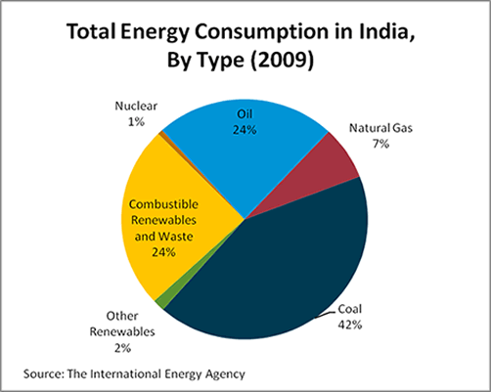
Is it necessary to plant any more nuclear reactors ?
India is the fourth largest energy consumer in the world, after the
United States, China, and Russia.
India produced roughly 0.95 million
barrels of oil per day. The country
consumed 3.2 million barrels per day.
So, we import 2.2 million barrels per
day from Saudi Arabia and Iran.
Coal based thermal power plant
generate 80 percent of electricity in
India.
India suffers from shortage of
electricity. Roughly 40 percent of
residences in India are without
electricity.

Slide 12

Future of Indian Nuclear Power
India's nuclear power reactors consume, at most, 478 tonnes of uranium per year.
Even if we quadruple our nuclear power output to 20GW by 2020, nuclear power generation would only consume 2000 tonnes of uranium per annum.
India has viable reserves of 80,000 to 112,000 tons of uranium, this represents a 40–50 years uranium supply for India's nuclear power Reactors.
India is developing thorium reactor since Uranium deposits in the nation are limited,
but there are much greater reserves of thorium and it could provide hundreds of times the energy with the same mass of fuel.
ITER (International Thermonuclear Experimental Reactor)
is an international nuclear fusion research and
engineering project, which is currently building the
world's largest and most advanced experimental
nuclear fusion reactor.
ITER's member states — the EU, India,
Russia, China, South Korea, Japan and the United States.

Slide 13
Thank you

