Slide 1
FOUNDATION SCIENCE · AI LEADERSHIP READOUT · v2 UPDATE
Guardrailed Agentic Research Loop
for Cross-Modal Fraud Modeling
Three sweep generations. v3 null → v4 CI-separated win → v5 ceiling.
Arun Menon
Foundation Science
Prepared for Prakhar + AI Leadership Team
2026-05-22 · v2 (supersedes v3-era v1)
v2

Slide 2
Bottom line
EXECUTIVE BOTTOM LINE
The loop is the reusable artifact.
Cross-attention is the worked example.
30 runs
v4 win
v5 ceiling
Three sweep generations
CI-separated lift on adversarial fraud
Bottleneck is upstream of architecture
v3 + v4 + v5 · zero format drift · zero races · zero manual reconciliation
phish_takeover recall 0.11 → 1.00 · phish_takeover_mfa_phished 0.00 → 0.97
hn_recovery_high_amount stuck at ~44% FPR across every tested dial
WHAT CHANGED SINCE THE v1 DECK
v1 deck (May 18) framed the result as a clean negative and de-prioritized architecture.
v2 (this deck, May 22) corrects that: v3 was data-confounded, v4 showed a CI-separated synthetic win, and v5 exposed a data-shaped ceiling.
Cross-Attention ATO POC · v4/v5 update · 2026-05-22
2 / 14

Slide 3
What changed
V3 NULL · V4 WIN · V5 CEILING
Three generations, three different stories
v3 · 3 days · 18 runs
v4 · 4-change data pivot
v5 · 11 runs across 2 phases
Honest null result
CI-separated architectural win
Robust win, one ceiling
18 cross-attention configs across 3 insertion patterns × 2 slot counts × 2 gate inits + LR perturbations.
Leader: 0.0524 worst-family HN-FPR.
Baseline (structured-as-text): 0.0507.
CIs heavily overlap. No separation.
Gates rode init bias. v1 deck called this "no architectural lift."
Same architecture, fixed data.
phish_takeover recall:
text_only 0.11 → xattn 1.00
phish_takeover_mfa_phished:
text_only 0.00 → xattn 0.97
Both CI-separated. Adversarial cross-modal families that text alone cannot solve.
Dial-robust: insertion pattern, slots, gate init, LoRA rank, encoder all confirm v4 win.
v5_adv_error band: 0.151 – 0.174
But hn_recovery_high_amount FPR stuck at ~0.44 across every dial.
97% of v5_adv_error comes from this one family. Ceiling is upstream in the generator template, not in the model.
Cross-Attention ATO POC · v4/v5 update · 2026-05-22
3 / 14

Slide 4
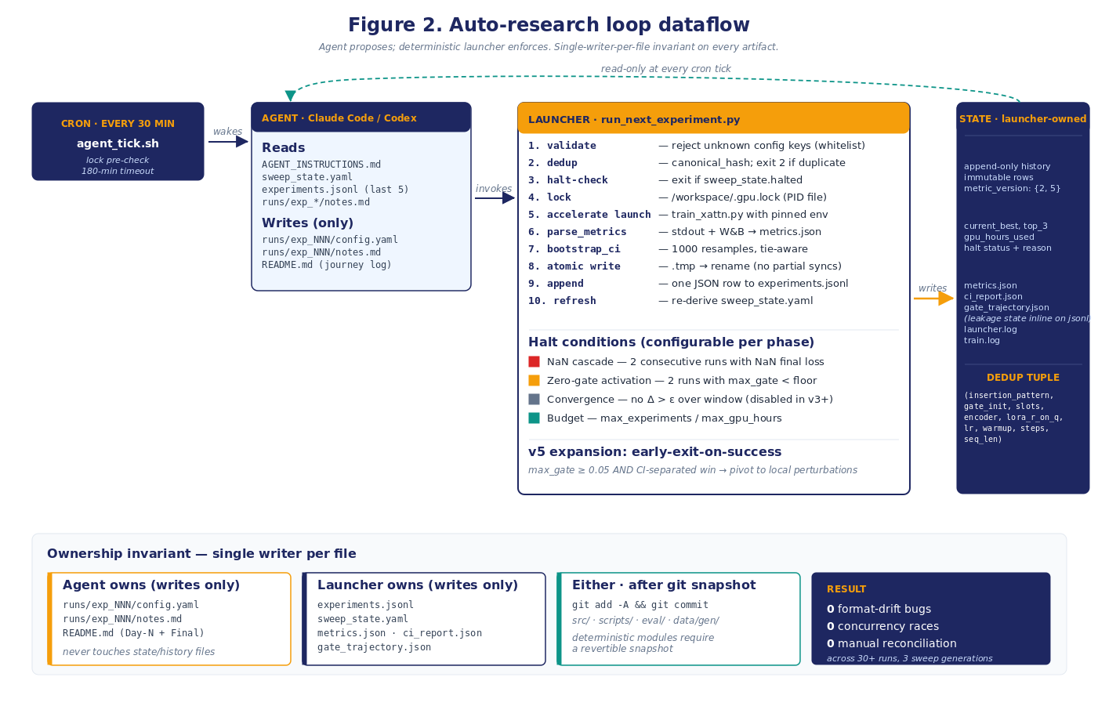
The loop
THE REUSABLE ARTIFACT
Agent proposes. Deterministic launcher enforces.
Cross-Attention ATO POC · v4/v5 update · 2026-05-22
4 / 14

Slide 5
Why the loop mattered
METRIC + LEAKAGE + IMMUTABILITY
What the guardrails caught
01
AUC saturation, v3 Day-1
02
sklearn-cliff phantom advantage, v3 Day-2
Every variant hit AUC 1.0 on the 5k eval. The loop's per-run JSON exposed it immediately; the human reframed the headline metric to worst-family HN-FPR @ 1% legit FPR. metric_version 1 lived for one day.
First-cut leaderboard had event_only beating LM baselines 5–7×. Codex review caught the artifact: sklearn's recall_at_fpr lands tied-mass distributions at the wrong operating point. Fixed with tie-aware exact-target metric (metric_version 2). No retraining.
03
Narrator-cache leakage, v3 → v4 pivot
04
Convergence-halt premature firing, v3 Day-2
10.7% of v3 eval rows shared narrative text with train (35% on hn_large_purchase). leakage_checks.py caught it; the v4 pipeline fixed it (text-hash + structured-events-hash dedup, narrator-prompt-version in cache key, clean-eval mask drops to 0 rows in v4).
Window-based halt fired when the round-1 leader sat in slot 1 of the window — mathematically impossible for siblings to beat by 0.005. Fixed: halt logic made configurable per phase. v4/v5 inherited the fix; v5 added early-exit-on-success on top.
All four were caught at low cost because the loop produced an immutable per-run audit trail. The same audits on a less-disciplined pipeline would have either missed them or made the v4 pivot much more expensive to validate.
Cross-Attention ATO POC · v4/v5 update · 2026-05-22
5 / 14

Slide 6
Updated numbers
30 RUNS · ZERO MANUAL RECONCILIATION
What the loop got us across three generations
30
Total experiments across v3 + v4 + v5
3
Metric corrections rolled forward
22 cross-attention + 8 baselines. Two GPU caps (18h v3 · 12h v5), both halted by stop conditions before exhausting budget.
metric_version 1 → 2 (tie-aware exact-target) → 5 (adversarial-error decomposition). No retraining for any of them.
0
Format drift, concurrency races, manual reconciliation
1
Honest negative result, later traced + repaired
Single-writer-per-file ownership held cleanly across 30 runs. Final synthesis built directly from experiments.jsonl.
v3 null wasn't an architectural failure — the loop's audit trail enabled the data-pathology diagnosis that drove the v4 pivot.
What the loop did NOT do: redefine the research question. Three reframes (AUC pivot · sklearn-cliff · v3-null diagnosis) came from human judgment on top of the loop's evidence — force multiplier, not substitute.
Cross-Attention ATO POC · v4/v5 update · 2026-05-22
6 / 14

Slide 7
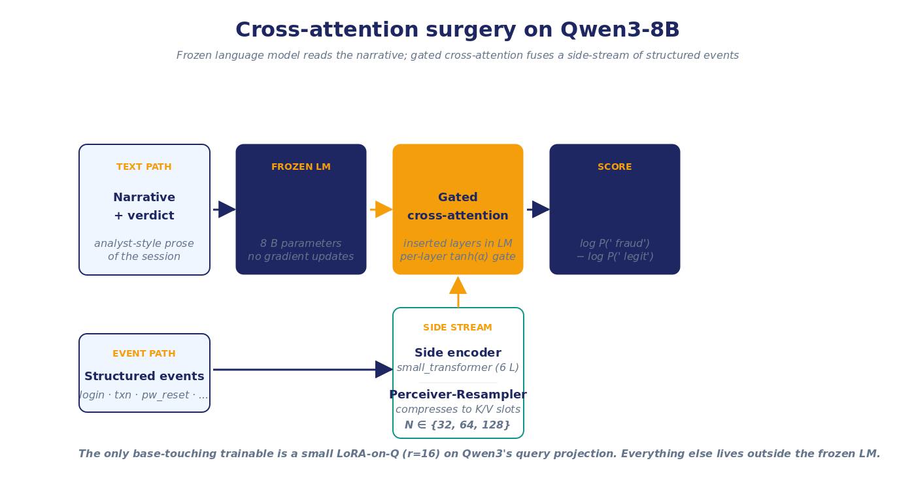
Architecture
FLAMINGO-STYLE GATED CROSS-ATTENTION
Architecture in one slide
Cross-Attention ATO POC · v4/v5 update · 2026-05-22
7 / 14

Slide 8
v3
ACT 1 · NOT THE FINAL ANSWER
v3 — the honest null result
⚠ This is v3 only. v4 and v5 changed the conclusion — see slides 10–12.
#
Run
Worst HN-FPR
95% CI
Notes
1
structured_as_text_v2 (baseline)
0.0507
[0.0408, 0.0635]
Load-bearing baseline
2
exp_xa_round1_002 (v3 x-attn leader)
0.0524
[0.0420, 0.0647]
+0.0017 worse on point estimate
3
exp_xa_round1_001 + 003 (other x-attn)
0.057 – 0.061
all overlap baseline
Architecture dials neutral on this surface
THE v3 READING (as we shipped it on May 18)
"Cross-attention did not separate from structured-as-text concat within 95% bootstrap CIs; gates rode their initialization. That v3 reading was honest but later superseded by the v4/v5 result."
That reading was honest. It was also wrong — for reasons that only became clear after a code audit. See slide 9.
Cross-Attention ATO POC · v4/v5 update · 2026-05-22
8 / 14

Slide 9
v3 diagnosis
ACT 2 · WHAT THE CODE AUDIT FOUND
The v3 null was a data-design artifact
01
Narrator paraphrased the side stream into the text
narrative_generator.py serialized the full structured event stream into the narrator's prompt, including bucket key=value pairs. The narrator's compliant-example phrases taught it to write "high-value transfer" for amount_bucket=high, "freshly-added recipient" for recipient_age=newly_added. The bucketed fraud signal flowed end-to-end from event → narrator input → narrative text. The LM, reading the narrative, already had the structured signal — cross-attention had nothing unique to fetch.
02
Hard-negative templates were label-deterministic
v3 journey templates hard-coded feature signatures. hn_account_recovery was always {mfa_strong, known device, low ip risk}; phish_takeover was always the opposite. A feature-level classifier could perfectly separate them. The 0.05–0.07 worst-family HN-FPR ceiling in v3 was a statistical edge effect at the 1%-FPR operating point on a label-deterministic surface — not a measure of model capability.
03
Baseline contract was muddied
v3 text_only and xattn arms saw different LM prompts (text_only included event-line blocks wrapped in <journey_*> tokens; xattn did not). The architecture comparison was confounded with a prompt-content comparison.
The diagnosis: the v3 null was the data, not the architecture. Time to fix the data and re-run.
Cross-Attention ATO POC · v4/v5 update · 2026-05-22
9 / 14

Slide 10
v4 pivot
ACT 3 · RESTORE THE MODALITY GAP
v4 — the four-change data pivot
CHANGE 1
CHANGE 2
Strip narrator's view of bucketed features
Stochastic feature signatures
Narrator now sees only event types + timing. No quantitative buckets. Quantitative features live exclusively in the structured event stream.
Each journey family draws features from a distribution, not a fixed signature. Fraud and legit overlap on individual features. A feature-level classifier can no longer perfectly separate.
CHANGE 3
CHANGE 4
Two new adversarial cross-modal families
Byte-identical LM prompts across arms
hn_recovery_high_amount (legit, text reads fraud) and phish_takeover_mfa_phished (fraud, text reads safe). Designed to demand cross-modal reasoning.
text_only and xattn arms now see the same LM prompt modulo the side stream. The architecture comparison turns only on the presence/absence of cross-attention.
Same architecture. Same training recipe. Different data. — Result on next slide.
Cross-Attention ATO POC · v4/v5 update · 2026-05-22
10 / 14

Slide 11
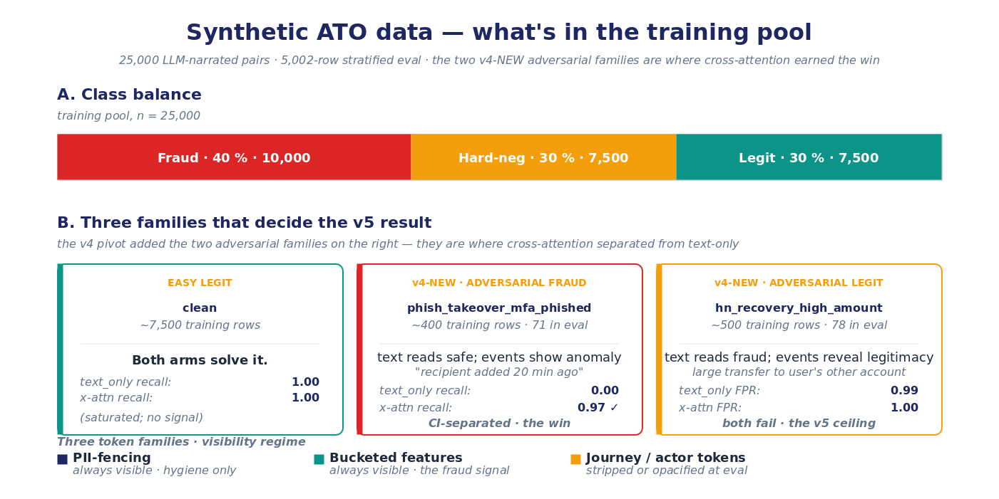
v4 result
CI-SEPARATED LIFT ON ADVERSARIAL CROSS-MODAL FRAUD
v4 result — x-attn wins where the side stream matters
Cross-Attention ATO POC · v4/v5 update · 2026-05-22
11 / 14

Slide 12
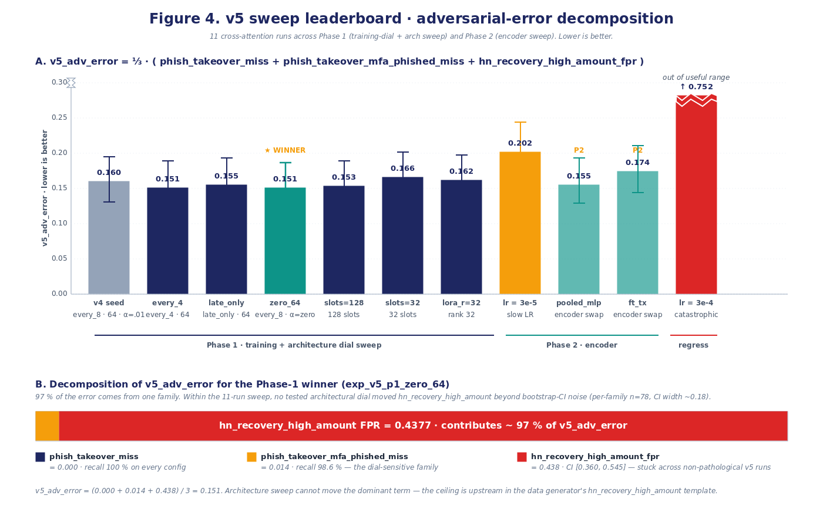
v5 sweep
11 RUNS · ARCHITECTURE EXHAUSTED · DATA NEXT
v5 — dial-robust win, one bottleneck
Cross-Attention ATO POC · v4/v5 update · 2026-05-22
12 / 14

Slide 13
Claims at a glance
BOUNDARIES OF THE EVIDENCE
What we explicitly do not claim
NOT CLAIMED
NOT CLAIMED
Production transfer
Production-fraud-system superiority
Every result is on synthetic data. The v4 win on adversarial cross-modal fraud is real architectural lift within the synthetic eval; real-traffic behavior is open. A held-out anonymized production-replay window is the next gate.
We have not benchmarked against any current PayPal ATO routing model. The numbers in this deck are intra-architectural (text_only vs xattn on the same LM); they are not comparisons to a fraud system in operation.
NOT CLAIMED
NOT CLAIMED
Non-LLM tabular baseline superiority
Calibration
No XGBoost or LightGBM model was trained on the bucketed event features. The absence does not invalidate the text_only-vs-xattn causal comparison — but it prevents any "cross-attention beats fraud baselines" claim. This is a deliberate gap in evidence.
Eval is discrimination-only (AUC, R@FPR, HN-FPR). No Expected Calibration Error, Brier score, or reliability diagram. For a production risk-scoring use case, calibration matters as much as discrimination.
These gaps are deliberate. The whitepaper's §1.2 "Claims at a glance" table marks each one. Closing them is the work on the recommendation slide.
Cross-Attention ATO POC · v4/v5 update · 2026-05-22
13 / 14

Slide 14
Recommendation
WHAT WE RECOMMEND FOR THE NEXT 1–3 MONTHS
Invest in the loop; validate cross-attn through data and replay, not blind architecture sweeps
THE STRATEGIC CALL
Cross-attention is no longer a failed architecture.
v3 was a data-confounded null. v4 was a CI-separated synthetic win. v5 exposed a data-shaped ceiling. The next dollar goes into data redesign and production replay — not more architecture dial sweeps.
NOW · IN FLIGHT
NEXT · 1-4 WEEKS
THEN · 1-2 MONTHS
Package the loop
Redesign hn_recovery_high_amount
Production replay + tabular baseline
Launcher, agent playbook, whitelist, lockfile, dedup tuple, halt conditions, bootstrap-CI eval, tie-aware metrics. Every subsequent POC inherits these for free.
Richer disambiguating event context: device-trust history, step-up-auth chain, recovery chain, out-of-band verification. Target: drop bottleneck FPR below 0.15 before any further architecture sweep.
Anonymized production-replay window. XGBoost / LightGBM on the same bucketed features. This is the test that converts the v4 synthetic win into either a production claim or a data-quality claim — both are valuable.
30 runs · three sweep generations · 1 honest negative result, traced and repaired · 1 reusable methodology asset.
Full readout: 00-executive-summary · 01-auto-research-loop-deep-dive · 02-cross-attn-poc-technical-readout · 03-integration-friction-catalog · whitepaper/v1.2
Cross-Attention ATO POC · v4/v5 update · 2026-05-22
14 / 14

