Slide 1
Next-Gen Continuous Delivery Roadmap
Executive Overview of Phases

Slide 2
Phase 1: CD Abstraction Platform
  Build abstraction layer to reduce migration efforts
  Seamless experience across tools
  Challenges: High engineering effort, platform resilience
  Resource Needs: 6–9 months, 6–8 engineers

Slide 3
Phase 2: Spinnaker Continuation + GAP/GKP Support
  Continue Spinnaker until contract end
  Add GAP/GKP deployment capabilities
  Challenges: Legacy complexity, migration workload
  Resource Needs: 12–18 months parallel team

Slide 4
Phase 3: OSS Spinnaker Exploration
  Explore OSS features with OpsMx
  Develop custom Spinnaker plugins
  Challenges: OSS gaps, support dependencies
  Resource Needs: 4–6 engineers, 6 months

Slide 5
Phase 4: Self-Maintained Spinnaker Distribution
  Fork Spinnaker codebase
  Security patching and internal image builds
  Allowed under Apache License 2.0
  Challenges: Full lifecycle mgmt, team commitment
  Resource Needs: Dedicated team + vendor support

Slide 6
Phase 5: Multi-Tool Integration via Jet Deploy
  Use Jet Deploy to integrate tools per cloud
  Flexibility to plug AWS, Azure, GCP tools
  Challenges: Connector engineering, abstraction design
  Resource Needs: Continuous investment

Slide 7
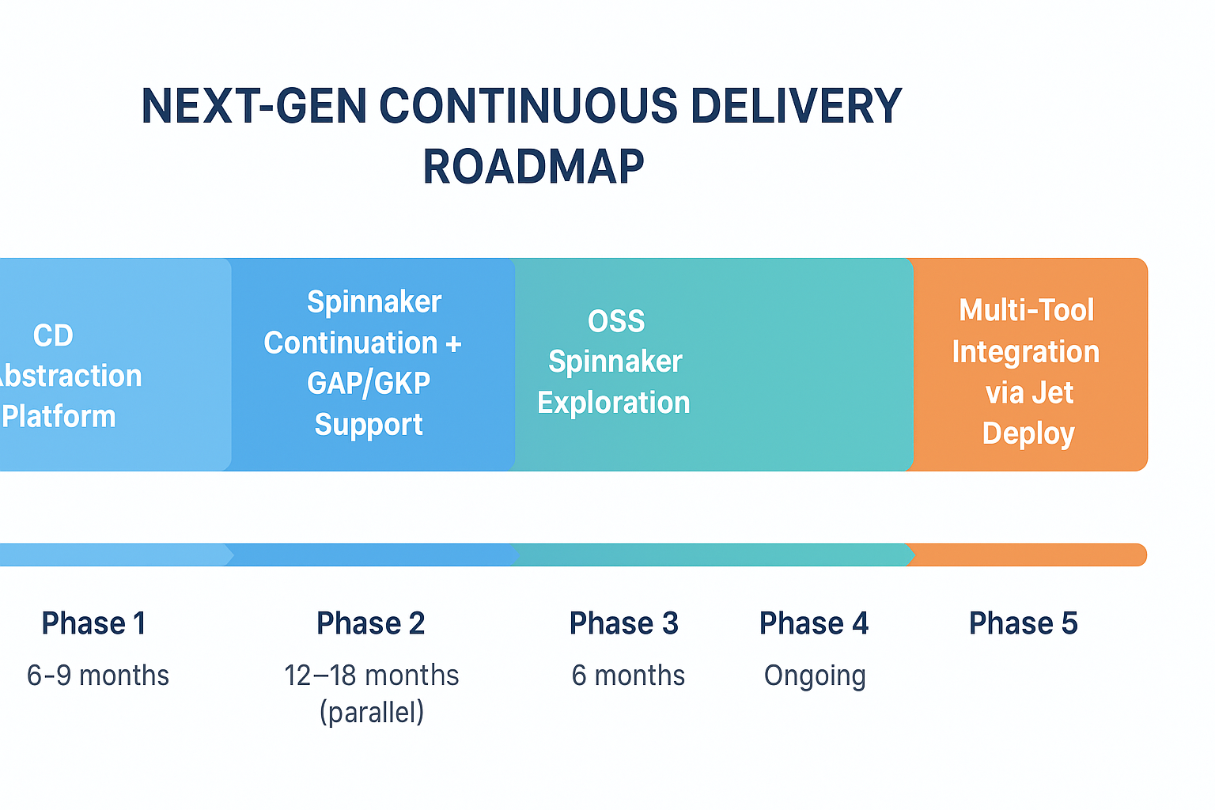
Visual Roadmap

