Slide 1
Job Searching Portal
Job Applications and Recruitment
System
Submitted by: Arun M & Vinith S

Slide 2
Overview and Objectives
The Job Searching Portal is a comprehensive CLI-based application automating job search and recruitment.
Objectives:
Enable applicants to search, apply, and track job applications.
Allow companies to manage job advertisements.
Provide admin monitoring and CRUD operations.
Ensure data persistence via JDBC and MySQL.

Slide 3
Problem Statement & Scope
Problem: Traditional job portals are complex and web-heavy.
Solution: A lightweight CLI-based system for educational and automation use.
Scope:
Modules: Login, Registration, Apply Jobs, Post Ads, Track Status, Alerts.
Limitations: Simulated emails, text-based resumes only.

Slide 4
Abstract / Technical Details
Implements Job Portal using Java, JDBC, and MySQL.
Modular OOP Design: User, Job, Application, Resume classes.
DAO Pattern for CRUD operations.
Security: Role-based access with authentication.
Features: Search, Apply, Email Alerts (simulated).

Slide 5
Benefits & Future Enhancements
Benefits:
Automation and efficiency.
Scalable and educational.
Demonstrates Java OOP and DB normalization.
Future Enhancements:
Real email integration.
Resume file uploads.
Web UI using JSP/Servlets or Spring Boot.

Slide 6
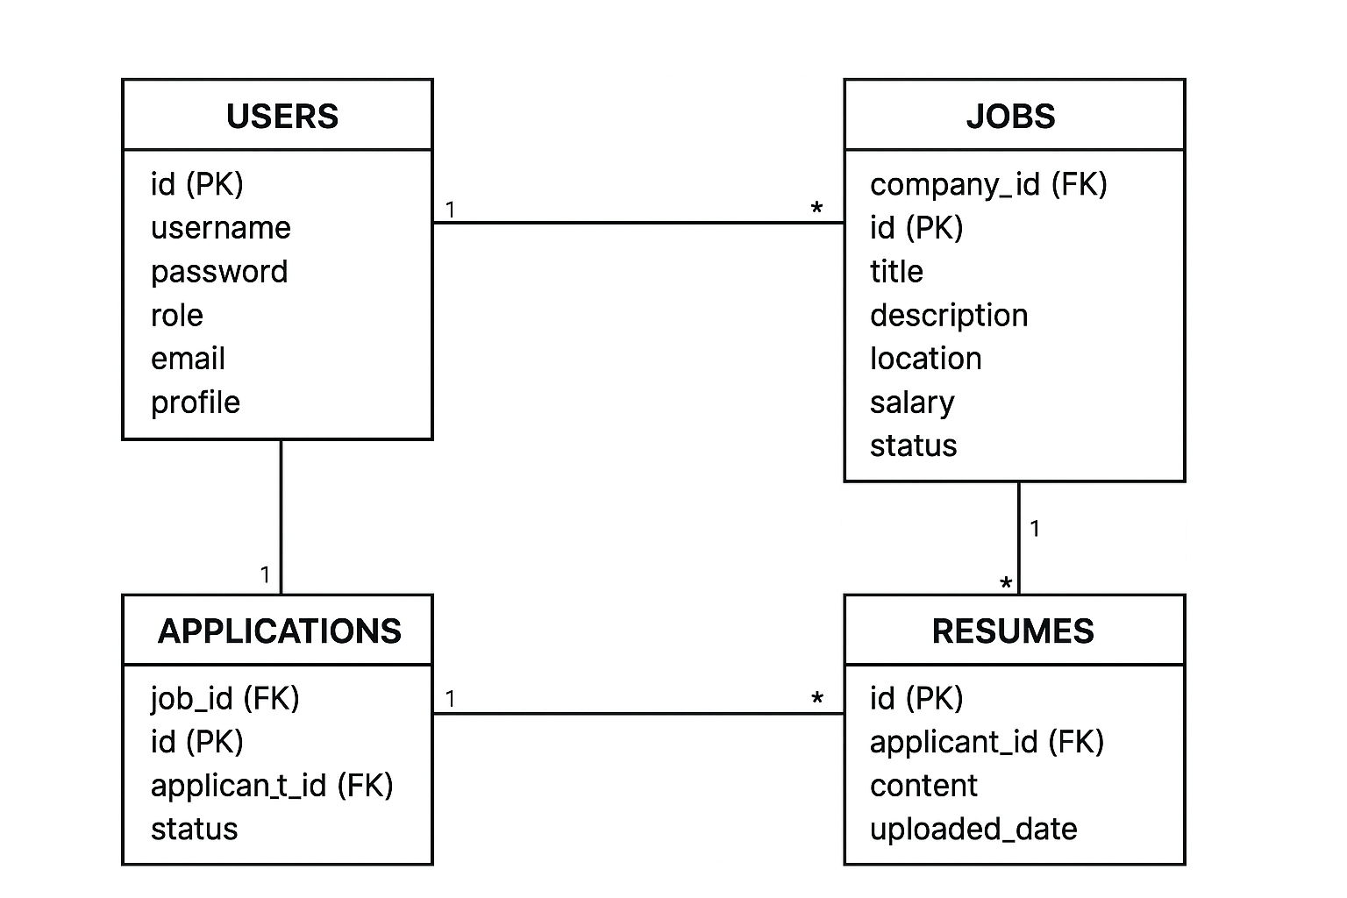
ER Diagram

Slide 7
Keywords & Conclusion
Keywords: Java, JDBC, MySQL, CLI, Job Portal, CRUD, Role-Based Access
Conclusion:
The Job Searching Portal automates recruitment operations through a role-based CLI system integrating Java and MySQL, providing efficiency, educational value, and scalability.

Slide 8


