Slide 1
Amazon product recommendation system by using apache spark
Group 8:
Arun Kumar – 122AD0043
PUNYAMURTHY VIJAY – 122AD0045
MANJUNATH REDDY – 122AD0018

Slide 2
Problem Statement
Objective:
To develop a personalized product recommendation system for Amazon users using big data tools and machine learning algorithms.
To process large-scale user-item interaction data efficiently using Apache Spark.
To implement and compare collaborative filtering techniques, specifically ALS vs. SVD, for recommending relevant products.
To enhance user experience and engagement by delivering accurate and scalable recommendations.
Challenges:
Handling sparse and high-dimensional data with millions of users and products.
Fine-tuning the ALS model parameters (like rank, regularization, and iterations) for optimal recommendations.
Dealing with the cold-start problem (new users or items with no historical data).

Slide 3
Solution Overview
Approach:
Collected and cleaned Amazon user-product rating data.
Utilized Apache Spark to handle data preprocessing and distributed processing.
Trained the recommendation engine using the ALS algorithm, tuning key parameters like rank, maxIter, and regParam.
Evaluated model performance using RMSE and compared it with traditional techniques like SVD.
Generated Top-N recommendations for users based on predicted preferences.
Outcome:
Successfully built a scalable and efficient recommendation system..
Apache Spark enabled rapid processing of massive datasets.
The ALS model outperformed SVD, especially with sparse user-item data.
Delivered personalized product suggestions, enhancing user experience.
Laid groundwork for further improvements like real-time recommendations and user feedback integration.

Slide 4
Dataset Collection & Preprocessing
Data Collection & Cleaning:
Collected user-product interaction data from the Amazon Reviews dataset.
Extracted essential fields: userId, productId, and rating.
Performed data cleaning to remove null or duplicate records.
Converted user and product IDs into numerical format for compatibility with ALS.
Split the data into training and testing sets (e.g., 80/20) for model validation.
Outcome:
Efficient preprocessing of large-scale data using Spark’s in-memory computation.
Reduced noise and redundancy, improving data quality.
Successfully transformed raw data into a machine learning-ready format.
Enabled smooth training of the ALS model, leading to more accurate product recommendations.

Slide 5
Setting Up Spark Cluster
Infrastructure:
1 Master Node
2 Slave Nodes
Steps:
Install required software.
Configure environment settings.
Launch the cluster.
Verify setup via interface.

Slide 6
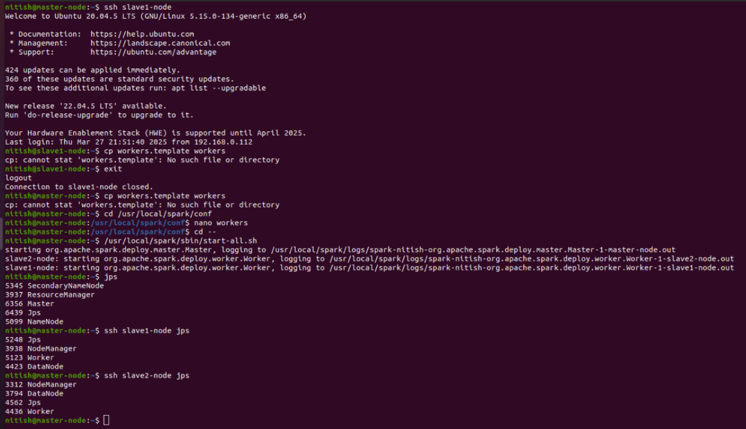

Slide 7
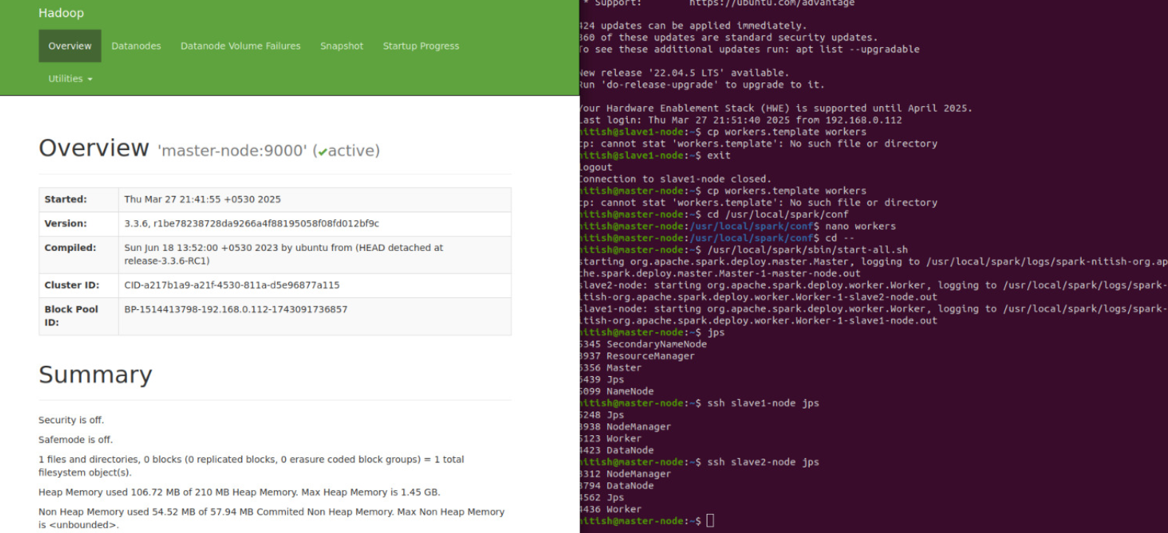

Slide 8
Integrating Jupyter Notebook
Steps:
Install Jupyter Notebook.
Set up integration with Spark.
Launch the notebook environment.
Run interactive analysis tasks.

Slide 9
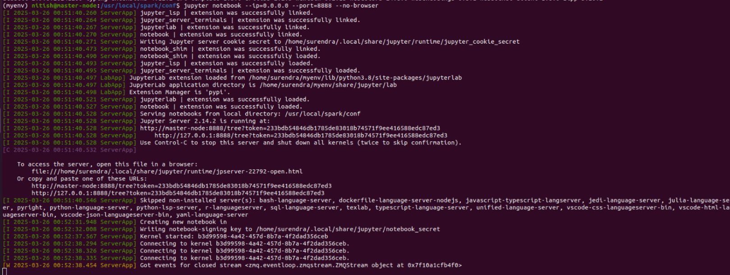

Slide 10
Initializing Spark Session
Content:
Purpose: Establish a Spark session in Google Colab using PySpark to enable distributed data processing in a cloud-based notebook environment.
Key Feature:
Allows seamless integration of Apache Spark with Colab.
Enables scalable and parallel data processing for large datasets.
Leverages cloud resources without local Spark installation.

Slide 11
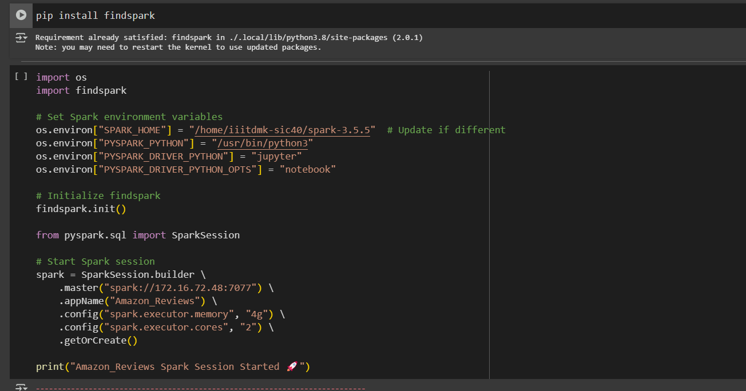
Content:
Purpose:To configure the environment variables and initialize Spark session in Google Colab using a standalone Spark cluster.
Key Feature:
Uses findspark to enable PySpark in Colab.
Sets custom SPARK_HOME and other PySpark-related variables.
Connects to Spark master node via spark:// URI.

Slide 12
Importing Required Libraries
Content:
Purpose:Load essential Python libraries for data manipulation, text processing, visualization, and machine learning tasks.
Key Feature:
Libraries include Numpy, Pandas, Matplotlib, Seaborn, NLTK, BeautifulSoup, Scikit-learn.
Supports tasks like data cleaning, feature extraction, model building, and evaluation.

Slide 13
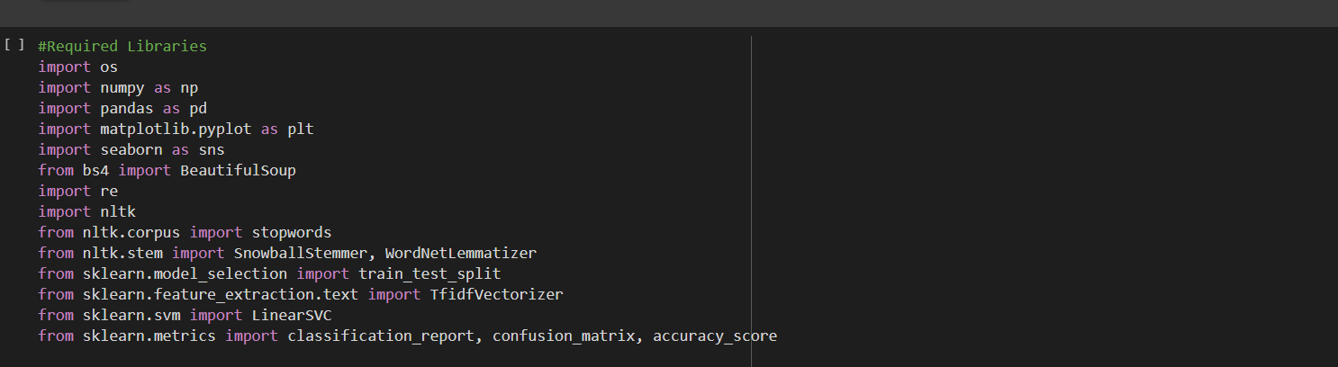
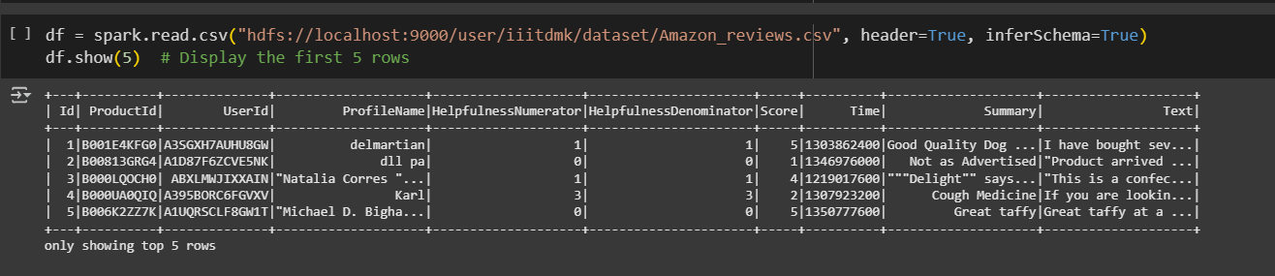

Slide 14
Installing and Downloading NLTK Resources
Content:
Purpose:Install the NLTK library and download essential linguistic datasets required for text preprocessing.s.
Key Feature:
Downloads wordnet, stopwords, and punkt.
Enables lemmatization, tokenization, and stopword removal for natural language processing tasks.

Slide 15
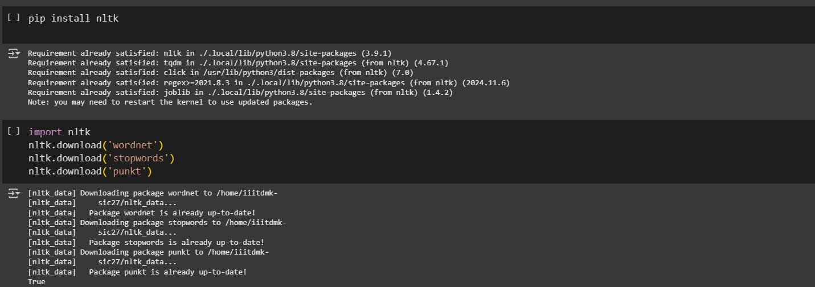

Slide 16
Initialize Spark & Load Data from HDFS
Content:
Content:
Purpose:Set up PySpark in Jupyter Notebook and load the dataset from HDFS for further processing.
Key Feature:
Configure Spark environment for Jupyter.
Create a Spark session named Amazon_Reviews.
Load CSV data from HDFS with headers and automatic schema inference.

Slide 17
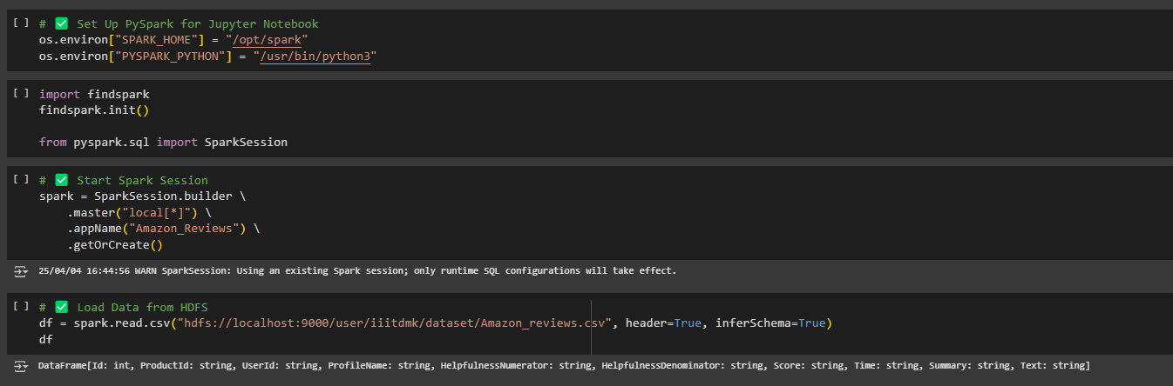

Slide 18
Convert PySpark DataFrame to Pandas
Content:
Purpose:Convert Spark DataFrame to Pandas for easier inspection and manipulation in local memory (suitable for small datasets).
Key Feature:
Check if the loaded data is a PySpark DataFrame.
Convert it to Pandas using toPandas().
Display the first few rows with df.head() to verify successful loading.

Slide 19
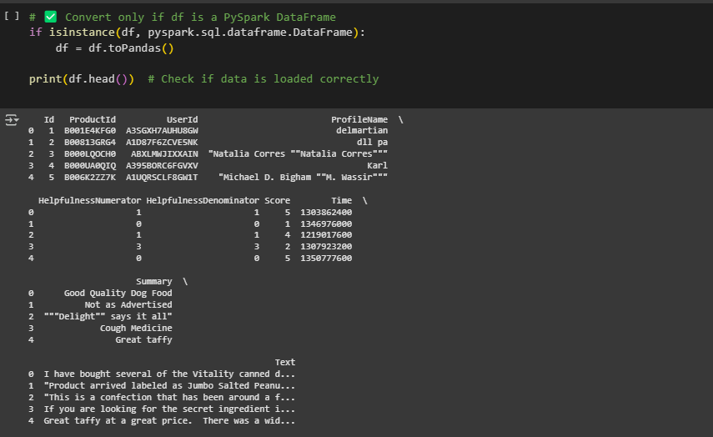
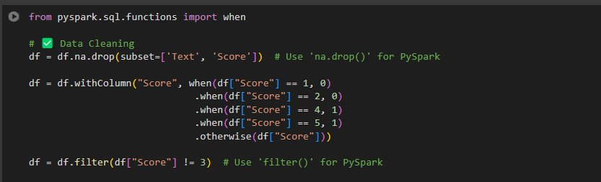

Slide 20
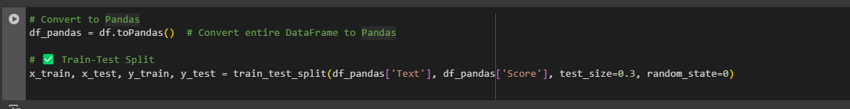
Data Conversion & Splitting for Model Training
Content:
Convert the PySpark DataFrame to Pandas format and split it into training and testing sets to prepare for model building.
Key Feature:
Converts the Spark DataFrame into a Pandas DataFrame.
train_test_split() ➤ Splits Text (features) and Score (labels) into:
70% training data.
30% testing data.

Slide 21
Text Preprocessing for NLP
Content:
Purpose:Cleans and standardizes text data for Natural Language Processing by removing noise and reducing words to their base forms.
Key Feature:
HTML Handling: Extracts text from HTML content.
Normalization: Converts text to lowercase and removes non-alphabetic characters.
Stop Word Removal: Eliminates common, less informative words.
Word Reduction: Applies both stemming and lemmatization to get root forms.

Slide 22
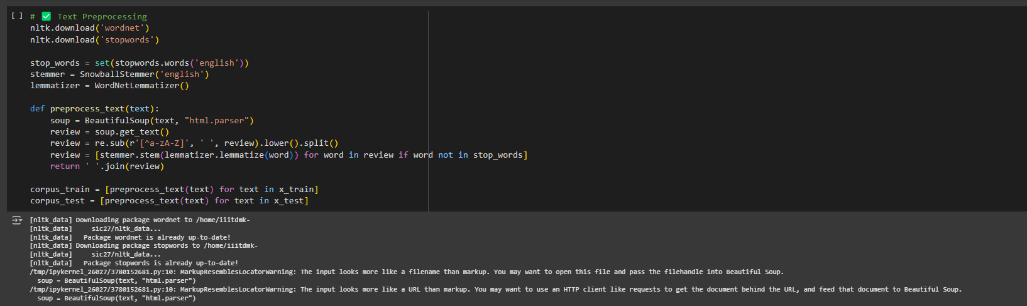

Slide 23
Text Feature Extraction using TF-IDF
Content:
Purpose:To convert text data into numerical vectors for machine learning by evaluating the importance of words (and n-grams) within a collection of documents..
Key Feature:
Handles Missing Data: Fills missing text values to ensure proper processing.
Splits Data: Divides the dataset into training and testing sets for model development and evaluation.
Applies TF-IDF: Transforms text into numerical vectors, weighting terms based on their frequency in a document and the entire corpus.
N-gram Support: Considers single words, pairs, and triplets of words as features.
Limits Vocabulary: Restricts the number of features to the top 5000 most frequent n-grams.
Consistent Transformation: Fits the vectorizer on training data and applies the same transformation to both training and testing sets.

Slide 24
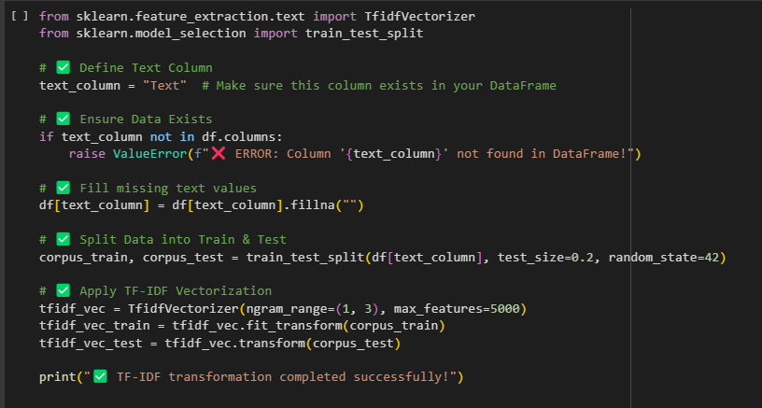

Slide 25
Logistic Regression Model Training and Evaluation
Content:
Purpose:To train a Logistic Regression model on the TF-IDF transformed training data and evaluate its performance on the test data for text classification.
Key Feature:
Logistic Regression: Utilizes a linear model suitable for binary or multi-class classification tasks, noted for handling sparse data well.
Model Training: Fits the Logistic Regression model to the TF-IDF features of the training data and their corresponding labels.
Prediction: Uses the trained model to generate predictions on the TF-IDF features of the unseen test data.
Accuracy Evaluation: Calculates the accuracy score by comparing the model's predictions to the actual labels in the test set.

Slide 26
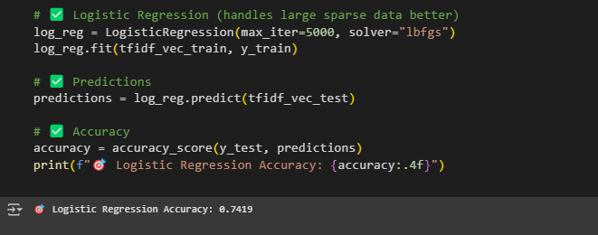

Slide 27
Working
Execution Flow:
Load dataset from storage.
Preprocess tweet content.
Extract key features.
Train and evaluate the model.
Identify disaster-related tweets.
Visualize key insights.

Slide 28
References
Apache Spark Documentation
Machine Learning with PySpark
Natural Language Processing with Python
Project Paper: Amazon Product Recommendation Using Apache Spark.
IEEE

