Slide 1


Bhagwan Mahavir College of Computer Application
TWO FACTOR AUTHENTICATION
Guided by Mr. Ravi J. Patel
Presented by Mr. Arun S. Bharti

Slide 2
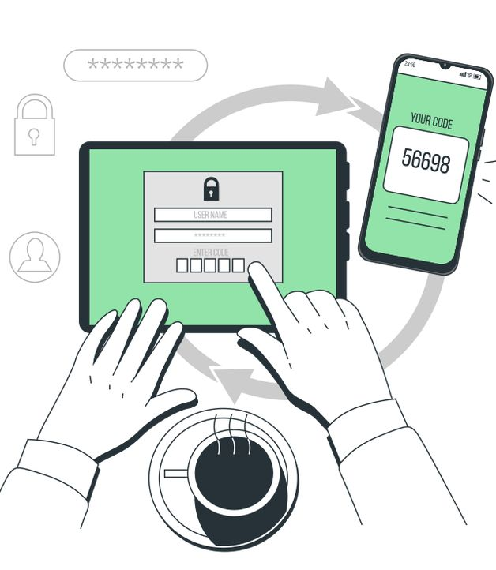
Table of contents -
SR | Headings
1 | Introduction to Two Factor Authentication
2 | Types of Two Factor Authentication
3 | Step-by-Step 2FA Login Flow
4 | Benefits of Two Factor Authentication
5 | Challenges and limitations
6 | Future of Two Factor Authentication
7 | Conclusion

Slide 3
What is Two Factor AUTHENTICATION (2FA)?
01. Introduction to Two Factor AUTHENTICATION
Two-factor authentication adds an extra layer of security. It requires two forms of verification. This protects accounts from unauthorized access.

Slide 4

Two Factor authentication Stands for :
Something you know - the password or pin for an account.
Something you have - a physical device such as a mobile phone or a software application that can generate one-time passwords.
Something you are - a biologically unique feature to you such as your fingerprints, voice or retinas.

Slide 5
Types of Two Factor Authentication
02. Types of Two Factor AUTHENTICATION
Knowledge-Based
Possession-Based
Inherence-Based
Location-Based
Time-Based
QR code-Based
Smartcards
Push notification
Passwordless Authentication

Slide 6
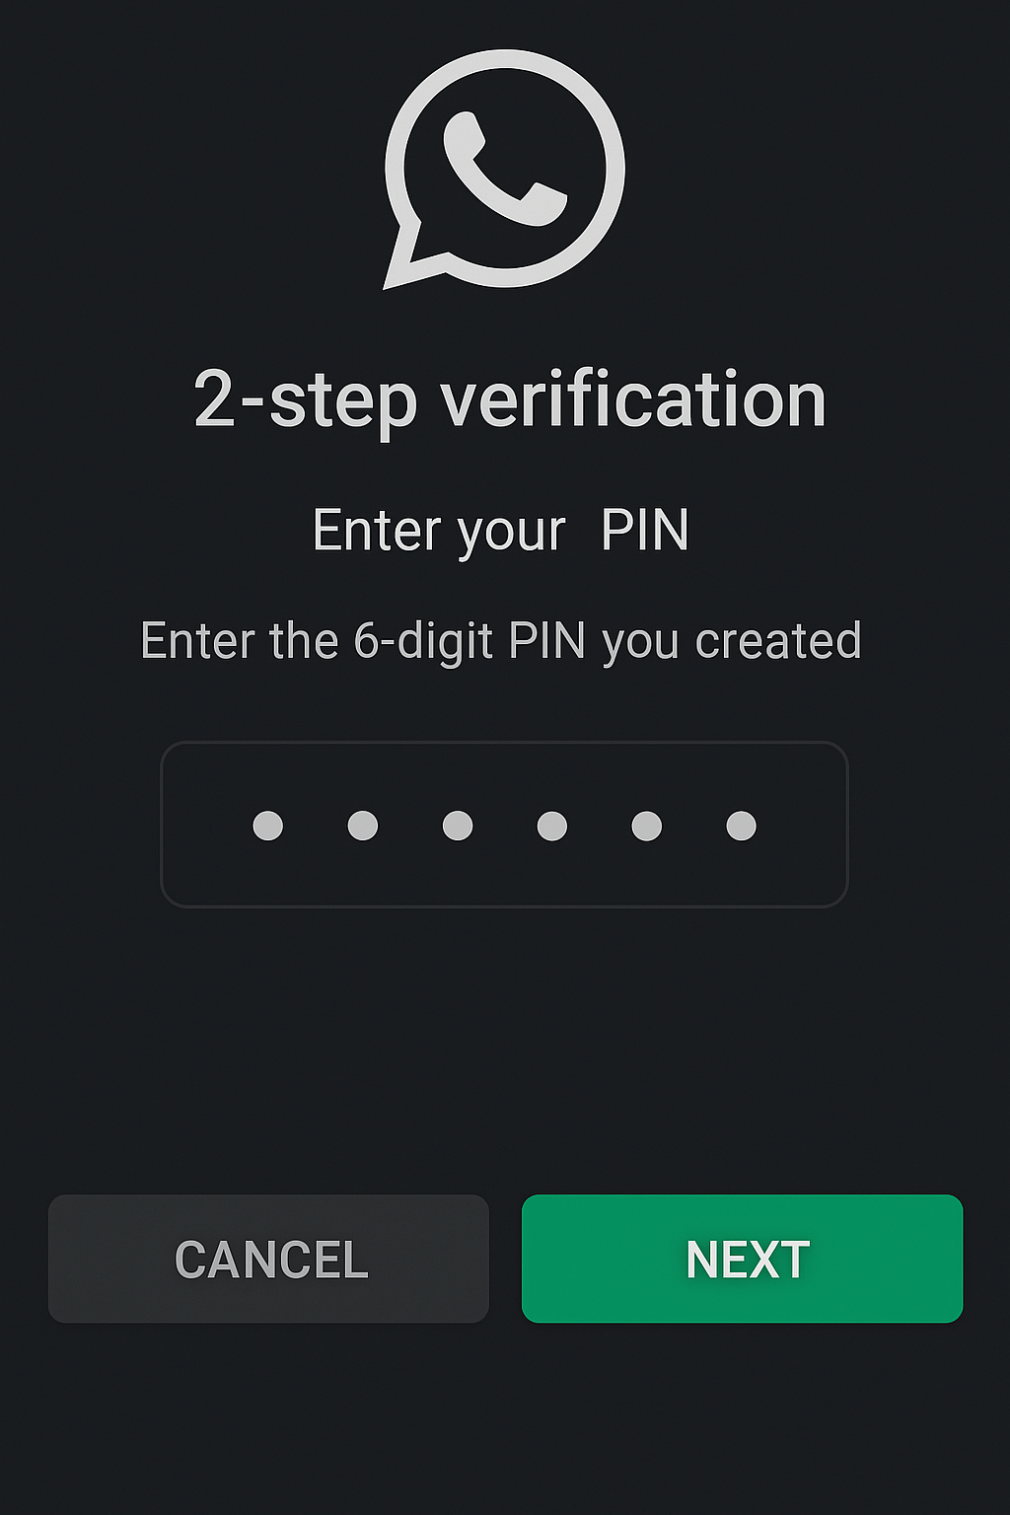
Knowledge-based factors
Passwords and pins: A secret string or number known only to the user.
Security Questions: Answers to pre-set personal questions.

Slide 7
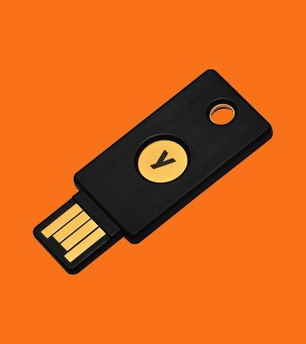
Possession-based factors
Hardware Tokens: Physical devices generating one-time passcodes (e.g., YubiKey, RSA SecurID).
Software Tokens: Apps like Google Authenticator or Authy generating time-based OTPs.
SMS or Email Codes: One-time codes sent via text or email.

Slide 8

Inherence-based factors
Biometric Authentication: Fingerprint, face recognition, iris scans, or voice recognition.
Behavioral Biometrics: Typing patterns or mouse movement analysis.

Slide 9
Location-Based factors
Geolocation: Verifying the user’s location using GPS or IP address.
IP Address: Matching login attempts to known or trusted IPs.

Slide 10
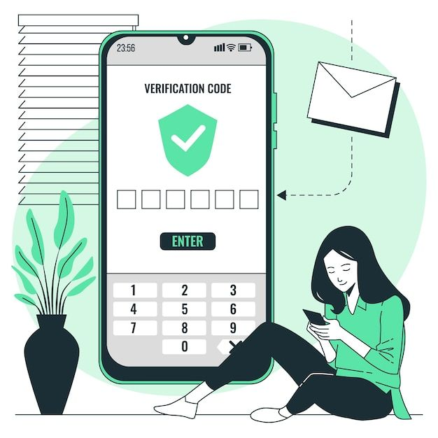
Time-based factors
Time-Limited OTPs: Codes that expire after a specific duration, enhancing security.

Slide 11
Smartcards
Physical cards embedded with a chip.
Used in corporate environments to provide access to systems or facilities.

Slide 12
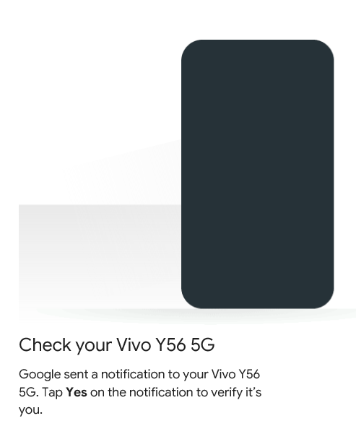
PUSH NOTIFICATION FACTOR
Login Approval: Notifications sent to a device for the user to approve or deny access.

Slide 13
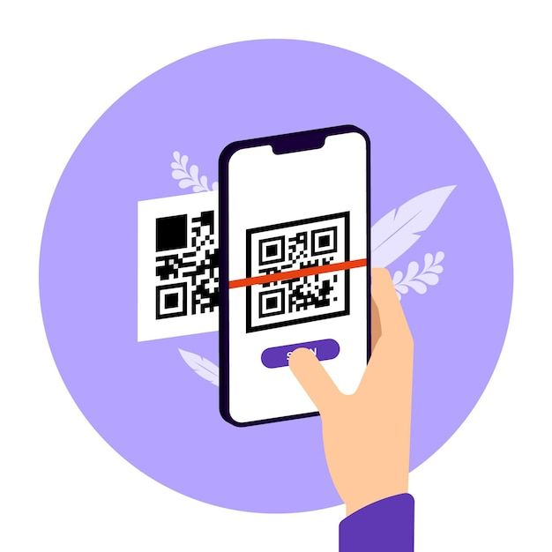
QR CODE-BASED FACTORS
Scanned Codes: QR codes scanned via an authentication app to verify identity

Slide 14
PASSWORDLESS AUTHENTICATION
Magic Links: One-time links sent to an email for direct login.
Single Sign-On (SSO): Unified login across services through trusted providers.

Slide 15
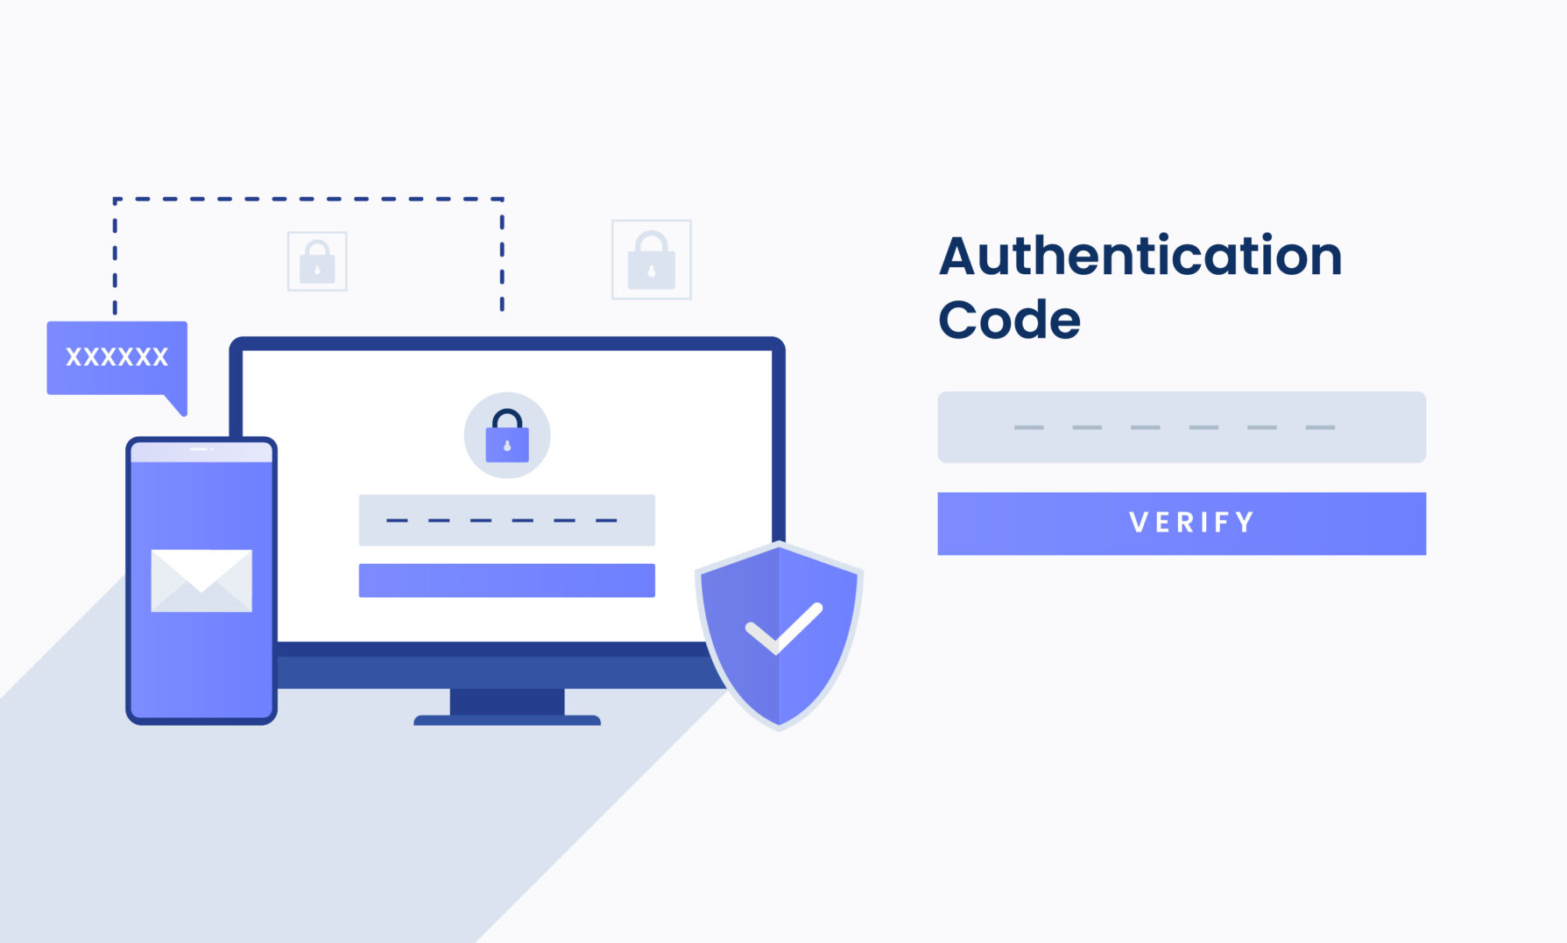
03. Step-by-step 2fa login flow
Steps of 2fa login flow :

Slide 16
Step 1) Enter Username and Password – User inputs credentials.
Step 2) Prompt for Second Factor – System requests second factor (OTP, app prompt etc.)
Step 3) Perform Second Factor – User opens app and enter code or approves push notification.
Step 4) Access Granted – User authenticated and Logged in successfully.

Slide 17
Benefits of 2fa :
04. Benefits of Two Factor AUTHENTICATION
Enhanced Security - Two-Factor Authentication (2FA) adds an additional layer of protection by requiring two independent factors for account access, reducing the risk of unauthorized access.​
Protection Against Cyberattacks – It effectively prevents common attack such as phishing, brute. Force, credential stuffing, and keylogging by requiring a second form of verification beyond passwords.

Slide 18

Mitigates Weak Password Risks - 2FA compensates for weak, stolen, or reused passwords, as the second factor ensures security even if the password is compromised.
User Trust and Compliance - Boosts user confidence in the system security and helps meet regulatory requirements.

Slide 19
Challenges & Limitations :
05. Challenges and limitations
Usability Issues: Users may find 2FA inconvenient or confusing, and losing access to the second factor (e.g., phone or token) can lock them out of their accounts.
Vulnerabilities in SMS-Based 2FA: SMS-based 2FA is prone to SIM swapping, phishing, and interception attacks, reducing its reliability.

Slide 20

Account Recovery Challenges: Recovering accounts without access to the second factor can be difficult and time-consuming for both users and support teams.
Cost and Integration Complexity: Implementing and maintaining 2FA (e.g., SMS costs or hardware tokens) can be expensive and challenging for some organizations.

Slide 21
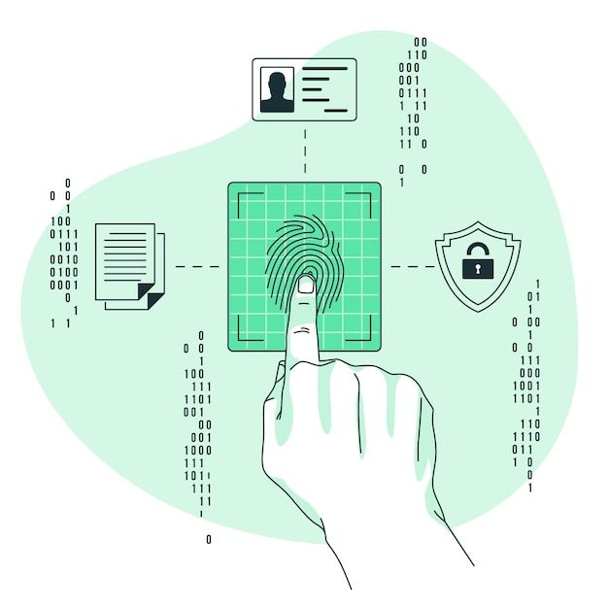
FUture of 2fa
06. Future of 2fa
The future of 2FA lies in passwordless authentication, with advancements in biometrics, hardware security keys, and AI-driven risk-based authentication for enhanced security.

Slide 22
Shift to Passwordless Authentication - Traditional 2FA relies on passwords combined with another factor (e.g., SMS codes or apps). However, the future is leaning towards password-less methods where biometrics, hardware tokens, or one-time codes are used as the primary method of authentication.​
Biometric Authentication - Fingerprints, facial recognition, and voice authentication are becoming more common as the second factor.
Context-aware Authentication - 2FA systems will become smarter by using contextual data (e.g., device location, usage patterns, or IP address) to decide when to challenge a user with additional authentication factors.

Slide 23
SMS-Based 2FA Decline - SMS-based 2FA is vulnerable to SIM swapping and phishing attacks, and its use is declining. ​ ​
Integration with AI and Machine Learning - AI-powered 2FA can analyze user behavior in real-time to detect anomalies and trigger additional verification only when necessary.​ ​
Focus on User Experience - In future 2FA includes single-tap approvals, seamless biometrics, and invisible risk-based authentication processes. ​
Mandatory 2FA for Critical Services - Governments and organizations are increasingly mandating 2FA for accessing critical services, financial accounts, and sensitive platforms.

Slide 24

Thank you
07. Conclusion
Two-factor authentication (2FA) adds an extra layer of security to keep accounts safe. New methods like biometrics and passwordless options make it easier and more secure to use. Using 2FA is an important step to protect yourself online.
ARUN BHARTI
ENR NO – 2202020101060
abarunnn@gmail.com

