Slide 1
GO-TO-MARKET FINAL PROJECT
Roamly Groups
Launching group booking: one link, everyone in, everyone pays their own share.
Arun · Senior Product Manager, Roamly · September 30, 2026
Notes:
Title. Roamly is a marketplace of curated local experiences: 12,000+ vetted hosts, 40 cities, repeat booking at 3x the industry average. Leadership has decided to launch Roamly Groups. The question I answer: who is it for, how do we bring it to market, and how do we avoid disrupting what already works.

Slide 2
01 · GTM STRATEGY
Win the organizer first, with a product-led loop
WHO
MOTION
V1 THESIS
Friend-group and celebration organizers (5–12 people), already Roamly users.
Why first: users already force group bookings through the product, the product is ready, and every organizer brings in invitees.
Deferred: corporate offsites, families, wedding parties.
Product-led (PLG)
For trip organizers who end up chasing friends for replies and money, Roamly Groups lets one person book, split and plan a whole party from a single link. Unlike a group chat, a payments app and a spreadsheet, it collects each share up front.
Time to value: minutes
Buyer and user: same person
Contract value: low to mid
Sales cycle: self-serve
Scales via: product virality
Goal: Expand existing users; Acquire through invitees. Launch tier 2.
54%
of U.S. adults took a group trip in the last five years [S1]
45%
of group travelers report financial conflict or discomfort [S1]
3x
industry-average repeat booking on Roamly [Brief]
North-star: fully paid group bookings per month. Riskiest assumption: invitees join from a link and pay fast (tested in the closed beta).
Sources: [S1] CIT Bank / Harris Poll, May 2026 (n = 2,067); [Brief] project brief.
2
Notes:
GTM strategy. I ran the Discover Framework: demand is visible in behavior (users forcing group bookings, high drop-off). Of five candidate segments I chose friend-group and celebration organizers because the product is ready for them and they fit a product-led motion: four of five inputs point to PLG. Corporate offsites would be sales-led and the product likely is not ready, so I deferred them. Tier 2 launch. North-star is fully paid group bookings. Riskiest assumption: invitees will join from a link and pay fast. Sources: S1 CIT Bank / Harris Poll, May 2026, n=2,067. Roamly baselines were not provided; targets are proposals.

Slide 3
02 · COMPETITIVE INTEL AND STRATEGIC BET
The real competitor is the group chat
Competitor | They win on | Their weakness for this ICP
DIY stack (primary) | Free, familiar, no sign-up | Books nothing; organizer fronts and chases
Viator / GetYourGuide | Catalog, free cancellation | Fixed-departure tours; no split payment described
Planning and payment apps | Each does one slice well | None combines booking, payment and plan
Airbnb Experiences | Brand and scale | Private groups depend on host opt-in; no payment split described
THE STRATEGIC BET
We are betting that Roamly Groups wins by making the organizer’s job disappear, because the organizer’s burden is the problem every alternative leaves in place, and invitees create a product-led loop.
Not doing: corporate features, paid acquisition, changes to individual booking
90-day proof (proposed): 70%+ of invitees pay within 72 hours; 2+ new accounts per group; individual booking conversion within ±2%.
Why they win: for close friends, “I’ll just Venmo you” costs nothing. Invitees must trust a platform they may not know.
Sources: [S2] findingtheuniverse.com; [S3] Airbnb Help Center; [S4] weplanify.com; [S5] squadtrip.com (vendor-published). Competitor flows assessed from public pages, not hands-on tests.
3
Notes:
Per Module 2, my primary competitor is the status quo, because over half of sales processes end in no decision and the group chat plus Venmo plus spreadsheet is what organizers use today. Named competitors each solve a slice: tour sites sell fixed group tours, Airbnb private groups depend on host opt-in and show no payment split, planning and payment apps are single purpose. Be honest about why they win: for close friends, I'll just Venmo you costs nothing. Data to insight to belief to bet: the pain is the organizer's burden, not booking logistics. The sacrifice: no corporate features, no paid acquisition, no changes to individual booking. Competitor facts come from public pages, not hands-on tests; S5 is vendor-published.

Slide 4
03 · POSITIONING
One link. Everyone pays their own share.
For the friend who ends up organizing everyone’s group trip, Roamly Groups is the group booking tool for curated local experiences that gets everyone in and paid with a single link. Unlike a group chat, a payments app and a spreadsheet stitched together, it handles booking, payment and the shared plan in one place, with vetted local hosts.
FOR
WHO NEEDS
WE OFFER
The friend who organizes the group trip (5–12 people)
Everyone booked and paid without fronting money or chasing replies
Group booking for curated local experiences
BECAUSE OF
DESPITE
BETTER THAN
One link; each person pays their own share
New to groups, no track record yet; invitees must trust Roamly
DIY stack and tour sites: booking, payment and plan in one flow
Pressure tests (desk review): Ownable — partial; Believable — conditional until beta; Relevant — pass; Durable — pass, watch for drift.
Proof: 12,000+ vetted hosts, 40 cities, 3x repeat booking [Brief]; 45% of group travelers report money friction [S1].
4
Notes:
Positioning follows the six-component framework starting with the target audience. Category play: reframe. Tour marketplaces compete on catalog and price; I change what matters to how much work the organizer carries. The Despite line is deliberately honest: Groups is new, has no track record, and invitees must trust a platform they may not know. Core product truth: among the alternatives I reviewed, none combines a booking marketplace, split payment and shared itinerary; verify hands-on before launch. Pressure tests were a desk review; the real five-customer test happens in the beta. Ownability is the weak spot: 'one link, everyone pays' is copyable, so the ownable part is the combination plus vetted local hosts.

Slide 5
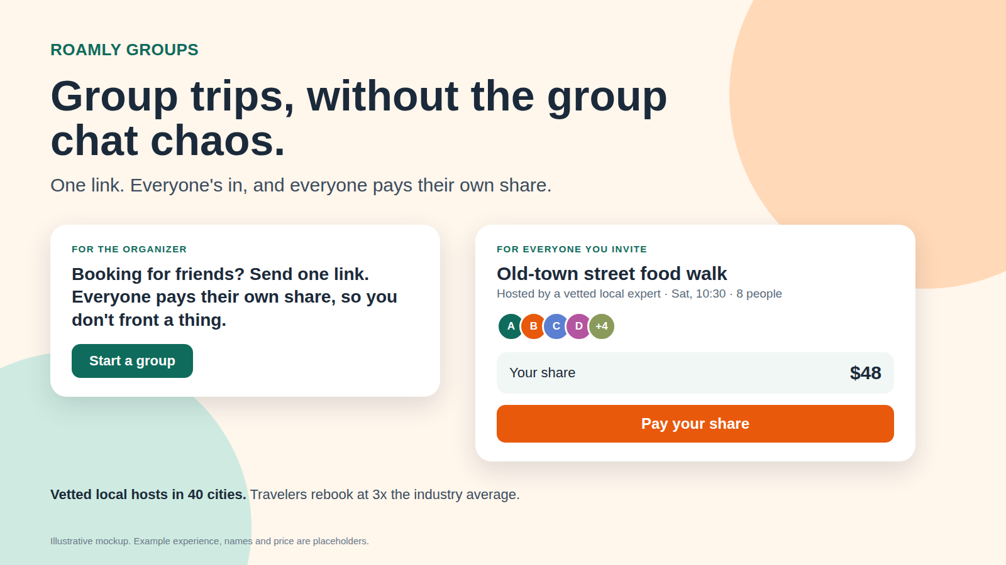
04 · MESSAGING
Two people, two promises
FROM: one person becomes the unpaid travel agent, chasing replies and fronting the money.
TO: one link; everyone sees the plan and their share, and pays it.
The Organizer
The Invitee
VALUE
Plan the trip, not the paperwork. You never front the money or chase anyone.
CAPABILITIES
One group booking, split payments by share, shared itinerary, vetted hosts
EVIDENCE
12,000+ hosts, 40 cities, 3x repeat [Brief]; 45% report money friction [S1]
VALUE
Join in seconds, see exactly what you pay for, pay only your share.
CAPABILITIES
See plan and your share first; pay your share; reminders
EVIDENCE
Vetted hosts [Brief]; 41% felt pressured into trips [S1]. Beta slots to fill.
Launch visual (illustrative mockup): homepage hero, organizer prompt, invitee payment screen.
HOMEPAGE
Group trips, without the group chat chaos.
IN-APP (ORGANIZER)
Booking for friends? Send one link. You don’t front a thing.
Sources: [S1] CIT Bank / Harris Poll; [Brief]. Blind read with a real peer is still to do.
5
Notes:
Two audiences need their own pillar: the organizer decides and fronts the money; the invitee pays but did not choose and may be new to Roamly. Hosts are an enablement audience in the launch plan rather than an external pillar. Pillars run value first, capabilities second, evidence last. Market evidence is sourced (S1); Groups-specific proof slots are left empty until the beta, with no invented performance claims. The visual asset is an illustrative mockup with placeholder price and experience. A human blind read is still to be done. Invite email subject line: '[Name] invited you to [experience]. Your share is $[amount].'

Slide 6
05 · PRICING RECOMMENDATION
Free to organize, priced to protect the loop
Group Basics
Group Plus ★
Group Concierge
Up to ~6 people
Up to ~15 people
16+ people
Free to the organizer; no group fee
Small all-in per-person fee (test 0%, 3%, 5%)
Waitlist / custom quote
Invite link, split payments, shared itinerary
Basics + deadlines and reminders, polls, spot hold, multi-experience plans
Host coordination for private groups; sizes corporate demand, nothing built
Model: transaction-based hybrid. Goal: prove group booking is a repeatable behavior and seed the invite loop. Prices are hypotheses (no willingness-to-pay data yet).
Validate first: who bears the fee. Van Westendorp for the range, Max-Diff for tier contents; beta fee cells compared on the invitee payment rate.
Cost check: splitting $480 into eight payments costs ~$2.10 more to process (about 0.4% of the basket) at a 2.9% + $0.30 benchmark [S5].
Benchmarks: SquadTrip 6% traveler-paid fee; WeTravel 2.5% [S5, vendor-published]; Viator keeps ~20% of gross [S2].
6
Notes:
Pricing goal: enter a new market, not maximize revenue, because the bet depends on a product-led loop and friction in price, especially on the invitee side, works against it. Model: transaction-based hybrid, because value is event-driven and the organizer, our loop starter, should pay nothing to organize. Packaging by group size and features in a Good-Better-Best ladder; Plus is the Goldilocks middle. Concierge is a waitlist to measure larger and corporate demand without building enterprise features. All fee levels are hypotheses; we have no willingness-to-pay data and no commission data. Biggest open question: who bears the fee. Research: Van Westendorp for the range, Max-Diff for tier contents, recruited against the ICP. Cost check uses the 2.9% + $0.30 benchmark as a stand-in for Roamly's real rates.

Slide 7
06 · INDIVIDUAL INSIGHTS
What building this taught me
Biggest aha
What changed
Friction and next time
The biggest competitor wasn’t a company. It was the group chat, Venmo and spreadsheet people already use. Reframing the job from “book for many” to “make one person’s burden disappear” changed the segment, the bet and the pricing.
Positioning, messaging and pricing are one argument, not three steps. A fee that adds friction for invitees would have broken the loop the motion depends on.
No Roamly data beyond the brief, so every claim is sourced or labeled an assumption. Next: pull the real baseline, test the invitee flow with organizers, and run a true blind read.
Monday: write down the one assumption that would break the strategy, and the cheapest way to test it.
7
Notes:
DRAFT insights, written from the working process; edit these to match your own experience before presenting. Friction points: no Roamly data beyond the brief; choosing friend-groups over corporate offsites; vendor-published sources flagged as indicative.

Slide 8
THE GTM BET
Make the organizer’s job disappear.
Roamly Groups: one link, everyone in, everyone pays their own share.
Thank you
Notes:
Close on the one-line bet. The six pieces form one argument: organizer burden defines the segment, the segment defines the motion, the competitor insight defines the bet, and the bet shapes positioning, messaging, price and launch. Appendix follows with the launch plan, metrics and open assumptions.

Slide 9
APPENDIX · LAUNCH PLAN
Prove the loop in beta, then go wide
Pre-launch
Closed beta
Launch
Post-launch
W-8 to W-5
W-4 to W-1
W0 (Tue–Thu)
W+1 to W+12
Leadership signs off on metrics and tripwires
Week-0 baseline; unpaid-share policy
Commission pricing research
Enablement briefs; lock positioning
High-value organizers only
Test invitee flows and fee cells
Owned channels only
Collect named testimonials
In-app prompt and launch email
Landing page; host announcement
48-hour support watch
Light earned push
“Plan the next one” lifecycle prompt
Case studies; set Plus price
30/60/90-day reviews
Decide on paid and next segment
Enable in order: Leadership → Support → CS → Host Partnerships → Marketing last. Dates are relative to launch (W0).
Owners: Product, Analytics, Finance, Support, CS, Host Partnerships, Marketing.
9
Notes:
Launch is not release: the product is ready, but the launch waits for beta evidence. Closed beta first, owned channels only, to test the riskiest assumption. Enablement order for a product-led launch: Leadership, Support, Customer Success, Host Partnerships, then Marketing last, once positioning is locked. Dates are relative to launch day because no calendar was given; a post-holiday window is an assumption to check against Roamly's seasonality.

Slide 10
APPENDIX · METRICS AND GUARDRAILS
Success metrics and tripwires
SUCCESS LOOKS LIKE
TRIPWIRES: WHEN TO PULL BACK
North-star: fully paid group bookings per month
70%+ of invitees pay within 72 hours (proposed)
2+ new-to-Roamly accounts per group (proposed)
Group-session completion closes half the gap to individual
Individual booking conversion within ±2% of holdout
Individual conversion down more than 3% for two weeks: pause exposure
Under 40% of invitees pay in 72 hours by beta week 3: stop and fix the flow
Refunds, chargebacks or host cancellations above 2x baseline: pause fees
A fee cell that lowers the invitee payment rate: remove it
All thresholds are proposals to re-set against the week-0 baseline.
10
Notes:
Every metric points to a decision: acquisition by channel tests channel choice; activation tests messaging and onboarding; conversion by fee cell tests pricing; repeat groups and displacement of the DIY stack test positioning; support tickets test enablement. Thresholds are proposals until the week-0 baseline is pulled.

Slide 11
APPENDIX · ASSUMPTIONS AND RISKS
What we still need to validate
Invitees join and pay fast
Who bears the fee
Unpaid-share policy
Closed beta: pay-first vs account-first flows
Beta fee cells; Van Westendorp; Max-Diff
Decide with Product, Finance, Host Partnerships before beta
Host capacity for parties of ~12
Competitor claims
Roamly baselines and commission
Host Partnerships confirms per experience type
Try Viator, GetYourGuide and Airbnb group flows hands-on
Analytics and Finance pull data in week 0
No internal Roamly data was provided beyond the brief; external facts are cited and Roamly-specific numbers are labeled assumptions.
11
Notes:
Full assumption register is in Deliverable 1 (A1 to A9).

