Slide 1




JP Morgan: A Leading Financial Institution
Explore the profile of JP Morgan, a renowned global financial services firm. Discover the company's general information, financial performance, locations, employee benefits, and more. Gain insights into its earnings, revenue, debt, and employee count.
by Manoj Kumar

Slide 2
Company Overview
About JP Morgan
Core Values
Industry Leadership
JP Morgan is a multinational investment bank and financial services company headquartered in New York City. With a rich history spanning over 200 years, JP Morgan is known for its strong commitment to client relationships and innovative financial solutions.
JP Morgan operates on a foundation of integrity, trust, and excellence. The company embraces a client-centric approach, striving to deliver outstanding value and support to its diverse clientele across the globe.
JP Morgan has established itself as a leader in the financial services industry, offering a comprehensive suite of services including investment banking, asset management, and private banking. The company's expertise and global reach enable it to deliver exceptional results for clients.

Slide 3
Financial Performance
Earnings
JP Morgan has consistently achieved impressive earnings, bolstered by its diversified business model and strong risk management practices.
Revenue
With a strong performance across various business lines, JP Morgan continues to generate substantial revenue, solidifying its position as a top financial institution.
Debt
JP Morgan manages its debt prudently, maintaining a strong balance sheet and capital position, ensuring stability even in challenging market conditions.

Slide 4


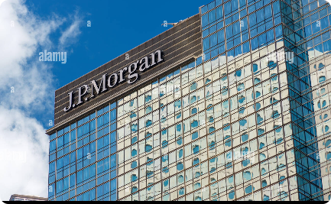
Locations
New York City
London
Hong Kong
Located in the heart of Manhattan, New York City, JP Morgan's headquarters serves as a hub for its global operations, reflecting the dynamism and energy of the financial capital of the world.
With a prominent presence in the City of London, JP Morgan's UK office plays a vital role in serving its European clients and driving innovation in the global financial landscape.
Located in one of Asia's leading financial centers, JP Morgan's Hong Kong office is well-positioned to meet the evolving needs of its clients across the Asia-Pacific region.

Slide 5

Employee Benefits
1
Competitive Compensation
2
Comprehensive Healthcare
JP Morgan offers a competitive compensation package that recognizes and rewards employees' contributions and exceptional performance.
Employees enjoy access to comprehensive healthcare benefits, ensuring their well-being is prioritized both in and out of the workplace.
3
Professional Development
JP Morgan is committed to fostering the growth and development of its employees, offering a range of training and development programs to enhance their skills and knowledge.

Slide 6

Employee Count
With a global workforce of talented professionals, JP Morgan takes pride in its diverse and inclusive culture. The company boasts a strong team comprising thousands of dedicated individuals who contribute to its success across various locations worldwide.

