Slide 1


CERTIFIED
AGENTIC AI
ENGINEER
Project Title: RAG-based Unified Career and Research Assistant for Resume–Job Matching and Uploaded-Paper Queries
Participant(s): arunnatarajan01-dev
Organisation: REVA University
Submission Date: 1 October 2026

Slide 2
01. Problem & Context
07. Testing and Validation
02. Current Process and Pain Points
08. Analysis and Results
Agenda
03. Project Objectives
09. Business Impact
04. Agentic workflow, System Architecture
10. Conclusion and Future Scope
05. Data, tools, and technology stack
11. References
06. Implementation and Demo

Slide 3
Problem Statement and Context
Why career screening, job search, and research sit in too many places
A resume is read by hand for ATS fit, missing skills, and a learning plan.
LinkedIn and Naukri are searched as two separate tasks, then copied into a sheet.
A question about a paper, and an IEEE-style draft, sit outside that career flow.
Approve, reject, and edit are not mailed to both the requester and the approver.
A blocked prompt, and the steps behind a result, are hard to show to a reviewer.

Slide 4
Project Objectives
Four outcomes this build delivers
Score a resume and return skills, role matches, gaps, a roadmap, and interview practice.
Search LinkedIn and Naukri by city and posting date, and download that table as Excel.
Answer from an uploaded paper, and draft an IEEE paper from a public repository for review.
Keep approve, reject, and edit with a named person, email both parties, and log every step.

Slide 5
Current Vs Proposed Approach
Same work, with the checks and the record added
Current process
Resume fit, gaps, and a study plan are assembled by hand.
Two job sites are searched, then pasted into a spreadsheet.
Paper questions and a first draft are a separate task.
Review notes do not automatically reach both parties.
This build
One dashboard returns the score, matches, gaps, roadmap, and practice.
One search filters by city and date, then downloads job-search.xlsx.
Chat uses retrieved passages. The IEEE draft is reviewed before PDF download.
A named role decides. Both parties are emailed. The trace is kept.

Slide 6
System Architecture
Career analysis, job search, and research draft
Career and Research Assistant
1
2
3
4
5
TRIGGER
SENSE
REASON
ACT
OBSERVE
Resume upload, job search, paper question, or a repository link.
PDF or DOCX, city and date, paper text, and a public repository URL.
The orchestrator sends career, research, or draft. The order is fixed.
ATS tools, search_jobs, retrieve_passages, and the Gemini writer.
Guardrail, human review, email, trace, and 13 local checks.
Every request uses the same six middleware steps: bind the user, trim the text, check input, open a trace, run the handler, check the output.

Slide 7
Agentic Workflow
SENSE
REASON & PLAN
ACT
OBSERVE & REFLECT
Signed-in user, resume, city and date, uploaded paper, or a repository link.
Orchestrator delegates. Research retrieves, then writes. Career calls job search. The order is fixed.
Search jobs, retrieve passages, and read the repository. Scores and the roadmap stay in Python.
Output is checked. A person approves, rejects, or edits. Both parties are emailed.
Techniques
LLM Agent
Tool Calling
RAG
Multi-Agent
Planning
Memory
HITL
RL
Green chips are in this build. Grey chips are not. Also included: guardrails, grounded answers, IEEE JSON, and model routing.

Slide 8
Data, Tools, and Technology Stack
What the application uses, and what it does not invent
Framework. One Flask application. Pages are Jinja templates with HTML, CSS, and JavaScript.
Model. Gemini is used for a grounded paper answer and for the IEEE draft. Routing tries a flash model, then a pro model.
Agents. An orchestrator hands work to research, retriever, writer, or career.
Tools. retrieve_passages, search_jobs, and read_repository_request. Resume scoring and the roadmap are Python tools.
Data. A skills list, a role catalog, interview and coding questions, and local LinkedIn and Naukri catalogs.
Configuration. Gemini, Apify, and SMTP are read from .env. Traces are appended to logs/traces.jsonl.

Slide 9
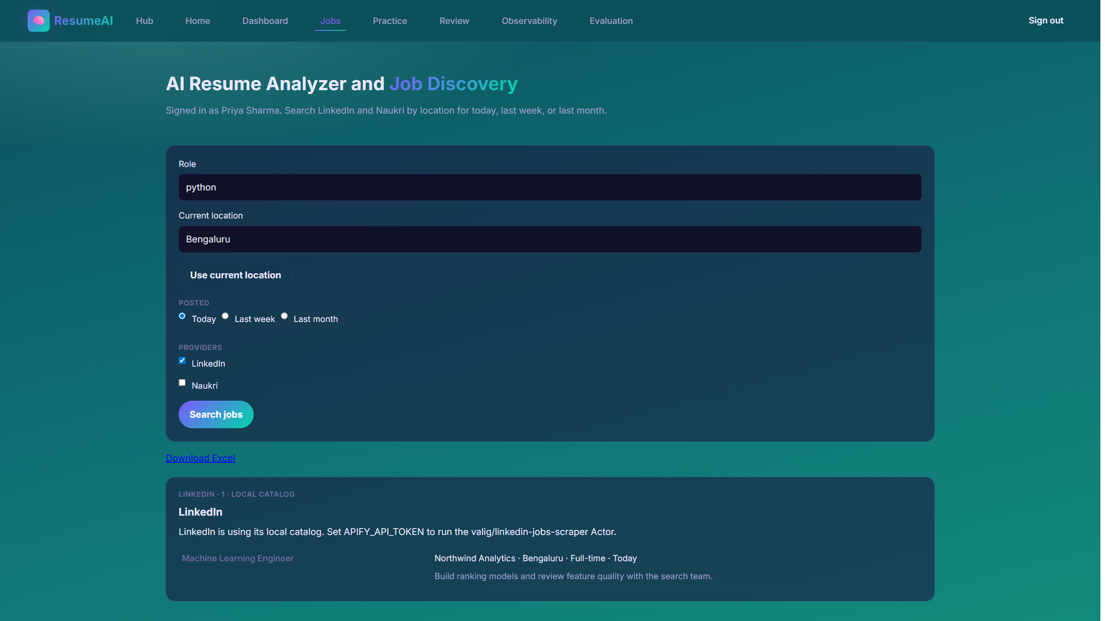
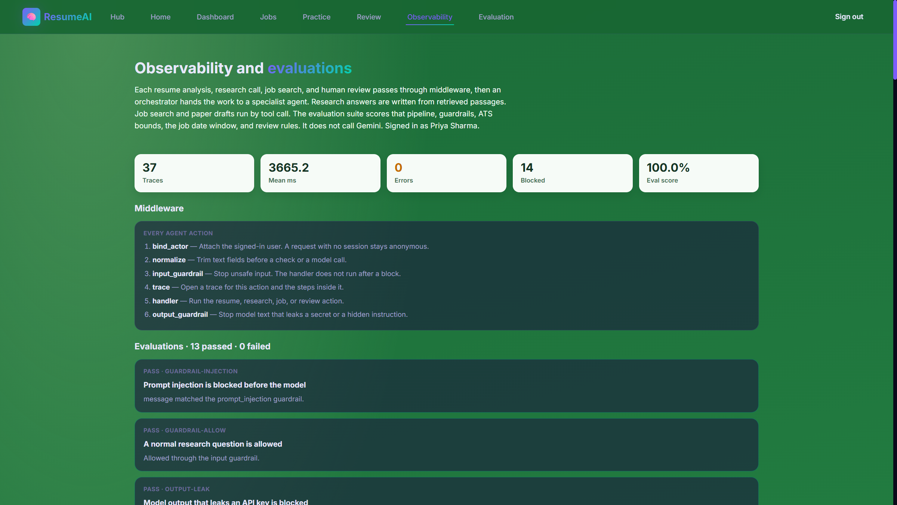
Implementation and Demo
Walk-through on http://localhost:5000
1. Sign in as the candidate, then open Jobs or upload a resume.
2. Download job-search.xlsx, or resume-analysis.xlsx after a score.
3. Ask a paper question, or build an IEEE draft and review it before PDF download.
4. As hiring manager or auditor, approve, reject, or edit. Open Observability for the 13 checks.

Slide 10
Testing and Validation
Local checks. No invented time or cost savings.
Check
Risk if skipped
This build
Result
Unsafe prompt
Could reach Gemini
Stopped first
Blocked and logged
Incomplete review
Blank advance
Form rejected
Reason required
Jobs posted today
Today can be missed
Today stays in
Date filter holds
Grounded answer
Unrelated text
Top passage only
RAG check passed
Evaluation suite
Checks were separate
13 local checks
13 passed, 0 failed
Latest local run: 13 passed, 0 failed. The suite does not call Gemini or a live job provider.

Slide 11
Analysis and Results
What a user receives from one pass
A resume upload returns an ATS score, skills, role matches, missing skills, a roadmap, and interview practice.
Job search returns a LinkedIn and Naukri table for one city and date window. The file is job-search.xlsx.
The dashboard downloads as resume-analysis.xlsx: summary, recommendations, skill gaps, and roadmap.
A paper question is answered from retrieved passages. A repository link becomes an IEEE-style draft.
The user reviews that draft before the PDF download. Unsafe prompts are blocked and recorded.
A review stores the requester, the approver, and whether the mail was sent or only logged.

Slide 12
Business Impact
Value for a candidate, a reviewer, and an author
A candidate gets an ATS score, matched roles, missing skills, and a learning plan in one pass.
A reviewer keeps the decision: advance, reject, or correct, and both parties are told by email.
LinkedIn and Naukri results for one city and date window come back as a table that can be shared as Excel.
An author can question a paper from its own text and take a first IEEE-style draft into review.
Unsafe prompts are stopped and recorded, and every step is logged so the result can be explained.
The time saved is in screening, search, and the first draft. The final decision stays with the person.

Slide 13
Suggestions and Conclusions
Governance, limits, and the support this demo still needs
Governance. Gemini runs only after the input check. Output is checked for secrets. Approve, reject, and edit stay with a named role, and both parties are emailed.
Limits. The step order is fixed. Chat keeps only the current question. Results live in the session. Review mail is logged until SMTP settings are filled.
Support needed. A Gemini key, an Apify token for live job search, SMTP settings, an administrator address, and a short demo slot with one resume and one paper or repository.
Next step. Run the walk-through on this machine, or on a shared host with the existing Docker setup, and replace the participant name on the title slide if the submission needs a legal name.

Slide 14
Annexure
Stack, data, and where the code lives
Framework. Flask, Jinja, HTML, CSS, and JavaScript. Entry point: unified_app.py.
Model and agents. Gemini, flash then pro. Orchestrator, research, retriever, writer, and career.
Tools. retrieve_passages, search_jobs, read_repository_request. Optional embeddings: all-MiniLM-L6-v2.
Data. data/skills_db.csv, data/jobs.csv, interview and coding question files, data/job_feeds/linkedin.json and naukri.json.
Records. logs/traces.jsonl, the review mail log, and evaluations/suite.py (13 checks).
Run. python unified_app.py, then open http://localhost:5000.

