Slide 1

Basic Details of the Team and Problem Statement
Ministry/Organization Name/Student Innovation:
CrowStro team
PS Code: SIH1446
Problem Statement Title: Developing a GUI based hardening script for Ubuntu operating system with flexibility to cater for organisational security policies Team Name:
Team Leader Name: Arun Natarajan
Institute Code (AISHE): U-0263
Institute Name: NITC
Theme Name: Miscellaneous

Slide 2
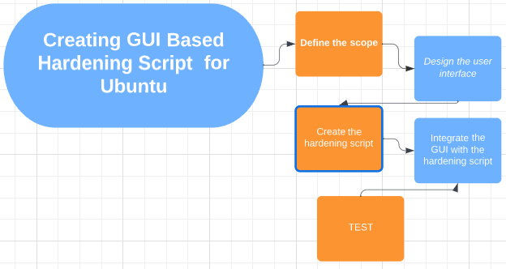
Idea/Approach Details
The idea is to have the GUI present the user with various levels of hardening scripts from low to high security to secure their ubuntu. They will also be presented with a customize option, which allows the user to select the hardening functionality that they want. After which the script will be executed based on the user inputs and ubuntu will be hardened accordingly
Describe your Technology stack here:
Linux (ubuntu)
C- gtk framework
Shell script

Slide 3
Idea/Approach Details
Describe your Use Cases here
Dependencies / Show stopper here
Individuals and home users looking to secure their personal Ubuntu systems.
System administrators managing Ubuntu servers in corporate environments.
Developers working on Internet of Things (IoT) projects with Ubuntu-based embedded systems can enhance the security of their devices before deployment.
Government entities that use Ubuntu for various administrative tasks can employ the application to maintain the security of their systems.
Dependencies:
GTK+ Library (gtk+)
GLib
GDK (GIMP Drawing Kit)
Show stopper:
Licensing issues for pre existing hardening scripts

Slide 4
Team Member Details
Team Leader Name: Arun Natarajan
Branch (Btech/Mtech/PhD etc):Btech Stream (ECE, CSE etc): CSE Year (I,II,III,IV): II
Team Member 1 Name: Manas Gupta
Branch (Btech/Mtech/PhD etc):Btech Stream (ECE, CSE etc): ECE Year (I,II,III,IV): II
Team Member 2 Name: Vinit Keshri
Branch (Btech/Mtech/PhD etc):Btech Stream (ECE, CSE etc): CSE Year (I,II,III,IV): II
Team Member 3 Name: Aditya Kamble
Branch (Btech/Mtech/PhD etc):Btech Stream (ECE, CSE etc): CSE Year (I,II,III,IV): II
Team Member 4 Name: Harshini Babu
Branch (Btech/Mtech/PhD etc):Btech Stream (ECE, CSE etc): CSE Year (I,II,III,IV): II
Team Member 5 Name: Sarah Elizabeth Paul
Branch (Btech/Mtech/PhD etc):Btech Stream (ECE, CSE etc): CSE Year (I,II,III,IV): II
Team Mentor 1 Name: Type Your Name Here
Category (Academic/Industry): Expertise (AI/ML/Blockchain etc): Domain Experience (in years):
Team Mentor 2 Name: Type Your Name Here
Category (Academic/Industry): Expertise (AI/ML/Blockchain etc): Domain Experience (in years):

