Slide 1
CamperBot for KGISL Meetups
Team Members:
ArunPandian.M
Bhargav .A
Indhumathi.R
Madhanmohanprasanth.M
Industry Guide:
Ms. Ramya
Faculty Guide:
Ms. Priscilla Joy
Department of CSE, KGiSL Institute of Technology, Coimbatore

Slide 2
Abstract
Free code camp is community of web developers. They help the campers to learn and to develop projects for the Organization about Web Technologies.
Organization can built a community around Freecodecamp to help students to learn more about web technologies. It’s very difficult task to the campus to track the activity of the campers. This project will overcome this problem. This project will help to track the activity of the campers.
Free Code Camp status viewer designed & developed for ranking the campers based on their brownie points. This will display the overall count of the problem solved in the Free code Camp by the campers.
Department of CSE, KGiSL Institute of Technology, Coimbatore

Slide 3
The count can be compared based on the dates like yesterday count, yearly count; monthly count etc. user can view the maximum problem solver and minimum problem solvers based on their brownie points.
Free code camp has their own API for sharing their details. It is integrated in the gitter.im chat application. In this project gitter.im API is used to fetch the user data from the Organization/campsite room.
Users are already registered themselves in the gitter room. This application helps to get the data from the gitter room and send it to free code camp API to get their points. That will shortlisted and stored in the database and json file too. By manipulating these data to get the necessary details will be displayed in this web application.
Department of CSE, KGiSL Institute of Technology, Coimbatore

Slide 4
Problem Statement
Camperbot for KGISL meets up as per existing system discussed in the earlier slide it gives only the names and points.
Problem is tracking the specific set of users activity from the gitter room. This data will stored in a specific database to generate reports.
Problem here is monthly data, yearly data, highest rank, total number of challenges solved, overall statistics, maximum problem solver is not displayed , and excluder option is not available. Only limited information is provided in the existing system.
This project has got these problems to overcome and make it more informative one.

Slide 5
Existing system and its disadvantages
At present Camperbot is helping to get the brownie points of the specific user. For get any other result every thing was done in manual system.
Each user activities with clear description will be given whereas before there is no detailed description of users activity.
In this web Application the user name with high grade points are listed.
Drawbacks of Existing system
Only single user brownie points will return by the Camperbot.
Can’t get minimum problem solver list.
No option for excluding the users.
No options to compare the user progress based on Day, Month, Year.
No user Authentication is provided.
Department of CSE, KGiSL Institute of Technology, Coimbatore

Slide 6
Proposed System
Advantages of the proposed system:
Helps to find the count of the campers.
Helps to find the total problem solved by the campers.
Helps to find the rank of the campers.
Daily activities report of the camper/community.
Helps to find the maximum problem solver and minimum problem solver.
Helps to exclude the user.ie user with higher rank such as Mrs.Ashok, Quincy larison, Ramya
Department of CSE, KGiSL Institute of Technology, Coimbatore

Slide 7
Module Split-up
Modules
User Rank Viewer:
This module used to display all the campers Based on their brownie points with their avatars and the link will be displayed. That link redirects the user to the specific users profile page.
User Profile Viewer:
This module display the each user profile and activity in the free code camp. This module will have the graphs and charts which display the user
Activities.
Department of CSE, KGiSL Institute of Technology, Coimbatore

Slide 8
User Excluder:
This module used to exclude the users those who flagged as dishonesty and inactive campers from the all counts. This module is allowed for some specific user and this will hardcoded in the webpage.
Time Based Activity Viewer:
This module used to display the campers activity based on the time interval. User can select the time interval for the graph. The graph is generated based on the data.
Live updates:
Add some content related to that. This module Like Live cricket score
Department of CSE, KGiSL Institute of Technology, Coimbatore

Slide 9
Project Planner / Timeline (Gantt chart)
Particulars | Dec-16 |  |  | Jan-17 |  |  |  | FEb-17 |  |  |  | Mar-17 |  |  |  | April
 | Wk 1 | Wk 3 | Wk 4 | Wk 1 | Wk 2 | Wk 3 | Wk 4 | Wk 1 | Wk 2 | Wk 3 | Wk 4 | Wk 1 | Wk 2 | Wk 3 | Wk 4 | Wk 1
Problem Identification
Literature Survey
Module 1
Module 2
Module 3
Module 4
Thesis Draft
Final Thesis
Viva
Department of CSE, KGiSL Institute of Technology, Coimbatore

Slide 10
Architectural design
Data flow diagram

Slide 11
ER-diagram
Display name
url
uname
excluder
uid
user
Rank
Excluder date
R_date
points
updates
uid
Daily_update
U_count
Pts_count
Fetches
data
Dialy_count
U_date

Slide 12
First module -Dashboard
First module mainly covers the application design .
It includes the information such as,
Total challenge solved by the individual user.(includes current date and yesterday date )
Displays highest count solved by the user.
Displays inactive user count .
The current month status describes graphically total points acquired by the user.

Slide 13
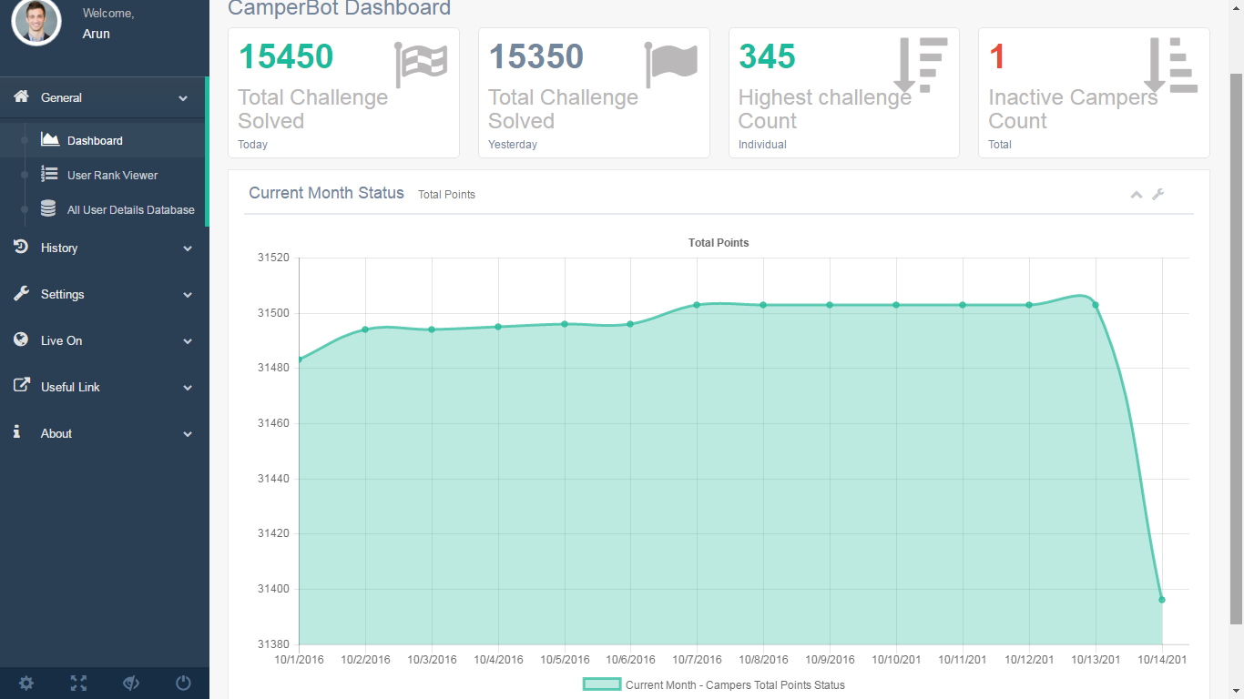
Screenshots

Slide 14
Thank you !!!
Any queries???

