Slide 1
CS598 DL4H Final Project
Reproducibility
Explainable Automated Coding of Clinical Notes using Hierarchical Label-wise Attention Networks and Label Embedding Initialization
Arun Prabhakaran Geethabai and
Senthil Kumar Kuppan Group ID: 171 Paper ID: 149

Slide 2
Project Introduction
The intention of this project is to use HLAN for automated medical coding of clinical notes.
Past deep learning-based methods lack explainability and accuracy. HLAN solves these problems.
The proposed approach is to recreate the paper and provide more interpretable explanation of the model prediction while achieving state of the art performance on various data settings

Slide 3
Automated Medical Coding
Assigning medical codes for clinical notes, to facilitate the work of professional medical coders.
ICD (International Classification of Diseases) or other coding systems
Challenging task (Baumel et al., 2018):
Large number of labels: 13k codes in ICD-9, 68k in ICD-10, and more in ICD-11
Multi-label setting: 16 code per discharge summary in average in MIMIC-III
Long documents: 2000 tokens in a discharge summary in average in MIMIC-III
This can be formalized as a multi-label classification problem.
Tal Baumel, Jumana Nassour-Kassis, Raphael Cohen, Michael Elhadad, and Noemie Elhadad. 2018. Multi-label classification of patient notes: case study on icd code assignment. In Workshops at the 32nd AAAI Conference on Artificial Intelligence.

Slide 4
Requirements- to recreate
Python 3 (tested on versions 3.6.* and 3.7.*)
Tensorflow 1.* (tested on versions 1.4.1, 1.8.0, 1.13.1, 1.14.0, and 1.15.5)
Numpy
scikit-learn for implementing evaluation metrics
Gensim 3.* (tested on 3.8.3) for pre-training word and label embeddings with the word2vec algorithm
NLTK for tokenisation
Spacy 2.3.2 (before 3.x) for customised rule-based sentence parsing
TFLearn for sequence padding

Slide 5
How was it trained
Process latest MIMIC-III data from Physionet - MIMIC-III was downloaded from Physionet
Prepare Embedding -prepare word embeddings and the optional label embeddings using Gensim package, using existing embeddings or those trained from your texts
Configuration: validate hyper-parameters
Data preprocessing: (i) vocabulary building; (ii) sentence parsing, tokenisation
Prediction and visualistion: (i) loading a pre-trained HLAN model (from the MIMIC-III dataset) to predict the top 50 ICD-9 codes; (ii) visualising the word-level and sentence-level attention scores for each assigned ICD-9 code.

Slide 6

Label correlation in multi-label classification
A challenging and open problem in multi-label classification, especially for deep learning-based approaches.
Label correlation: an example in the ICU setting (MIMIC-III dataset)
Code 486 (ICD9 as Pneumonia) and Code 518.81 (Acute respiratory failure) appeared together for over 1.5k times (out of about 53k documents).
How to leverage label correlation for deep learning-based multi-label classification?
Notes:
Such co-occurrences are underlied by the clinical, biomedical, and biological associations between different diseases.

Slide 7
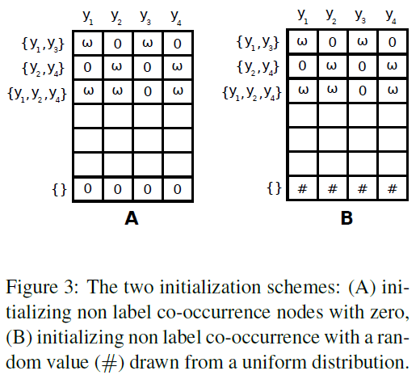
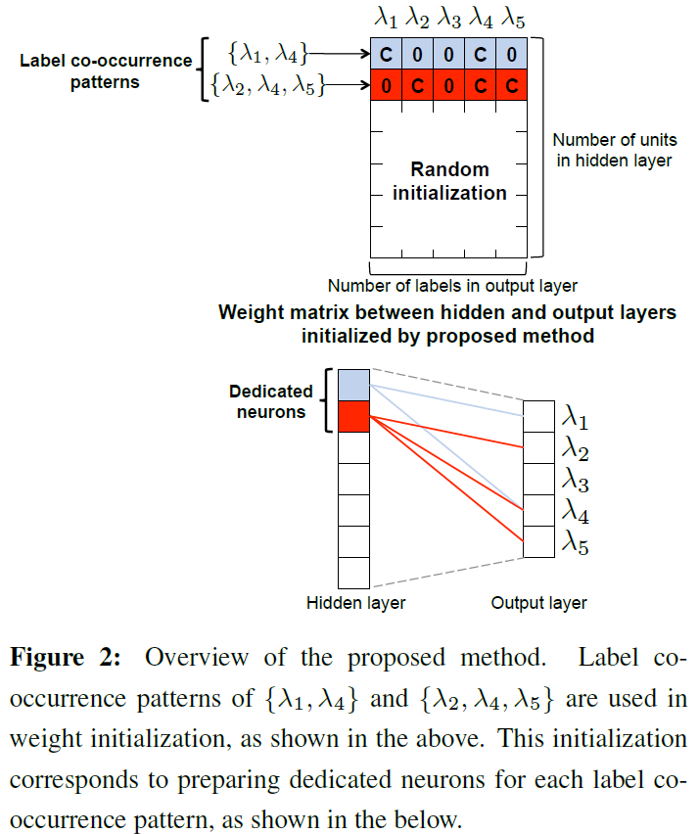
Previous studies: co-occurrence-based weight initialisation
Can we initialise embedding instead of co-occurrence relations?
G. Kurata, B. Xiang, and B. Zhou, ‘Improved Neural Network-based Multi-label Classification with Better Initialization Leveraging Label Co-occurrence’, in NAACL 2016, pp. 521–526. (on the left, Figure 2)
S. Baker and A. Korhonen, ‘Initializing neural networks for hierarchical multi-label text classification’, in BioNLP 2017 (with ACL), 2017, pp. 307–315. (on the right, Figure 3)

Slide 8
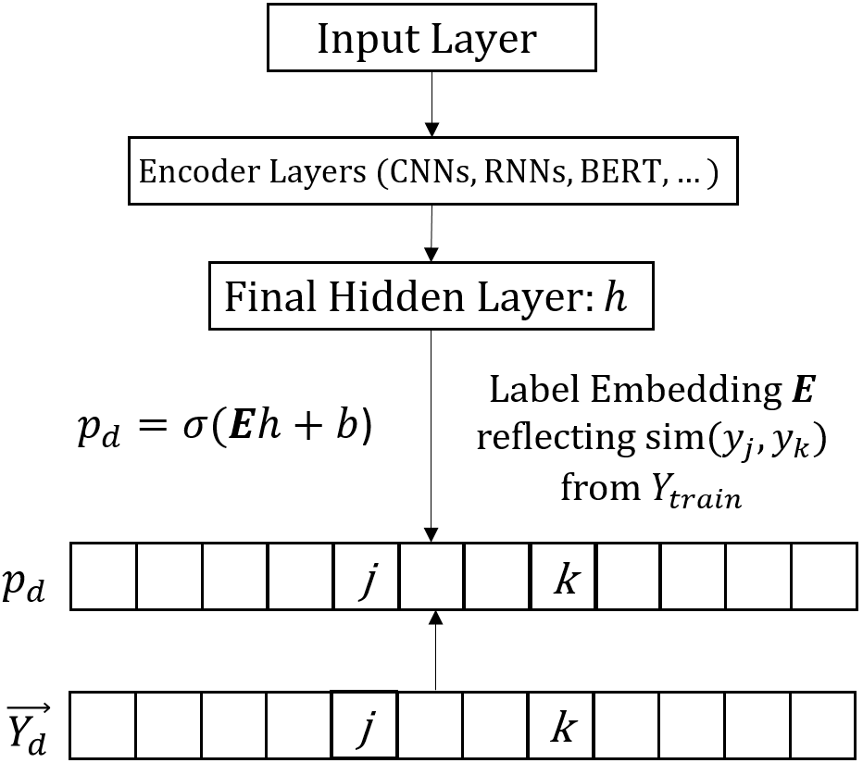
Label Embedding Initialisation

Slide 9
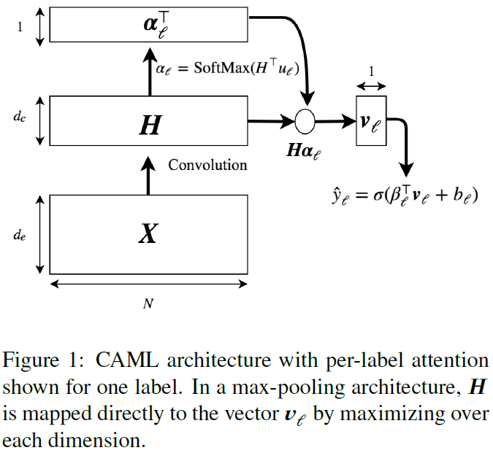
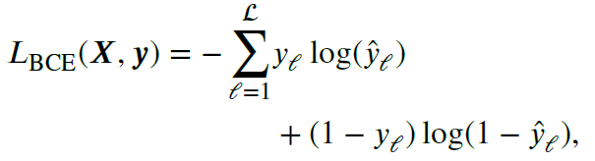
Convolutional Attention for Multi-Label Classification (CAML)
Figure from J. Mullenbach, S. Wiegreffe, J. Duke, J. Sun, and J. Eisenstein, ‘Explainable Prediction of Medical Codes from Clinical Text’, in NAACL 2018 (Long Papers), New Orleans, Louisiana, 2018, pp. 1101–1111.

Slide 10
Datasets
MIMIC-III and MIMIC-III-50 (top-50 code prediction), Medical Information Mart for Intensive Care.
Discharge summaries, padded to 2500 tokens.
Numbers | MIMIC-III | MIMIC-III-50
Training documents | 47,724 | 8,067
Validation documents | 1,623 | 1,574
Testing documents | 3,372 | 1,730
Vocabularies in training documents | 51,917 | 51,917
Labels | 8,922 | 50
Labels per document | 15.9 | 5.7

Slide 11
Implementation
We applied label embedding initialisation on four different neural network models for multi-label classification:
Bi-directional Gated Recurrent Unit (Bi-GRU)
Convolutional Neural Networks (CNN)
CNN with attention mechanisms (CNN+att or CAML)
Bi-directional Encoding Representation from Transformers (BERT)
PyTorch implementations adapted from caml-mimic and SimpleTransformers 0.20.0
Label embeddings were pre-trained from label sets in the training data using the word2vec algorithm, having same dimensionality as the final hidden size of each NN model.
BioBERT used (pre-trained with PubMed abstracts).
Dealing with the token length limit for BERT: averaged output of separated sub-documents.

Slide 12
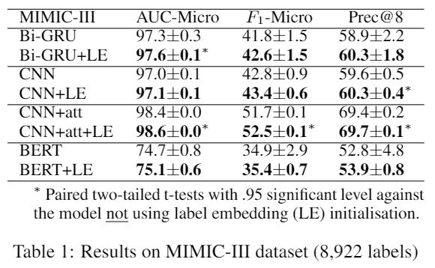
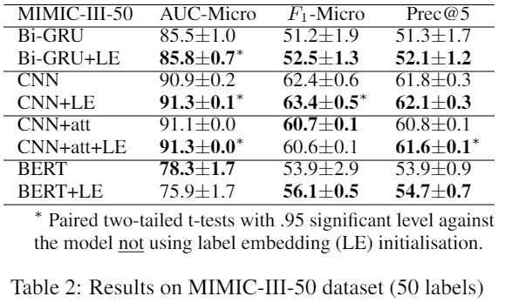
Results with MIMIC-III and MIMIC-III-50
Averaged results of 10 random runs.
Results of Macro-averaged and example-based metrics are consistent to the reported metrics.
More results are available at https://github.com/acadTags/Label-Embedding-Medical-Coding
Notes:
Consistent improvement.
Best model: CNN+att and CNN.
Results with BERT not good.

Slide 13
Conclusion and Future Improvements
We recreated the label embedding initialization approach to improve automated medical coding.
Independent from neural network encoders.
Consistent improvement.
Future studies:
Ontologies
Using knowledge graph embeddings to represent label relations
Document Structure
Using attention mechanisms to model the guidance between document structures
Providing explainable visualization for medical coding

Slide 14
Thanks for your attention

