Slide 1
Recommending ingredients: modifying recipe flavor profiles
Brandon Kelly

Slide 2
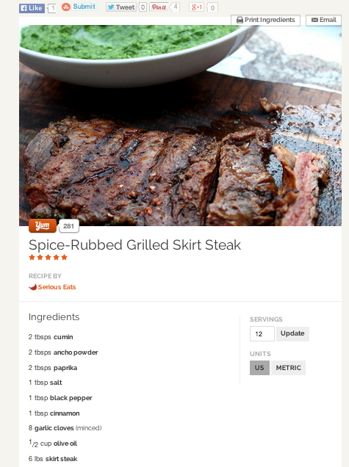
Problem: Recipes that are “almost there”
Looks good. But I’m feeling like something a little more
sweet/savory/piquant tonight…

Slide 3
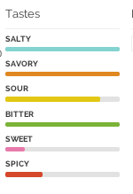
Can we recommend ingredients in a data-driven way?
Yummly database contains over 1 million recipes
API allows easy access to ingredient lists and quantitative flavor profiles for best recipes
Python wrapper for API on github
Derive flavor profiles of common ingredients from recipes
LASSO
Only recommend ingredients that are typically found with ingredients in the recipe
Build a graph to find ingredients commonly found together

Slide 4
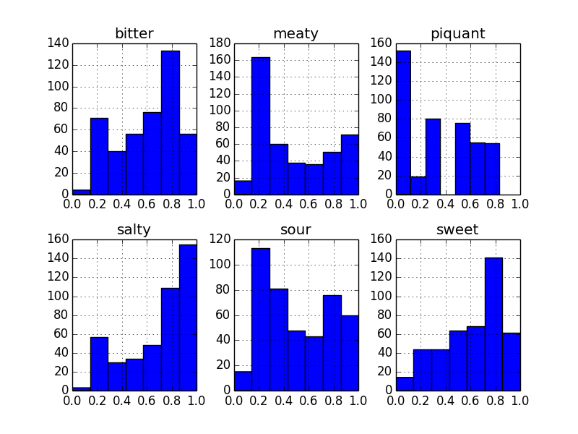
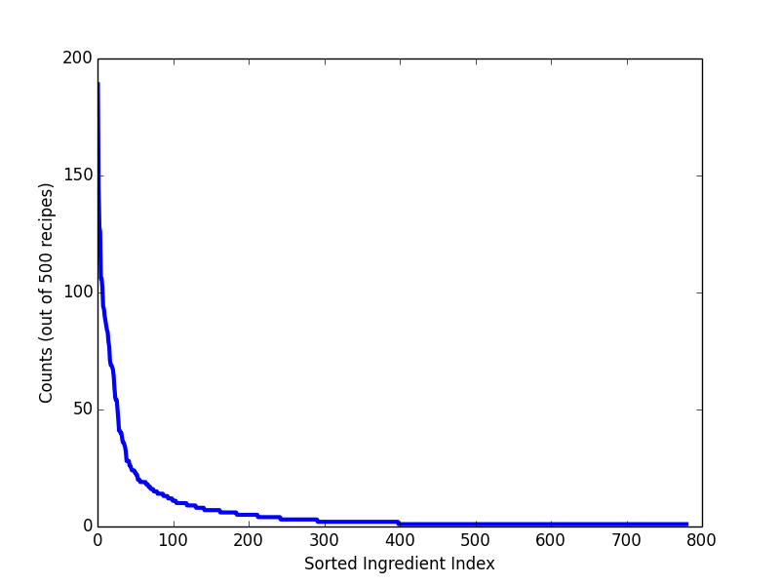
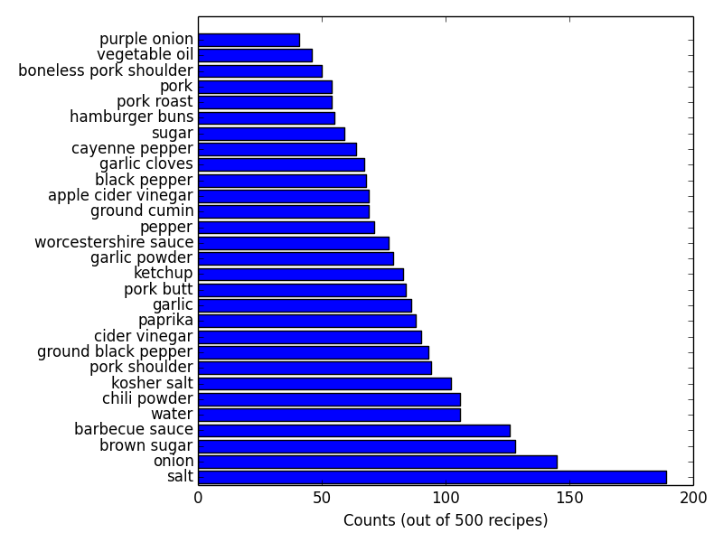
Some data from 500 pulled pork recipes

Slide 5
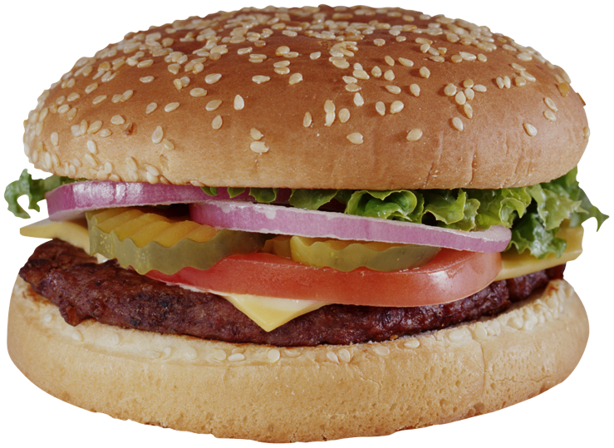
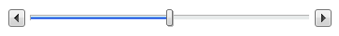
Product
url to yummly recipe
Make my recipe more:
sweet savory
sour bitter
salty piquant
Recipe
suggested
ingredient 1
new
profile
amount
suggested
ingredient 2
original
flavor
profile
new
profile
amount

