Slide 1
Recommending ingredients: modifying recipe flavor profiles
Brandon Kelly
Week 2: MVP

Slide 2
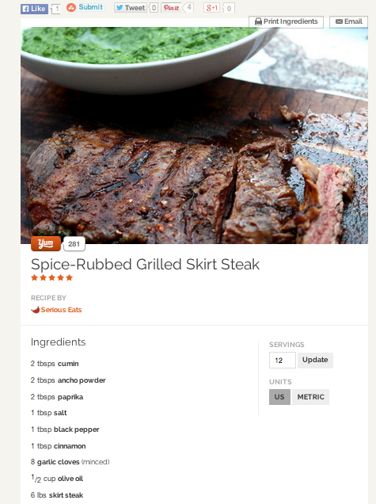
Problem: Recipes that are “almost there”
Looks good. But I’m feeling like something a little more
sweet/savory/piquant tonight…

Slide 3
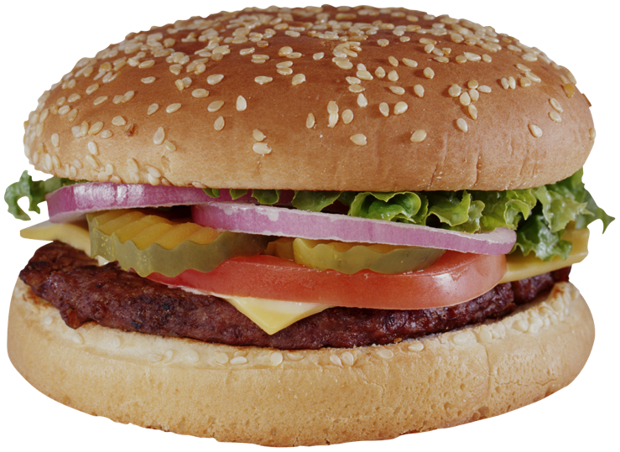
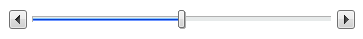
Product
url to yummly recipe
Make my recipe more:
sweet savory
sour bitter
salty piquant
Recipe
suggested
ingredient 1
new
profile
amount
suggested
ingredient 2
original
flavor
profile
new
profile
amount

Slide 4
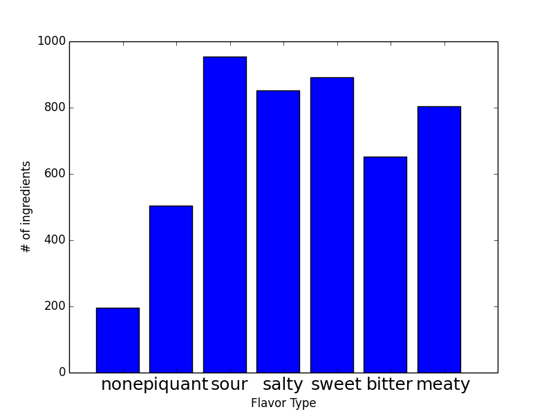
Can we recommend ingredients in a data-driven way?
Only using recipes tagged as ‘condiments and sauces’ to derive ingredients
~20K sauce recipes with ~ 4000 ingredients
Can use many more to create ingredient similarity graph (for recommending)
Most common piquant ingredients:
chili powder, hot sauce, dijon mustard,
cayenne pepper, jalapeno, paprika, black
pepper, chicken broth, red pepper flakes,
cilantro, cumin, …

Slide 5
Analysis: Deriving Ingredients
Model ingredients flavors F as n_ingredient x n_flavors matrix:
Fit for F using non-negative least-squares or LASSO on logit(y)
ingredient amount
in recipe
recipe flavor
profiles

Slide 6
Analysis: Recommending similar ingredients
Learn a graph using the pointwise mutual information to define similarity:
Recommended ingredients have small distance on the graph

