Slide 1
Recommending ingredients: modifying recipe flavor profiles
Brandon Kelly
Week 3: Beta Launch

Slide 2
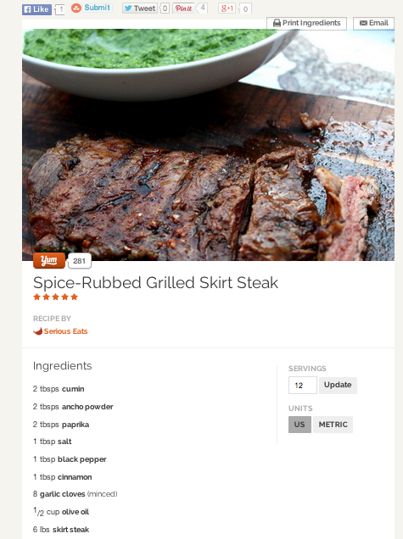
Problem: Recipes that are “almost there”
Looks good. But I’d like to make this a little more interesting, what can I add?

Slide 3
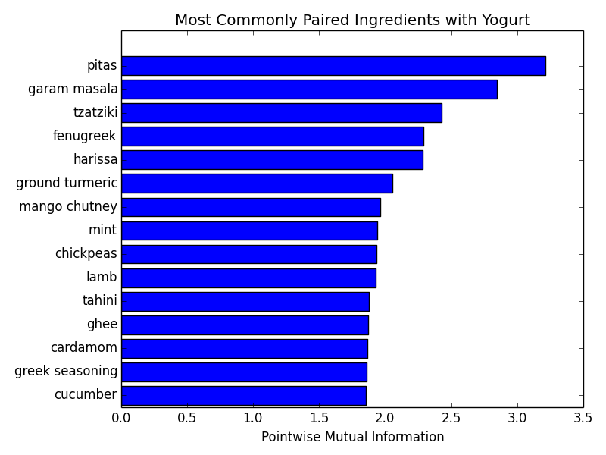
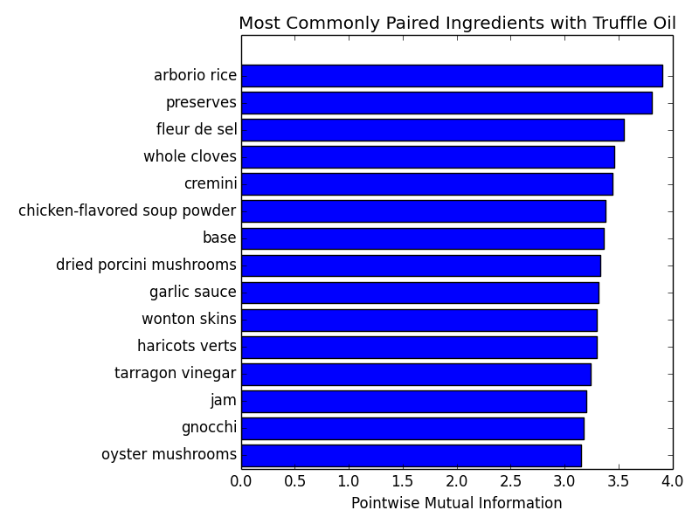
Can we recommend ingredients in a data-driven way?
Have ~ 100,000 recipes and 866
unique ingredients within at least
50 recipes.

Slide 4
Analysis: Recommending similar ingredients
Learn a graph using the pointwise mutual information to define similarity:
Only use ingredients in at least 50 recipes
Shrink the estimated PMI toward independence (PMI = 0) for stability:

