Slide 1
Customizing recipes through ingredient recommendations
Brandon Kelly
Insight Data Science Fellow

Slide 2
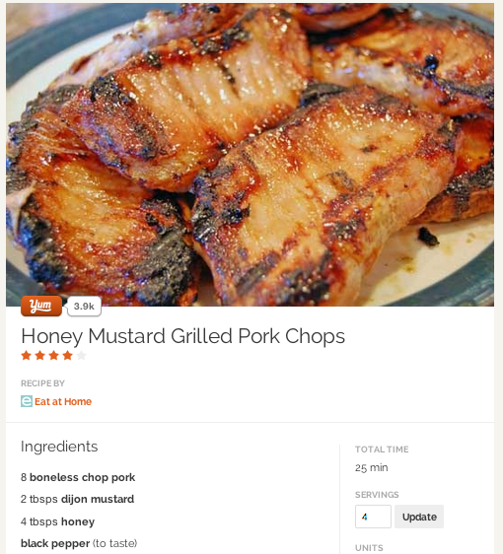
Problem: Improving simple recipes
Looks good. But I’d like to make this a little more interesting, what can I add?
Numerous recipe recommendation
services, but nothing at the ingredient
level.

Slide 3
Solution: theflavory.me
theflavory.me: An ingredient recommendation factory.

Slide 4
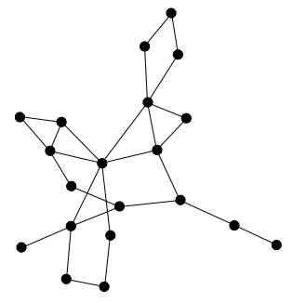
Can we recommend ingredients in a data-driven way?
Ingredient Graph
(network)
Trained using ~ 110,000 recipes and
816 unique ingredients within at
least 50 recipes (yummly.com API)
(replace with real data soon)

Slide 5



A little of my background

Slide 6
Analysis: Recommending similar ingredients
Learn a graph using the pointwise mutual information to define similarity:
Only use ingredients in at least 50 recipes
Shrink the estimated PMI toward independence (PMI = 0) for stability:

