Slide 1
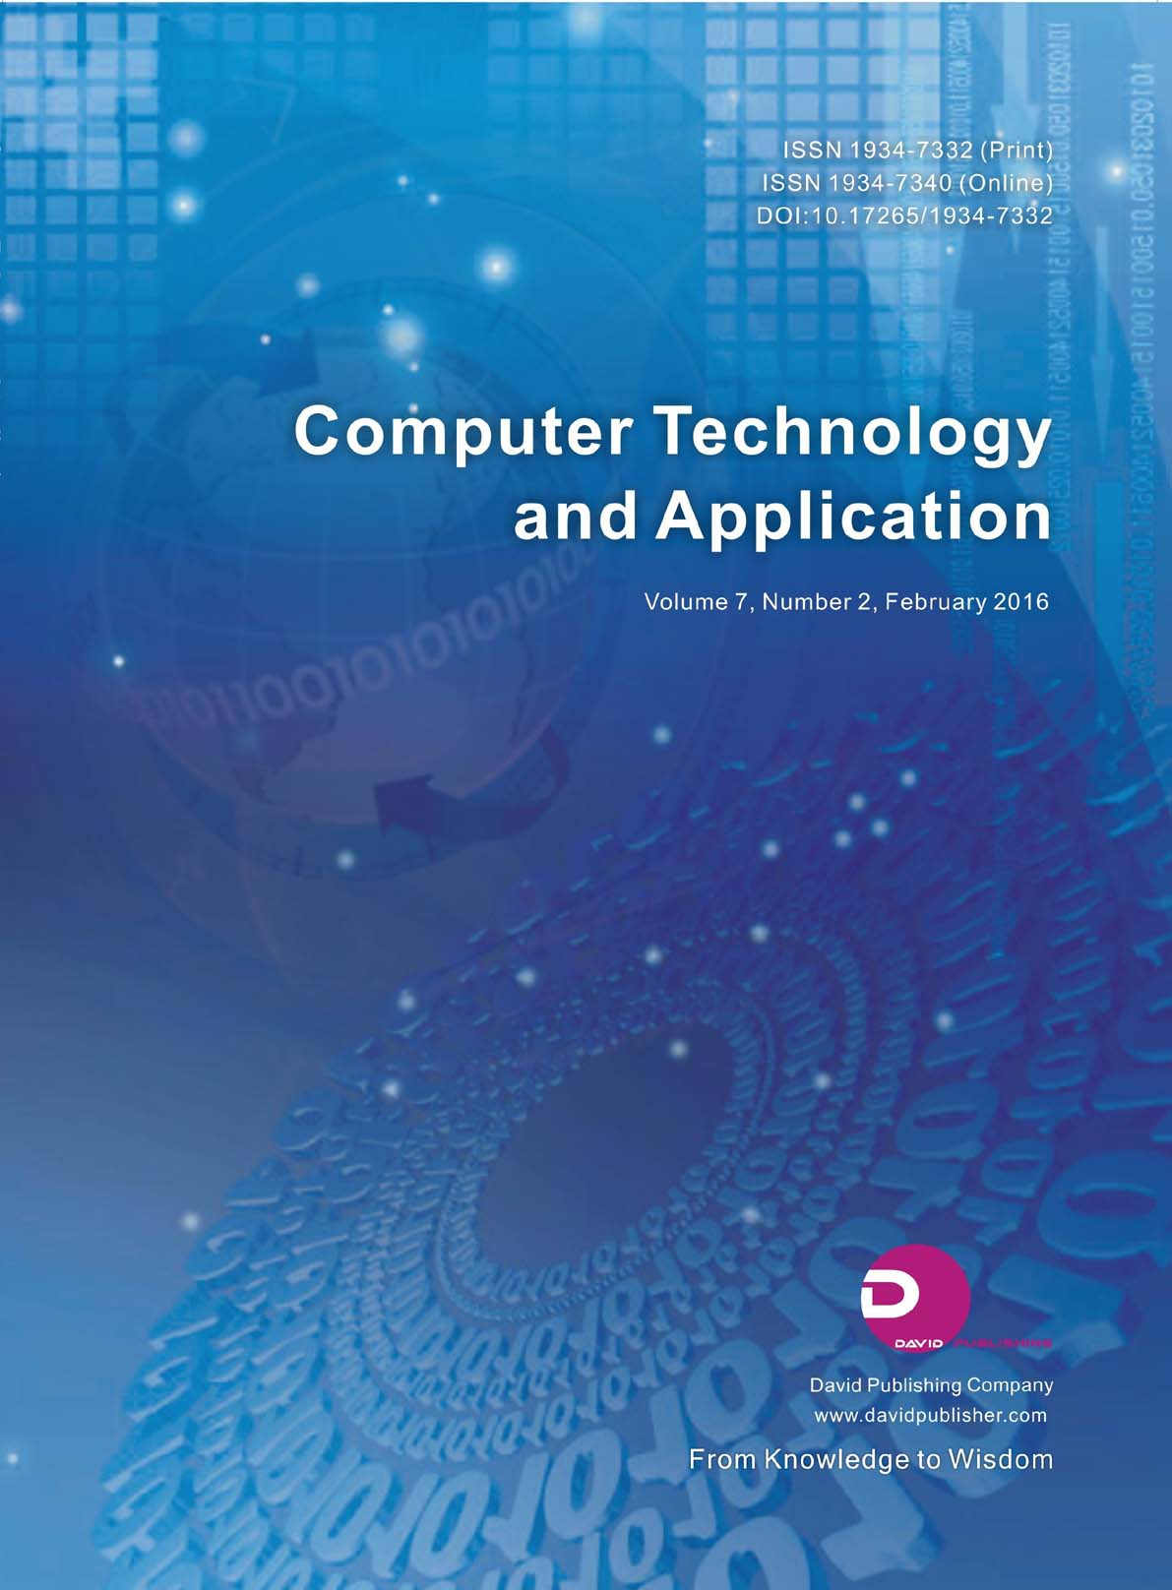
MCQs Generator
This project uses NLP tools to generate MCQs from text, leveraging summarization, keyword extraction, and distractor creation.

Slide 2

The Main Objective of this project-
The objective of this project is to automate the creation of multiple-choice questions (MCQs) from input text, enabling efficient quiz generation and assessment preparation.

Slide 3
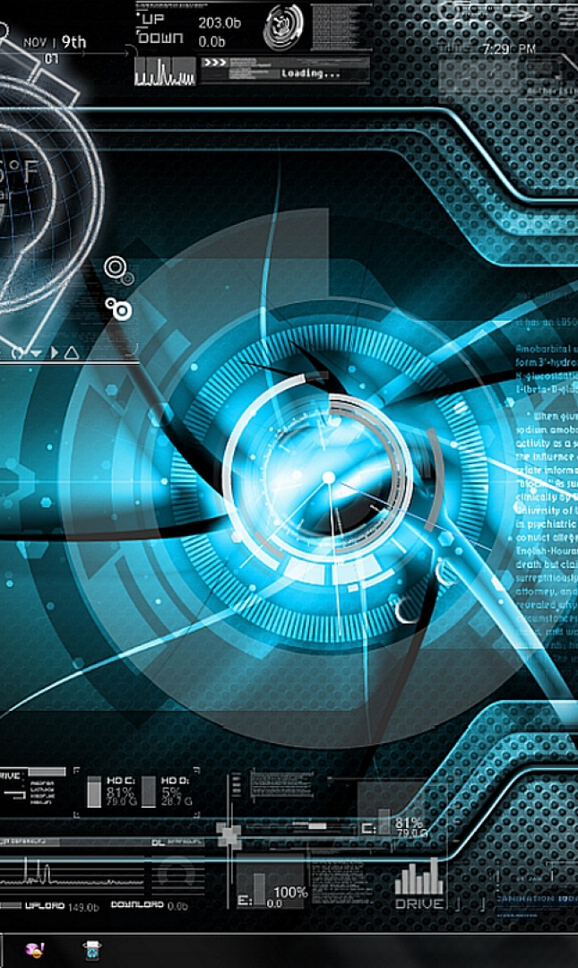
Key Features-
Text Summarization: Utilizes BART for concise summaries of input text.
Keyword Extraction: Extracts key phrases using RAKE for focus points.
Sentence Mapping: Maps keywords to relevant sentences for question framing.
Distractor Generation: Creates plausible answer options using WordNet.
Efficient Quiz Creation: Outputs formatted MCQs with multiple-choice answers.

Slide 4

How does it work-
Code Workflow for MCQs Generator
Input Text:
User provides a passage or text to process.
Text Summarization:
Summarize the input using the BART model for concise content.
Keyword Extraction:
Extract key phrases using the RAKE algorithm.
Sentence Tokenization and Mapping:
Tokenize text into sentences and map keywords to relevant sentences.
Distractor Generation:
Generate distractors for keywords using WordNet synonyms.
MCQs Creation:
Frame MCQs by replacing keywords with blanks and adding distractors.
Output MCQs:
Display or export formatted questions and answer options.

Slide 5


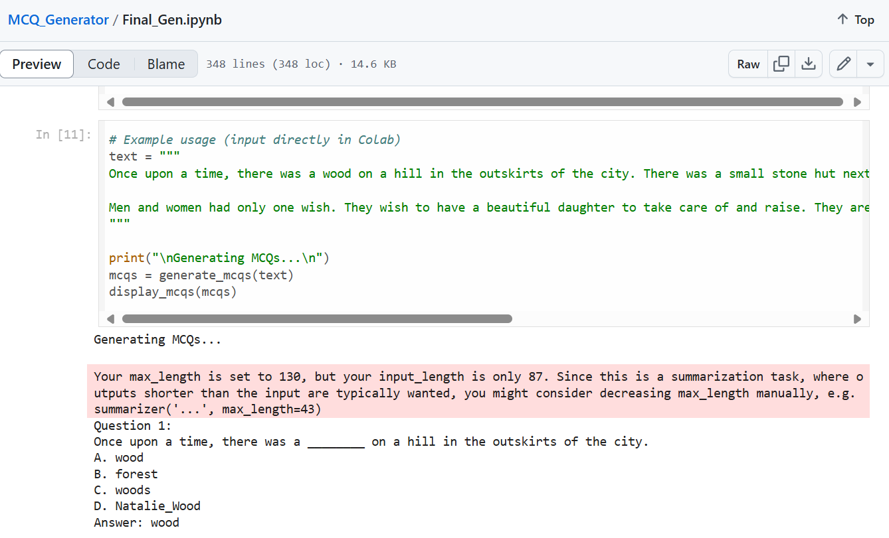


Demonstration of its Working-

Slide 6
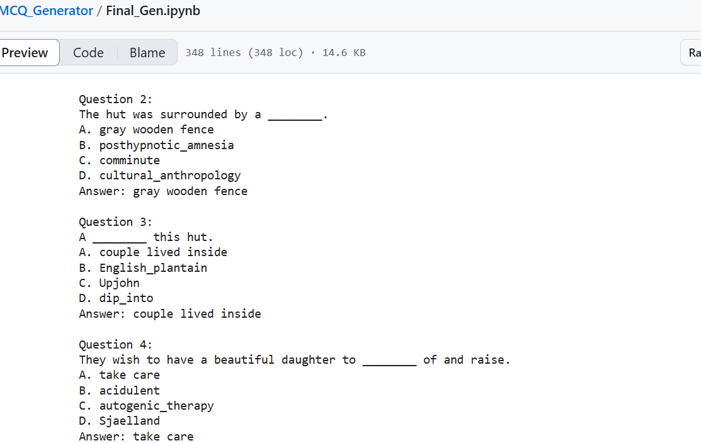

Slide 7



Conclusion-
A
Impact of the Project:
This MCQ Generator revolutionizes learning and assessment by automating quiz creation, saving time, and enhancing educational interactivity with AI-powered precision.
Future Improvements:
Enhanced Contextual Understanding: Better handling of complex or ambiguous text.
Multilingual Support: Generate MCQs in multiple languages.
Integration: Seamless integration into learning platforms for broader accessibility.
🚀
.

