Slide 1
GraphQL
Arunprabu Ganesan

Slide 2
Restful API
Uniform URL and methods to identify and utlitze resources in server.
Stateless (state to identify the resources will be part of the request only as query params,headers,body)
Identified resources are send back to client in different representations (text,json,html)

Slide 3
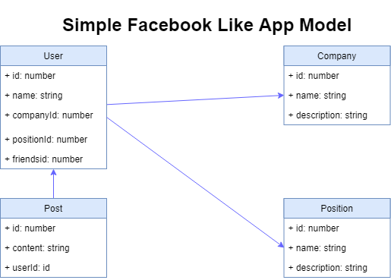

Slide 4
Simple Restul APIs
URL | METHOD | OPERATION
/posts | POST | Creates a new post
/posts | GET | Get list of post
/posts/1 | GET | Get a post with id 1
/posts/2 | UPDATE | Update a post with id 2
/posts/3 | DELETE | Delete a post with id 3

Slide 5
Slightly Complex Apis
URL | METHOD | OPERATION
/users/1/posts | POST | Create post associated with user 1
/users/1/posts | GET | Get all post associated with user 1
/users/1/posts/1 | GET | Get post with id 1 associated with user of id 1
/users/1/posts/2 | UPDATE | Update post with id 2 associated with user of id 1
/users/1/posts/3 | DELETE | Delete post with id 3 associated with user of id 1

Slide 6
Friends Page in App !!!
Arunprabu
Senior Developer
Infosys
Vidyasagar
Senior Developer
Infosys

Slide 7
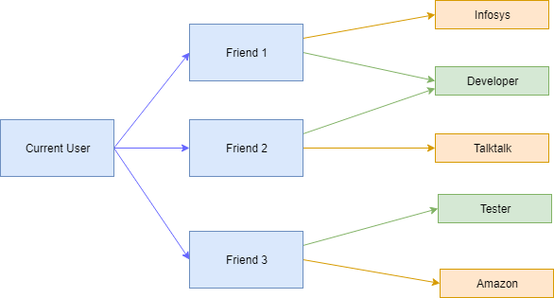

Slide 8
Complex Scenarios
URL | METHOD | SCENARIO
/users/1 | GET | Get user with id 1
/users/1/friends | GET | Get friends of user with id 1
? | GET | Get companies and position of user with id 1

Slide 9
Complex Scenarios
URL | METHOD | SCENARIO
/users/1 | GET | Get user with id 1
/users/1/friends | GET | Get friends of user with id 1
/users/2/companies /users/2/positions /users/3/companies /users/3/positions
/users/1/friends/companies /users/1/friends/positions | GET | Get companies and position of user with id 1
/users/1/friends_with_companies_and_positions | GET | Get friends , companies and position of user with id 1

Slide 10
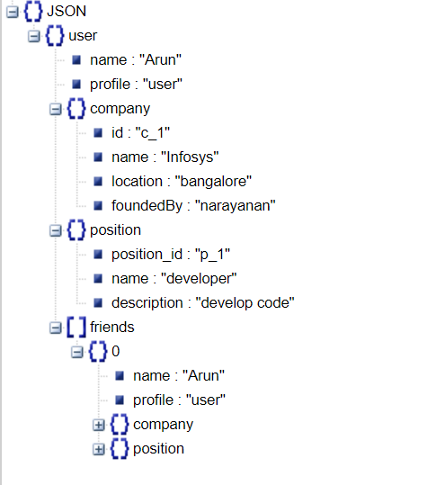
Complex response

Slide 11
Issue with the approach
So in cases of highly nested/related data we have below problems while using Restful Services
Too many http request
Very customized endpoint which is tightly coupled with UI
Send lot of data back to client than what is necessary

Slide 12
GraphQL
Developed by Facebook.
Used by Facebook for mobile app news feed since 2012
https://graphql.org/
https://github.com/facebook/graphql

Slide 13
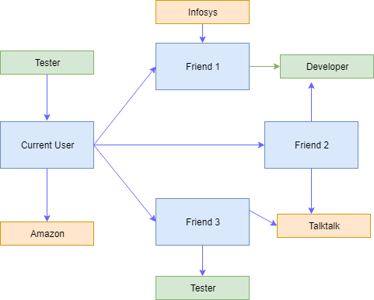
Graph in ‘GraphQL’
Refers to Graph Datastructure

Slide 14
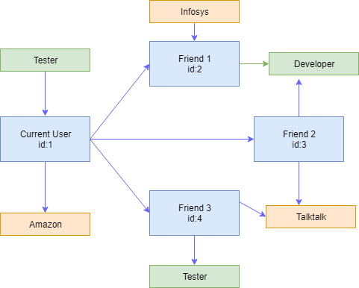

Slide 15
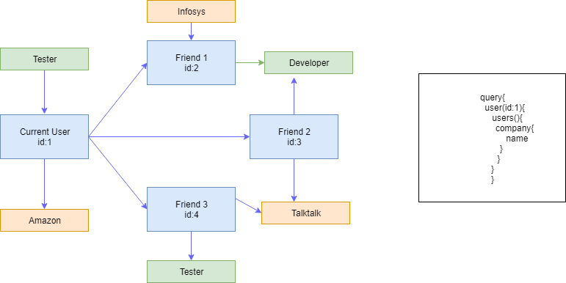

Slide 16
Node API + GraphQL
GraphiQL
Express + GraphQL server
Datastore

Slide 17
Request Flow
Request from client comes to Nodejs Server
Nodejs checks if request is for GraphQL
If yes Proceeds with GraphQL processing and send response back to client
Else process the request and send response back to client

Slide 18
Simple Express server
const express = require('express');
app = express();
app.listen(4000,() => {
console.log('listening');
});

Slide 19
Add GraphQL Middleware
const express = require('express');
const expressGraphQL = require('express-graphql');
app = express();
app.use('/graphql',expressGraphQL({
graphiql:true
})); // wiring GraphQL middleware
app.listen(4000,() => {
console.log('listening');
});

Slide 20
How GraphQL Works
Describe your data – Creating Schema
Ask for what you want – Query API
Get predictable data – Response from GraphQL

Slide 21
Schema files
Contains information on what property each object has
How different objects are related to each together
Steps
Create Schema for all objects
Create Root Query
Export Schema for GraphQL middleware

Slide 22
Schema for our User object
const graphql = require('graphql');
const {
GraphQLObjectType
} = graphql; // object destructuring
const UserType = new GraphQLObjectType({
name: 'User',
fields: {
id: { type: GraphQLString },
firstName: { type: GraphQLString },
age: { type: GraphQLInt }
}
});

Slide 23
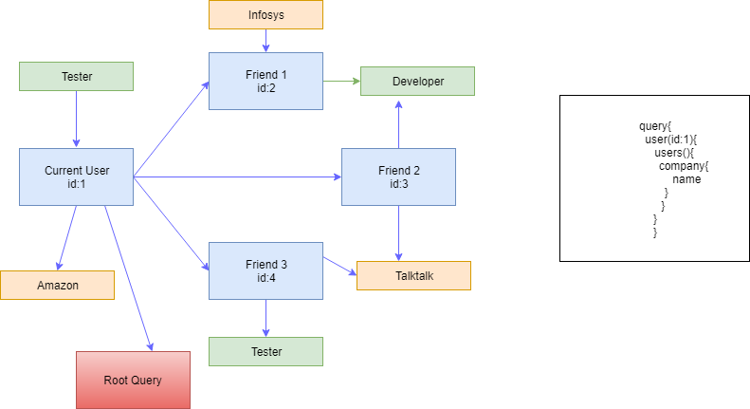
Root query
Every Schema file should have a root query which is entry point for GraphQL (find user with id 1)

Slide 24
Root Query
const RootQuery = new GraphQLObjectType({
name: 'RootQueryType',
fields: {
user: {
type: UserType,
args: { id: { type: GraphQLString } },
resolve(parentValue, args) {
// This is where we connect to datastore.
}
}
}
});

Slide 25
Root Query with Resolve
const RootQuery = new GraphQLObjectType({
name: 'RootQueryType',
fields: {
user: {
type: UserType,
args: { id: { type: GraphQLString } },
resolve(parentValue, args) {
return _.find(users, { id: args.id }); //_ id lodash object which finds the object with given id
}
}
}
});
module.exports = new GraphQLSchema({
query:RootQuery
});

Slide 26
First Query
{
user(id:"1"){
firstName
}
}
This query corresponds to RootQuery

Slide 27
Questions ??????

Slide 28
Coming up Part 2

