Slide 1
GraphQL
Arunprabu Ganesan

Slide 2
Restful Services
Uses uniform URL and methods(GET,POST) to identify and utilize resources in server.
100% Stateless (state to identify the resources will be part of the request only as query params,headers,body)
Identified resources are send back to client in different representations (text,json,html)
Representational state transfer - REST

Slide 3
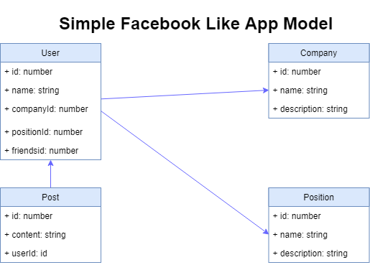

Slide 4
Simple Restul APIs
URL | METHOD | OPERATION
/posts | POST | Creates a new post
/posts | GET | Get list of post
/posts/1 | GET | Get a post with id 1
/posts/2 | UPDATE | Update a post with id 2
/posts/3 | DELETE | Delete a post with id 3

Slide 5
Slightly Complex Apis
URL | METHOD | OPERATION
/users/1/posts | POST | Create post associated with user 1
/users/1/posts | GET | Get all post associated with user 1
/users/1/posts/1 | GET | Get post with id 1 associated with user of id 1
/users/1/posts/2 | UPDATE | Update post with id 2 associated with user of id 1
/users/1/posts/3 | DELETE | Delete post with id 3 associated with user of id 1

Slide 6
Friends Page in App !!!
Arunprabu
Senior Developer
Infosys
Vidyasagar
Senior Developer
Infosys

Slide 7
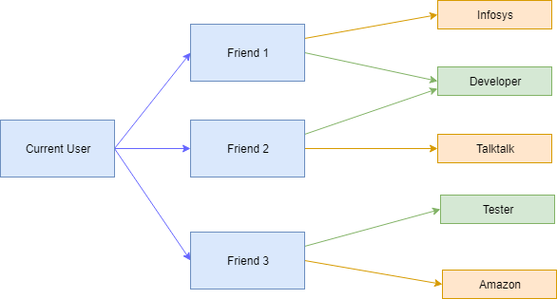
Notes:
Data flow for the friends page.

Slide 8
Complex Scenarios (APIs to populate the Friends page)
URL | METHOD | SCENARIO
/users/1 | GET | Get user with id 1
/users/1/friends | GET | Get friends of user with id 1
? | GET | Get companies and position of user with id 1(We need this api to populate friends page)

Slide 9
Complex Scenarios
URL | METHOD | SCENARIO
/users/1 | GET | Get user with id 1
/users/1/friends | GET | Get friends of user with id 1
/users/2/companies /users/2/positions /users/3/companies /users/3/positions |  | User with id 2 and 3 or friends of user id 1. We may need to call this api to get the company and position details of user id 1
/users/1/friends/companies /users/1/friends/positions | GET | Get companies and position of friends of user with id 1
/users/1/friends_with_companies_and_positions | GET | Get friends , companies and position of user with id 1

Slide 10
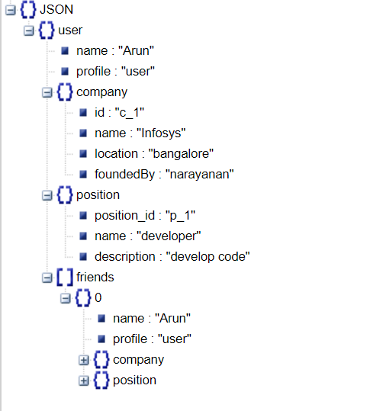
Complex response

Slide 11
Issue with the Restful approach
So in cases of highly nested/related data we have below problems while using Restful Services
Too many http request (under fetching)
Very customized endpoint which is tightly coupled with UI(over fetching)
Send lot of data back to client than what is necessary

Slide 12
Why GraphQL ?
https://www.youtube.com/watch?v=PTphFRHJ3d0&t=6s
https://www.youtube.com/watch?v=IvsANO0qZEg
https://medium.com/@ajaysaini.official/why-graphql-886ba866ae75
https://medium.com/@camachojuan_18475/graphql-solving-rests-problems-9a78820aeff
https://www.prisma.io/blog/top-5-reasons-to-use-graphql-b60cfa683511/
https://engineering.shopify.com/blogs/engineering/solving-the-n-1-problem-for-graphql-through-batching

Slide 13
GraphQL
Developed by Facebook.
Used by Facebook for mobile app news feed since 2012
https://graphql.org/
https://github.com/facebook/graphql

Slide 14
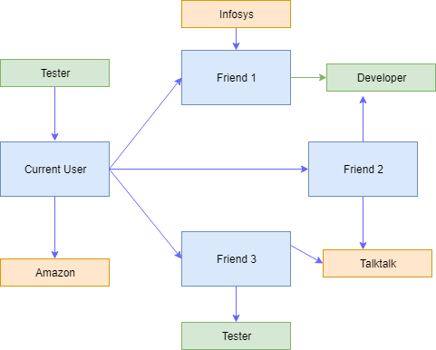
Graph in ‘GraphQL’ refers to Graph Datastructure.
Reference :https://www.youtube.com/watch?v=dCQ9g5V_CxE

Slide 15
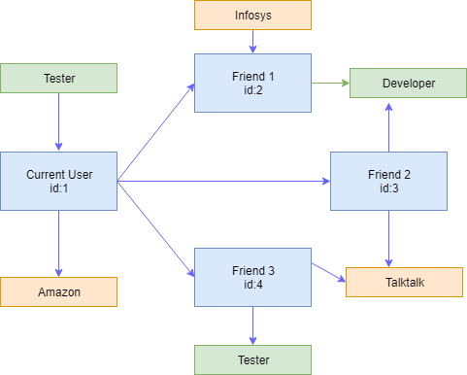
Notes:
Graph with user id

Slide 16
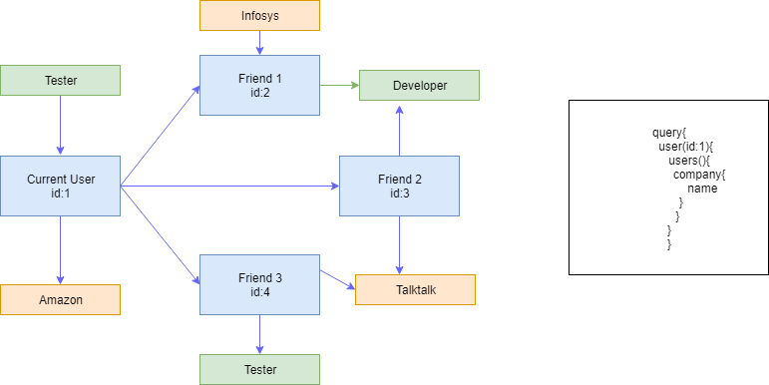
Notes:
Simple GraphQL query

Slide 17
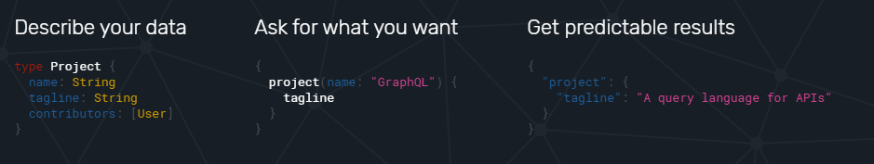
How GraphQL Works
Describe your data – Use GraphQL schema to describe data
Ask for what you want – Use GraphQL Query
Get predictable data

Slide 18
Node API + GraphQL Demo
In the demo , we will build a node based GraphQL server and query it using GraphiQL interface
GraphiQL
Express + GraphQL server
Datastore

Slide 19
Request Flow
Request from client comes to Nodejs Server
Nodejs checks if the request is for GraphQL
If yes Proceeds with GraphQL processing and send response back to client
Else process the request and send response back to client

Slide 20
Simple Express server
const express = require('express');
app = express();
app.listen(4000,() => {
console.log('listening');
});

Slide 21
Add GraphQL Middleware
const express = require('express');
const expressGraphQL = require('express-graphql');
app = express();
app.use('/graphql',expressGraphQL({
graphiql:true
})); // wiring GraphQL middleware
app.listen(4000,() => {
console.log('listening');
});

Slide 22
Schema files
Contains information on what property each object has
How different objects are related to each together
Steps
Create Schema for all objects
Create Root Query
Export Schema for GraphQL middleware

Slide 23
Schema for User object
const graphql = require('graphql');
const {
GraphQLObjectType
} = graphql; // object destructuring
const UserType = new GraphQLObjectType({
name: 'User',
fields: {
id: { type: GraphQLString },
firstName: { type: GraphQLString },
age: { type: GraphQLInt }
}
});

Slide 24
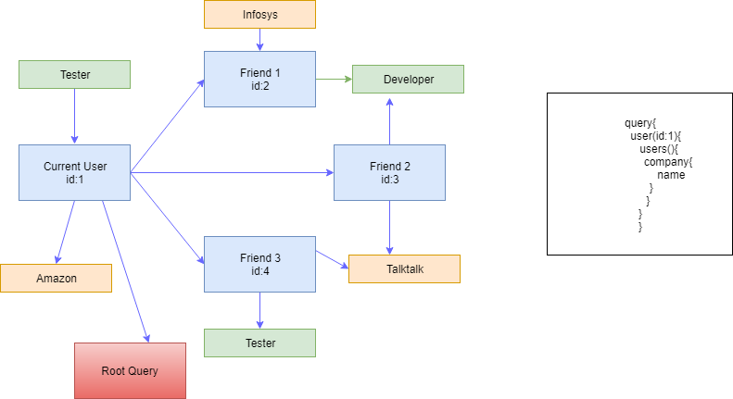
Root query
Every Schema file should have a root query which is entry point for GraphQL (find user with id 1)

Slide 25
Root Query
const RootQuery = new GraphQLObjectType({
name: 'RootQueryType',
fields: {
user: {
type: UserType,
args: { id: { type: GraphQLString } },
resolve(parentValue, args) {
// This is where we connect to datastore.
}
}
}
});

Slide 26
Root Query with Resolve
const RootQuery = new GraphQLObjectType({
name: 'RootQueryType',
fields: {
user: {
type: UserType,
args: { id: { type: GraphQLString } },
resolve(parentValue, args) {
return _.find(users, { id: args.id }); //_ id lodash object which finds the object with given id
}
}
}
});
module.exports = new GraphQLSchema({
query:RootQuery
});

Slide 27
First Query
{
user(id:"1"){
firstName
}
}

Slide 28
Change Datastore to API
Axios is third party library to make api calls.
We are using template strings (es6 feature) to resolve variables
return axios.get(`http://localhost:3000/users/${args.id}`)
.then(response => response.data);

Slide 29
Query for Nested Data
Write Schema for nested data
const CompanyType = new GraphQLObjectType({
name: 'Company',
fields: {
id: { type: GraphQLString },
name: { type: GraphQLString },
description: { type: GraphQLString }
}
});

Slide 30
Query for Nested Data
Update the Parent Schema(User) with the nested data (Company)
const UserType = new GraphQLObjectType({
name: 'User',
fields: {
id: { type: GraphQLString },
firstName: { type: GraphQLString },
age: { type: GraphQLInt },
company:{type:CompanyType}
}
});

Slide 31
Add resolve for nested data
const UserType = new GraphQLObjectType({
name: 'User',
fields: {
id: { type: GraphQLString },
firstName: { type: GraphQLString },
age: { type: GraphQLInt },
company:{
type:CompanyType,
resolve:(parentValue,args){
console.log(parentValue,args)
}
}
}
});

Slide 32
Resolve nested data using api call
const UserType = new GraphQLObjectType({
name: 'User',
fields: {
id: { type: GraphQLString },
firstName: { type: GraphQLString },
age: { type: GraphQLInt },
company: {
type: CompanyType,
resolve(parentValue, args) {
return axios.get(`http://localhost:3000/companies/${parentValue.companyId}`)
.then(response => response.data);
}
}
}
});

Slide 33
Nested Query
{
user(id:"1"){
firstName,
age,
company {
name
}
}
}

Slide 34
Add fields to root query
company: {
type: CompanyType,
args: { id: { type: GraphQLString } },
resolve(parentValue, args) {
//return _.find(users, { id: args.id });
return axios.get(`http://localhost:3000/companies/${args.id}`)
.then(response => response.data);
}
}

Slide 35
Bidirectional mapping
const CompanyType = new GraphQLObjectType({
name: 'Company',
fields: () => ({ // Closures to solve circular references issue
id: { type: GraphQLString },
name: { type: GraphQLString },
description: { type: GraphQLString },
users: {
type: new GraphQLList(UserType),
resolve(parentValue, args) {
return axios.get(`http://localhost:3000/companies/${parentValue.id}/users`)
.then(response => response.data);
}
}
})
});

Slide 36
Bidirectional Query
{
company(id:"1"){
name,
users{
id,
company{
name
users{
id
}
}
}
}
}

Slide 37
Can have ‘query’ before queries
query {
company(id:"1"){
name
}
}

Slide 38
Can have name for queries
query getCompanyId {
company(id:"1"){
name
}
}

Slide 39
Can namespace different data inside a query
query {
infy:company(id:"1"){
name
}
amazon: company(id:"2"){
name
}
}

Slide 40
Query Fragments
query {
infy:company(id:"1"){
...companyDetails
}
amazon: company(id:"2"){
...companyDetails
}
}
fragment companyDetails on Company {
name,description
}

Slide 41
Mutations
Mutations are used to Manipulate a collection of resources in a server (CRUD operations)

Slide 42
Mutation Schema
Fields of mutation describe the action or manipulation
const mutation = new GraphQLObjectType({
name:'Mutation',
fields:{
addUser:{
type: UserType,
args: {
firstName: { type: new GraphQLNonNull(GraphQLString) },
age: { type: new GraphQLNonNull(GraphQLInt) },
companyId: { type: GraphQLString }
},
}
}); resolve(parentValue,{firstName,age}){
return axios.post('http://localhost:3000/users/',{
firstName,age
}).then(response => response.data);
}
}

Slide 43
Mutation Query
mutation {
addUser(firstname:"vs",age:29){
id,
firstName
}
}

Slide 44
Complete code for the demo covered
https://github.com/garunprabu/graphql-demo

Slide 45
References
https://medium.com/codingthesmartway-com-blog/creating-a-graphql-server-with-node-js-and-express-f6dddc5320e1
https://www.youtube.com/watch?v=PTphFRHJ3d0&t=6s

Slide 46
Integrating GraphQL with UI
NPM dependencies
npm install apollo-angular apollo-cache-inmemory apollo-client apollo-angular-link-http graphql graphql-tag –save

Slide 47
Node dependencies
apollo-client is the Apollo Client library
apollo-angular contains the bindings to use Apollo Client with Angular.
graphql-tag is a GraphQL parser. Every GraphQL operation you hand over to Apollo Client will have to be parsed by the gql function.
apollo-angular-link-http provides a similar HttpLink to Apollo’s HttpLink with one difference, it uses Angular’s HttpClient.
apollo-cache-inmemory is a cache implementation that supports all of Apollo Client 1.0’s features without the dependency on Redux.
graphql contains Facebook’s reference implementation of GraphQL - Apollo Client uses some of its functionality as well.

Slide 48
Code : GraphQL integration with Angular 6 application using Apollo Client
Code
https://github.com/garunprabu/ng-apollo-graphql
Reference
https://medium.com/codingthesmartway-com-blog/apollo-client-for-angular-making-use-of-graphql-8d9a571e020c

Slide 49
Questions ??????

Slide 50
Thanks

