Slide 1



Lending club –loan data analysis
Presented by Arun Prakash
This Photo by Unknown author is licensed under CC BY-SA.

Slide 2
Agenda
Objective and Problem Statement
Approach
2. Data analysis
Business review of Statistical analysis
Summary
1.Problem Solving

Slide 3
OBJECTIVE & problem STATEMENT
Objective of the case study was to identify risk applicants, what factors contribute to defaulting proportions and how can company leverage this information for portfolio and Risk assessment.
Problem Statement: In the last three financial year (2008-11), on an average at 10% default rate at Lending company has increased . Over same period of time, the median annual income has remained same by increasing by ~5%

Slide 4
LOAN DEFAULT: Possible hypotheses
Fraud : Over last 3 years the possible cases of fraud over consumer purchases has increased
Interest rate : The interest rate over the loan amount and tenure is high.
Verification : The client selection, monitoring of application has typically dropped over 3 years
Ticket size of Loan : With increased annual income, the possible increase in loan amount in last 3 years

Slide 5
APPROACH- understanding business
The typical consumer finance company is looking at building business model relying on past purchases to make a decision on whether to reject or select a loan application. For building this model ,they are looking to identify the attributes which impact the payment . Attributes which indicate tendency to default.
Why is the model Important?
1.Because it impacts the revenue bottom line of the company.
2. Because no finance company wants NPA on their accounts.

Slide 6
APPROACH- BUSINESS ANALYSIS
POLITICAL
ECONOMIC
SOCIAL
TECH
In hand money has not increased but costs have increased
Purchasing power has been impacted
Consumerism is high
Easier Paperwork to get loan
Stable political scenario has led to increase purchases
The public deliquency has not changed and more rigid verification needs to be done
LEGAL
PESTEL Frame work Analysis – Consumer Finance Lending Scenario

Slide 7
APPROACH- DATA ANALYSIS
DATA CLEANING
Removing outliers
DATA PREPARATION
Formatting the data by stripping extra characters
Dropping the irrelevant columns and rows
Exploratory Data Analysis
Univariate analysis
Bivariate analysis
Removing the null value rows and columns

Slide 8
Exploratory data ANALYSIS- Business review

Slide 9
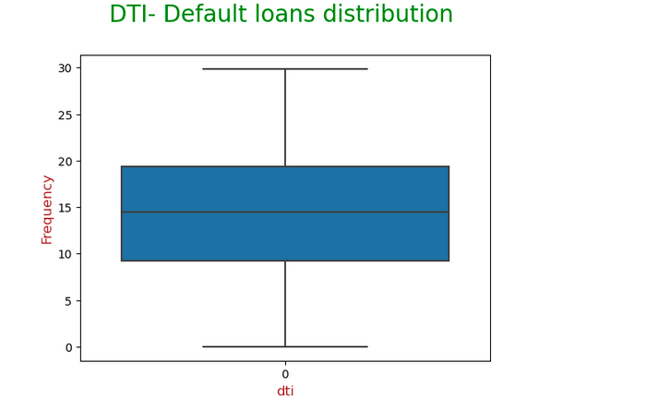
univariate analysis-
DTI
#As per industry standard good DTI should be less than 36% ,since the Loans have been dispersed with max dti of 30% it is good.

Slide 10
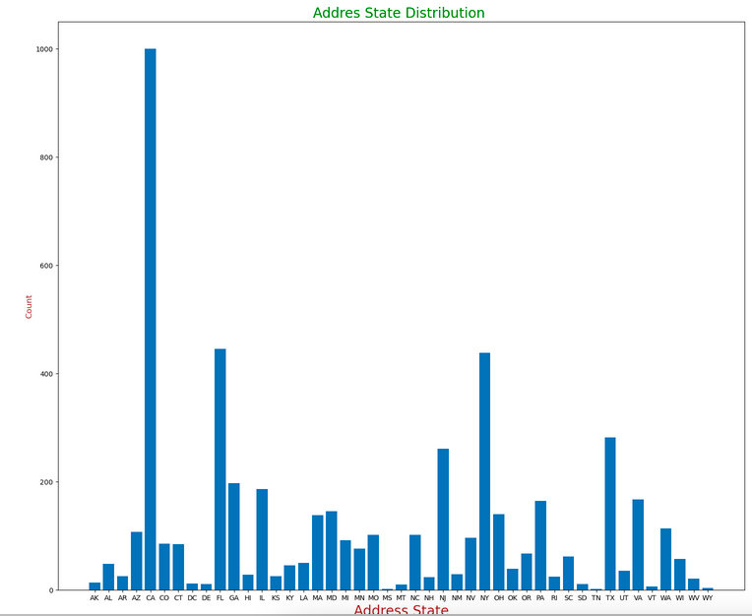
univariate analysis-
Address State
Many of the defaulters are from CA and NY

Slide 11
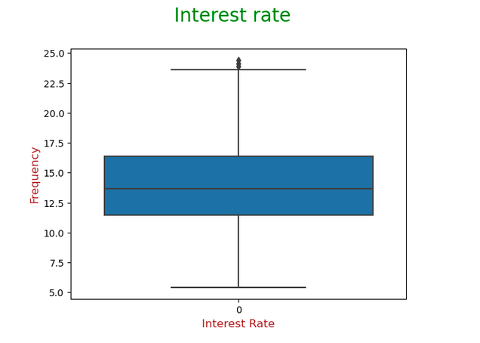
univariate analysis-
Interest Rate
#Most defaulters received interest at the rate of 11.5-17% against median interest of all borrowers of 10%
#Some defaulters received loans at more than 22.5%

Slide 12
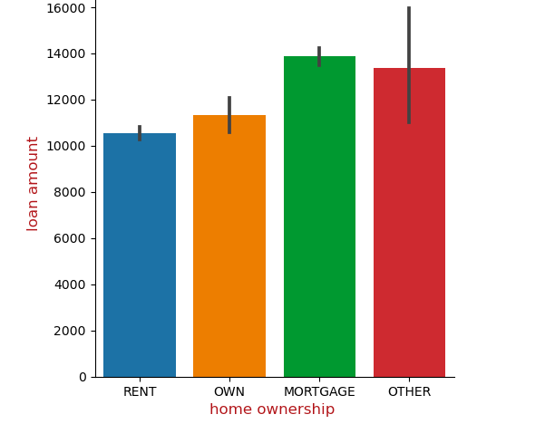
bivariate analysis-
Home Ownership vs Loan Amount
IIn case of "Charged of Loans"- Most of the defaulters whose home ownership is 'MORTGAGE and RENT ".

Slide 13
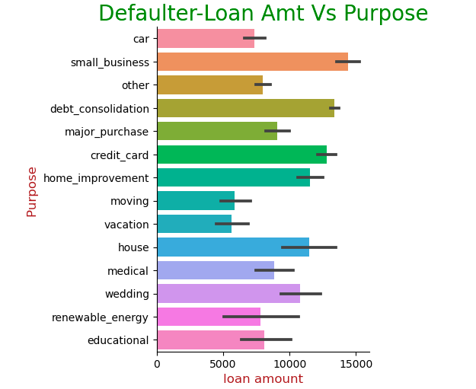
bivariate analysis-
Purpose vs Loan Amount
IIn case of "Charged off Loans"- Most defaulters took loan had small business' or had to pay of Credit Card Debt.

Slide 14
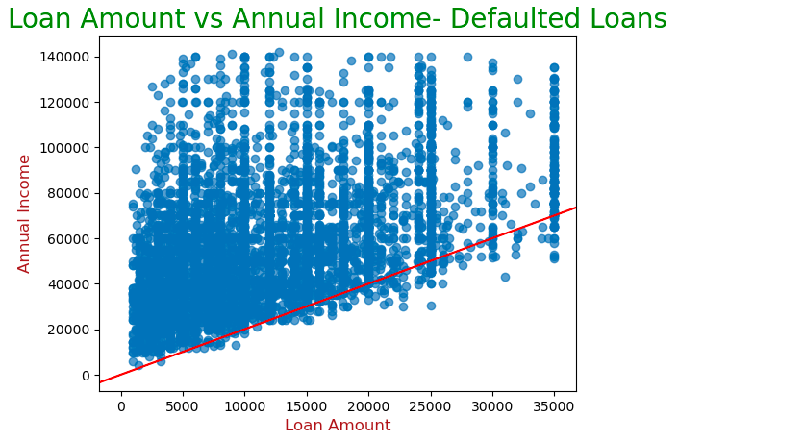
bivariate analysis-
Annual Income vs Loan Amount
IIn case of "Charged off Loans"- Only high income people with salary higher than 23500$ took more than 30000$ loan amount.

Slide 15
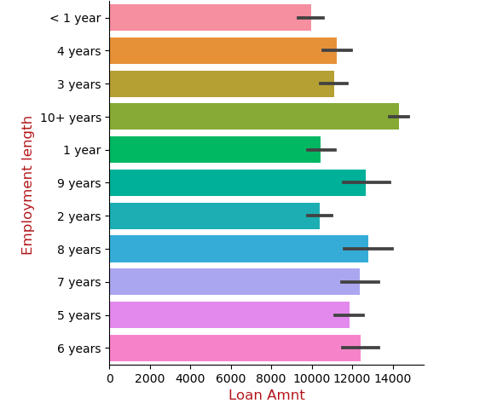
bivariate analysis-
Employment Length vs loan Amount .
In case of Charged of Loans-Most defaulters have 10+yrs experience and loan amount is 14k+

Slide 16
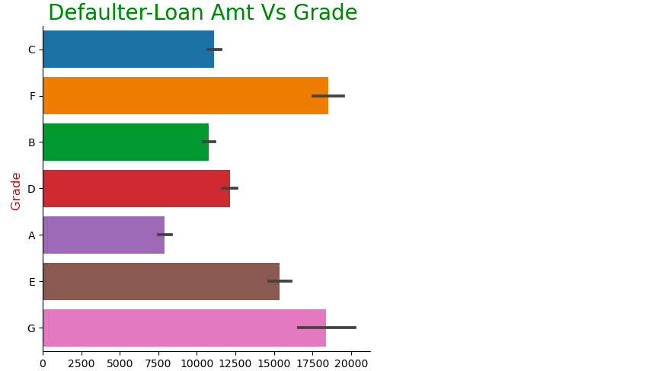
bivariate analysis-
Grade vs Annual Income
IIn case of "Charged off Loans"- Most defaulters took loan had small business' and loan was upwards of 12500 to pay of Credit Card Debt.

Slide 17
conclusion
Key driver variables behind loan default are
Home ownership & Loan-Purpose
Annual Income & Loan amount
Loan Term
Grade
Applicant residing State

Slide 18
Conclusion-
Observations
Borrowers particularly from California with home ownership as Rent or Mortage have higher chances of default.
Lending club should look into verification of applicants for loans taken for purpose of Debt Consolidation or Small business in fourth quarter of the year.
There is high risk of default with employees having 10+ years' experience and in Grades F & G
Most defaults have been for loans with average interest rates have been 10-15% and for lower loan amounts upto 10k.

Slide 19


