Slide 1

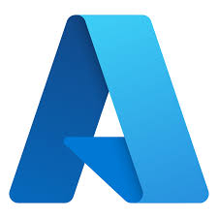

MICROSOFT INNOVATION CHALLENGE - QueryGenie
Team Members:
Aruthra S (Female - Asian)
Arun Pranav A T (Male - Asian)
R S Kierthana (Female - Asian)

Slide 2
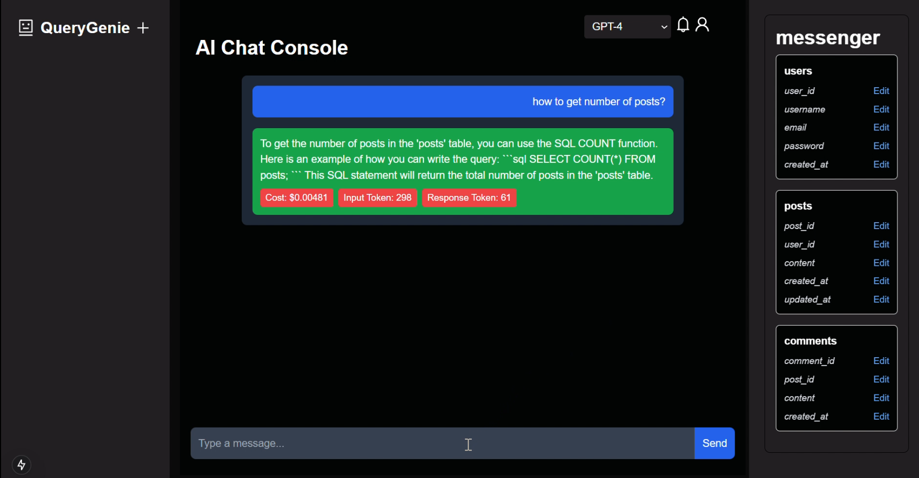
QueryGenie
Talk it, query it, done!
QueryGenie is an advanced tool that converts natural language prompts (both text and voice inputs) to SQL queries. It manages the usage based on token counts and cost incurred, along with detailed analytics for each user profile.
Executive Challenge - "Chat with your data" token utilization and cost monitoring challenge

Slide 3
Features
Converts natural language prompts to SQL queries.
Supports both text and voice inputs and outputs.
Tracks token counts and cost incurred.
Provides detailed analytics for each user profile.
Notifies users when token limit is nearing based on set limits.
Allows any form of databases to be linked.
Considers history of the chat when required.

Slide 4
Innovation
Provides detailed analytics for each user profile while existing projects concentrates only on natural language prompts to SQL queries.
Follows separate notification system while existing projects lack them.
History can be deleted supporting responsible AI while existing projects could have missed them.
SQL Queries generated are read out loud which supports visually impaired users.
Prompts can be given in form of voice too for those who find it difficult to type.

Slide 5
Tools Used
Azure Database for PostgreSQL (Database)
Azure OpenAI (AI)
Azure App Service (Hosting)
Azure Authentication (Authentication)
Python (Backend)
Next.js (JavaScript - Frontend)
GitHub Copilot
Git and GitHub
LangChain

Slide 6
SCREENSHOTS (main dashboard – prompt to query, right side database structure pane, left side history pane)

Slide 7
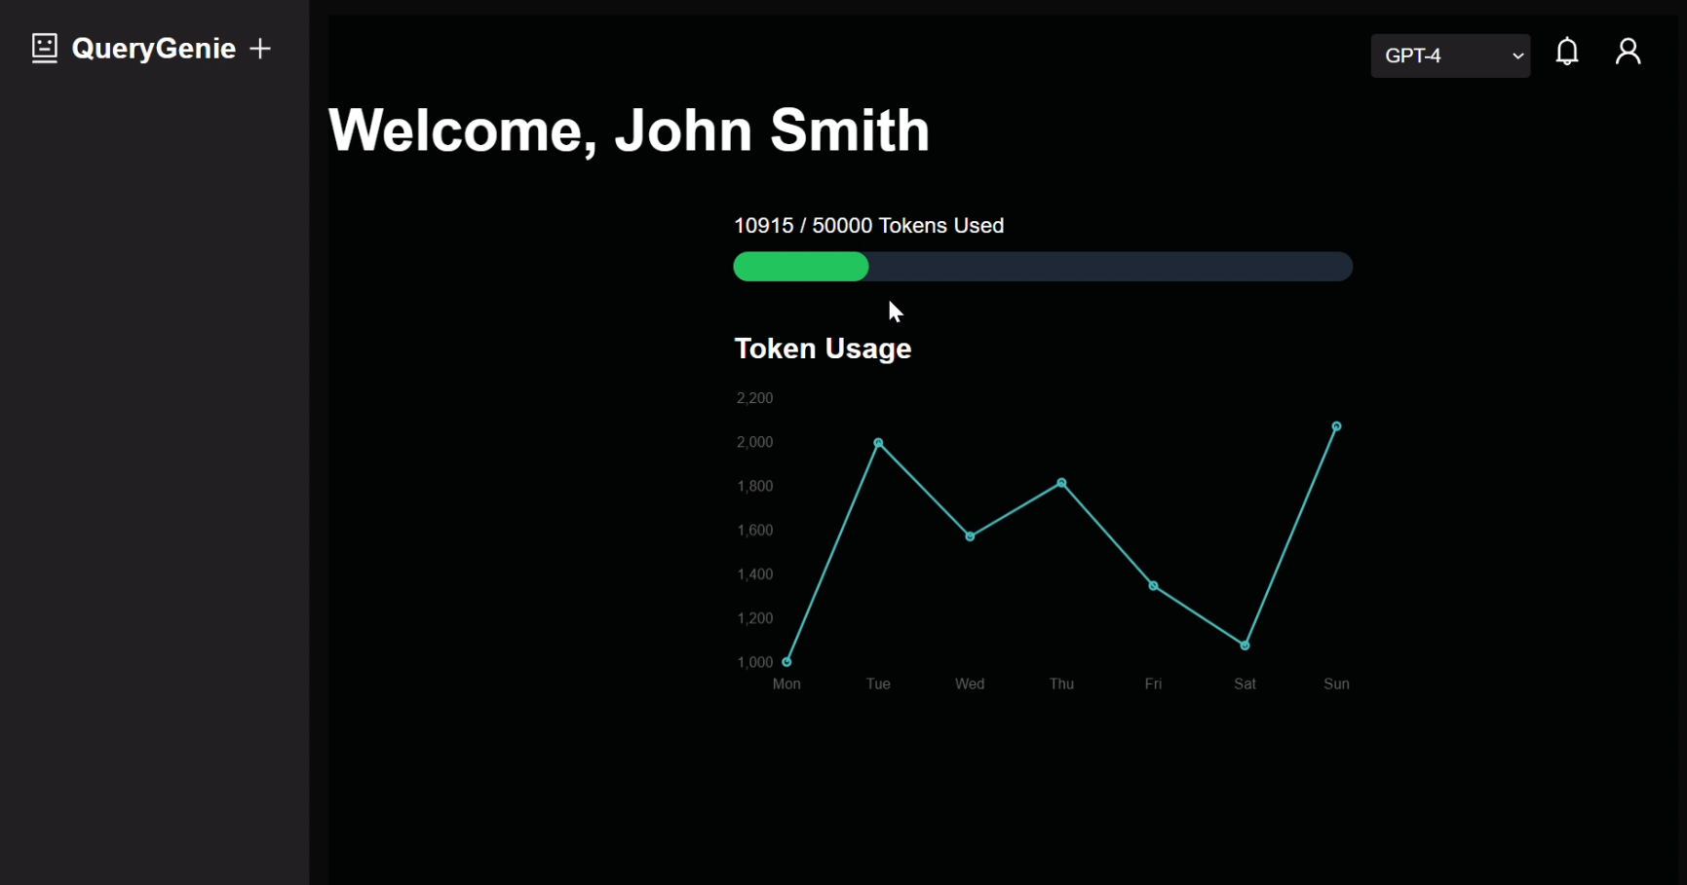
SCREENSHOTS (token limit notification)

Slide 8
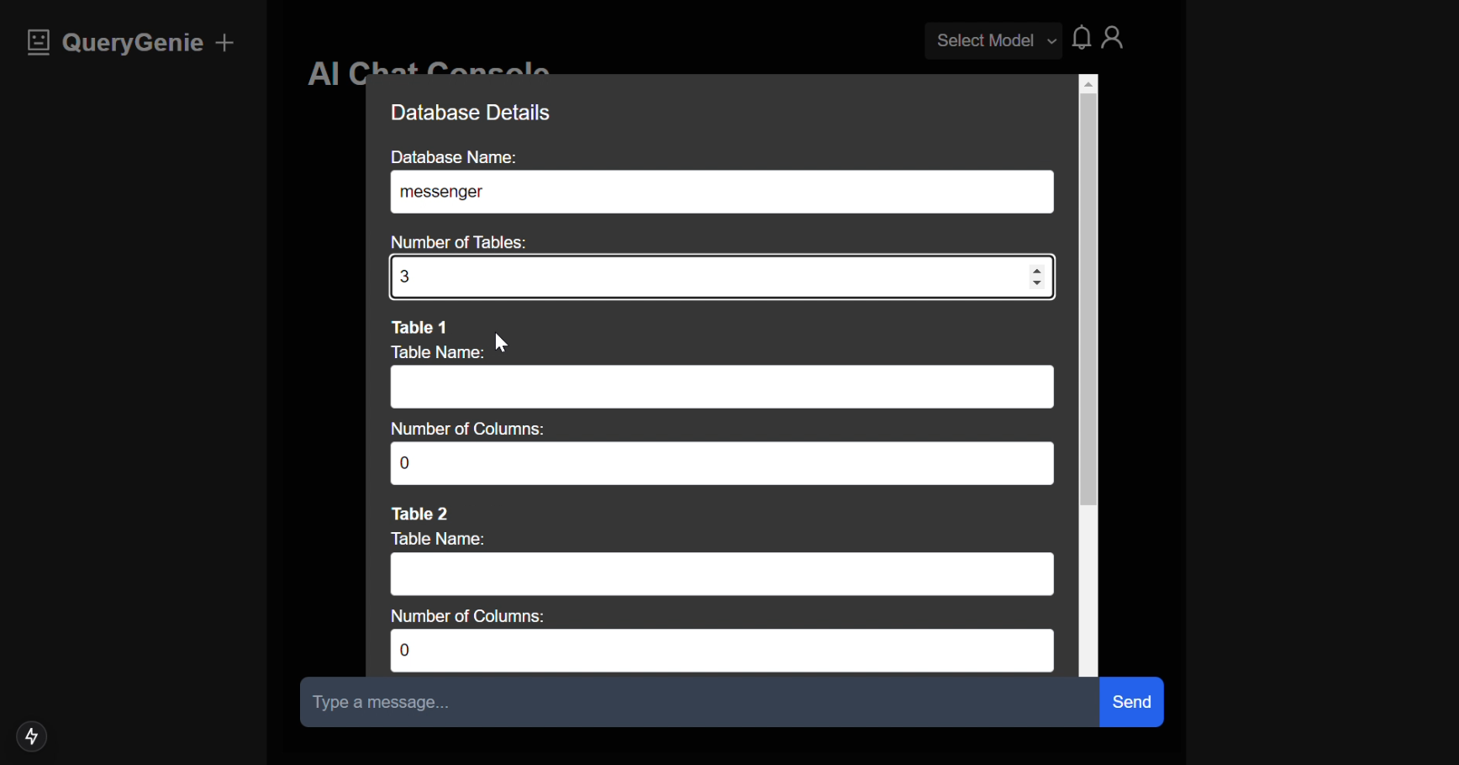
SCREENSHOTS (database details linking)

Slide 9
SCREENSHOTS (token limit notification)

Slide 10
THANK YOU

