Slide 1
Human-Friendly Intuitive and Deterministic Sudoku Solver
Based on simple to complex logics incorporated by humans
Arun Prasaad Gunasekaran

Slide 2
Overview
Sudoku Basics
Why this approach?
Terms used

Slide 3
Sudoku Basics
An n x n number puzzle with numbers 1 to n filled in n rows, n cols, and n subgrids.
Every number appears only once in each row, column, and subgrid.
Classic sudoku: eg: 9 x 9 Sudoku
  n = 9 “square” puzzle
  9 rows, 9 columns and 9 3x3 subgrids.
  Called a “square” puzzle as the subgrids are also squares.
Classic Sudoku derivatives: eg: 4 x 4, 16 x 16, 25 x 25
Non-classic sudoku derivatives: eg: 6 x 6 sudoku with 6 2 x 3 subgrids.

Slide 4
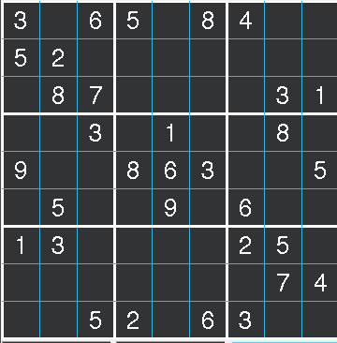
Sudoku Basics
A typical 9 x 9 sudoku
  Usually more numbers imply easier sudoku.
  Exceptions exist, as some outliers exist where even with many numbers, the solution is hard, and with less numbers, the puzzle is easy.
  When framed manually, or generated using computers, care is made to make sure only one solution exists

Slide 5
Why this approach?
Computer programs that solve this puzzle are far too abstract or tedious to manually do.
  Knuth’s Algorithm X Exact Cover Solution.
    Elegant, and wonderful problem to get an exact solution.
    But the method used is not human-friendly to solve.
  Backtracing.
    Just educated guessing.
    Solving time does not depend upon the difficulty of the sudoku.
  Constraint Programming / Optimisation techniques
    Elegant mathematical solutions
    Hard to manually do it.

Slide 6
Why this approach?
Manual method is quite obvious and doable.
  We can find patterns and missing numbers.
  Logics can be used very effectively.
  Using computers makes it faster and efficient
  More the number of logics and algorithms implemented, the better the solution.

Slide 7
Terms used
Problem Matrix
  Simply put, it is the given sudoku in the form of a matrix.
  Problem matrix can be easy, medium, hard, or expert level in terms of difficulty.
  Has a lot of missing numbers that needs to be filled.
  Almost always – as a rule of principle – has only one solution!

Slide 8
Terms used
Grid/Cell
  Each and every box that stores a number.
  Each grid/cell is referred using the row and column indices.
  Indices start with 1 in normal speech and 0 in the program.
  Eg: grid(3, 2) = 8; grid[2][1] = 8

Slide 9
Terms used
Subgrid
  Each 3x3 box with 9 grids is a subgrid.
Row
  Each 9 consecutive horizontally placed grids.
Column
  Each 9 consecutive vertically placed grids.

Slide 10
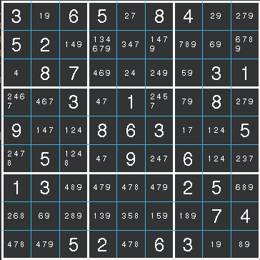
Terms used
Markup
  A universal set of all possible numbers in each and every cell/grid of a problem matrix.
  Each empty cell initially has all the possible numbers it can hold at the beginning of the problem.
  The sudoku problem is merely reducing the number of potential numbers in each and every cell/grid to only 1 – thereby making an exact solution.

Slide 11
Terms used
Obvious Solution
  When doing a markup, only one entry occurs in one or more number of cells.
Hidden solution
  When doing a markup, a particular number occurs only once in a row or column or subgrid.

Slide 12
Terms used
Doublets
  Two numbers exactly appearing twice in a row/column/subgrid.
  There are different types:
    SG Doublet, SG Row doublet, SG Col doublet
    Naked Row doublet, Naked Col doublet
Triplets
  Similar to doublets but with three numbers.
Row/Col blocker
  A number occurs only along the row/column in a Subgrid. So, it cannot occur in other subgrids along the row or column.

