Slide 1
Fortran with MPI
Arun Prasaad Gunasekaran
What is it? How to get started, and details
Image Sources:https://computing.llnl.gov/tutorials/parallel_comp/

Slide 2
Outline
What to Expect?
What is MPI?
How does it work?
Supported Languages?
Requirements
Installation
Pros/Cons
Alternatives

Slide 3
What to Expect?
Covers some vital commands
Semi-Realistic examples
Designed to give a good motivation into the topic
Covers basics with a few advanced topics
For Beginners
  Motivating Examples
  Explainer
  Reference
For Advanced Users
  Reference
  Brush-up

Slide 4
What is MPI?
MPI – Message Passing Interface.
It works on top of a compiled programming language.
Created for enabling Parallel Programming.
Works on Distributed Memory Systems.
The program runs in all processors.
Parallelized programs are much different from serial programs.
Selective portions are done by different processors
Results and data are communicated (“passed”) between processes as packets of data (“messages”) through the network (“Interface”)
Hence the name “Message Passing Interface”

Slide 5
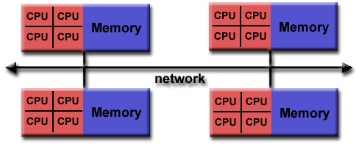
How does it work? - Distributed Memory Systems

Slide 6
How does it work?
Each process runs the program separately,
Individual processes communicate with other processes requesting data,

Slide 7
Supported Languages
Compiled Languages - C, C++, Fortran
Also available in Python (MPI4PY)

Slide 8
Requirements
Compilers
  GNU (gcc, g++, gfortran)
  Intel (icc, icpc, ifort)
Atleast One MPI Implementation
  OpenMPI
  MPICH
  MVAPICH

Slide 9
Installation
Will be using GNU Fortran with MPICH
Installting gnufortran
Installing mpich
Verification
Check for gfortran, mpirun, mpiexec, mpicc, mpi++, mpif90

Slide 10
Pros/Cons
Scalable
Portable
Avoids Race Condition
Can run in both Shared and Distributed Memory Systems
Cannot compile the code serially
Speed limited by communication lags
Tendency to become complicated

Slide 11
Alternatives
OpenMP
OpenACC
GPU computing

