Slide 1
Second Year Anniversary
Thank You all!
Arun Prasaad Gunasekaran

Slide 2
Channel Statistics
360 000 + Views (last year: 100 000 + views)
1950 + Subscribers (last year: 700 + subscribers)
USD 320 pay-check! :) (last year 100 USD)
~800 views per day (28 day moving stat) (last year ~ 500 views per day)
~110+ subscribers per month (moving stat) (last year ~80)
331 videos so far (211 at last year)
16 playlists (plus 1 playlist about the series and 1 about my shout outs )

Slide 3
Public Reach
Most viewers from (top 25 countries)
  India, USA, Germany, UK, Brazil, Canada, France, Japan, South Korea, Turkey, Italy, Mexico, Netherlands, Australia, Columbia, Bangladesh, Indonesia, Spain, Algeria, Nigeria, Greece, Singapore, Taiwan, Pakistan, Nepal .
  But, I noticed that the viewers are from atleast 100 countries!
Age wise:
  People of age group 18-34 are the major viewers.
  ~87-88% Male (2-3% drop) and ~12-13% Female (2-3% rise)
Most Popular Channel: Fortran Programming Tutorials(Revised)

Slide 4
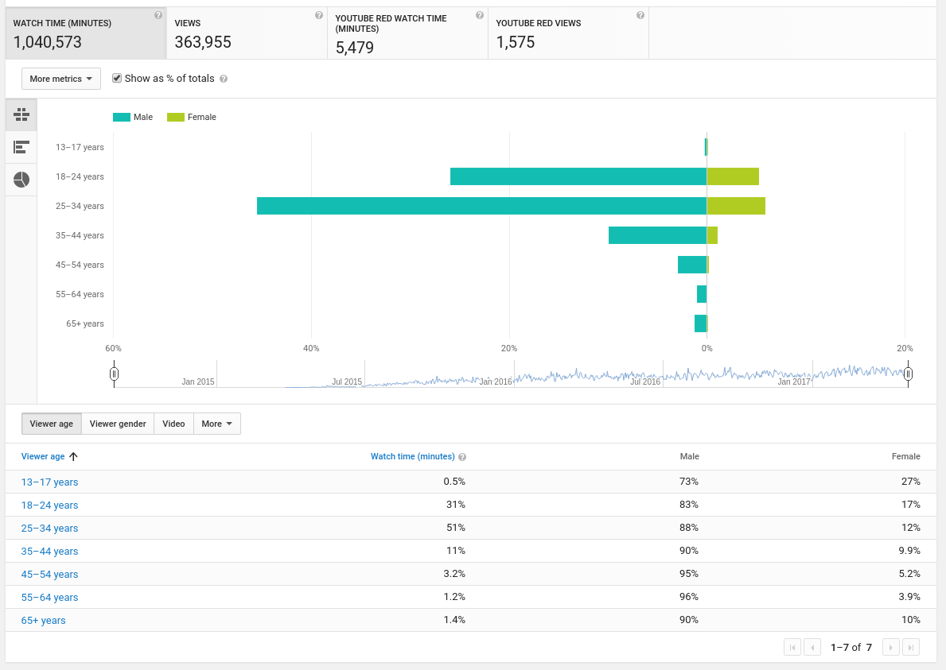

Slide 5
Playlists – 2016-2017
Playlists Under Progress
Linux Programming
C programming
Matplotlib
Playlists Stalled
Fortran – OpenMP
Computer Terminologies in HPC
New – Additions
Makefile Tutorials
Linux Distro Review (Open)
Linux Hacks (Open)
Linux News (Open)
Matplotlib
C programming

Slide 6
Playlists – 2017-2018
Playlists Will finish
C Programming
Matplotlib Plotting
Playlists to be revamped
Linux Tutorials
Terminologies in HPC
Fortran OpenMP
Under Consideration
C++ Programming
Numerical Methods
Data Analysis
Approaching N-S Equations
High School and Advanced Mathematics
Demo videos – programming and live demos
Basic Python
MPI in Python

Slide 7
What happened this year
Went to Germany and returned (could not work on channel)
Reading quite a lot (Programming, Linux, video styles, presentation styles, ideas ...)
Hectic schedule
Got new gadgets (Blue Snowball Microphone, Dell 1920x1080 monitor)
Thumbnails to the videos (Thanks to my friend Ali)

Slide 8
Suggestions, Feedbacks and Recommendations?
Drop a comment or leave a message
  Will definitely read through
Open to constructive criticism
FILL THIS FEEDBACK FORM!
https://docs.google.com/forms/d/e/1FAIpQLSca1GCaO3Sx9ldPjdTq2txvlW8dnOUhoDVIyj7DPIOgnoauCQ/viewform?usp=sf_link
Open till October 31st 2017!

Slide 9
Thank you all!
Friends,
Family,
Mentor,
Viewers and Subscribers! :)

