Slide 1
Third Year Anniversary
Thank You all!
Arun Prasaad Gunasekaran

Slide 2
Channel Statistics
724 000 + Views (last year: 360 000 + views)
3750 + Subscribers (last year: 1950 + subscribers)
~1150 views per day (28 day moving stat) (last year ~ 800 views per day)
~140+ subscribers per month (moving stat) (last year ~110)
374 videos so far
23 playlists.

Slide 3
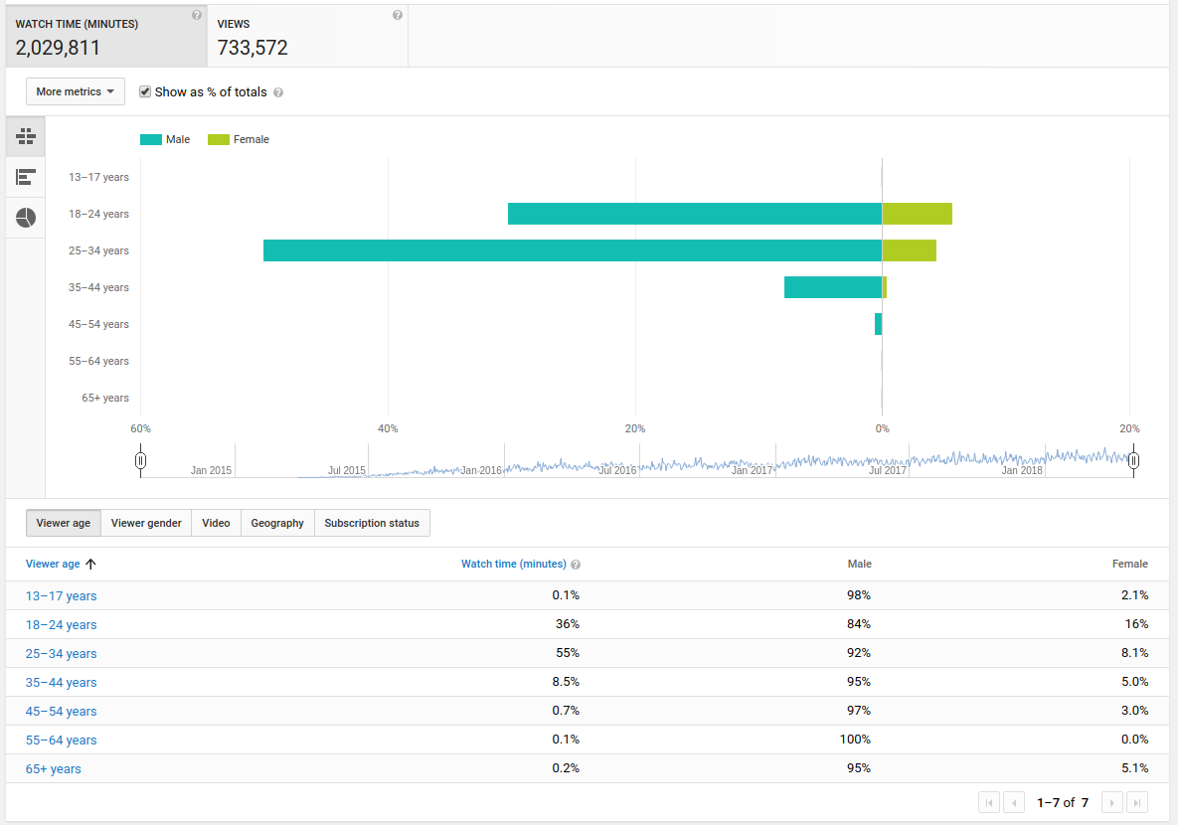

Slide 4
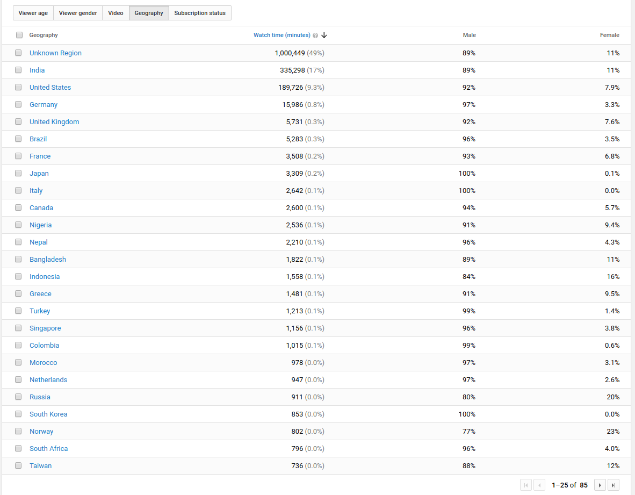

Slide 5
What happened last year.
Rough Year
  Issues with PhD,
  Felt emotionally, and physically ill and weak,
  Diagnosed with Depression and Anxiety,
Most of the time
  Reading obsessively (books, programming, motivation lectures),
  Adjusting a broken sleep cycle,
  Trying hard to keep myself motivated to work, and not quitting,
Dilemma about the Channel
  Should I drop the channel?
  Struggling to good examples / time / motivation to finish playlists,
Beating myself (figuratively) with too high standards
  Wanted to learn animation, Web design, a musical instrument, and blog besides PhD, and Channel (I know I am crazy!)
  Felt frustrated and sunk deeper into sadness because I could not do justice,

Slide 6
There is hope!
Slowly taking steps to recover,
  Seeking medical help
Trying to engage physically
  No significant physical activity for the past few years
(Trying hard) adjusting my schedule,
Being closer to family and friends, (Tried to distance them to solve the issues on my own – but it never helped!)
(Again, trying hard in) Incorporating my crazy wishlist,

Slide 7
What you can see for the future years?
Finish some of the existing playlists
Planning for new programming playlists
  HTML
  CSS
  JavaScript
Planning for new non-programming playlists
  Mathematics
    Calculus
    Linear Algebra
    Numerical Methods
    Probability and Statistics
  Physics
    University Physics,
    Thermodynamics, Fluid Dynamics,

Slide 8
Thank you for the feedback!
23 responses!
Good feedback from all of you!
Will work on the feedback given.
There is one more feedback link in the description! Please fill it! Would like to know about your views.

Slide 9
New Land Mark!
Website coming soon!
  Design stage nearing completion
  Hosting plans under review
  In my free-time, (if at all I get lol :D), I’ll fill in the blogs and share my personal notes!
  You can access them easily, along with my blogs and other fancy stuff (stay tuned!)
Thinking of opening a Patreon Account to sustain my channel. (Leave your opinions, suggestions, in the comments! :) )

Slide 10
Thank you all!
Friends,
Family,
Mentor,
Viewers and Subscribers! :)
Indirectly and directly, thanks to your support, I am persisting forward! Your support means a lot to me!

