Slide 1
OpenMP
What is it? Details and Setup!
Image Sources: https://computing.llnl.gov/tutorials/parallel_comp/

Slide 2
What is it?
Open Specifications for Multi-processing
Application Programming Interface (API)
Works on top of a compiled programming language.

Slide 3
Applied to ...
Compiled Programming Languages (C, C++, Fortran)
  Because the code is optimized and all “memory” and functional requirements are known before the execution.
  N/A to interpreted programming languages as this is not known before hand.

Slide 4
How does it Work?
  Uses pre-processor directives, functions and subroutines which COMMAND the compiler to do certain operation more stingently.
  Takes the machine codes and optimizes them even further.
  So, taking a well working serial code and making slight tweaking using OpenMP does the job!
  User should specify the regions where “parallelisation” is possible.
  Works on a shared memory system

Slide 5
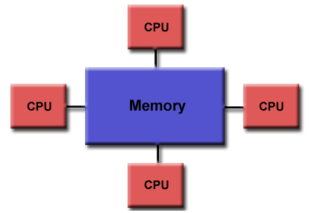
Shared Memory System

Slide 6
Syntax
Pre processor directives:
!$ fortran code
eg:
!$ print *, (“Hello world from”, omp_get_thread_num())

Slide 7
Syntax
Blocks or constructs
!$omp <construct name> <clause> <args>
......
!$omp end <construct name>

Slide 8
What do you need to Start with?
GNU Fortran (preferrably a latest version)
  It has pre-defined OpenMP commands, subroutines etc., built in it.

Slide 9
About MPI ...
Message Passing Interface
  Works on Distributed Memory Systems
  The program is defined such that it runs on all processors
  Selective elements are done by different processors
  The results are “passed” between processors using “message” calls through “interfaces” - hence the name.
  Parallelized program cannot be run serially!!!

Slide 10
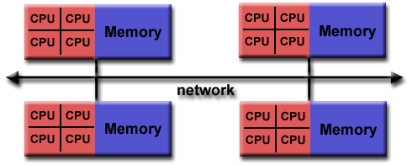
Distributed Memory System

