Slide 1
Review Rating Prediction
Submitted by

Slide 2
Our Vision
Build an application which can predict the rating by seeing the review
We have a client who has a website where people write different reviews for technical products. Now they are adding a new feature to their website i.e. The reviewer will have to add stars(rating) as well with the review. The rating is out 5 stars and it only has 5 options available 1 star, 2 stars, 3 stars, 4 stars, 5 stars. Now they want to predict ratings for the reviews which were written in the past and they don’t have a rating.
Problem Statement

Slide 3

Problem Statement And Understanding
A client who has a website where people write different reviews for technical products is introducing the ‘add star’ feature to their website.
The company wants to use data science and Machine Learning techniques to predict the ratings for the review which were written in the past that does not have a rating.
The goal is to build an application which can predict the rating by seeing the review.

Slide 4
Data Collection and Ingestion
Scraping data: data_collection.ipynb
Selenium webdriver was used to scrape data from websites.
Data was scraped from Amazon, Flipkart websites. There are some outliers in the dataset.
Data Ingestion: data_ingestion
The scraped data from different sites are combined and stored together in a single file.

Slide 5
Exploratory Data Analysis
Variable Data Analysis
This is a Multi-Rating Ratingification problem. The target variable contains numeric integers 1, 2, 3, 4 and 5. 1 being poor and 5 being excellent.
The dataset contains Reviews and Ratings fields which are scraped from Amazon, Flipkart and Snapdeal sites for different products.
Shape and Features
There are 280332 records and 1 feature + 1 target variable in the whole data.
The dataset has text features.

Slide 6
Exploratory Data Analysis
Data Set
Sampling
Null Values
The original data is imbalanced with the Ratinges:
Rating 5 has 7486 samples
Rating 4 has 3619 samples
Rating 1 has 2840 samples
Rating 3 has 2250 samples
Rating 2 has 1130 samples
The Duplicates are droped from the original dataset. After dropping duplicates, there are 5650 records.
Sampling technique was used to balance the dataset.
Upsampling gave better model performance than downsampling.
Google Translator was used for upsampling the data.
There were 2 NAN Values Present
we will remove the Missing value with dataframe.dropna()

Slide 7
Data Cleaning and Data encoding
Data Cleaning Approach
Text Data Encoding
Email addresses are converted to the text ‘emailaddress’.
Web site links are converted to the text ‘webaddress’
Phone numbers are converted to the text ‘phonenumber’
Currencies are converted to the text ‘currencyamount’
Numbers are converted to the text ‘numbr’.
The non-alphabetic characters are removed from the review texts.
Extra white spaces are removed.
Stop words are removed.
Monograms, bigrams and trigrams are used.
10,000 is used as the max_feature value to avoid memory error and slowness.
Adding more than 10000 features did not show significant increase in the model performance till max_features = 25000.
Using max_features > 25000 takes too long to execute.

Slide 8
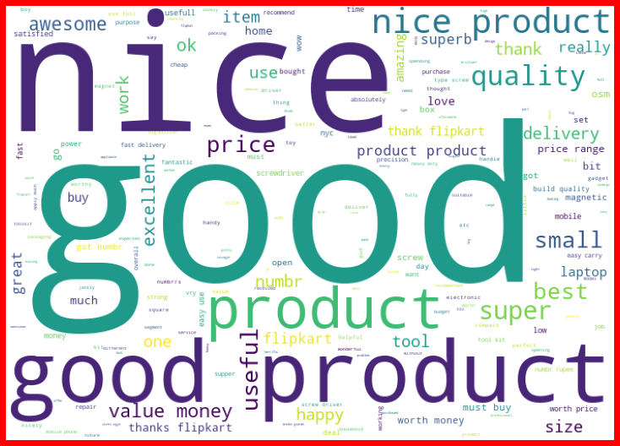
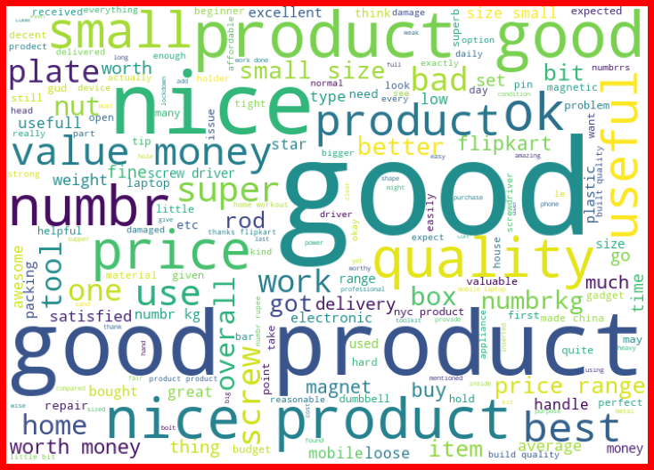
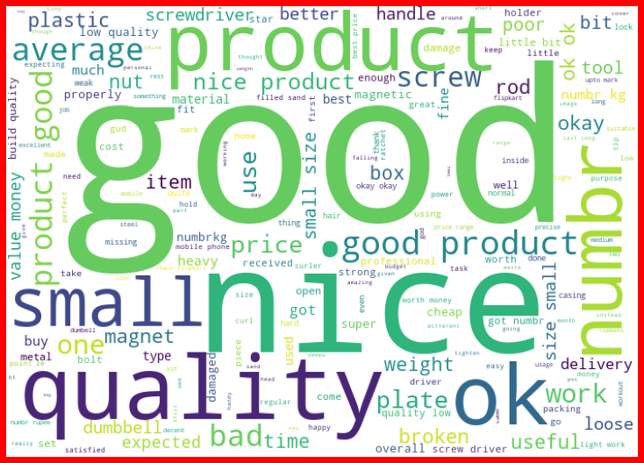
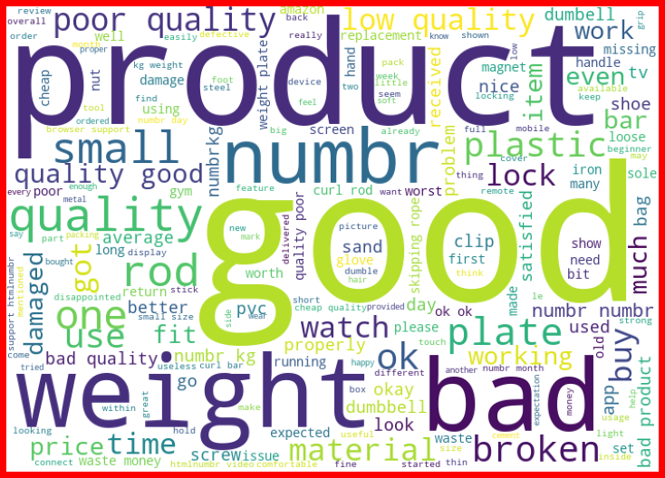
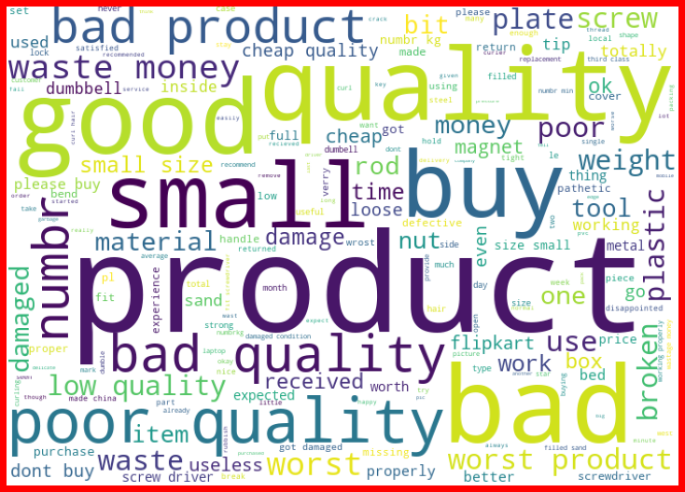
Rating Word Cloud
Rating 5
Rating 4
Rating 3
Rating 2
Rating 1

Slide 9
Rating Word Cloud
We can see that there is a clear distinction between the words used in the reviews of Rating 1 and Rating 5.
The Rating 1 reviews have many negative words for eg: 'Stopped working', 'waste money', 'bad product', etc,.
The Rating 5 reviews have many positive words for eg: 'value money', 'nice product', 'better', 'good quality'.
Some of these positive words in Rating 5 reviews are also available in Ratings 3 and 4.
Also, there are some other words in the word cloud that are unique to Ratings 3, 4 and 5 respectively.
Hence monogram, bigram and trigram are used in TFIDF.

Slide 10
Steps taken to complete the project
Performed data cleaning based on NLP approaches.
Trained and validated different Machine Learning classification models(base and ensemble models) to select a suitable model.
Chose the final model based on Accuracy and Classification Report.
Steps

Slide 11
Final Model
The final model used is GradientBoostingClassifier
The tuned hyper parameters used are:
n_estimators = 233,
min_samples_split = 2,
min_samples_leaf = 1,
max_features = 'auto',
max_depth = 100

Slide 12
Final Model

Slide 13
The more the data the better the model performs.
Accuracy is a good metric since the data is perfectly balanced.
The GradientBoostingClassifier gives a good result after hyperparameter tuning.
Adding more sample data to the training can improve the performance.
Using Word Embedding techniques like Word2Vec with better computation power can give better performance
Conclusion

Slide 14
Thank You!
Any Questions?

