Slide 1

Lending Club Case Study
Chaitanya Patchigolla
ARUNPRASAD SRIDHARAN

Slide 2
Unlocking Data For Informed Lending Analysis
PROBLEM STATEMENT

Slide 3
Tasks Done
Data preprocessing Summary
Lots of Data cleaning activities done which can be seen in ipython notebook
Univariate Analysis
Segmented Univariate Analysis
Multivariate Analysis
Analysis done on multiple variables explained in the presentation Segmented Univariate Analysis Multivariate and Bivariate analysis

Slide 4
Data Preprocessing Summary
Identified Data Issues:
54 fully n.a. and null columns dropped
9 duplicate columns dropped
10 irrelevant columns dropped
Data Imputation:
Imputed missing values in 5 columns meaningfully. i.e. mths_since_last_delinq, emp_length, pub_rec_bankruptcies, mths_since_last_record, revol_util
Data Transformation:
Replaced and transformed values in few columns by changing type from object to int64 / float64
Removed ‘months’ keyword for all values in ‘term’ column and converted to int64
Removed ‘%’ keyword for all values in ‘int_rate’ and ‘revol_util’ columns and converted type to float64
‘emp_length’ is converted from object type to float64

Slide 5
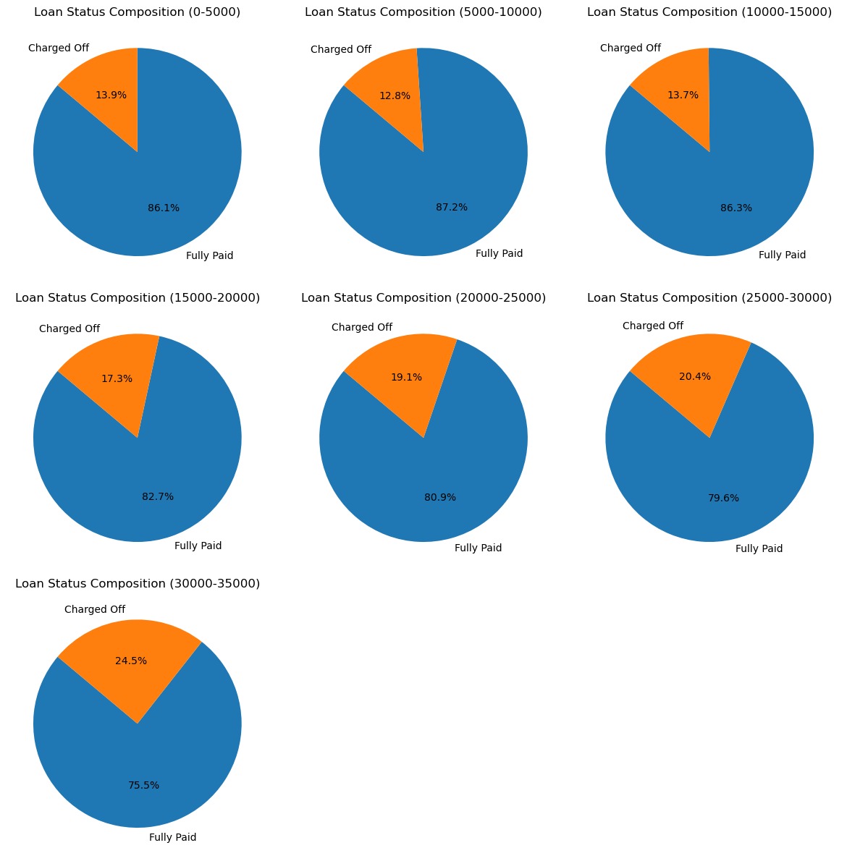
Univariate analysis
"Higher Loan Amounts Lead to Increasing Charge-Offs”
In Loans exceeding $30,000 -> ~24.5% of borrowers default (among both Charged Off and Fully Paid categories).

Slide 6
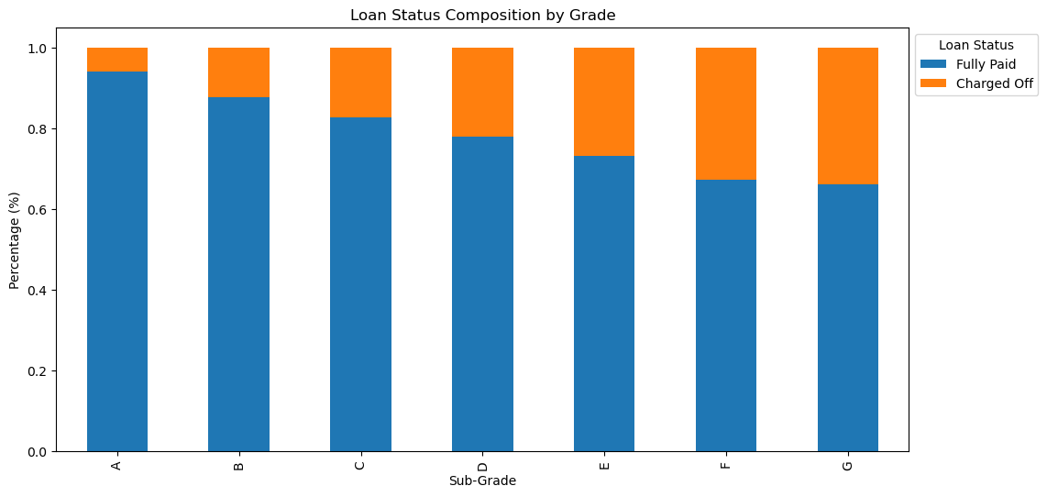
Significant Charge-Off Rates in Grade F and G Loans
Higher the grade alphabetically, higher the risk.
Notably, F5 subgroup stands out with a striking 50% charge-off rate

Slide 7
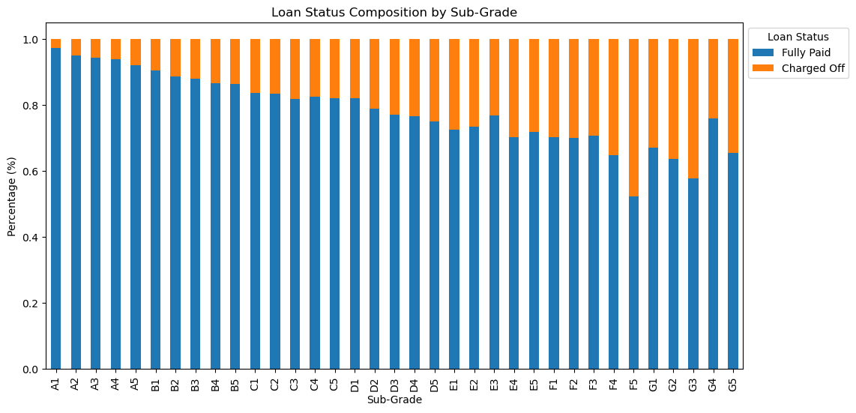
Bar graph depicting “Defaulters distribution by Sub-Grade”

Slide 8
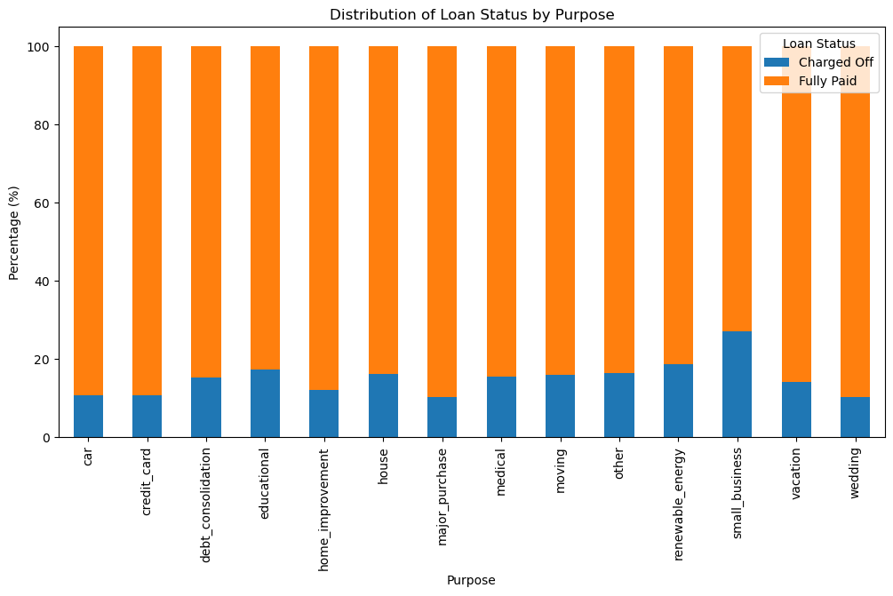
Marriage loan is safest. Small Business Loans are risky.
“Small Business” Loans exhibit the highest charge-off rate, Warranting a closer look at their interest rates.
“Marriage” Loans are the most secure, suggesting the potential for rate adjustments elsewhere."

Slide 9
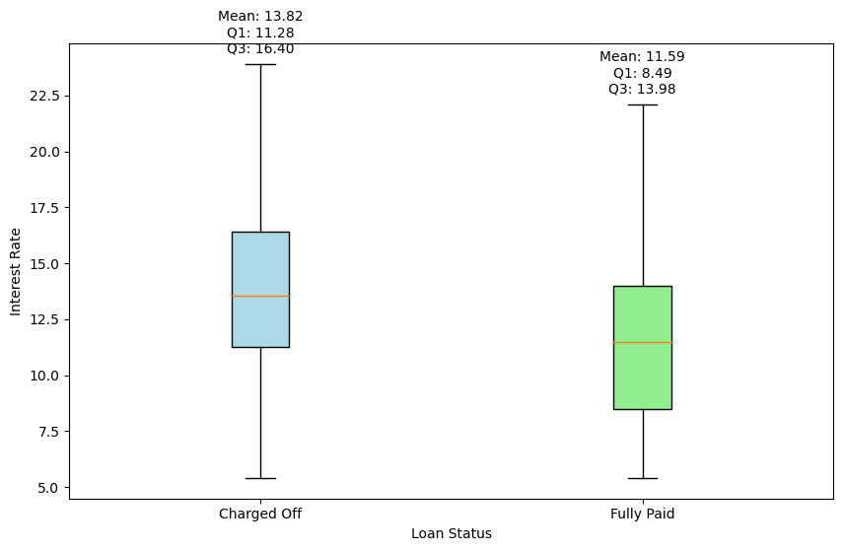
Exploring Interest Rate Influence on Loan Repayment
Box plot of Charged Off loans and Fully Paid loans provide many insights.
Loans featuring interest rates less than 11.26% demonstrate a notably elevated likelihood of achieving full repayment

Slide 10
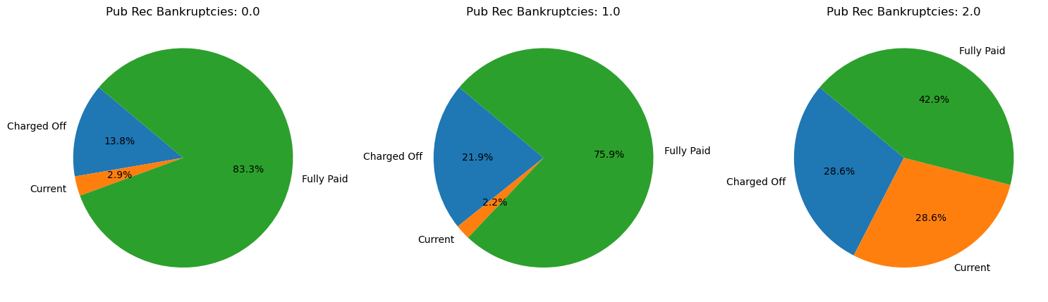
Assessing Default Risk Factors
Clients with a history of derogatory credit incidents or a public record of bankruptcies are at a heightened risk of loan defaults

Slide 11
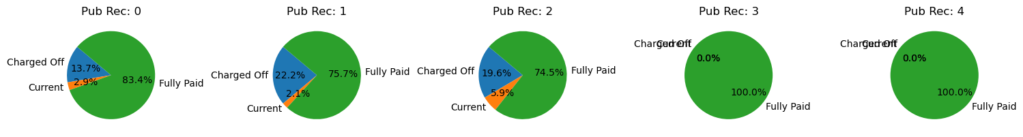
Public Record of Bankruptcies distribution

Slide 12
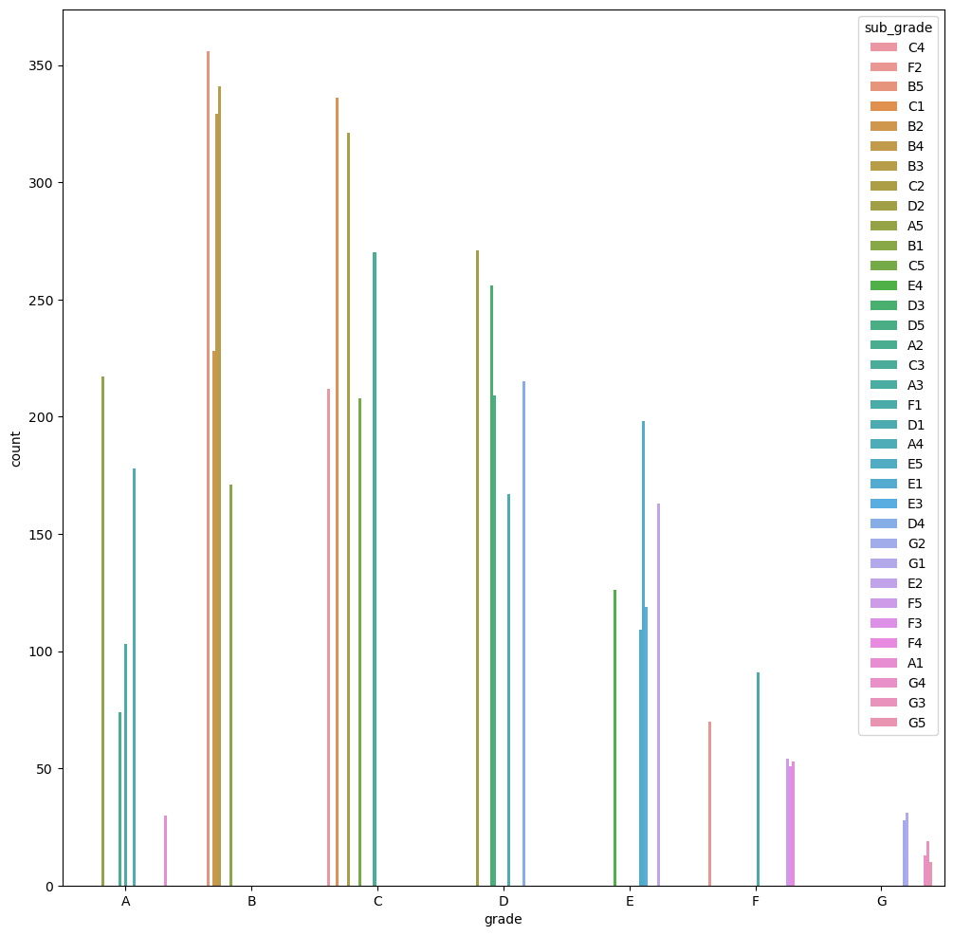
Multi variate Analysis
Bar graph between Grade Vs Sub-Grade Vs Count (Aggregation)

Slide 13
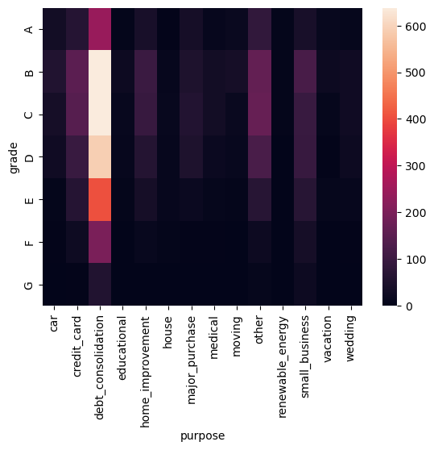
Heatmap of Grade Vs Purpose

Slide 14
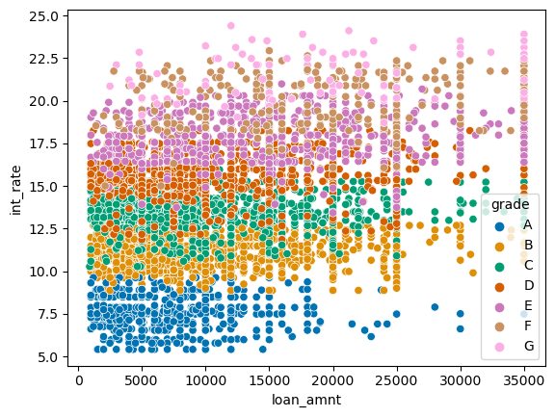
Multi variate analysis 2
Scater plot for int_rate vs loan_amount vs grade
Higher the grade. Higher the interest rate

