Slide 1

Important Python Concepts – in Detail
-- Arunkumar Nair
04 Jan 2020

Slide 2
Data Types, Data Structures

Slide 3
Help for Python
More Information about Python
https://docs.python.org/3/
More information about data types
https://docs.python.org/3/library/datatypes.html

Slide 4
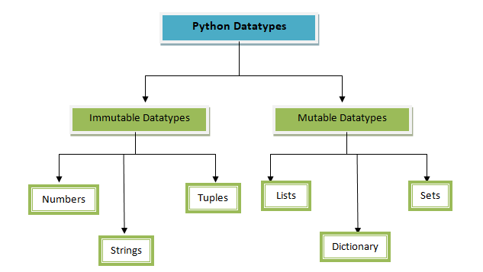

Slide 5
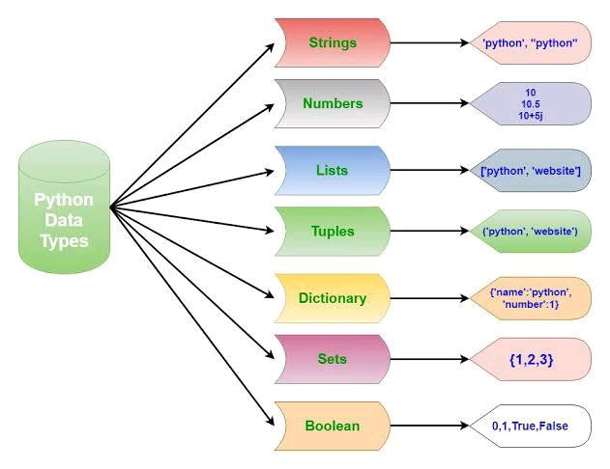

Slide 6
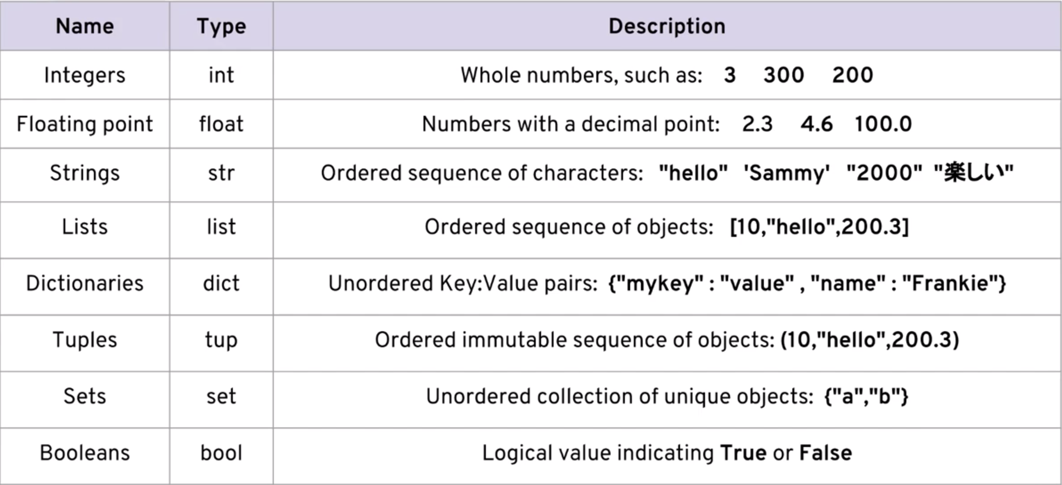

Slide 7
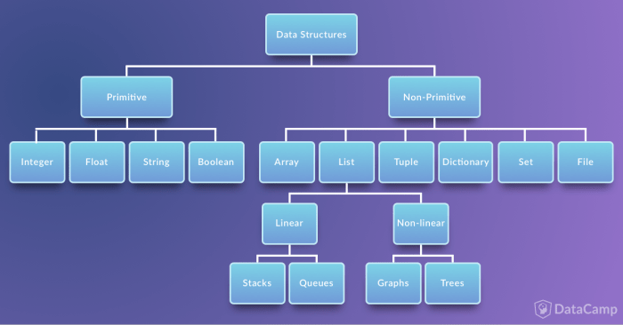
Data Structures
Immutable:
In primitive type, it copies the actual value and therefore changing one value won't change a different variable even if they were used the same root var..
In Python : Tuple is Immutable
Mutable
Non primitive however, only use references and therefore changing one value will change in all the vars that store the same reference...

Slide 8
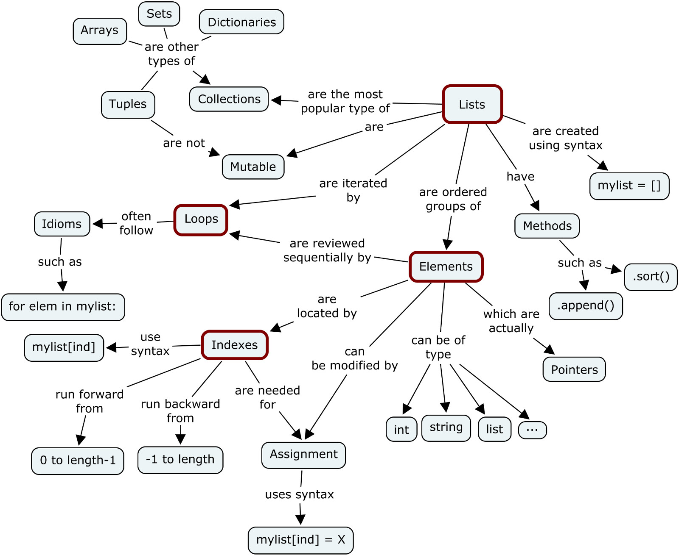

Slide 9
Tuples are Immutable ?
Python tuples have a surprising trait: they are immutable, but their values may change.
This may happen when a tuple holds a reference to any mutable object, such as a list.
Variables are NOT like boxes where you store data.
http://radar.oreilly.com/2014/10/python-tuples-immutable-but-potentially-changing.html

Slide 10
Mutable and Immutable
https://medium.com/@meghamohan/mutable-and-immutable-side-of-python-c2145cf72747

Slide 11
Tuples are Immutable?
What is immutable is the physical content of a tuple, consisting of the object references only. The value of the list referenced by dum[1] changed, but the referenced object id is still the same. A tuple has no way of preventing changes to the values of its items, which are independent objects and may be reached through references outside of the tuple, like the skills name we used earlier. Lists and other mutable objects inside tuples may change, but their ids will always be the same.

Slide 12
Types of Data Structures
String
Data Structures
  List
  Tuple
  Set
  Dictionary

Slide 13
String
Its a sequence of characters
Single Quotes & Double Quotes are treated similar
Triple Quotes : doc-string, multiline comments
Strings are immutable
Representation & Slicing

Slide 14
String
Methods :-
  count
  index
  find
  join
  Isalnum, isalpha, isdigit, islower, isspace, isupper
  lstrip, rstrip, replace, partition, split, rsplit
  endswith, startswith

Slide 15
List
Ordered collections of heterogeneous objects
Representation is similar to String
Mutable, can grow and shrink whenever required

Slide 16
List
Methods :-
  count
  append
  extend
  index
  insert, pop, remove, reverse, sort
  __add__, __contains__, __eq__, __ge__, __sizeof__ .....

Slide 17
Tuple
Ordered collections of heterogenous objects
Representation is similar to String, List
Immutable
Methods :-
  count
  index
  __mul__, __add__, __contains__, __eq__, __ge__, __sizeof__ .....

Slide 18
Set
Ordered collections of heterogeneous unique objects
Representation is similar to String, List but cannot be sliced or accessed using index
Mutable

Slide 19
Set
Methods :-
  add
  pop
  clear
  copy
  discard v/s remove (raise KeyError)
  difference, intersection, union .....

Slide 20
Dictionary
Unordered collection of key-value pairs
Representation is similar to String, List but cannot be sliced or accessed using index.
Mutable

Slide 21
Dictionary
Methods :-
  copy
  fromkeys
  has_key
  items
  keys, values
  iteritems, iterkeys, itervalues
  pop, popitem
  viewitems, viewkeys, viewvalues

Slide 22
Slicing
Slicing : extracting specific set of data from the container.
Lists, Strings & Tuple support Slicing
Reverse Indexing

Slide 23
Formatting for Printing in Python

Slide 24
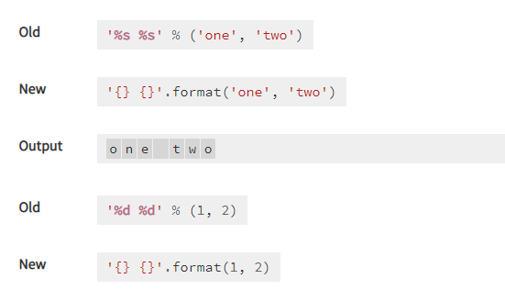
Format
Basic Formatting-Simple positional formatting is probably the most common use-case
https://docs.python.org/3.4/library/string.html

Slide 25
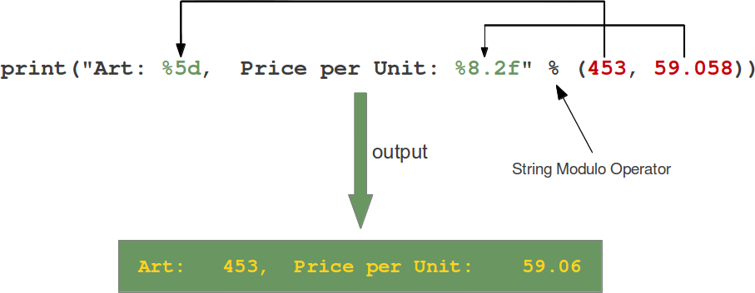
Format
How % string modulo operator works
https://www.python-course.eu/python3_formatted_output.php
(Below is the old style)

Slide 26
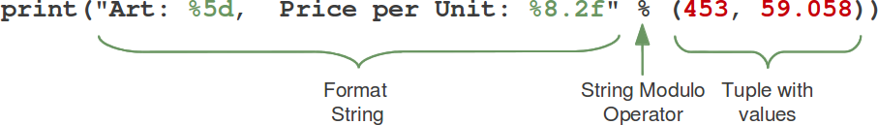
Format
How % string modulo operator works
https://www.python-course.eu/python3_formatted_output.php
(Below is the old style)

Slide 27
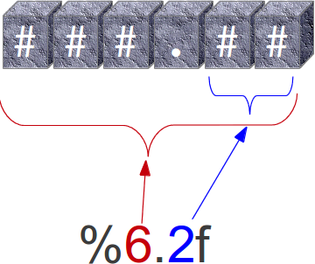
Format
How % string modulo operator works
https://www.python-course.eu/python3_formatted_output.php
(Below is the old style)
The second one "%8.2f" is a format description for a float number. Like other placeholders, it is introduced with the "%" character. This is followed by the total number of digits the string should contain. This number includes the decimal point and all the digits, i.e. before and after the decimal point. Our float number 59.058 has to be formatted with 8 characters. The decimal part of the number or the precision is set to 2, i.e. the number following the "." in our placeholder. Finally, the last character "f" of our placeholder stands for "float".

Slide 28
Format
How % string modulo operator works
https://www.python-course.eu/python3_formatted_output.php
(Below is the old style)
The second one "%8.2f" is a format description for a float number. Like other placeholders, it is introduced with the "%" character. This is followed by the total number of digits the string should contain. This number includes the decimal point and all the digits, i.e. before and after the decimal point. Our float number 59.058 has to be formatted with 8 characters. The decimal part of the number or the precision is set to 2, i.e. the number following the "." in our placeholder. Finally, the last character "f" of our placeholder stands for "float".

Slide 29
Format
NEW STYLE of Positional Parameter of the format {}
https://www.python-course.eu/python3_formatted_output.php
A positional parameter of the format method can be accessed by placing the index of the parameter after the opening brace, e.g. {0} accesses the first parameter, {1} the second one and so on. The index inside of the curly braces can be followed by a colon and a format string, which is similar to the notation of the string modulo, which we had discussed in the beginning of the chapter of our tutorial, e.g. {0:5d}
If the positional parameters are used in the order in which they are written, the positional argument specifiers inside of the braces can be omitted, so '{} {} {}' corresponds to '{0} {1} {2}'. But they are needed, if you want to access them in different orders: '{2} {1} {0}‘

Slide 30
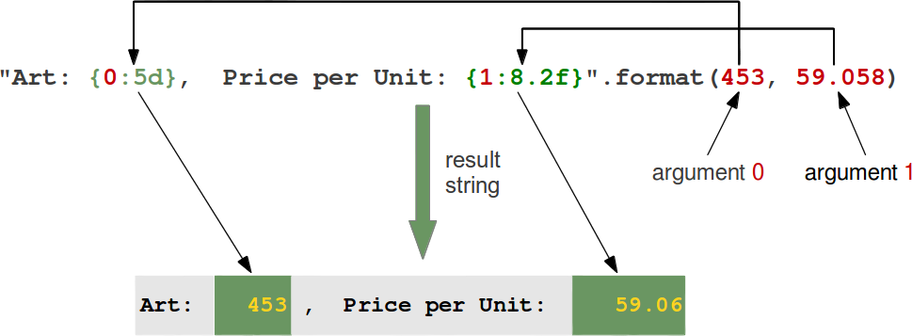
Format
NEW STYLE of Positional Parameter of the format {}
https://www.python-course.eu/python3_formatted_output.php

Slide 31
Format
Join()
https://www.python-course.eu/python3_formatted_output.php
join() function in Python
The join() method is a string method and returns a string in which the elements of sequence have been joined by str separator.

Slide 32
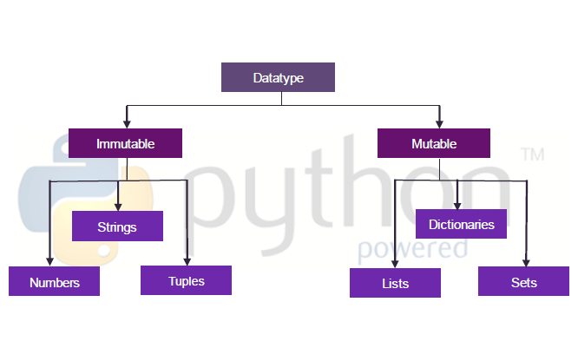
Immutable Vs Mutable

Slide 33
Mutable vs Immutable Example
Mutable instances is passed by reference.
Immutable instances is passed by value.
Abstract example. Suppose that exist a file named txtfile in my HDD. Now, when you ask txtfile from me, I can return it in two modes:
1. Create a shortcut to txtfile and pas shortcut to you (Mutable)
2. Take a copy for txtfile and pas copy to you.(Immutable)

Slide 34
Mutable vs Immutable Example
Create a shortcut to txtfile and pas shortcut to you (Mutable)
In first mode, returned txtfile is a mutable file, because when you do changes in shortcut file, you do changes in original file too. Advantage of this mode is that each returned shortcut required less memory (on RAM or in HDD) and disadvantage is that everyone (not only me, owner) have permissions to modify file content.

Slide 35
Mutable vs Immutable Example
2. Take a copy for txtfile and pas copy to you.(Immutable)
In second mode, returned txtfile is an immutable file, because all changes in received file does not refer to the original file. Advantage of this mode is that only me (owner) can modify original file and disadvantage is that each returned copy required memory (in RAM or in HDD).

Slide 36
By Val, By Ref
Different way in which ByVal and ByRef are implemented in Python
(Python has no ByVal and ByRef Implementation, there are only work around)

Slide 37
Object references are passed by value
Amongst programming languages are pass-by-reference and pass-by-value. Unfortunately, Python is “pass-by-object-reference”, of which it is often said:
“Object references are passed by value.”

Slide 38
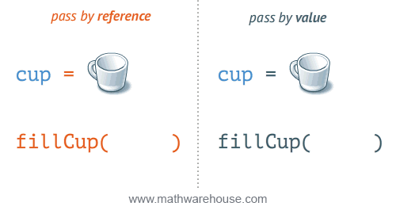
Pass by Ref and Pass by Value
By Reference
A also changes
It maintains a Reference to the location
By Value
A doesn’t change
Because it maintains a copy

Slide 39
Pass by Ref and Pass by Value
Pass by reference means that a number (called a memory address) is passed on, this address defines where the value is stored.
pass by value means the actual value is passed on.

Slide 40
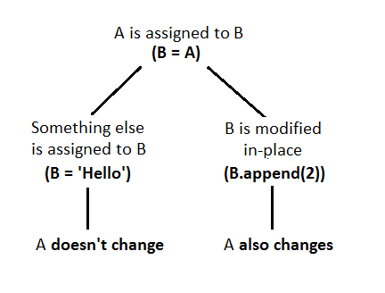
ByVal vs ByRef
By Value
A doesn’t change
Because it maintains a copy
By Reference
A also changes
It maintains a Reference to the location

Slide 41
Mutable object : By Reference
If you pass a mutable object into a method, the method gets a reference to that same object and you can mutate it to your heart's delight, but if you rebind the reference in the method, the outer scope will know nothing about it, and after you're done, the outer reference will still point at the original object.

Slide 42
Immutable object : By Value
If you pass an immutable object to a method, you still can't rebind the outer reference, and you can't even mutate the object.
There are techniques to change the values of Immutable by using the RETURN VALUE

Slide 43
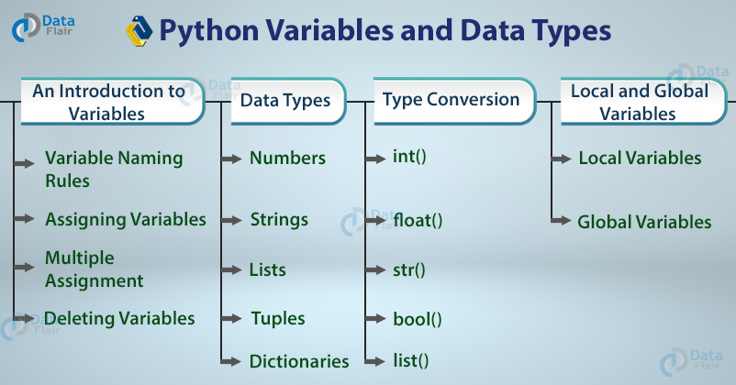

Slide 44
End

