Slide 1
Mutable vs Immutable list vs tupule

Slide 2
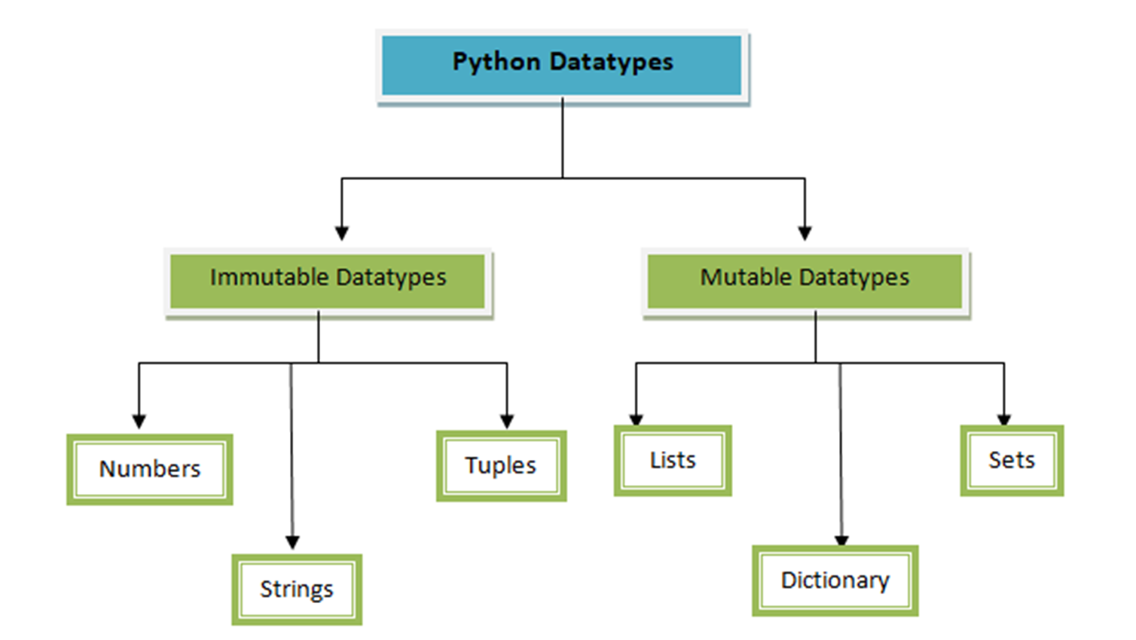

Slide 3
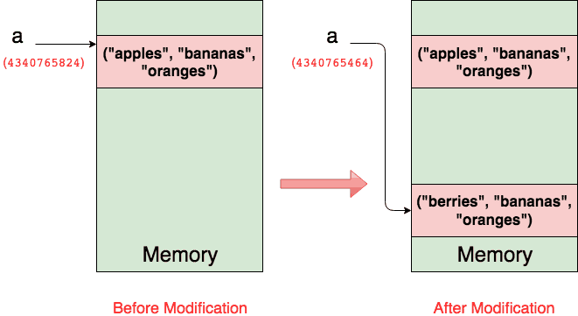
tupule
a = (“apples”, “bananas”, “oranges”)

Slide 4
tupule
a = (“apples”, “bananas”, “oranges”)
a = (“berries”, “bananas”, “oranges”)

Slide 5
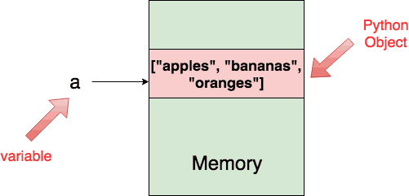
list
a = [“apples”, “bananas”, “oranges”]

Slide 6
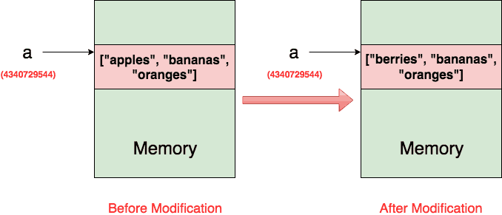
list
a = [“apples”, “bananas”, “oranges”]
a = [“berries”, “bananas”, “oranges”]

Slide 7
When to use Mutable vs Immutable

