Slide 1
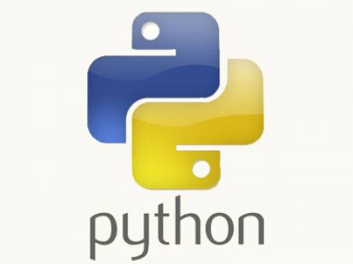
Important Python Concepts – in Detail
-- Arunkumar Nair
04 Jan 2020

Slide 2
Data Types, Data Structures

Slide 3
Help for Python
More Information about Python
https://docs.python.org/3/
More information about data types
https://docs.python.org/3/library/datatypes.html

Slide 4
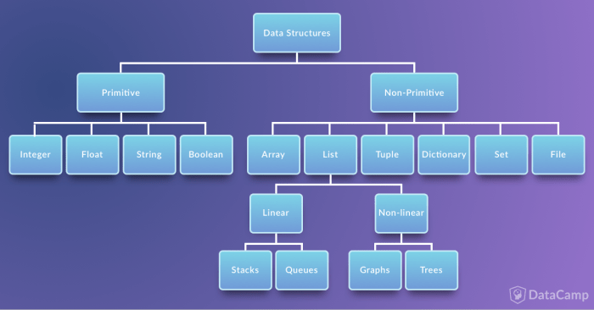
Data Structures
Immutable:
In primitive type, it copies the actual value and therefore changing one value won't change a different variable even if they were used the same root var..
Mutable
Non primitive however, only use references and therefore changing one value will change in all the vars that store the same reference...

Slide 5
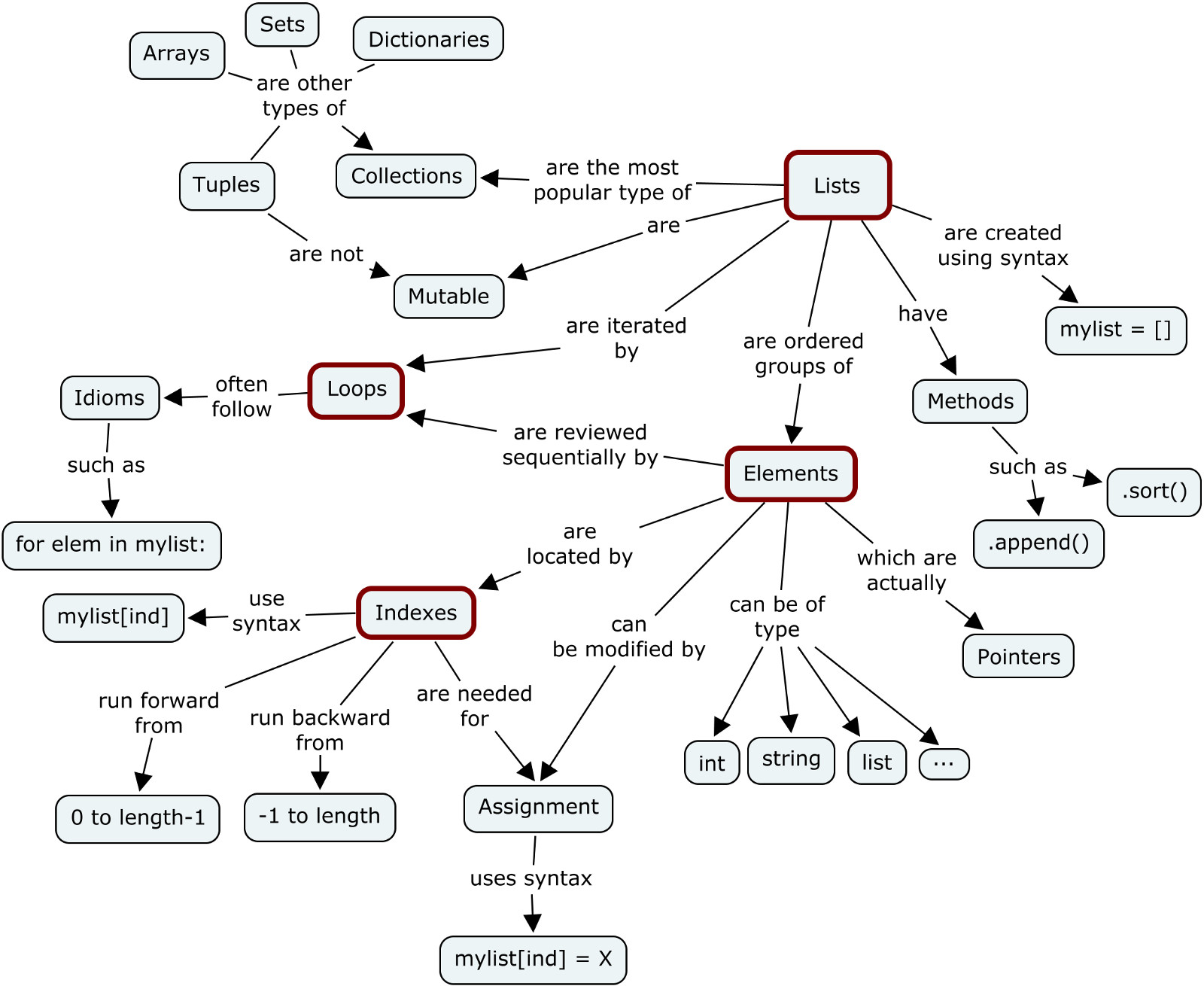

Slide 6
Types of Data Structures
String
Data Structures
  List
  Tuple
  Set
  Dictionary

Slide 7
String
Its a sequence of characters
Single Quotes & Double Quotes are treated similar
Triple Quotes : doc-string, multiline comments
Strings are immutable
Representation & Slicing

Slide 8
String
Methods :-
  count
  index
  find
  join
  Isalnum, isalpha, isdigit, islower, isspace, isupper
  lstrip, rstrip, replace, partition, split, rsplit
  endswith, startswith

Slide 9
List
Ordered collections of heterogeneous objects
Representation is similar to String
Mutable, can grow and shrink whenever required

Slide 10
List
Methods :-
  count
  append
  extend
  index
  insert, pop, remove, reverse, sort
  __add__, __contains__, __eq__, __ge__, __sizeof__ .....

Slide 11
Tuple
Ordered collections of heterogenous objects
Representation is similar to String, List
Immutable
Methods :-
  count
  index
  __mul__, __add__, __contains__, __eq__, __ge__, __sizeof__ .....

Slide 12
Set
Ordered collections of heterogeneous unique objects
Representation is similar to String, List but cannot be sliced or accessed using index
Mutable

Slide 13
Set
Methods :-
  add
  pop
  clear
  copy
  discard v/s remove (raise KeyError)
  difference, intersection, union .....

Slide 14
Dictionary
Unordered collection of key-value pairs
Representation is similar to String, List but cannot be sliced or accessed using index.
Mutable

Slide 15
Dictionary
Methods :-
  copy
  fromkeys
  has_key
  items
  keys, values
  iteritems, iterkeys, itervalues
  pop, popitem
  viewitems, viewkeys, viewvalues

Slide 16
Slicing
Slicing : extracting specific set of data from the container.
Lists, Strings & Tuple support Slicing
Reverse Indexing

Slide 17
Formatting for Printing

Slide 18
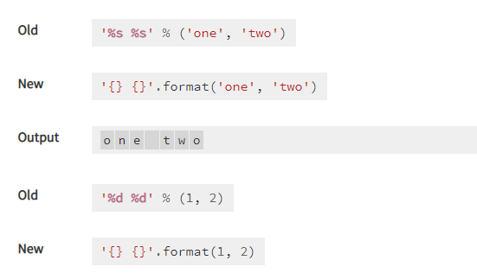
Format
Basic Formatting-Simple positional formatting is probably the most common use-case
https://docs.python.org/3.4/library/string.html

Slide 19
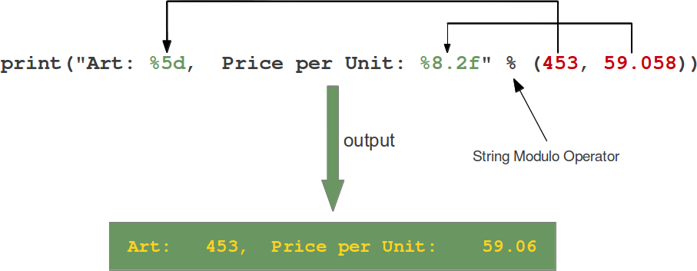
Format
How % string modulo operator works
https://www.python-course.eu/python3_formatted_output.php
(Below is the old style)

Slide 20
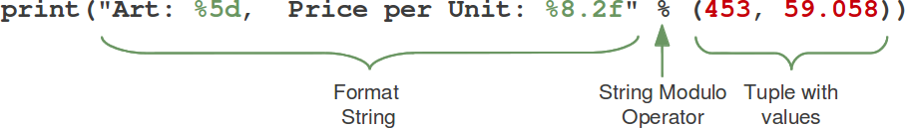
Format
How % string modulo operator works
https://www.python-course.eu/python3_formatted_output.php
(Below is the old style)

Slide 21
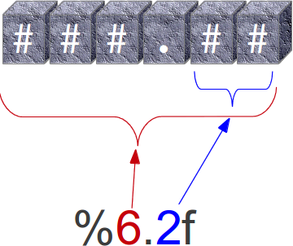
Format
How % string modulo operator works
https://www.python-course.eu/python3_formatted_output.php
(Below is the old style)
The second one "%8.2f" is a format description for a float number. Like other placeholders, it is introduced with the "%" character. This is followed by the total number of digits the string should contain. This number includes the decimal point and all the digits, i.e. before and after the decimal point. Our float number 59.058 has to be formatted with 8 characters. The decimal part of the number or the precision is set to 2, i.e. the number following the "." in our placeholder. Finally, the last character "f" of our placeholder stands for "float".

Slide 22
Format
How % string modulo operator works
https://www.python-course.eu/python3_formatted_output.php
(Below is the old style)
The second one "%8.2f" is a format description for a float number. Like other placeholders, it is introduced with the "%" character. This is followed by the total number of digits the string should contain. This number includes the decimal point and all the digits, i.e. before and after the decimal point. Our float number 59.058 has to be formatted with 8 characters. The decimal part of the number or the precision is set to 2, i.e. the number following the "." in our placeholder. Finally, the last character "f" of our placeholder stands for "float".

Slide 23
Format
NEW STYLE of Positional Parameter of the format {}
https://www.python-course.eu/python3_formatted_output.php
A positional parameter of the format method can be accessed by placing the index of the parameter after the opening brace, e.g. {0} accesses the first parameter, {1} the second one and so on. The index inside of the curly braces can be followed by a colon and a format string, which is similar to the notation of the string modulo, which we had discussed in the beginning of the chapter of our tutorial, e.g. {0:5d}
If the positional parameters are used in the order in which they are written, the positional argument specifiers inside of the braces can be omitted, so '{} {} {}' corresponds to '{0} {1} {2}'. But they are needed, if you want to access them in different orders: '{2} {1} {0}‘

Slide 24
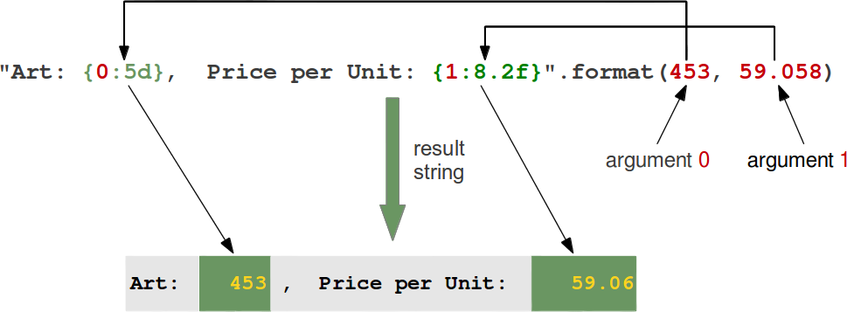
Format
NEW STYLE of Positional Parameter of the format {}
https://www.python-course.eu/python3_formatted_output.php

Slide 25
Format
Join()
https://www.python-course.eu/python3_formatted_output.php
join() function in Python
The join() method is a string method and returns a string in which the elements of sequence have been joined by str separator.

Slide 26
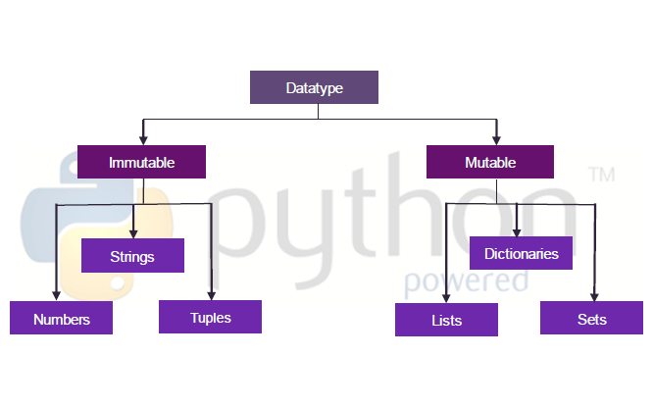
Immutable Vs Mutable

Slide 27
Mutable vs Immutable Example
Mutable instances is passed by reference.
Immutable instances is passed by value.
Abstract example. Suppose that exist a file named txtfile in my HDD. Now, when you ask txtfile from me, I can return it in two modes:
1. Create a shortcut to txtfile and pas shortcut to you (Mutable)
2. Take a copy for txtfile and pas copy to you.(Immutable)

Slide 28
Mutable vs Immutable Example
Create a shortcut to txtfile and pas shortcut to you (Mutable)
In first mode, returned txtfile is a mutable file, because when you do changes in shortcut file, you do changes in original file too. Advantage of this mode is that each returned shortcut required less memory (on RAM or in HDD) and disadvantage is that everyone (not only me, owner) have permissions to modify file content.

Slide 29
Mutable vs Immutable Example
2. Take a copy for txtfile and pas copy to you.(Immutable)
In second mode, returned txtfile is an immutable file, because all changes in received file does not refer to the original file. Advantage of this mode is that only me (owner) can modify original file and disadvantage is that each returned copy required memory (in RAM or in HDD).

Slide 30
By Val, By Ref
Different way in which ByVal and ByRef are implemented in Python
(Python has no ByVal and ByRef Implementation, there is a work around)

Slide 31
Object references are passed by value
Amongst programming languages are pass-by-reference and pass-by-value. Unfortunately, Python is “pass-by-object-reference”, of which it is often said:
“Object references are passed by value.”

Slide 32
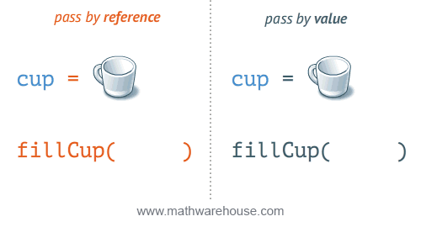
Pass by Ref and Pass by Value
By Reference
A also changes
It maintains a Reference to the location
By Value
A doesn’t change
Because it maintains a copy

Slide 33
Pass by Ref and Pass by Value
Pass by reference means that a number (called a memory address) is passed on, this address defines where the value is stored.
pass by value means the actual value is passed on.

Slide 34
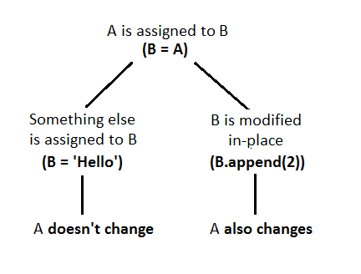
ByVal vs ByRef
By Value
A doesn’t change
Because it maintains a copy
By Reference
A also changes
It maintains a Reference to the location

Slide 35
Mutable object : By Reference
If you pass a mutable object into a method, the method gets a reference to that same object and you can mutate it to your heart's delight, but if you rebind the reference in the method, the outer scope will know nothing about it, and after you're done, the outer reference will still point at the original object.

Slide 36
Immutable object : By Value
If you pass an immutable object to a method, you still can't rebind the outer reference, and you can't even mutate the object.
There are techniques to change the values of Immutable by using the RETURN VALUE

Slide 37
Passing Immutable Objects-7.a
def increment(n):
n += 1
#though we are increment n+1 there is no change in the data
a = 3
increment(a)
print(a)
#Output
#a = 3 # a is still referring to the same object

Slide 38
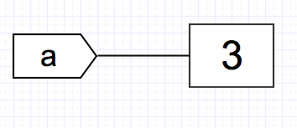
Immutable Int-7.a
You may be wondering: if functions in Python can modify the value in place, then why is it that the value of a remains unchanged? Let’s parse this out:
With a = 3, we have the variable a referring to the object with value 3:

Slide 39
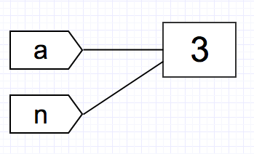
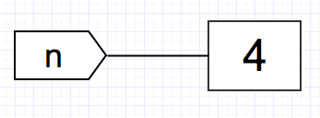
When we pass a to increment(n), the function has the local variable n referred to the same object:
Now comes the interesting part: n += 1. Since integer is immutable, by definition we are not able to modify the object’s value to 4 in place: we must create a new object with the value 4. We may visualize it like below:

Slide 40
All this time, the variable a continues to refer to the object with the value 3, since we did not change the reference:
…which explains why the value of a does not change after calling increment().

Slide 41
Change the values of Immutable by using the RETURN VALUE(by Ref) -7.b
Does that mean we will never be able to manipulate immutable objects by passing it to functions? Turns out, we can still “modify” immutable objects by capturing the return of the function. (thus making it MUTABLE NOW)

Slide 42
#7.b)Immutable-ByRef-Value is changed by using the return value
def increment(n):
n += 1
return n
a = 3
a = increment(a)
# the return value of increment() is captured!
print(a)
#Output#a = 4 # a now refers to the new object created by the function

Slide 43

Return: reassigns a

Slide 44
7.b
By assigning the return value of the function to a, we have reassigned a to refer to the new object with the value 4 created in the function.
Note the object a initially referred to never change — it is still 3 — but by having a point to a new object created by the function, we are able to “modify” the value of a.

Slide 45
7.C -Passing Mutable Objects- By Ref-Change
The same increment() function generates a different result when we passing a mutable object: The value is changed by using append
>>> def increment(n):
... n.append([4])
>>> L = [1, 2, 3]
>>> increment(L)
>>> print(L)
L = [1, 2, 3, 4] # a changed!

Slide 46
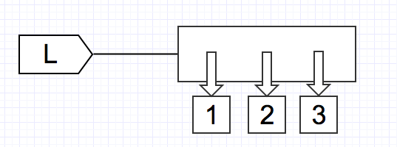
7.C -Passing Mutable Objects- By Ref-Change
The code L = [1, 2, 3] has the variable L refer to the list object containing references to three immutable objects: integer 1, 2, and 3.

Slide 47
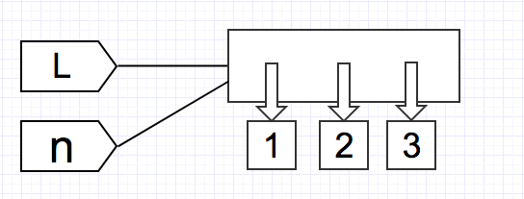
7.C -Passing Mutable Objects- By Ref-Change
As usual, when we pass L to increment(), the function has the local variable n refer to the same object as L:

Slide 48
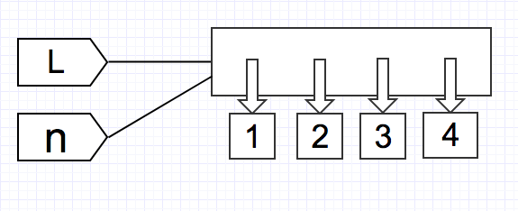
7.C -Passing Mutable Objects- By Ref-Change
The .append() method modifies the list in place, since list is mutable:
Since no new object is created and the change occurred in place of the object, when we print L, we get the modified list.

Slide 49
7.d -Passing Mutable Objects- By Value-No Change
>>> def assign_value(n, v):
... n = v
>>> L1 = [1, 2, 3]
>>> L2 = [4, 5, 6]
>>> assign_value(L1, L2)
>>> print(L1)
>>> print(L2)
L1 = [1, 2, 3]
L2 = [4, 5, 6]

Slide 50
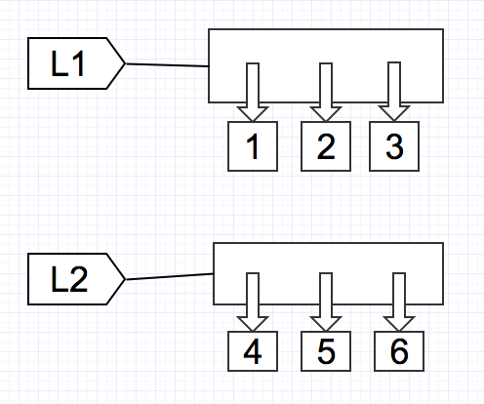
7.d -Passing Mutable Objects- By Value-No Change
the lists look like this:

Slide 51
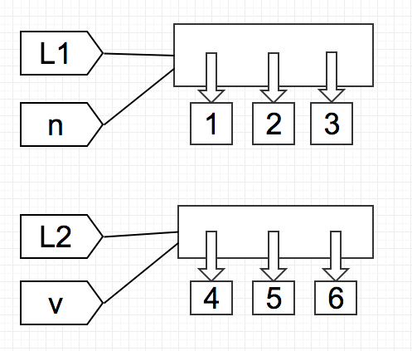
7.d -Passing Mutable Objects- By Value-No Change
When we pass them to assign_value(n, v), the function has n, v, refer to L1, L2 respectively:

Slide 52
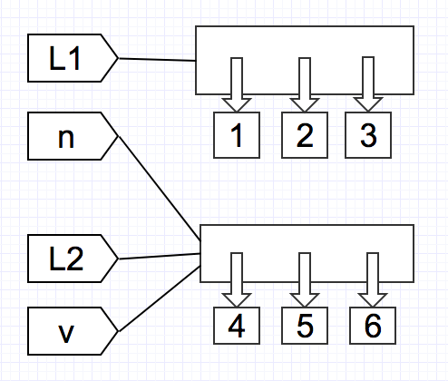
7.d -Passing Mutable Objects- By Value-No Change
However, since the function body has n = v, this reassigns n to refer to what v refers to (which is L2):

Slide 53
7.d -Passing Mutable Objects- By Value-No Change
At the end, both n , L2, and v refer to the list [4, 5, 6], while L1 refers to [1, 2, 3].

Slide 54
Python Functions
List of Functions

Slide 55
Python Functions
https://docs.python.org/3/library/functions.html

Slide 56
End

