Slide 1

Important Python Concepts – in Detail
-- Arunkumar Nair
04 Jan 2020

Slide 2
Data Types, Data Structures

Slide 3
Help for Python
More Information about Python
https://docs.python.org/3/
More information about data types
https://docs.python.org/3/library/datatypes.html

Slide 4
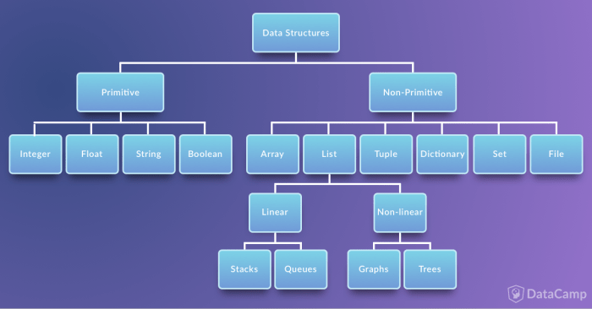
Immutable:
In primitive type, it copies the actual value and therefore changing one value won't change a different variable even if they were used the same root var..
In Python : Tuple is Immutable
Mutable
Non primitive however, only use references and therefore changing one value will change in all the vars that store the same reference...

Slide 5
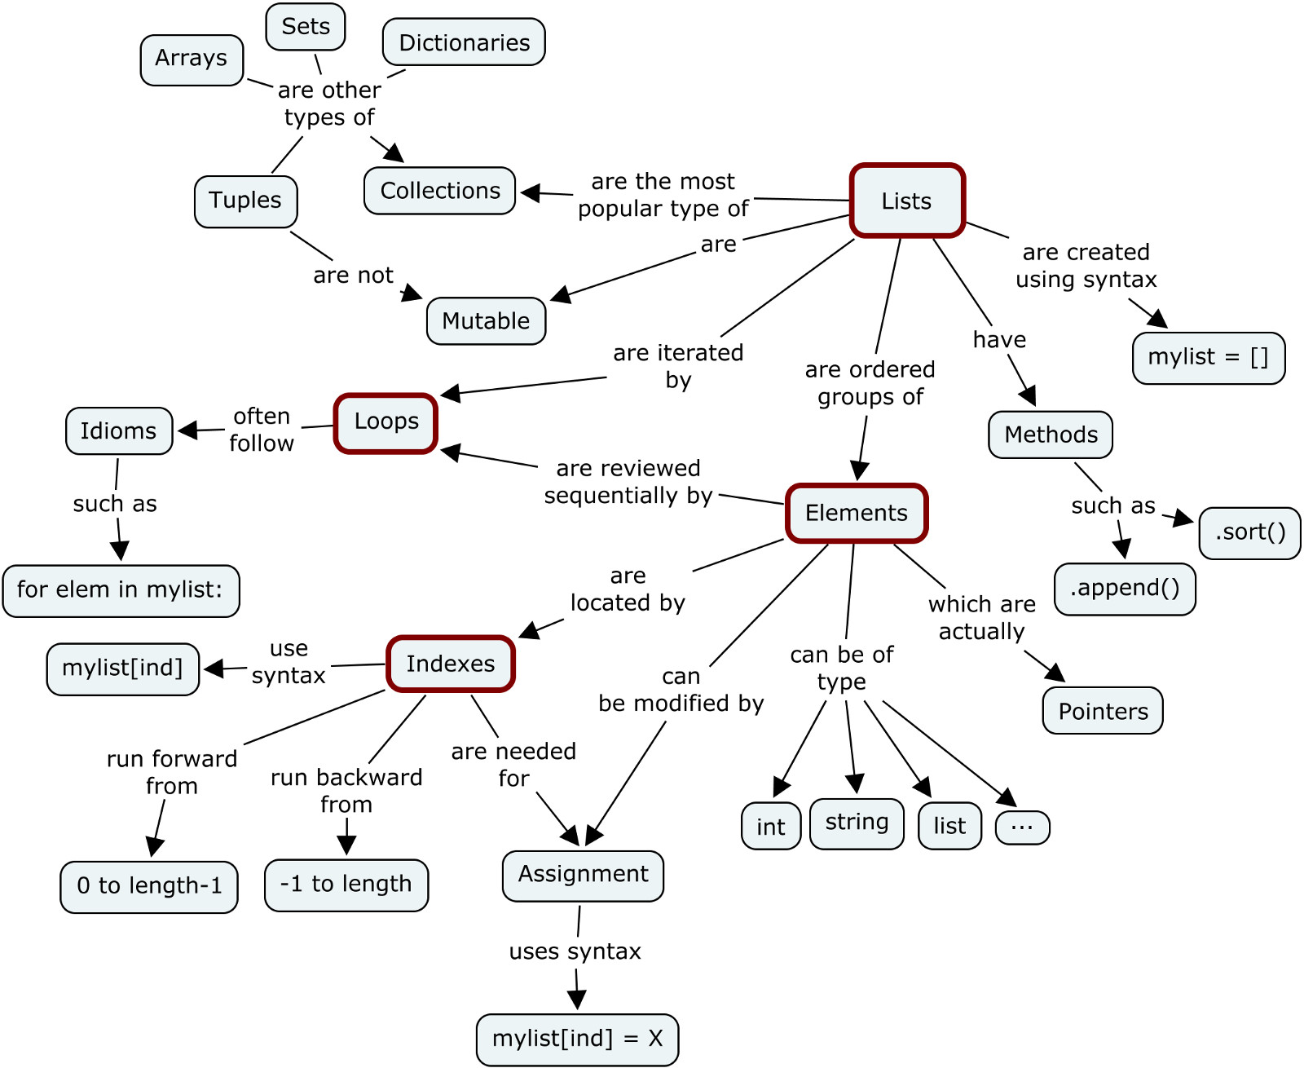

Slide 6
Tuples are Immutable ?
Python tuples have a surprising trait: they are immutable, but their values may change.
This may happen when a tuple holds a reference to any mutable object, such as a list.
Variables are NOT like boxes where you store data.
http://radar.oreilly.com/2014/10/python-tuples-immutable-but-potentially-changing.html

Slide 7
Mutable and Immutable
https://medium.com/@meghamohan/mutable-and-immutable-side-of-python-c2145cf72747

Slide 8
Tuples are Immutable?
What is immutable is the physical content of a tuple, consisting of the object references only. The value of the list referenced by dum[1] changed, but the referenced object id is still the same. A tuple has no way of preventing changes to the values of its items, which are independent objects and may be reached through references outside of the tuple, like the skills name we used earlier. Lists and other mutable objects inside tuples may change, but their ids will always be the same.

Slide 9
Types of Data Structures
String
Data Structures
  List
  Tuple
  Set
  Dictionary

Slide 10
String
Its a sequence of characters
Single Quotes & Double Quotes are treated similar
Triple Quotes : doc-string, multiline comments
Strings are immutable
Representation & Slicing

Slide 11
String
Methods :-
  count
  index
  find
  join
  Isalnum, isalpha, isdigit, islower, isspace, isupper
  lstrip, rstrip, replace, partition, split, rsplit
  endswith, startswith

Slide 12
List
Ordered collections of heterogeneous objects
Representation is similar to String
Mutable, can grow and shrink whenever required

Slide 13
List
Methods :-
  count
  append
  extend
  index
  insert, pop, remove, reverse, sort
  __add__, __contains__, __eq__, __ge__, __sizeof__ .....

Slide 14
Tuple
Ordered collections of heterogenous objects
Representation is similar to String, List
Immutable
Methods :-
  count
  index
  __mul__, __add__, __contains__, __eq__, __ge__, __sizeof__ .....

Slide 15
Set
Ordered collections of heterogeneous unique objects
Representation is similar to String, List but cannot be sliced or accessed using index
Mutable

Slide 16
Set
Methods :-
  add
  pop
  clear
  copy
  discard v/s remove (raise KeyError)
  difference, intersection, union .....

Slide 17
Dictionary
Unordered collection of key-value pairs
Representation is similar to String, List but cannot be sliced or accessed using index.
Mutable

Slide 18
Dictionary
Methods :-
  copy
  fromkeys
  has_key
  items
  keys, values
  iteritems, iterkeys, itervalues
  pop, popitem
  viewitems, viewkeys, viewvalues

Slide 19
Slicing
Slicing : extracting specific set of data from the container.
Lists, Strings & Tuple support Slicing
Reverse Indexing

Slide 20
Formatting for Printing

Slide 21
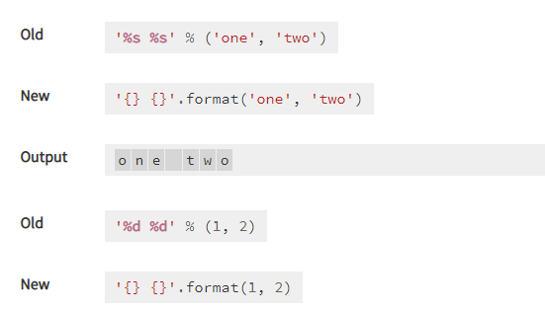
Format
Basic Formatting-Simple positional formatting is probably the most common use-case
https://docs.python.org/3.4/library/string.html

Slide 22
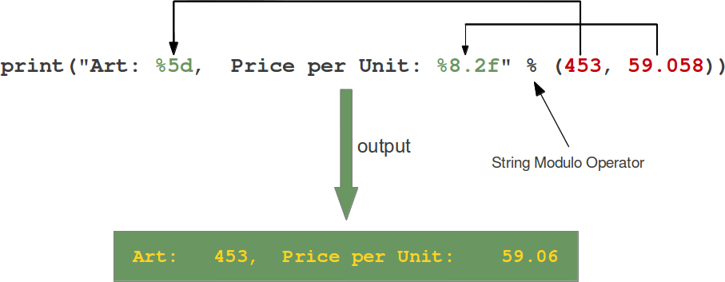
Format
How % string modulo operator works
https://www.python-course.eu/python3_formatted_output.php
(Below is the old style)

Slide 23
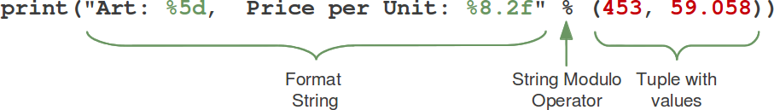
Format
How % string modulo operator works
https://www.python-course.eu/python3_formatted_output.php
(Below is the old style)

Slide 24
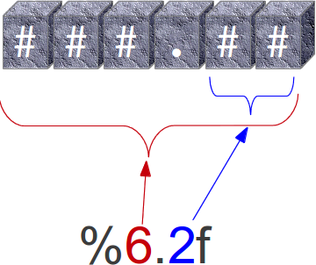
Format
How % string modulo operator works
https://www.python-course.eu/python3_formatted_output.php
(Below is the old style)
The second one "%8.2f" is a format description for a float number. Like other placeholders, it is introduced with the "%" character. This is followed by the total number of digits the string should contain. This number includes the decimal point and all the digits, i.e. before and after the decimal point. Our float number 59.058 has to be formatted with 8 characters. The decimal part of the number or the precision is set to 2, i.e. the number following the "." in our placeholder. Finally, the last character "f" of our placeholder stands for "float".

Slide 25
Format
How % string modulo operator works
https://www.python-course.eu/python3_formatted_output.php
(Below is the old style)
The second one "%8.2f" is a format description for a float number. Like other placeholders, it is introduced with the "%" character. This is followed by the total number of digits the string should contain. This number includes the decimal point and all the digits, i.e. before and after the decimal point. Our float number 59.058 has to be formatted with 8 characters. The decimal part of the number or the precision is set to 2, i.e. the number following the "." in our placeholder. Finally, the last character "f" of our placeholder stands for "float".

Slide 26
Format
NEW STYLE of Positional Parameter of the format {}
https://www.python-course.eu/python3_formatted_output.php
A positional parameter of the format method can be accessed by placing the index of the parameter after the opening brace, e.g. {0} accesses the first parameter, {1} the second one and so on. The index inside of the curly braces can be followed by a colon and a format string, which is similar to the notation of the string modulo, which we had discussed in the beginning of the chapter of our tutorial, e.g. {0:5d}
If the positional parameters are used in the order in which they are written, the positional argument specifiers inside of the braces can be omitted, so '{} {} {}' corresponds to '{0} {1} {2}'. But they are needed, if you want to access them in different orders: '{2} {1} {0}‘

Slide 27
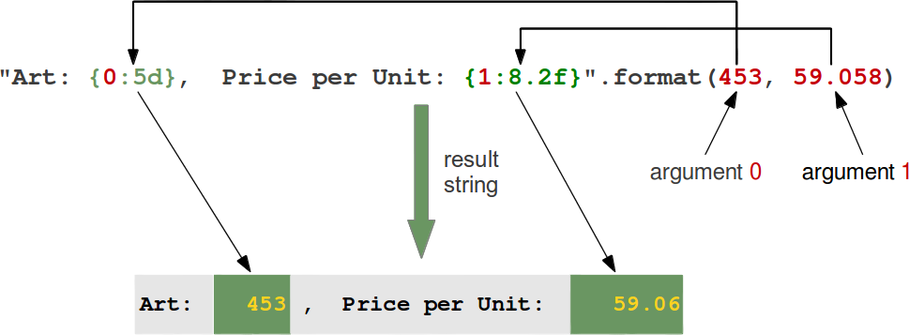
Format
NEW STYLE of Positional Parameter of the format {}
https://www.python-course.eu/python3_formatted_output.php

Slide 28
Format
Join()
https://www.python-course.eu/python3_formatted_output.php
join() function in Python
The join() method is a string method and returns a string in which the elements of sequence have been joined by str separator.

Slide 29
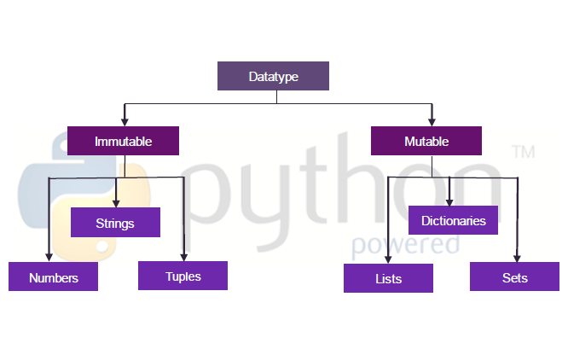
Immutable Vs Mutable

Slide 30
Mutable vs Immutable Example
Mutable instances is passed by reference.
Immutable instances is passed by value.
Abstract example. Suppose that exist a file named txtfile in my HDD. Now, when you ask txtfile from me, I can return it in two modes:
1. Create a shortcut to txtfile and pas shortcut to you (Mutable)
2. Take a copy for txtfile and pas copy to you.(Immutable)

Slide 31
Mutable vs Immutable Example
Create a shortcut to txtfile and pas shortcut to you (Mutable)
In first mode, returned txtfile is a mutable file, because when you do changes in shortcut file, you do changes in original file too. Advantage of this mode is that each returned shortcut required less memory (on RAM or in HDD) and disadvantage is that everyone (not only me, owner) have permissions to modify file content.

Slide 32
Mutable vs Immutable Example
2. Take a copy for txtfile and pas copy to you.(Immutable)
In second mode, returned txtfile is an immutable file, because all changes in received file does not refer to the original file. Advantage of this mode is that only me (owner) can modify original file and disadvantage is that each returned copy required memory (in RAM or in HDD).

Slide 33
By Val, By Ref
Different way in which ByVal and ByRef are implemented in Python
(Python has no ByVal and ByRef Implementation, there is a work around)

Slide 34
Object references are passed by value
Amongst programming languages are pass-by-reference and pass-by-value. Unfortunately, Python is “pass-by-object-reference”, of which it is often said:
“Object references are passed by value.”

Slide 35
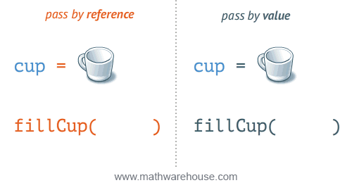
Pass by Ref and Pass by Value
By Reference
A also changes
It maintains a Reference to the location
By Value
A doesn’t change
Because it maintains a copy

Slide 36
Pass by Ref and Pass by Value
Pass by reference means that a number (called a memory address) is passed on, this address defines where the value is stored.
pass by value means the actual value is passed on.

Slide 37
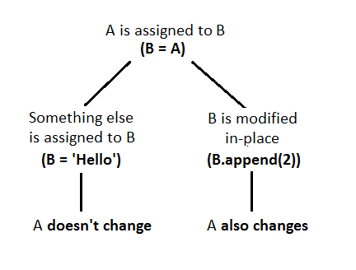
ByVal vs ByRef
By Value
A doesn’t change
Because it maintains a copy
By Reference
A also changes
It maintains a Reference to the location

Slide 38
Mutable object : By Reference
If you pass a mutable object into a method, the method gets a reference to that same object and you can mutate it to your heart's delight, but if you rebind the reference in the method, the outer scope will know nothing about it, and after you're done, the outer reference will still point at the original object.

Slide 39
Immutable object : By Value
If you pass an immutable object to a method, you still can't rebind the outer reference, and you can't even mutate the object.
There are techniques to change the values of Immutable by using the RETURN VALUE

Slide 40
Passing Immutable Objects-7.a
def increment(n):
n += 1
#though we are increment n+1 there is no change in the data
a = 3
increment(a)
print(a)
#Output
#a = 3 # a is still referring to the same object

Slide 41
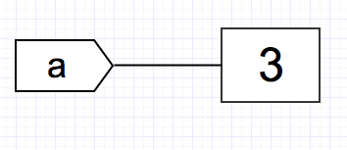
Immutable Int-7.a
You may be wondering: if functions in Python can modify the value in place, then why is it that the value of a remains unchanged? Let’s parse this out:
With a = 3, we have the variable a referring to the object with value 3:

Slide 42
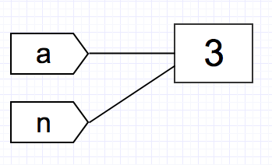
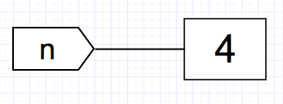
When we pass a to increment(n), the function has the local variable n referred to the same object:
Now comes the interesting part: n += 1. Since integer is immutable, by definition we are not able to modify the object’s value to 4 in place: we must create a new object with the value 4. We may visualize it like below:

Slide 43
All this time, the variable a continues to refer to the object with the value 3, since we did not change the reference:
…which explains why the value of a does not change after calling increment().

Slide 44
Change the values of Immutable by using the RETURN VALUE(by Ref) -7.b
Does that mean we will never be able to manipulate immutable objects by passing it to functions? Turns out, we can still “modify” immutable objects by capturing the return of the function. (thus making it MUTABLE NOW)

Slide 45
#7.b)Immutable-ByRef-Value is changed by using the return value
def increment2(n):
n += 1
return n
a = 3
a = increment2(a)
# the return value of increment2() is captured!
print(a)
#Output#a = 4 # a now refers to the new object created by the function

Slide 46
Return: reassigns a
n += 1
Return n
“a” now points to the new object that is created by n

Slide 47
7.b
By assigning the return value of the function to a, we have reassigned a to refer to the new object with the value 4 created in the function.
Note the object a initially referred to never change — it is still 3 — but by having a point to a new object created by the function, we are able to “modify” the value of a.

Slide 48
Lists are Mutable
Using Mutable and Immutable concepts using Lists

Slide 49
7.C -Passing Mutable Objects- By Ref-Change
The same increment() function generates a different result when we passing a mutable object: The value is changed by using append
>>> def increment(n):
... n.append([4])
>>> L = [1, 2, 3]
>>> increment(L)
>>> print(L)
L = [1, 2, 3, 4] # a changed!

Slide 50
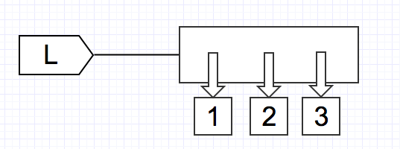
7.C -Passing Mutable Objects- By Ref-Change
The code L = [1, 2, 3] has the variable L refer to the list object containing references to three immutable objects: integer 1, 2, and 3.

Slide 51
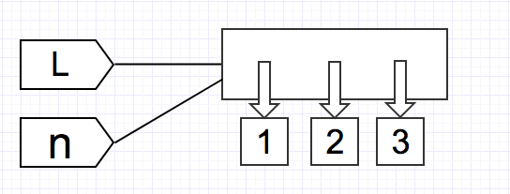
7.C -Passing Mutable Objects- By Ref-Change
As usual, when we pass L to increment(), the function has the local variable n refer to the same object as L:

Slide 52
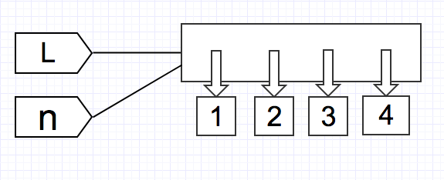
7.C -Passing Mutable Objects- By Ref-Change
The .append() method modifies the list in place, since list is mutable:
Since no new object is created and the change occurred in place of the object, when we print L, we get the modified list.

Slide 53
7.d -Passing Mutable Objects- By Value-No Change
>>> def assign_value(n, v):
... n = v
>>> L1 = [1, 2, 3]
>>> L2 = [4, 5, 6]
>>> assign_value(L1, L2)
>>> print(L1)
>>> print(L2)
L1 = [1, 2, 3]
L2 = [4, 5, 6]

Slide 54
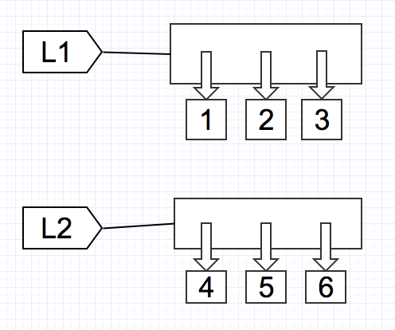
7.d -Passing Mutable Objects- By Value-No Change
the lists look like this:

Slide 55
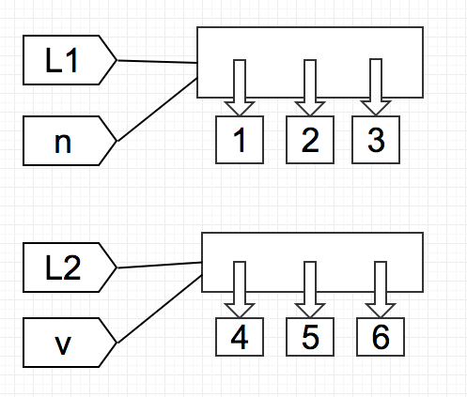
7.d -Passing Mutable Objects- By Value-No Change
When we pass them to assign_value(n, v), the function has n, v, refer to L1, L2 respectively:

Slide 56
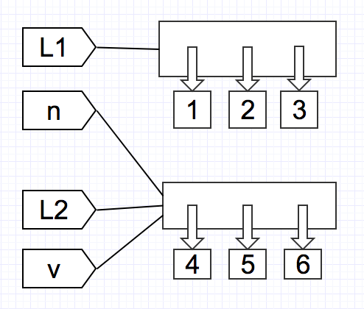
7.d -Passing Mutable Objects- By Value-No Change
However, since the function body has n = v, this reassigns n to refer to what v refers to (which is L2):

Slide 57
7.d -Passing Mutable Objects- By Value-No Change
At the end, both n , L2, and v refer to the list [4, 5, 6], while L1 refers to [1, 2, 3].

Slide 58
End
03 July 2020

Slide 59
Python Functions
List of Functions

Slide 60
Python Functions
https://docs.python.org/3/library/functions.html

Slide 61
Bin
Convert integer to binary
number = 5
print('The binary equivalent of 5 is:', bin(number))

